Slide 1


Y4 M1f. Can round any number to the nearest 10, 100 or 1000, using the context of measures
Commissioned by The PiXL Club Ltd.
September 2018
This resource is strictly for the use of member schools for as long as they remain members of The PiXL Club. It may not be copied, sold nor transferred to a third party or used by the school after membership ceases. Until such time it may be freely used within the member school.
All opinions and contributions are those of the authors. The contents of this resource are not connected with nor endorsed by any other company, organisation or institution.
PiXL Club Ltd endeavour to trace and contact copyright owners. If there are any inadvertent omissions or errors in the acknowledgements or usage, this is unintended and PiXL will remedy these on written notification.
© Copyright The PiXL Club Limited, 2018

Slide 2
Teachers’ Notes
The purpose of the priority therapies is to support the teaching of fundamental concepts for the year group.
The therapies can be taught to a whole class or a target group. Year 4 therapies are designed to take approximately 30 minutes. However, this is flexible: it may be that only part of the therapy is taught or it could, of course, be adapted or extended.
A vocabulary slide is included in each therapy. This identifies key words which relate to the taught concept along with a link to the ‘Vocabulary Shorts’ on PrimaryWise (20 activities to develop vocabulary). The intention is that the therapy begins with explicit teaching of this vocabulary.
The therapy adopts the ‘Teach, model and apply’ process with plenty of opportunities for pupils to demonstrate the taught skill.
Problem solving and reasoning activities are an integral part of each therapy.

Slide 3
Vocabulary: measurement
round
multiple
measure
estimate
approximate
Please select an activity from the ‘Vocabulary Shorts’ to develop understanding of the key vocabulary.

Slide 4
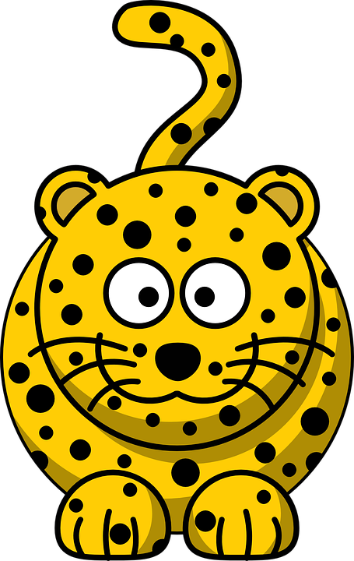
Teach
We can round numbers to give an estimation or an approximate value.

Slide 5
Teach
Rounding is when we say which multiple of 10, 100 or 1000 is closest to our number.

Slide 6
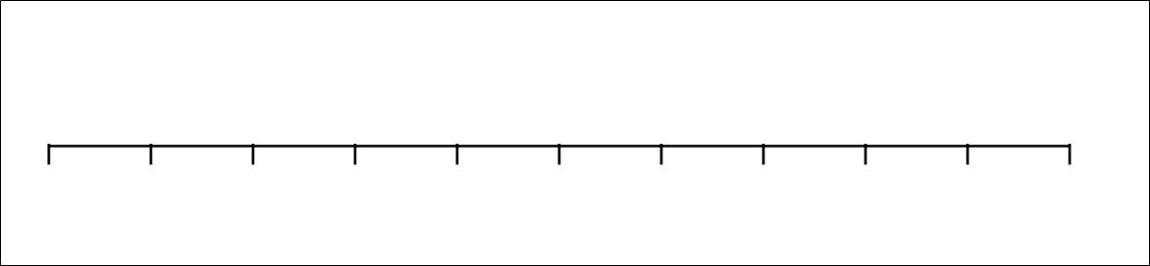
Model
For example, let’s look at the number 82. Is it closer to 80 or 90?
80
90

Slide 7
Model
It is closer to 80. Therefore, we can say 82 is 80 rounded to the nearest 10.
82
80
90

Slide 8
Model
Now let’s look at the number 482. Is it closer to 480 or 490?
480
490

Slide 9
Model
It is closer to 480. Therefore, we can say 482 is 480 rounded to the nearest 10.
482
480
490

Slide 10
Model
When we round, we don’t have to draw a number line every time.
482
480
490

Slide 11
Model
We can circle the column we are rounding to (for example, if we are rounding to the nearest ten, we circle the tens column).
482

Slide 12
Model
We then underline the next column to the right.
If the number is 0, 1, 2, 3, 4,
the rounded number is the ten before.
If it is 5, 6, 7, 8 or 9,
round to the next ten on the number line!
482

Slide 13
Model
Remember the rhyme when you are rounding today!
If the number is 0, 1, 2, 3, 4,
the rounded number is the ten before.
If it is 5, 6, 7, 8 or 9,
round to the next ten on the number line!
480

Slide 14
Model
For example, what is 34 millimetres to the nearest 10mm?
34mm
If the number is 0, 1, 2, 3, 4,
the rounded number is the ten before.
If it is 5, 6, 7, 8 or 9,
round to the next ten on the number line!

Slide 15
Model
34 millimetres rounds to 30 millimetres.
30mm
If the number is 0, 1, 2, 3, 4,
the rounded number is the ten before.
If it is 5, 6, 7, 8 or 9,
round to the next ten on the number line!

Slide 16
Apply
What is 67 millimetres to the nearest 10mm?
67mm
If the number is 0, 1, 2, 3, 4,
the rounded number is the ten before.
If it is 5, 6, 7, 8 or 9,
round to the next ten on the number line!

Slide 17
Apply
What is 123 millimetres to the nearest 10mm?
123mm
If the number is 0, 1, 2, 3, 4,
the rounded number is the ten before.
If it is 5, 6, 7, 8 or 9,
round to the next ten on the number line!

Slide 18
Model
If we want to round to the nearest hundred, we circle the hundreds column.
482

Slide 19
Model
We then underline the next column to the right.
If the number is 0, 1, 2, 3, 4,
the rounded number is the hundred before.
If it is 5, 6, 7, 8 or 9,
round to the next hundred on the number line!
482

Slide 20
Model
Remember this rhyme!
If the number is 0, 1, 2, 3, 4,
the rounded number is the hundred before.
If it is 5, 6, 7, 8 or 9,
round to the next hundred on the number line!
500

Slide 21
Model
For example, what is 320 centimetres to the nearest 100cm?
320cm
If the number is 0, 1, 2, 3, 4,
the rounded number is the hundred before.
If it is 5, 6, 7, 8 or 9,
round to the next hundred on the number line!

Slide 22
Model
320 centimetres rounds to 300 centimetres to the nearest 100cm.
300cm
If the number is 0, 1, 2, 3, 4,
the rounded number is the hundred before.
If it is 5, 6, 7, 8 or 9,
round to the next hundred on the number line!

Slide 23
Apply
What is 670 centimetres to the nearest 100cm?
670cm
If the number is 0, 1, 2, 3, 4,
the rounded number is the hundred before.
If it is 5, 6, 7, 8 or 9,
round to the next hundred on the number line!

Slide 24
Apply
What is 405 centimetres to the nearest 100cm?
405cm
If the number is 0, 1, 2, 3, 4,
the rounded number is the hundred before.
If it is 5, 6, 7, 8 or 9,
round to the next hundred on the number line!

Slide 25
Apply
What is 691 centimetres to the nearest 100cm?
691cm
If the number is 0, 1, 2, 3, 4,
the rounded number is the hundred before.
If it is 5, 6, 7, 8 or 9,
round to the next hundred on the number line!

Slide 26
Model
If we want to round to the nearest thousand, we circle the thousands column.
5612

Slide 27
Model
We then underline the next column to the right.
If the number is 0, 1, 2, 3, 4,
the rounded number is the thousand before.
If it is 5, 6, 7, 8 or 9,
round to the next thousand on the number line!
5612

Slide 28
Model
Don’t forget this rhyme!
If the number is 0, 1, 2, 3, 4,
the rounded number is the thousand before.
If it is 5, 6, 7, 8 or 9,
round to the next thousand on the number line!
6000

Slide 29
Model
For example, what is 2394 metres to the nearest 1000m?
2394m
If the number is 0, 1, 2, 3, 4,
the rounded number is the thousand before.
If it is 5, 6, 7, 8 or 9,
round to the next thousand on the number line!

Slide 30
Model
2394 metres rounds to 2000 metres to the nearest 1000m.
2000m
If the number is 0, 1, 2, 3, 4,
the rounded number is the thousand before.
If it is 5, 6, 7, 8 or 9,
round to the next thousand on the number line!

Slide 31
Apply
What is 6720 metres to the nearest 1000m?
6720m
If the number is 0, 1, 2, 3, 4,
the rounded number is the thousand before.
If it is 5, 6, 7, 8 or 9,
round to the next thousand on the number line!

Slide 32
Apply
What is 3300 metres to the nearest 1000m?
3300m
If the number is 0, 1, 2, 3, 4,
the rounded number is the thousand before.
If it is 5, 6, 7, 8 or 9,
round to the next thousand on the number line!

Slide 33
Apply
What is 8250 metres to the nearest 1000m?
8250m
If the number is 0, 1, 2, 3, 4,
the rounded number is the thousand before.
If it is 5, 6, 7, 8 or 9,
round to the next thousand on the number line!

Slide 34
Apply
Now try these!
Round 7462g to the nearest 100g
Round £1.31 to the nearest 10p
Round 5682ml to the nearest 1000ml
Round £645 to the nearest £100

Slide 35


Evaluate
Can you round any number to the nearest 10, 100 or 1000, using the context of measures?

