Slide 1


.
Y4 M3b Can recall and use multiplication and division facts for all the times tables (learning 6, 12, 9, 11 and 7)
Commissioned by The PiXL Club Ltd.
June 2019
This resource is strictly for the use of member schools for as long as they remain members of The PiXL Club. It may not be copied, sold nor transferred to a third party or used by the school after membership ceases. Until such time it may be freely used within the member school.
All opinions and contributions are those of the authors. The contents of this resource are not connected with nor endorsed by any other company, organisation or institution.
PiXL Club Ltd endeavour to trace and contact copyright owners. If there are any inadvertent omissions or errors in the acknowledgements or usage, this is unintended and PiXL will remedy these on written notification.
© Copyright The PiXL Club Limited, 2019

Slide 2
Teachers’ Notes
The PiXL therapies can be taught to a whole class or a target group. Year 3-5 therapies are designed to take approximately 30-40 minutes. However, this is flexible: it may be that only part of the therapy is taught or it could, of course, be adapted or extended.
Each therapy begins with a LORIC activity to develop relevant learning behaviours.
This is followed by a vocabulary task, which uses the PiXL 5-phase approach to teach key mathematical vocabulary. Further resources to develop vocabulary can be found in the Whole School area.
Each therapy adopts the ‘Teach, model and apply’ process with opportunities for pupils to demonstrate the taught skill independently.
Problem solving and reasoning activities are an integral part of each therapy.

Slide 3
Progress across amber – the 4-stage model
The three therapy tests which accompany this resource can be used to revisit the taught skill to check that the pupil is able to perform it independently and consistently.
A
A child has successfully completed a therapy test independently, following a set of therapy sessions.
A child has successfully completed a therapy test independently, a period after the relevant therapy sessions – we would advise about 2 weeks.
A child has successfully applied their knowledge or skill in an unfamiliar context. This may be application across the curriculum or in a problem.
A pupil has successfully re-visited the skills at a later point, and applies these in an unfamiliar context or problem, or across the curriculum.
A
DA
G

Slide 4

LORIC task
Today the LORIC task will focus on your Izzy Initiative skills:
This means you will have to:
Be resourceful
Think as someone who is part of a team
Use all skills available to overcome the problem

Slide 5

LORIC task
Look at the times tables provided.
Select the times table you need to practise the most.
Rehearse this times table and ask a partner to test your recall skills.
We have already learned the times tables for
x 2, x 5, x 10, x 3, x 4 and x 6. There may be some
that you still find tricky, so this is your
opportunity to practise.
Write down the times tables and practise recalling them with a partner.

Slide 6
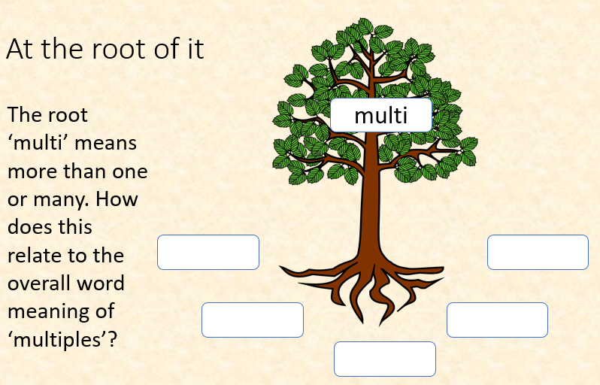
Vocabulary activity
times
multiply
multiples
DECONSTRUCT IT

Slide 7
Teach
1 x 6 =
2 x 6 =
3 x 6 =
4 x 6 =
5 x 6 =
6 x 6 =
6
7 x 6 =
8 x 6 =
9 x 6 =
10 x 6 =
11 x 6 =
12 x 6 =
42
This is the 6 times table.
Notice that all the products in the six times table are even.
12
48
18
54
24
60
30
66
36
72

Slide 8
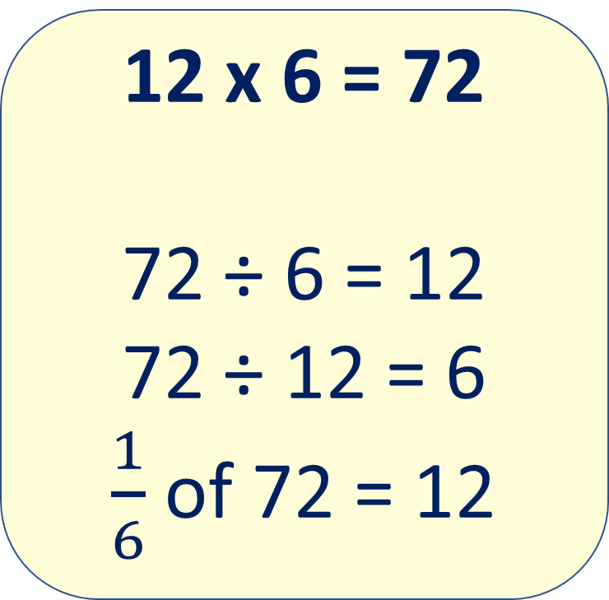
Model
The inverse of multiplication is division.
We can create a fact family from our known fact.
12 x 6 = 72
72 ÷ 6 = 12
72 ÷ 12 = 6
$\frac{1}{6}$ of 72 = 12
Can you think of another fact?
Notes:
Reinforce the point that finding a sixth is the same as dividing by 6.
This may be a teaching point for children who are secure in creating the fact families.

Slide 9
Teach
1 x 12 =
2 x 12 =
3 x 12 =
4 x 12 =
5 x 12 =
6 x 12 =
12
7 x 12 =
8 x 12 =
9 x 12 =
10 x 12 =
11 x 12 =
12 x 12 =
84
This is the 12 times table.
Notice that all the products in the twelve times table are even.
24
96
36
108
48
120
60
132
72
144

Slide 10
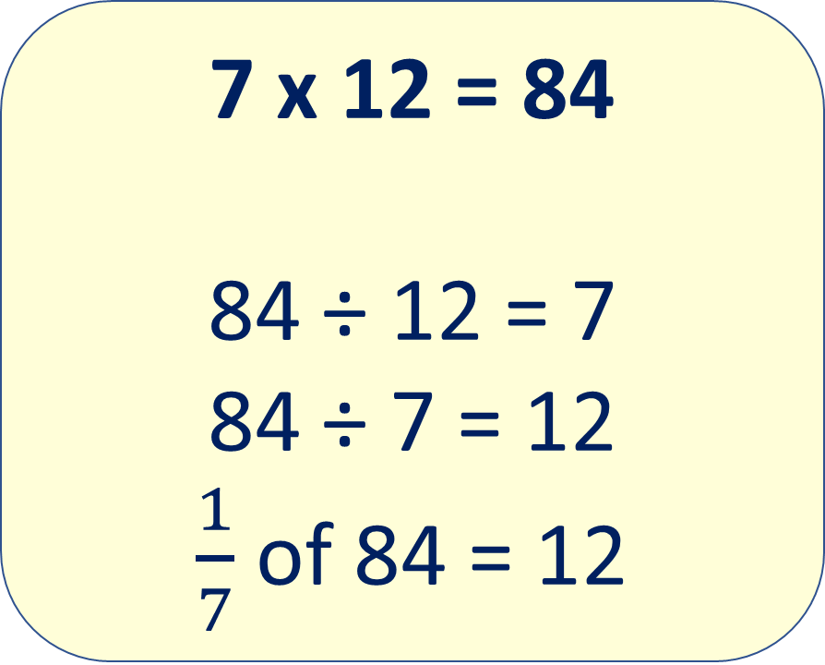
Model
The inverse of multiplication is division.
We can create a fact family from our known fact.
7 x 12 = 84
84 ÷ 12 = 7
84 ÷ 7 = 12
$\frac{1}{7}$ of 84 = 12
Can you think of another fact?
Notes:
Reinforce the point that finding a seventh is the same as dividing by 7.
This may be a teaching point for children who are secure in creating the fact families.

Slide 11
Teach
1 x 9 =
2 x 9 =
3 x 9 =
4 x 9 =
5 x 9 =
6 x 9 =
9
7 x 9 =
8 x 9 =
9 x 9 =
10 x 9 =
11 x 9 =
12 x 9 =
63
This is the 9 times table.
What do you notice about the root digit for each product?
For example:
18 is 1 + 8 = 9
18
72
27
81
36
90
45
99
54
108

Slide 12
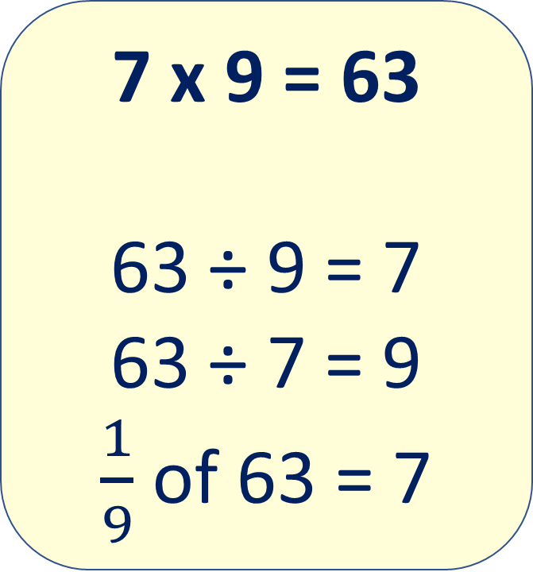
Model
The inverse of multiplication is division.
We can create a fact family from our known fact.
7 x 9 = 63
63 ÷ 9 = 7
63 ÷ 7 = 9
$\frac{1}{9}$ of 63 = 7
Can you think of another fact?
Notes:
Reinforce the point that finding a ninth is the same as dividing by 9.
This may be a teaching point for children who are secure in creating the fact families.

Slide 13
Teach
1 x 11 =
2 x 11 =
3 x 11 =
4 x 11 =
5 x 11 =
6 x 11 =
11
7 x 11 =
8 x 11 =
9 x 11 =
10 x 11 =
11 x 11 =
12 x 11 =
77
This is the 11 times table.
What do you notice about the products in the eleven times table?
22
88
33
99
44
110
55
121
66
132

Slide 14
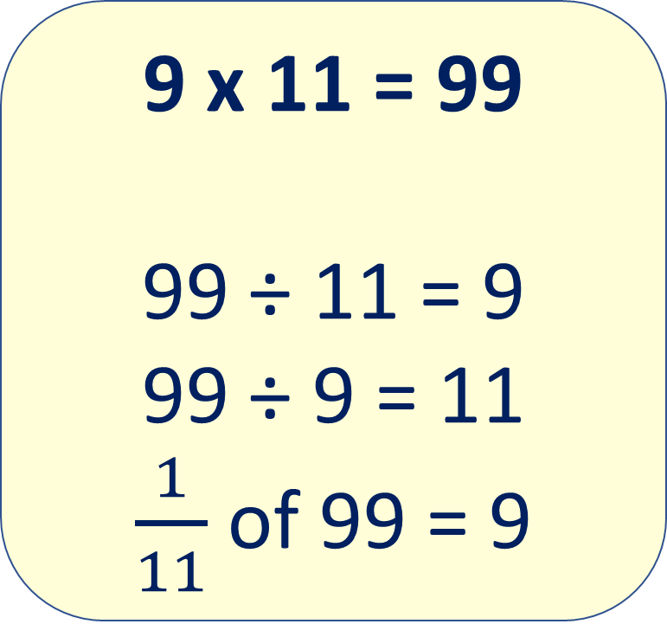
Model
The inverse of multiplication is division.
We can create a fact family from our known fact.
9 x 11 = 99
99 ÷ 11 = 9
99 ÷ 9 = 11
$\frac{1}{11}$ of 99 = 9
Can you think of another fact?

Slide 15
Teach
7
7 x 7 =
8 x 7 =
9 x 7 =
10 x 7 =
11 x 7 =
12 x 7 =
49
1 x 7 =
2 x 7 =
3 x 7 =
4 x 7 =
5 x 7 =
6 x 7 =
This is the 7 times table.
There is no specific pattern to the seven times table.
14
56
21
63
28
70
35
77
42
84

Slide 16
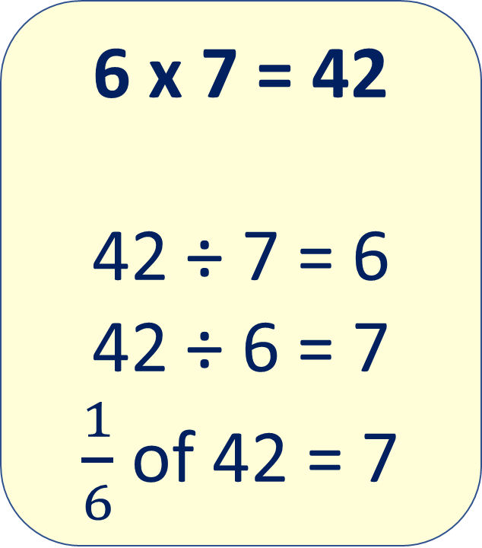
Model
The inverse of multiplication is division.
We can create a fact family from our known fact.
6 x 7 = 42
42 ÷ 7 = 6
42 ÷ 6 = 7
$\frac{1}{6}$ of 42 = 7
Can you think of another fact?

Slide 17
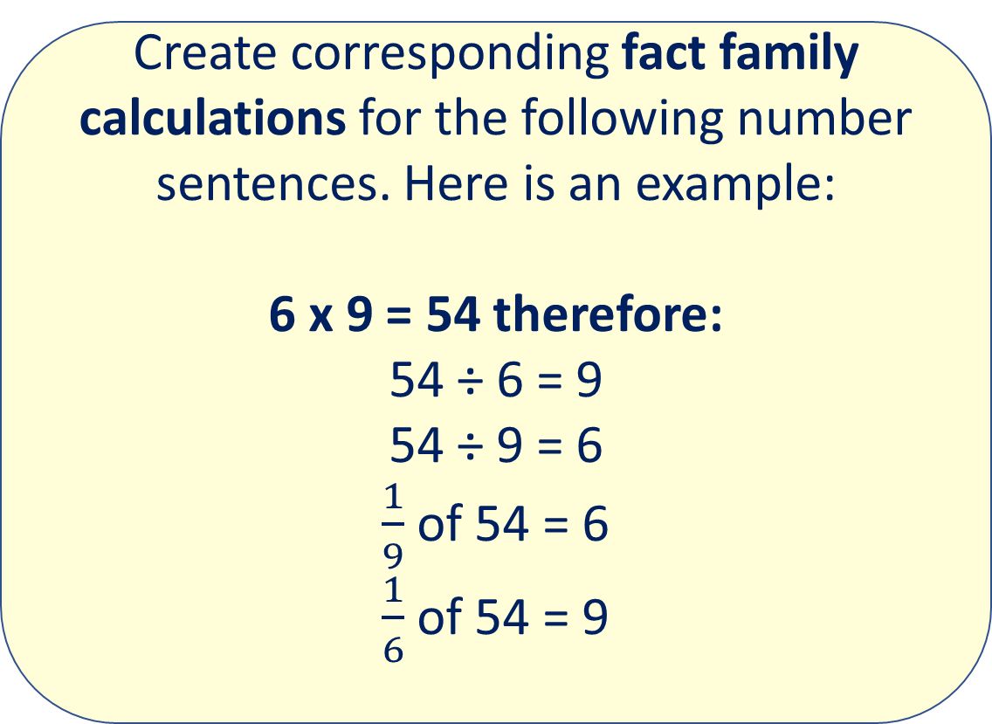
Apply
Create corresponding fact family calculations for the following number sentences. Here is an example:
6 x 9 = 54 therefore:
54 ÷ 6 = 9
54 ÷ 9 = 6
$\frac{1}{9}$ of 54 = 6
$\frac{1}{6}$ of 54 = 9
Now create your own for:
4 x 12
6 x 7
8 x 11
3 x 6
8 x 9

Slide 18
Apply – Problem Solving
First, I know I need to read and understand the question.
I know there are 5 levels in the car park and each level has 12 cars on it.
There are 12 cars on each level of the car park. There are 5 levels. How many cars are there in total?
That means the calculation I have to complete is 5 x 12.

Slide 19
Apply – Problem Solving
Remember to use a strategy you are confident with when working out times table calculations.
There are 84 children in the school and the teacher wants to split them up into groups of 7. How many children will be in each group?

Slide 20
Apply – Reasoning Problem
Remember to use a strategy you are confident with when working out times table calculations.
Complete the following table:
x | 11 |  | 9
 |  |  | 54
 | 55
7 |  | 49

