Slide 1


.
Y4 M3c Can multiply and divide mentally using derived facts or the associative law
Commissioned by The PiXL Club Ltd.
June 2019
This resource is strictly for the use of member schools for as long as they remain members of The PiXL Club. It may not be copied, sold nor transferred to a third party or used by the school after membership ceases. Until such time it may be freely used within the member school.
All opinions and contributions are those of the authors. The contents of this resource are not connected with nor endorsed by any other company, organisation or institution.
PiXL Club Ltd endeavour to trace and contact copyright owners. If there are any inadvertent omissions or errors in the acknowledgements or usage, this is unintended and PiXL will remedy these on written notification.
© Copyright The PiXL Club Limited, 2019

Slide 2
Teachers’ Notes
The PiXL therapies can be taught to a whole class or a target group. Year 3-5 therapies are designed to take approximately 30-40 minutes. However, this is flexible: it may be that only part of the therapy is taught or it could, of course, be adapted or extended.
Each therapy begins with a LORIC activity to develop relevant learning behaviours.
This is followed by a vocabulary task, which uses the PiXL 5-phase approach to teach key mathematical vocabulary. Further resources to develop vocabulary can be found in the Whole School area.
Each therapy adopts the ‘Teach, model and apply’ process with opportunities for pupils to demonstrate the taught skill independently.
Problem solving and reasoning activities are an integral part of each therapy.

Slide 3
Progress across amber – the 4-stage model
The three therapy tests which accompany this resource can be used to revisit the taught skill to check that the pupil is able to perform it independently and consistently.
A
A child has successfully completed a therapy test independently, following a set of therapy sessions.
A child has successfully completed a therapy test independently, a period after the relevant therapy sessions – we would advise about 2 weeks.
A child has successfully applied their knowledge or skill in an unfamiliar context. This may be application across the curriculum or in a problem.
A pupil has successfully re-visited the skills at a later point, and applies these in an unfamiliar context or problem, or across the curriculum.
A
DA
G

Slide 4
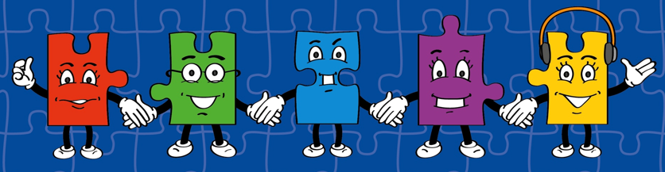

LORIC task
The LORIC task will focus on your Raj Resilience skills today:
Do not be put off by a difficult task.
Keep going – persevere.
Think about ways you can help yourself and others.

Slide 5
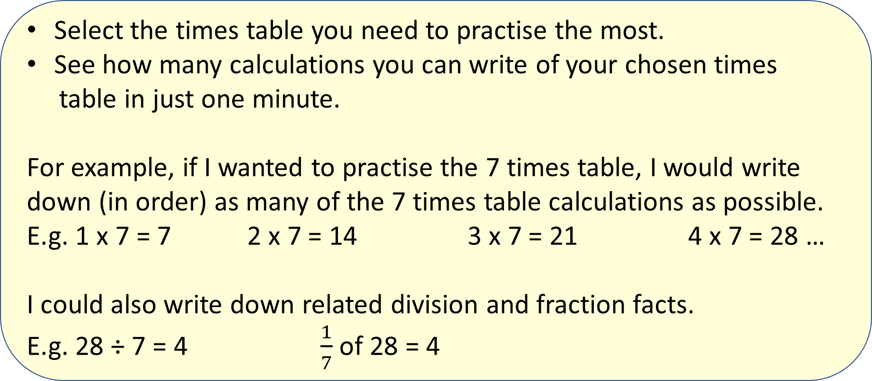
LORIC task
Select the times table you need to practise the most.
See how many calculations you can write of your chosen times
table in just one minute.
For example, if I wanted to practise the 7 times table, I would write down (in order) as many of the 7 times table calculations as possible.
E.g. 1 x 7 = 7 2 x 7 = 14 3 x 7 = 21 4 x 7 = 28 …
I could also write down related division and fraction facts.
E.g. 28 ÷ 7 = 4 $\frac{1}{7}$ of 28 = 4

Slide 6
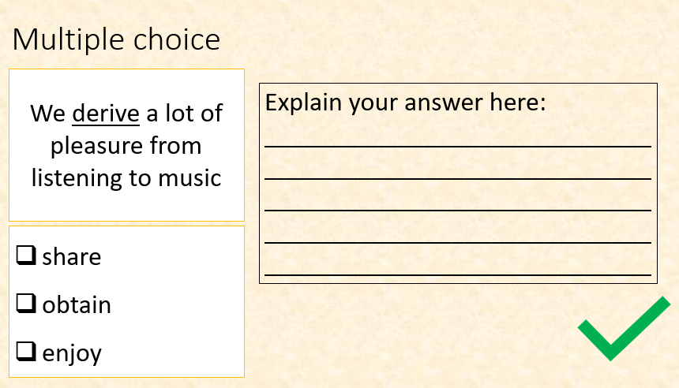
Vocabulary activity
multiply divide
mentally
derive
facts
LINK IT / USE IT

Slide 7
Teach
For example, if we know that 6 x 7 = 42 then that can help us to work out the following:
60 x 7 = 420
6 x 70 = 420
420 ÷ 60 = 7
420 ÷ 70 = 6
We can use what we know from our times tables to help us multiply and divide using larger numbers that are multiples of 10 or 100.

Slide 8
Model
We need to use known facts to help work out other problems.
If 8 x 9 = 72 then what is
8 x 90?
90 is ten times larger than 9. Therefore, our answer will be ten times larger.
H | T | 0
 |  | 9
 | 9 | 0
H | T | 0
 | 7 | 2
7 | 2 | 0
720 is ten times larger than 72.

Slide 9
Apply
We can use what we know from our times tables to help us multiply and divide using larger numbers that are multiples of 10 or 100.
Use your times table knowledge to solve the following:
40 x 8 =
6 x 70 =
80 x 5 =
70 x 9 =
3 x 90 =

Slide 10
Teach
Investigate the order of multiplying the following numbers:
3 4 5
We can also use the associative law (where no matter how the numbers are grouped, the answer will be the same).

Slide 11
Teach
For example, if we know that 2 x 6 x 5 = 60, then we can also work out the following:
6 x 5 x 2 = 60
5 x 2 x 6 = 60
10 x 6 = 60
We can also use the associative law (where no matter how the numbers are grouped, the answer will be the same).

Slide 12
Model
When multiplying numbers, the calculation can be done in any order. For example,
7 x 3 x 4 can be worked out as …
7 x 3 = 21 and then 21 x 4 = 84
or 4 x 3 = 12 and then 12 x 7 = 84
or 4 x 7 = 28 and then 28 x 3 = 84
I think that multiplying by 4 last is most efficient as we can double then double again.
So, I would complete the calculation by working out 7 x 3 first. This equals 21. I can then double 21 (42) and then double again (84).

Slide 13
Apply
Remember, if we know that
2 x 6 x 5 = 60 then we can also work out the following:
6 x 5 x 2 = 60
5 x 2 x 6 = 60
10 x 6 = 60
Explain which is the most efficient order to multiply the following numbers:
7 5 8

Slide 14
Apply
Work out the answers to these calculations using the most efficient order.
9 x 3 x 4 =
6 x 5 x 7 =
2 x 80 x 9 =
40 x 3 x 7 =
9 x 6 x 300 =
Remember, if we know that
2 x 6 x 5 = 60 then we can also work out the following:
6 x 5 x 2 = 60
5 x 2 x 6 = 60
10 x 6 = 60

Slide 15
Apply – Problem Solving
Firstly, I need to read and understand the question.
I know there are 30 children in each class and 9 classes. I have to work out how many in total so I will need to multiply the two numbers.
There are 30 children in each class in a school. There are 9 classes in the school. How many children are there in total at the school?
The calculation will be 30 x 9. I know 3 x 9 = 27, so this will help me work out 30 x 9.

Slide 16
Apply – Problem Solving
Remember to use a strategy you are confident with when working out times table calculations.
5 children each have 3 packs of pens. There are 7 pens in each pack. How many pens are there in total?

Slide 17
Apply – Reasoning Problem
Remember to use a strategy you are confident with when working out times table calculations.
Explain how 3 x 8 x 6 will give the same answer as 8 x 6 x 3.

Slide 18
Apply – Reasoning Problem
Remember to use a strategy you are confident with when working out times table calculations.
True or False?
6 x 70 is the same as
7 x 60. Explain how you know.

