Slide 1


.
Y4 M3f Can begin to divide three-digit by one-digit numbers with exact answers using short division
Commissioned by The PiXL Club Ltd.
June 2019
This resource is strictly for the use of member schools for as long as they remain members of The PiXL Club. It may not be copied, sold nor transferred to a third party or used by the school after membership ceases. Until such time it may be freely used within the member school.
All opinions and contributions are those of the authors. The contents of this resource are not connected with nor endorsed by any other company, organisation or institution.
PiXL Club Ltd endeavour to trace and contact copyright owners. If there are any inadvertent omissions or errors in the acknowledgements or usage, this is unintended and PiXL will remedy these on written notification.
© Copyright The PiXL Club Limited, 2019

Slide 2
Teachers’ Notes
The PiXL therapies can be taught to a whole class or a target group. Year 3-5 therapies are designed to take approximately 30-40 minutes. However, this is flexible: it may be that only part of the therapy is taught or it could, of course, be adapted or extended.
Each therapy begins with a LORIC activity to develop relevant learning behaviours.
This is followed by a vocabulary task, which uses the PiXL 5-phase approach to teach key mathematical vocabulary. Further resources to develop vocabulary can be found in the Whole School area.
Each therapy adopts the ‘Teach, model and apply’ process with opportunities for pupils to demonstrate the taught skill independently.
Problem solving and reasoning activities are an integral part of each therapy.

Slide 3
Progress across amber – the 4-stage model
The three therapy tests which accompany this resource can be used to revisit the taught skill to check that the pupil is able to perform it independently and consistently.
A
A child has successfully completed a therapy test independently, following a set of therapy sessions.
A child has successfully completed a therapy test independently, a period after the relevant therapy sessions – we would advise about 2 weeks.
A child has successfully applied their knowledge or skill in an unfamiliar context. This may be application across the curriculum or in a problem.
A pupil has successfully re-visited the skills at a later point, and applies these in an unfamiliar context or problem, or across the curriculum.
A
DA
G

Slide 4

LORIC task
The LORIC task will focus on your Olly Organisation skills today:
Work through the problem systematically
Make decisions
Share ideas in a logical way

Slide 5

LORIC task
Look at the numbers provided.
Sort them using any categories you decide.
Explain how you have sorted your numbers.
For example, you could sort the numbers into ‘multiples of…’, odd numbers, etc.
20 36 15 49 50 16
80 81 100 56 60 25

Slide 6
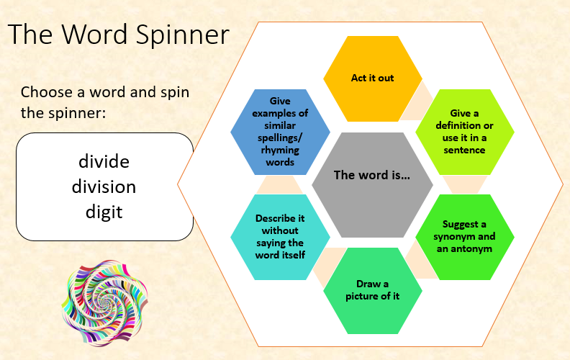
Vocabulary activity
divide
division
digit
share
ALL 5 PHASES

Slide 7
Teach
When dividing a three-digit number by a one-digit number, using a formal written method will help.
Let’s look at using the short division method.
Sometimes numbers are too large or there are too many numbers to calculate in our head. We need a reliable written method to help us.
7
1
9
6
Notes:
You may want to reference estimating first and model this as well as checking the answer against the estimate.

Slide 8
Teach
196 ÷ 7 = 28
1 5
Sometimes numbers are too large or there are too many numbers to calculate in our head. We need a reliable written method to help us.
0
2
8
7
1
9
6

Slide 9
Model
204 ÷ 6 =
2
First, you work out how many times 6 can be shared into 2. This is 0, so a 0 goes in the first square for your answer. The ‘2’ is carried over to the tens column.
0
?
?
6
2
0
4
Notes:
You may want to reference estimating first and model this as well as checking the answer against the estimate.

Slide 10
Model
204 ÷ 6 =
2 2
Then, you work out how many times 6 can be shared into 20. This is 3 times, so a 3 goes in the second square (the tens column) for your answer. As this is 18 and 2 are remaining, the 2 is carried over to the ones column.
0
3
?
6
2
0
4

Slide 11
Model
204 ÷ 6 = 34
2 2
The final part is working out how many times 6 can be shared into 24. The answer is 4 so this goes in the ones column. This means the overall answer is 34.
0
3
4
6
2
0
4

Slide 12
Model
296 ÷ 8 =
2
First, you work out how many times 8 can be shared into 2. This is 0, so a 0 goes in the first square for your answer. The ‘2’ is carried over to the tens column.
0
?
?
8
2
9
6
Notes:
You may want to reference estimating first and model this as well as checking the answer against the estimate.

Slide 13
Model
296 ÷ 8 =
2 5
Then, you work out how many times 8 can be shared into 29. This is 3 times, so a 3 goes in the second square for your answer. As this is 24 and 5 are remaining, the 5 is carried over to the ones column.
0
3
?
8
2
9
6

Slide 14
Model
296 ÷ 8 = 37
2 5
The final part is working out how many times 8 can be shared into 56. The answer is 7, so this goes in the ones column. This means the overall answer is 37.
0
3
7
8
2
9
6

Slide 15
Apply
Remember to use your times table knowledge to help solve each problem.
Use the short division strategy shown to work out the following:
294 ÷ 6 =
371 ÷ 7 =
252 ÷ 9 =
512 ÷ 8 =
388 ÷ 4 =

Slide 16
Apply – Problem Solving
Remember to use your times table knowledge to help solve each problem.
There are 217 children in the school. The children are split into 7 classes. How many children are in each class?

Slide 17
Apply – Problem Solving
Remember to use your times table knowledge to help solve each problem.
The school has ordered 261 new books for the school library. They have to group them in batches of 9. How many groups of books will they have in total?

Slide 18
Apply – Reasoning Problem
498 ÷ 6 = 84
4 2
Spot the error in this calculation. Explain how you know.
Challenge – work out the correct answer and explain it to a partner.
0
8
4
6
4
9
8

