Slide 1


Y4 M5a. Can convert between metric units of length
Commissioned by The PiXL Club Ltd.
August 2018
This resource is strictly for the use of member schools for as long as they remain members of The PiXL Club. It may not be copied, sold nor transferred to a third party or used by the school after membership ceases. Until such time it may be freely used within the member school.
All opinions and contributions are those of the authors. The contents of this resource are not connected with nor endorsed by any other company, organisation or institution.
PiXL Club Ltd endeavour to trace and contact copyright owners. If there are any inadvertent omissions or errors in the acknowledgements or usage, this is unintended and PiXL will remedy these on written notification.
© Copyright The PiXL Club Limited, 2018

Slide 2
Teachers’ Notes
The purpose of the priority therapies is to support the teaching of fundamental concepts for the year group.
The therapies can be taught to a whole class or a target group. Year 4 therapies are designed to take approximately 30 minutes. However, this is flexible: it may be that only part of the therapy is taught or it could, of course, be adapted or extended.
A vocabulary slide is included in each therapy. This identifies key words which relate to the taught concept along with a link to the ‘Vocabulary Shorts’ on PrimaryWise (20 activities to develop vocabulary). The intention is that the therapy begins with explicit teaching of this vocabulary.
The therapy adopts the ‘Teach, model and apply’ process with plenty of opportunities for pupils to demonstrate the taught skill.
Problem solving and reasoning activities are an integral part of each therapy.

Slide 3
Vocabulary: measurement
millimetre
centimetre
metre
kilometre
Please select an activity from the ‘Vocabulary Shorts’ to develop understanding of the key vocabulary.

Slide 4

Teach
In which units do we measure length?

Slide 5
Teach
When might we need to measure length?

Slide 6
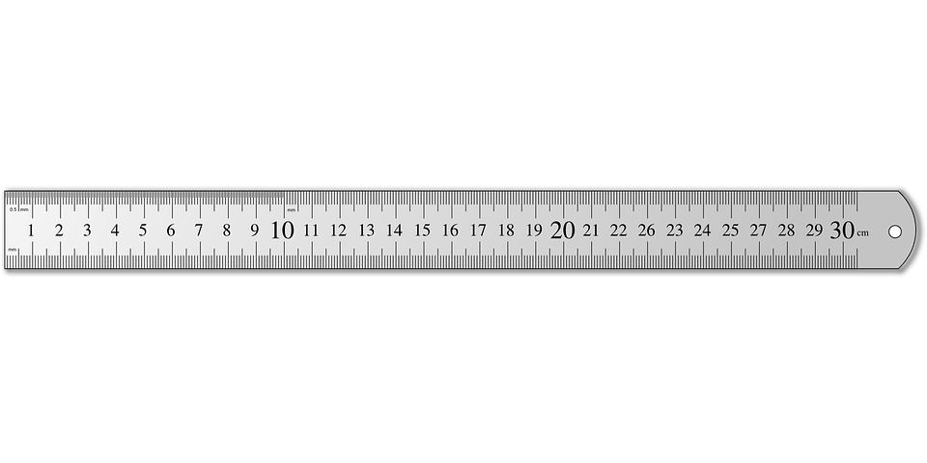

Teach
Look at your ruler. There are 10 millimetres in 1 centimetre.

Slide 7
Teach
x 10
To convert (change) between mm and cm, we need to multiply and divide by 10.
cm
mm
÷ 10

Slide 8
Model
To convert (change) 14cm into mm, we need to multiply by 10.
x 10
cm
mm
÷ 10

Slide 9
Model
To do this, place (or think of) 14 on a place value grid.
To multiply by 10, move the digits one column to the left.
x 10
cm
mm
Hundreds | Tens | Ones | Tenths | Hundredths
1
4
÷ 10
Notes:
Click once on slideshow mode to move the digit cards one space to the left.

Slide 10
Model
We then put 0 as a place holder so that the number now reads 140.
x 10
cm
mm
Hundreds | Tens | Ones | Tenths | Hundredths
1
4
0
÷ 10

Slide 11
Model
So,
14cm = 140mm
x 10
cm
mm
Hundreds | Tens | Ones | Tenths | Hundredths
1
4
0
÷ 10

Slide 12
Model
To convert (change) 56mm into cm, we need to divide by 10.
x 10
cm
mm
÷ 10

Slide 13
Model
To do this, place (or think of) 56 on a place value grid.
To divide by 10, move the digits one column to the right.
x 10
cm
mm
Hundreds | Tens | Ones | Tenths | Hundredths
5
6
÷ 10
Notes:
Click one on slideshow mode to move the digit cards one space to the right. This concept can be modelled with base ten apparatus.

Slide 14
Model
So,
56mm = 5.6cm
x 10
cm
mm
Hundreds | Tens | Ones | Tenths | Hundredths
5
6
÷ 10

Slide 15
Apply
Now try some of your own!
Use a place value mat or draw your own to help you.
75 mm = ____ cm
34 mm = ____ cm
823 mm = ____ cm
903mm = ____ cm
5 cm = ____ mm
23 cm = ____ mm
30 cm = ____ mm
542 cm = ____ mm
x 10
cm
mm
Hundreds | Tens | Ones | Tenths | Hundredths
÷ 10

Slide 16
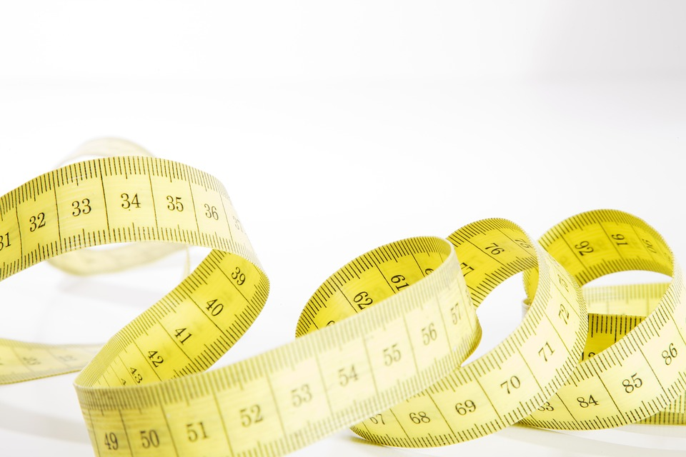
Teach
Look at a metre stick or tape measure. There are 100 centimetres in 1 metre.

Slide 17
Teach
x 100
m
cm
To convert (change) between cm and m, we need to multiply and divide by 100.
÷ 100

Slide 18
Model
Because we are multiplying and dividing by 100 this time, we need to move the digit… two spaces to the left to make it 100 times larger or two spaces to the right to make it 100 times smaller.
x 100
m
cm
÷ 100

Slide 19
Model
For example, to find how many centimetres are in 1.5 metres, we need to move the digits 1 and 5 two spaces to the left to make it 100 times larger.
x 100
m
cm
Hundreds | Tens | Ones | Tenths | Hundredths
1
5
÷ 100
Notes:
Click once on slideshow mode to move the digit cards two spaces to the left.

Slide 20
Model
We then put 0 as a place holder so that the number now reads 150.
x 100
m
cm
Hundreds | Tens | Ones | Tenths | Hundredths
1
5
0
÷ 100

Slide 21
Model
So,
1.5m = 150cm
x 100
m
cm
Hundreds | Tens | Ones | Tenths | Hundredths
1
5
0
÷ 100

Slide 22
Apply
Now try some of your own!
Use a place value mat or draw your own to help you.
400 cm = ____ m
560 cm = ____ m
3,333 cm = ____ m
802 cm = ____ m
4 m = ____ cm
12 m = ____ cm
3.4 m = ____ cm
76.1 m = ____ cm
x 100
m
cm
Thousands | Hundreds | Tens | Ones | Tenths | Hundredths
÷ 100

Slide 23
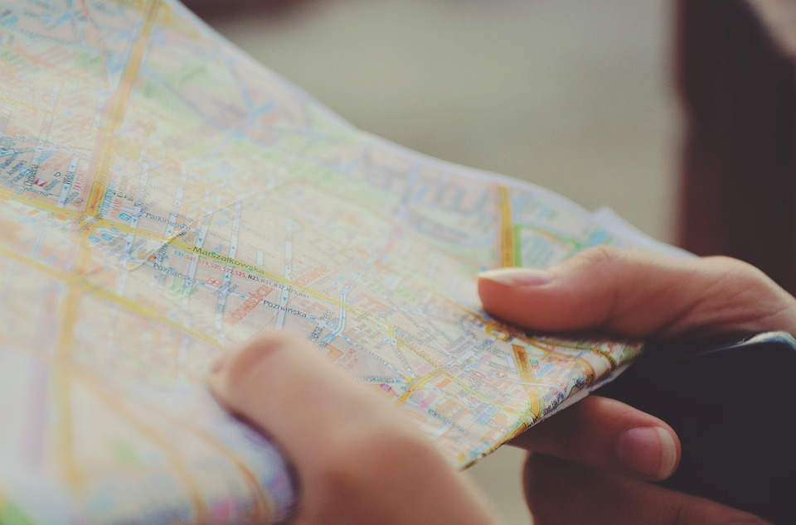
Teach
Look at a map. There are 1,000 metres in 1 kilometre.

Slide 24
Teach
x 1,000
km
m
To convert (change) between m and km, we need to multiply and divide by 1,000.
÷ 1,000

Slide 25
Model
Because we are multiplying and dividing by 1,000 this time, we need to move the digit three spaces larger or smaller.
x 1,000
km
m
÷ 1,000

Slide 26
Model
For example, to find how many km are in 7,000 metres, we need to move the digit 7 three spaces to the right to make it 1,000 times smaller.
x 1,000
km
m
Thousands | Hundreds | Tens | Ones | Tenths | Hundredths
7
0
0
0
÷ 1,000
Notes:
Click once on slideshow mode to move the digit cards three spaces to the right.

Slide 27
Model
Zeros at the end of a decimal do not change the value of the number, so we can write the answer as just 7.
x 1,000
km
m
Hundreds | Tens | Ones | Tenths | Hundredths
7
÷ 1,000

Slide 28
Model
So,
7,000m = 7km
x 1,000
km
m
Hundreds | Tens | Ones | Tenths | Hundredths
7
÷ 1,000

Slide 29
Apply
Now try some of your own!
Use a place value mat or draw your own to help you.
8,000 m = ____ km
34,000 m = ____ km
750 m = ____ km
6,250 m = ____ km
3 km = ____ m
56 km = ____ m
0.75 km = ____ m
1.25 km = ____ m
x 1,000
km
m
Thousands | Hundreds | Tens | Ones | Tenths | Hundredths
÷ 1,000

Slide 30
Apply
x 1,000
x 100
x 10
km
m
m
cm
cm
mm
÷ 1,000
÷ 100
÷ 10
4.5 km = _____ m
670 cm = _____ m
7,700 mm = _____ cm
Thousands | Hundreds | Tens | Ones | Tenths | Hundredths | Thousandths

Slide 31


Evaluate
Can you convert between metric units of length?

