Slide 1


Y4 M5b. Can convert between metric units of mass
Commissioned by The PiXL Club Ltd.
August 2018
This resource is strictly for the use of member schools for as long as they remain members of The PiXL Club. It may not be copied, sold nor transferred to a third party or used by the school after membership ceases. Until such time it may be freely used within the member school.
All opinions and contributions are those of the authors. The contents of this resource are not connected with nor endorsed by any other company, organisation or institution.
PiXL Club Ltd endeavour to trace and contact copyright owners. If there are any inadvertent omissions or errors in the acknowledgements or usage, this is unintended and PiXL will remedy these on written notification.
© Copyright The PiXL Club Limited, 2018

Slide 2
Teachers’ Notes
The purpose of the priority therapies is to support the teaching of fundamental concepts for the year group.
The therapies can be taught to a whole class or a target group. Year 4 therapies are designed to take approximately 30 minutes. However, this is flexible: it may be that only part of the therapy is taught or it could, of course, be adapted or extended.
A vocabulary slide is included in each therapy. This identifies key words which relate to the taught concept along with a link to the ‘Vocabulary Shorts’ on PrimaryWise (20 activities to develop vocabulary). The intention is that the therapy begins with explicit teaching of this vocabulary.
The therapy adopts the ‘Teach, model and apply’ process with plenty of opportunities for pupils to demonstrate the taught skill.
Problem solving and reasoning activities are an integral part of each therapy.

Slide 3
Vocabulary: Measurement
gram
kilogram
convert
measure
Please select an activity from the ‘Vocabulary Shorts’ to develop understanding of the key vocabulary.

Slide 4

Teach
In what units do we measure mass?

Slide 5
Teach
When might we need to measure mass?

Slide 6
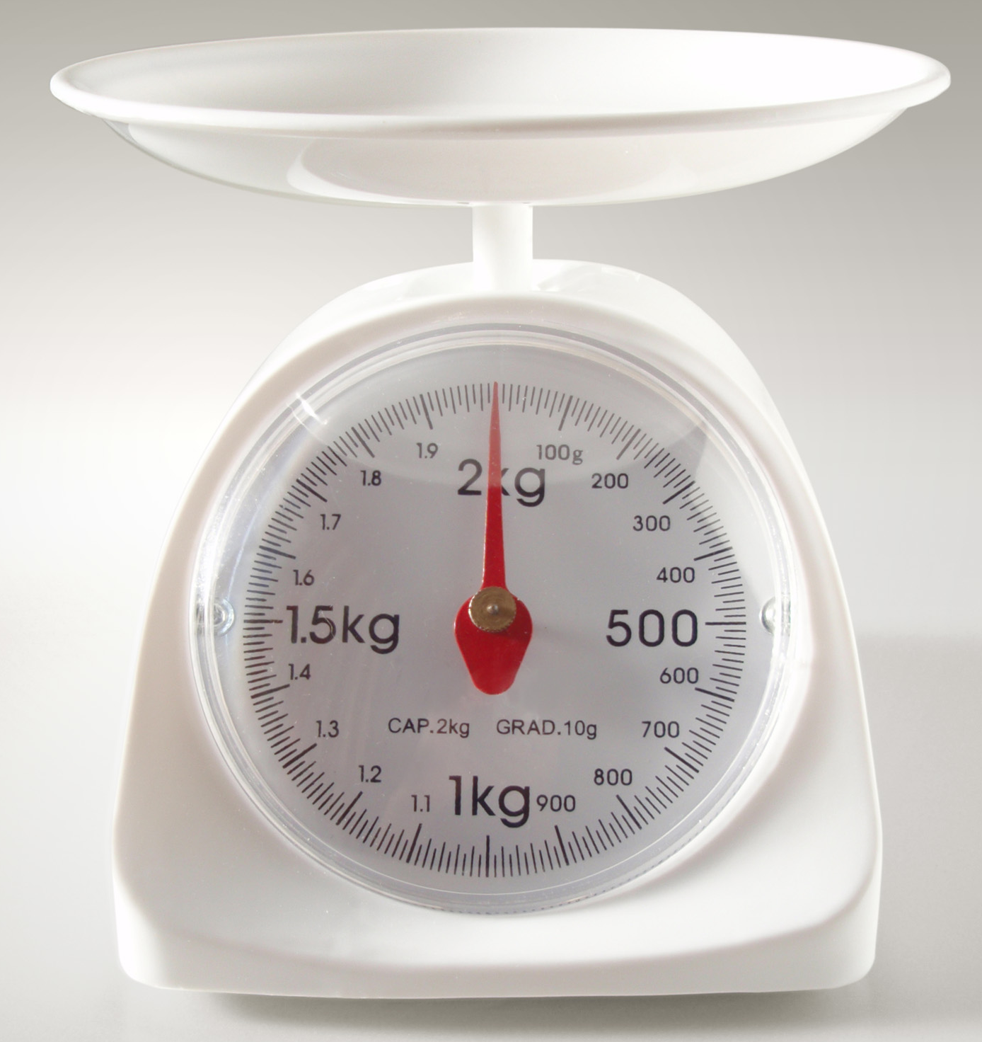
Teach
Look at the kitchen scales. There are 1,000 grams in one kilogram.

Slide 7
Teach
÷ 1,000
To convert (change) between kg and g, we need to multiply or divide by 1,000.
g
kg
x 1,000

Slide 8
Model
Because we are multiplying and dividing by 1,000 this time, we need to move the digits as follows: three spaces to the left to make the number 1,000 times larger or three spaces to the right to make the number 1,000 times smaller.
÷ 1,000
g
kg
x 1,000
Notes:
Base ten equipment can be used to model this.

Slide 9
Model
How many grams are in 3.6kg?
÷ 1,000
g
kg
x 1,000
Thousands | Hundreds | Tens | Ones | Tenths | Hundredths | Thousandths
3
6

Slide 10
Model
How many grams are in 3.6kg?
We need to multiply 3.6kg by 1,000.
x 1,000
kg
g
To do this we move all of the digits 3 places to the left to make the number 1,000 times larger.
÷ 1,000
Thousands | Hundreds | Tens | Ones | Tenths | Hundredths | Thousandths
3
6
Notes:
Click once on slideshow mode to move the digit cards three spaces to the left.

Slide 11
Model
How many grams are in 3.6kg?
x 1,000
We then put zeros as place holders.
We can now see that there are
3,600g in 3.6kg.
kg
g
÷ 1,000
Thousands | Hundreds | Tens | Ones | Tenths | Hundredths | Thousandths
3
6
0
0

Slide 12
Model
How many kilograms are in 7,800g?
÷ 1,000
g
kg
x 1,000
Thousands | Hundreds | Tens | Ones | Tenths | Hundredths | Thousandths
7
8
0
0

Slide 13
Model
How many kilograms are in 7,800g?
We need to divide 7,800g by 1,000.
x 1,000
kg
g
To do this we move all of the digits 3 places to the right to make the number 1,000 times smaller.
÷ 1,000
Thousands | Hundreds | Tens | Ones | Tenths | Hundredths | Thousandths
7
8
0
0
Notes:
Click once on slideshow mode to move the digit cards three spaces to the right.

Slide 14
Model
How many kilograms are in 7,800g?
Zeros at the end of a decimal do not change the value of the number, so we don’t need to write them.
We can now see that
7,800g converts to 7.8kg
÷ 1,000
g
kg
x 1,000
Thousands | Hundreds | Tens | Ones | Tenths | Hundredths | Thousandths
7
8

Slide 15
Apply
Now try some of your own!
Use a place value mat or draw your own to help you.
4,000g = ____kg
3,900g = ____kg
12,000g = ____kg
6,704g = ____kg
9kg = ____g
8.2kg = ____g
13kg = ____g
5.02kg = ____g
÷ 1,000
g
kg
Thousands | Hundreds | Tens | Ones | Tenths | Hundredths
x 1,000

Slide 16


Evaluate
Can you convert between metric units of mass?

