Slide 1


.
Y4 M5d Can convert between units of time
Commissioned by The PiXL Club Ltd.
November 2019
This resource is strictly for the use of member schools for as long as they remain members of The PiXL Club. It may not be copied, sold nor transferred to a third party or used by the school after membership ceases. Until such time it may be freely used within the member school.
All opinions and contributions are those of the authors. The contents of this resource are not connected with nor endorsed by any other company, organisation or institution.
PiXL Club Ltd endeavour to trace and contact copyright owners. If there are any inadvertent omissions or errors in the acknowledgements or usage, this is unintended and PiXL will remedy these on written notification.
© Copyright The PiXL Club Limited, 2019

Slide 2
Teachers’ Notes
The PiXL therapies can be taught to a whole class or a target group. Year 3-5 therapies are designed to take approximately 30-40 minutes. However, this is flexible: it may be that only part of the therapy is taught or it could, of course, be adapted or extended.
Each therapy begins with a LORIC activity to develop relevant learning behaviours.
This is followed by a vocabulary task, which uses the PiXL 5-phase approach to teach key mathematical vocabulary. Further resources to develop vocabulary can be found in the Whole School area.
Each therapy adopts the ‘Teach, model and apply’ process with opportunities for pupils to demonstrate the taught skill independently.
Problem solving and reasoning activities are an integral part of each therapy.

Slide 3
Progress across amber – the 4-stage model
The three therapy tests which accompany this resource can be used to revisit the taught skill to check that the pupil is able to perform it independently and consistently.
A
A child has successfully completed a therapy test independently, following a set of therapy sessions.
A child has successfully completed a therapy test independently, a period after the relevant therapy sessions – we would advise about 2 weeks.
A child has successfully applied their knowledge or skill in an unfamiliar context. This may be application across the curriculum or in a problem.
A pupil has successfully re-visited the skills at a later point, and applies these in an unfamiliar context or problem, or across the curriculum.
A
DA
G

Slide 4
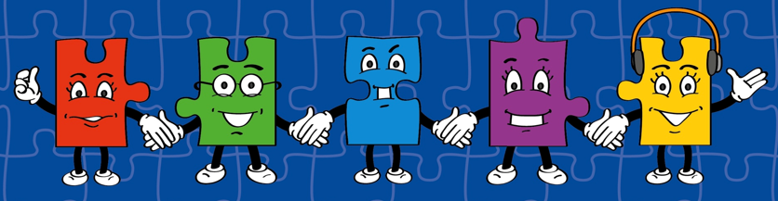
LORIC task
Our Primary Edge attributes help us to become better learners and today is no exception. Before you start this activity, here are some ideas for how you will need your Izzy Initiative skills today:
Be resourceful
Think as someone who is part of a team
Use all skills available to overcome the problem

Slide 5

LORIC task
We have to be confident in all times tables up
to 12 x 12, including corresponding division facts.
There may be some that you still find tricky
so this is your opportunity to practise.
Write down the times tables and practise recalling them with a partner. Then see if you can write down corresponding division facts and fractions facts too.

Slide 6
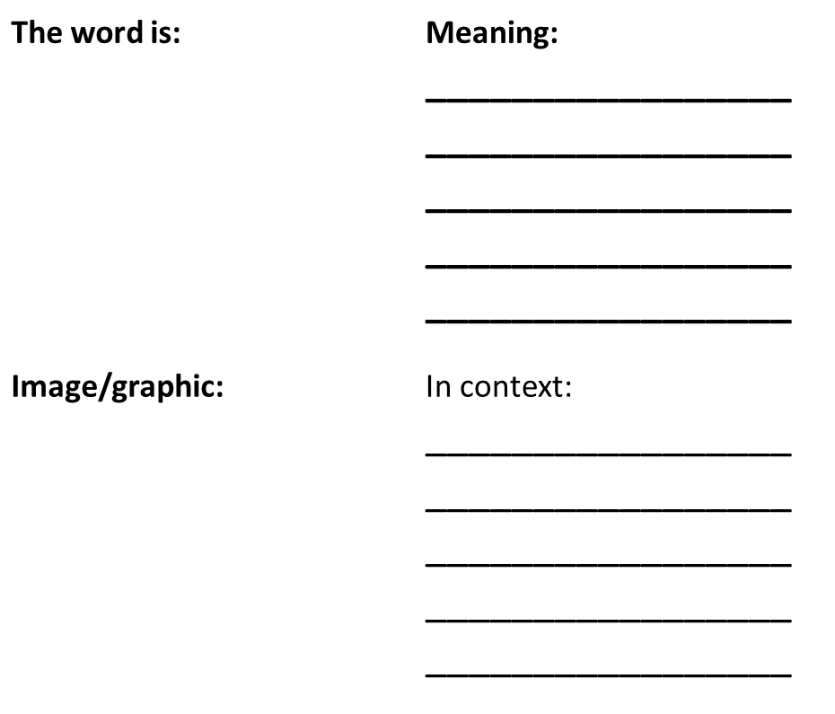
Vocabulary activity
time
units
digital analogue
convert
DEFINE IT / USE IT

Slide 7
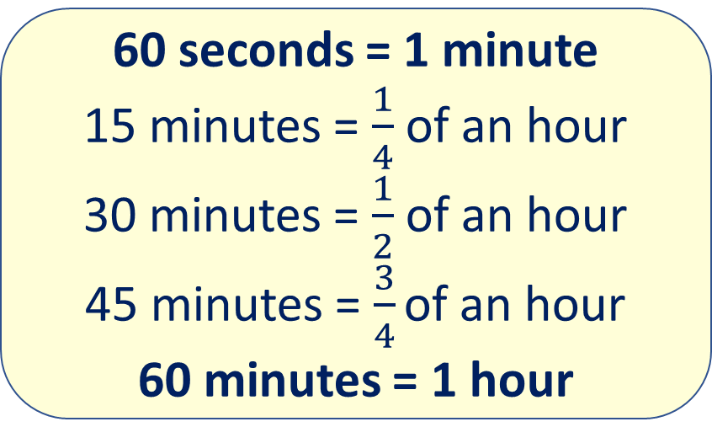
Teach
Today, we are going to convert between units of time.
To do this, we need to remember some time facts. E.g.
60 seconds = 1 minute
15 minutes = $\frac{1}{4}$ of an hour
30 minutes = $\frac{1}{2}$ of an hour
45 minutes = $\frac{3}{4}\text{of} \text{an} \text{hour}$
60 minutes = 1 hour
24 hours = 1 day
7 days = 1 week
52 weeks = 1 year
12 months = 1 year
365 days = 1 year
366 days in a leap year

Slide 8
Teach
When converting between units of time, it is important to remember the relationship between different units of time.
For example, if I want to work out how many seconds there are in 4 minutes, I first need to recall how many seconds there are in 1 minute:
1 minute = 60 seconds
4 minutes is the same as 4 x 60 seconds.
4 minutes = 240 seconds.

Slide 9
Teach
Using the time facts below, I can work out different conversions:
60 seconds = 1 minute
60 minutes = 1 hour
24 hours = 1 day
7 days = 1 week
52 weeks = 1 year
12 months = 1 year
180 seconds = 3 minutes
420 minutes = 7 hours
48 hours = 2 days
28 days = 4 weeks
260 weeks = 5 years
36 months = 3 years

Slide 10
Model
How many hours are there in 5 days?
24
x 5 20
100 120
I use my knowledge of time to recall that there are 24 hours in 1 day. I know I need to multiply 24 by 5 to work out the answer.
Answer: There are 120 hours in 5 days.
+

Slide 11
Model
There are 208 weeks in how many years?
I use my knowledge of time to recall that there are 52 weeks in 1 year.
I know I need to work out how many times 208 can be divided by 52.
I know I can also work this out by repeated addition:
52 + 52 + 52 + 52 = 208
There are 4 lots of 52.
This can also be shown as 208 ÷ 52 = 4
Answer: There are 4 years in 208 weeks.

Slide 12
Model
It takes Olivia 36 months to complete her course.
How many years did it take her?
I use my knowledge of time to recall that there are 12 months in 1 year.
I know I need to work out how many times 36 can be divided by 12.
36 ÷ 12 = 3
Answer: There are 3 years in 36 months.

Slide 13

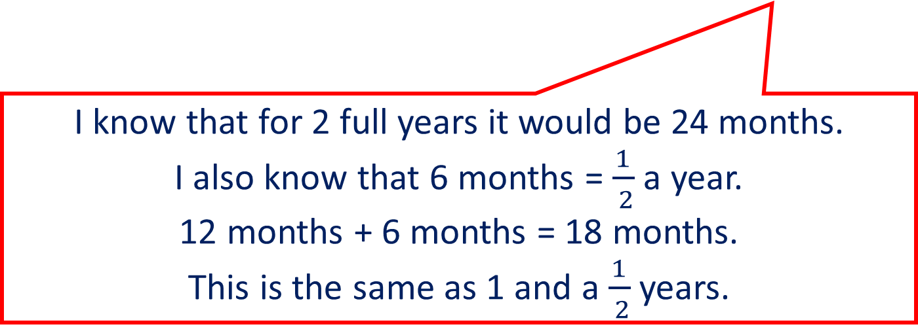
Model
It takes Ben 18 months to write his book. How many years does it take him?
I use my knowledge of time to recall that there are 12 months in 1 year.
I know that for 2 full years it would be 24 months.
I also know that 6 months =$\frac{1}{ 2}$ a year.
12 months + 6 months = 18 months.
This is the same as 1 and a $\frac{1}{ 2}$ years.
Answer: It took Ben 1 $\frac{1}{ 2}$ years.

Slide 14
Apply
Use the time facts below to work out the different conversions:
60 seconds = 1 minute
60 minutes = 1 hour
24 hours = 1 day
7 days = 1 week
52 weeks = 1 year
12 months = 1 year
300 seconds = mins
3 hours = mins
72 hours = days
49 days = weeks
3 years = weeks
60 months = years

Slide 15
Apply
Use the time facts below to work out the different conversions:
60 seconds = 1 minute
60 minutes = 1 hour
24 hours = 1 day
7 days = 1 week
52 weeks = 1 year
12 months = 1 year
300 seconds = 5 minutes
3 hours = 180 minutes
72 hours = 3 days
49 days = 7 weeks
3 years = 156 weeks
60 months = 5 years

Slide 16
Apply – Problem Solving
Katie took 4 hours and 48 minutes to complete a marathon.
Laura ran the same marathon in 268 minutes.
Who completed the marathon in the quicker time? Explain how you know.

Slide 17
Apply – Reasoning
Elliot says that 200 minutes is less time than 3 hours.
Is he correct?
Explain how you know.

Slide 18
Apply – Reasoning
96 months is the same as
8 years.
True or False?
Explain your answer.

