Slide 1


.
Y4 M5e Can read, write and convert analogue and digital 12 and 24 hour clocks
Commissioned by The PiXL Club Ltd.
November 2019
This resource is strictly for the use of member schools for as long as they remain members of The PiXL Club. It may not be copied, sold nor transferred to a third party or used by the school after membership ceases. Until such time it may be freely used within the member school.
All opinions and contributions are those of the authors. The contents of this resource are not connected with nor endorsed by any other company, organisation or institution.
PiXL Club Ltd endeavour to trace and contact copyright owners. If there are any inadvertent omissions or errors in the acknowledgements or usage, this is unintended and PiXL will remedy these on written notification.
© Copyright The PiXL Club Limited, 2019

Slide 2
Teachers’ Notes
The PiXL therapies can be taught to a whole class or a target group. Year 3-5 therapies are designed to take approximately 30-40 minutes. However, this is flexible: it may be that only part of the therapy is taught or it could, of course, be adapted or extended.
Each therapy begins with a LORIC activity to develop relevant learning behaviours.
This is followed by a vocabulary task, which uses the PiXL 5-phase approach to teach key mathematical vocabulary. Further resources to develop vocabulary can be found in the Whole School area.
Each therapy adopts the ‘Teach, model and apply’ process with opportunities for pupils to demonstrate the taught skill independently.
Problem solving and reasoning activities are an integral part of each therapy.

Slide 3
Progress across amber – the 4-stage model
The three therapy tests which accompany this resource can be used to revisit the taught skill to check that the pupil is able to perform it independently and consistently.
A
A child has successfully completed a therapy test independently, following a set of therapy sessions.
A child has successfully completed a therapy test independently, a period after the relevant therapy sessions – we would advise about 2 weeks.
A child has successfully applied their knowledge or skill in an unfamiliar context. This may be application across the curriculum or in a problem.
A pupil has successfully re-visited the skills at a later point, and applies these in an unfamiliar context or problem, or across the curriculum.
A
DA
G

Slide 4
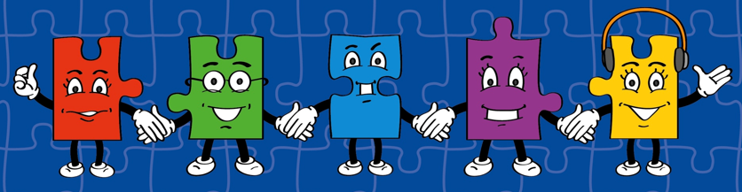
LORIC task
Our Primary Edge attributes help us to become better learners and today is no exception. Before you start this activity, here are some ideas for how you will need your Raj Resilience skills today:
Do not be put off by a difficult task
Keep going – persevere
Think about ways you can help yourself and others

Slide 5

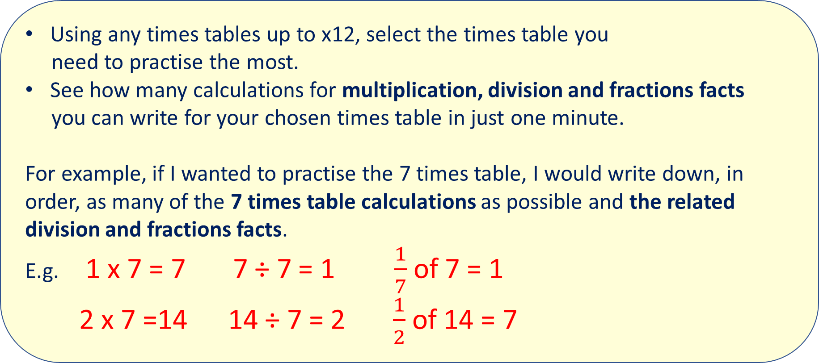
LORIC task
Using any times tables up to x12, select the times table you
need to practise the most.
See how many calculations for multiplication, division and fractions facts
you can write for your chosen times table in just one minute.
For example, if I wanted to practise the 7 times table, I would write down, in order, as many of the 7 times table calculations as possible and the related division and fractions facts.
E.g. 1 x 7 = 7 7 ÷ 7 = 1 $\frac{1}{7}$ of 7 = 1
2 x 7 =14 14 ÷ 7 = 2 $\frac{1}{2}$ of 14 = 7

Slide 6
Vocabulary activity
time
analogue
digital
convert
The word is…
Act it out
Give a definition or use it in a sentence
Suggest a synonym and an antonym
Draw a picture of it
Describe it without saying the word itself
Give examples of similar spellings/ rhyming words
ALL PHASES
Notes:
This game requires pupils to manipulate and demonstrate their understanding of the same word in lots of different ways. Print copies of the wheel (laminated, these can be reused multiple times). Give pupils a wheel between 2 or 3 and ask them to select a word from a given list (see Vocabulary Mats or Statutory words lists). Pupils should then spin the wheel and represent the new vocabulary using the method the wheel lands on.

Slide 7
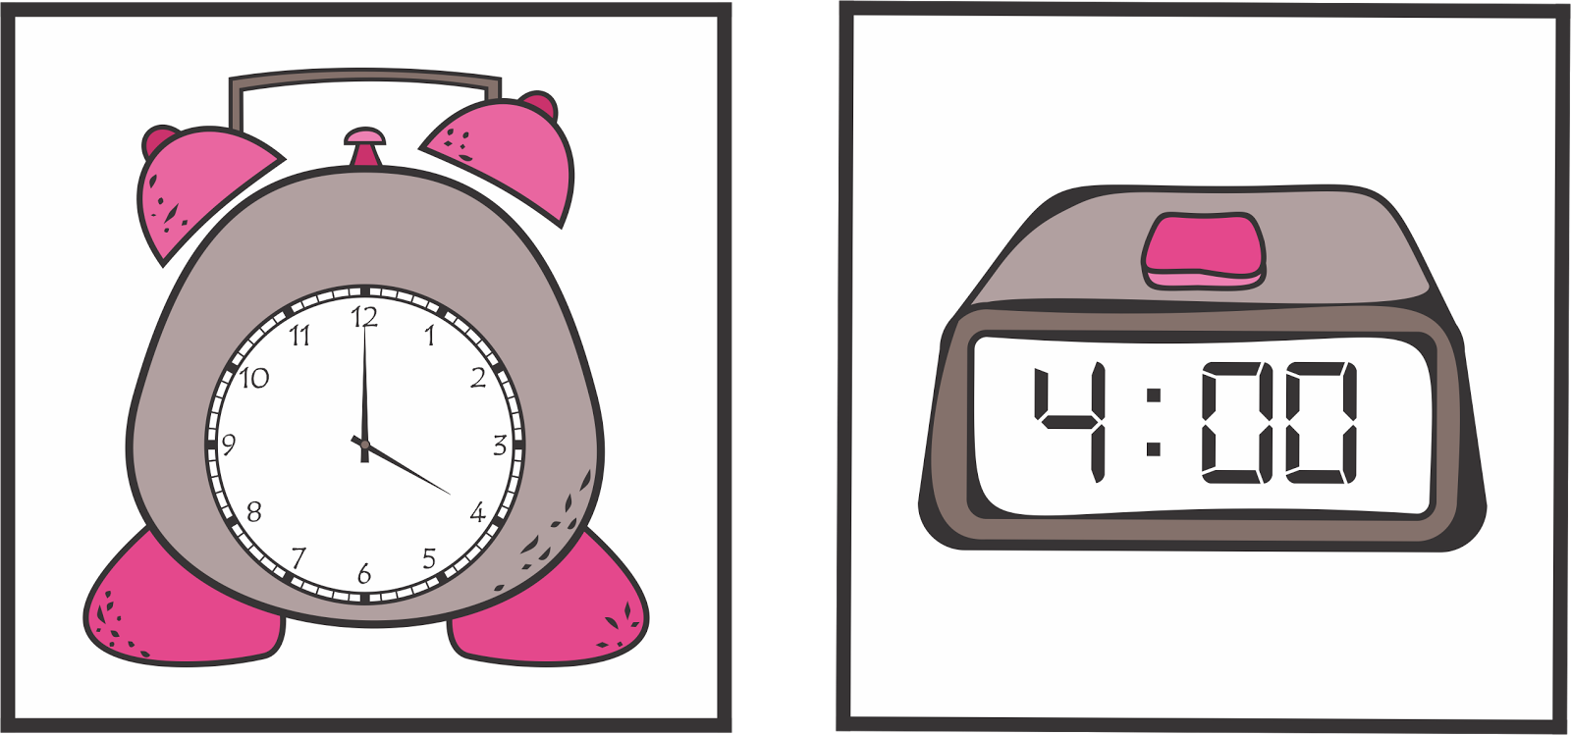
Teach
Today, we are going to read, write and convert between analogue and digital 12 and 24-hour clocks.
Analogue
Digital

Slide 8
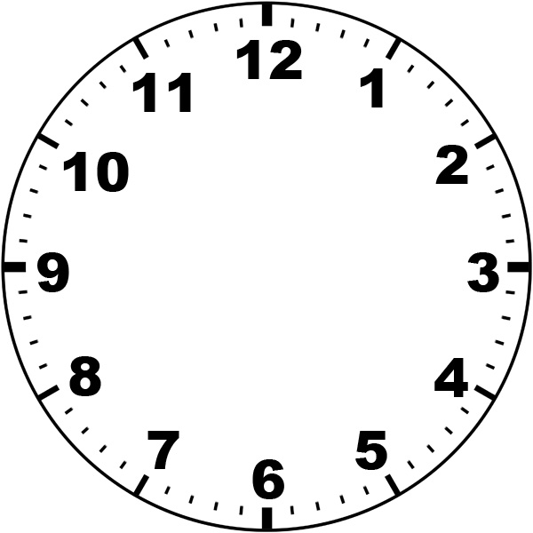
Teach
0
When telling the time using an analogue clock, it is important to look at the hands on the clock.
The shorter hand (the red one) tells the hour.
The longer hand (the green one) tells the minute.
55
5
It is also important to remember that each number represents
5-minute intervals.
The lines in-between each number represent 1-minute intervals.
50
10
45
15
40
20
35
25
30

Slide 9
Teach
A digital clock shows the time like this:
hour : minutes
07 : 12
15 : 48
A 24-hour clock shows the time since midnight.
Once you pass 12pm (midday / noon), you have to add 12 to each time, e.g. 2pm = 14:00.
There are 24 hours in a day.
There are 60 minutes in an hour.

Slide 10
Teach
Digital clocks can be
12 hour or
24 hour.
We are going to focus on 24-hour clocks today.
A digital clock shows the time like this:
hour : minutes
Note: 24-hour clock times always have 4 digits, so we place a zero before single-digit numbers.
07:12
15:48

Slide 11
Model
I know that the time is 5.55pm using an analogue clock.
I know that as it is pm, if I am to convert this to a digital time, I need to add 12 to the hour.
The hour is 5, so 5 + 12 = 17
I can write the digital time as 17:55.
PM

Slide 12
Teach
A digital clock shows the time like this:
hour : minutes
07 : 12
15 : 48
If we need to convert a time that is before midnight but after midday, we must subtract 12.
For example:
13 – 12 = 1
13:00 = 1pm
14:00 = 2pm
15:00 = 3pm
16:00 = 4pm
17:00 = 5pm
18:00 = 6pm
19:00 = 7pm
20:00 = 8pm
21:00 = 9pm
22:00 = 10pm
23:00 = 11pm

Slide 13
Model
21 : 42
I know this digital time is an evening (pm) time as it is past 12.
I know that 21 ­­˗ 12 = 9. This means the time is 9.42pm using an analogue clock.
I can also write this time as:
42 minutes past 9 in the evening
or
18 minutes to 10 in the evening
PM

Slide 14
Apply
Show 28 minutes past 4 in the morning on an analogue and digital clock.
04 : 28
AM

Slide 15
Apply
What is the time shown on this analogue clock?
Challenge:
Can you write it as a 12 hour digital time and a 24-hour digital time?
PM

Slide 16
Apply
Convert these times to an analogue clock.
State whether each time is am or pm.
03 : 18
21 : 04
19 : 44
02 : 37
12 : 52
14 : 42

Slide 17
Apply – Problem Solving
What will be the time be 20 minutes later?
Write this as a 24- hour digital time.
PM

Slide 18
Apply – Problem Solving
Eddie went to the park with some friends. He had to be home at 25 minutes past 4 in the evening.
Write the time he has to be home as a 24-hour digital clock time and as an analogue clock time.

Slide 19
Apply – Reasoning
Stephen’s analogue alarm goes off every morning. His 24 hour digital watch shows the time as 17 : 45.
Explain how Stephen knows his watch is not working properly.
AM

