Slide 1


.
Y4 M5f Can estimate length
Commissioned by The PiXL Club Ltd.
November 2019
This resource is strictly for the use of member schools for as long as they remain members of The PiXL Club. It may not be copied, sold nor transferred to a third party or used by the school after membership ceases. Until such time it may be freely used within the member school.
All opinions and contributions are those of the authors. The contents of this resource are not connected with nor endorsed by any other company, organisation or institution.
PiXL Club Ltd endeavour to trace and contact copyright owners. If there are any inadvertent omissions or errors in the acknowledgements or usage, this is unintended and PiXL will remedy these on written notification.
© Copyright The PiXL Club Limited, 2019

Slide 2
Teachers’ Notes
The PiXL therapies can be taught to a whole class or a target group. Year 3-5 therapies are designed to take approximately 30-40 minutes. However, this is flexible: it may be that only part of the therapy is taught or it could, of course, be adapted or extended.
Each therapy begins with a LORIC activity to develop relevant learning behaviours.
This is followed by a vocabulary task, which uses the PiXL 5-phase approach to teach key mathematical vocabulary. Further resources to develop vocabulary can be found in the Whole School area.
Each therapy adopts the ‘Teach, model and apply’ process with opportunities for pupils to demonstrate the taught skill independently.
Problem solving and reasoning activities are an integral part of each therapy.

Slide 3
Progress across amber – the 4-stage model
The three therapy tests which accompany this resource can be used to revisit the taught skill to check that the pupil is able to perform it independently and consistently.
A
A child has successfully completed a therapy test independently, following a set of therapy sessions.
A child has successfully completed a therapy test independently, a period after the relevant therapy sessions – we would advise about 2 weeks.
A child has successfully applied their knowledge or skill in an unfamiliar context. This may be application across the curriculum or in a problem.
A pupil has successfully re-visited the skills at a later point, and applies these in an unfamiliar context or problem, or across the curriculum.
A
DA
G

Slide 4
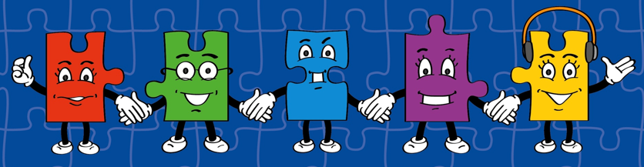
LORIC task
Our Primary Edge attributes help us to become better learners and today is no exception. Before you start this activity, here are some ideas for how you will need your Charlie Communication skills today:
Speak clearly
Discuss ideas by taking turns
Listen carefully

Slide 5


LORIC task
Today we are going to discuss a range of different questions.
These include:
How do we measure length?
How do we know when to use a different unit of measurement? E.g. measuring in metres instead of centimetres.
How do we know when to use a different measuring device? E.g. using a ruler rather than a metre stick.

Slide 6
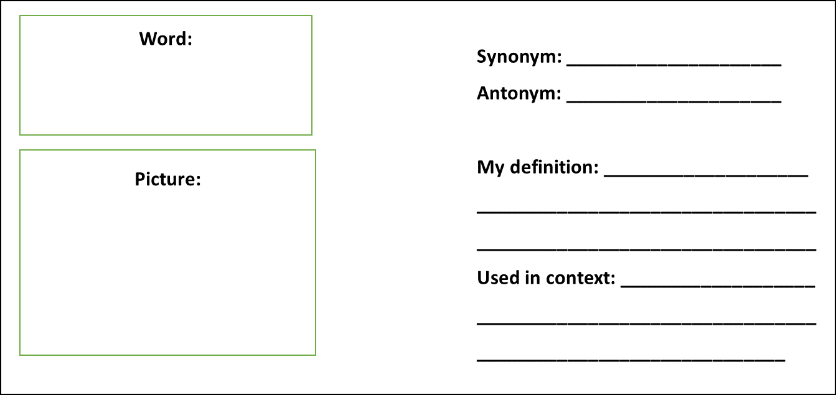
Vocabulary activity
length
estimate
distance
measure
DEFINE IT / USE IT

Slide 7
Teach
Today, we are going to estimate different lengths.
To do this, we also need to recap on our knowledge of measures:
10mm = 1cm
100cm = 1m
1,000m = 1km
mm = millimetres
cm = centimetres
m = metres
km = kilometres
In this therapy, some examples of length look at the longest side (this means that sometimes it is the height of the object).

Slide 8
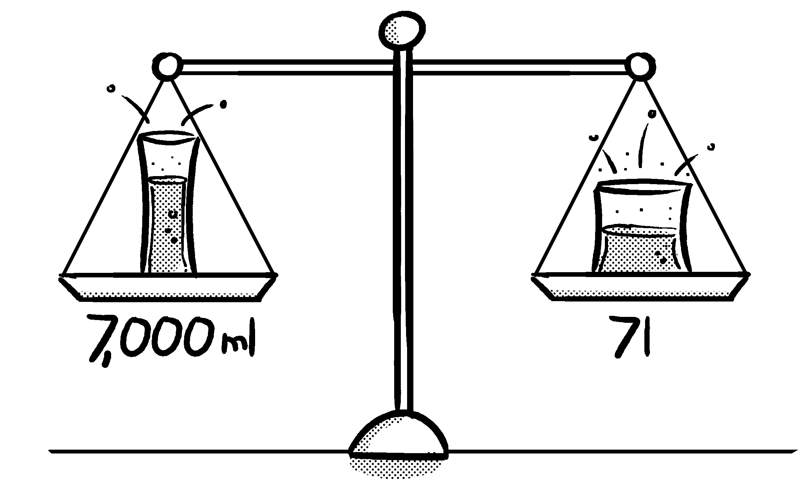
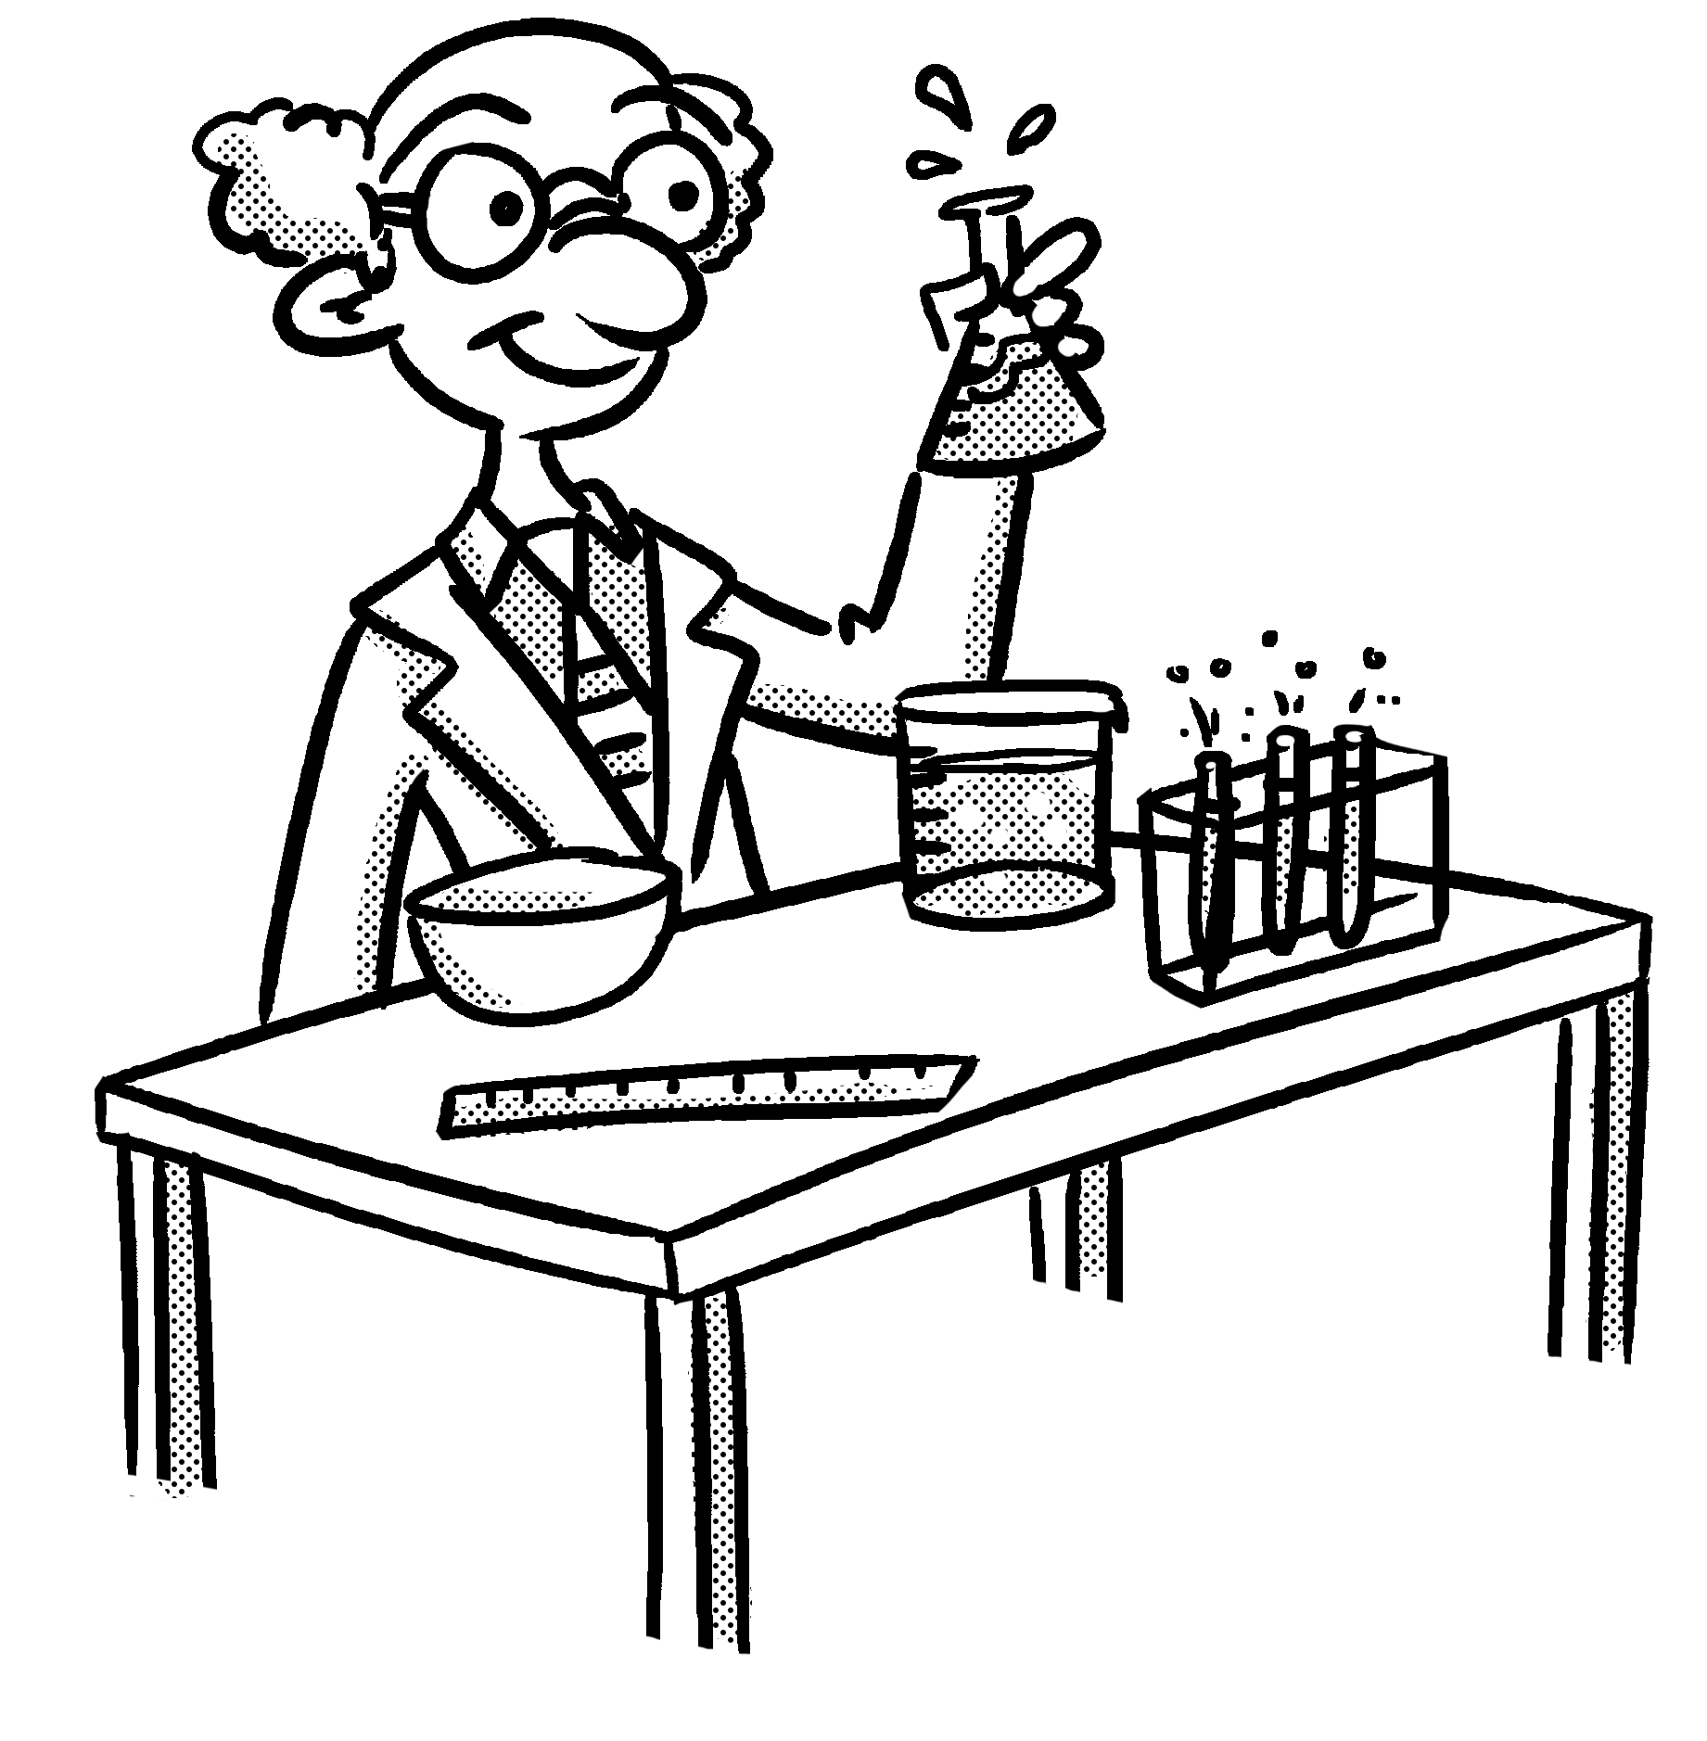
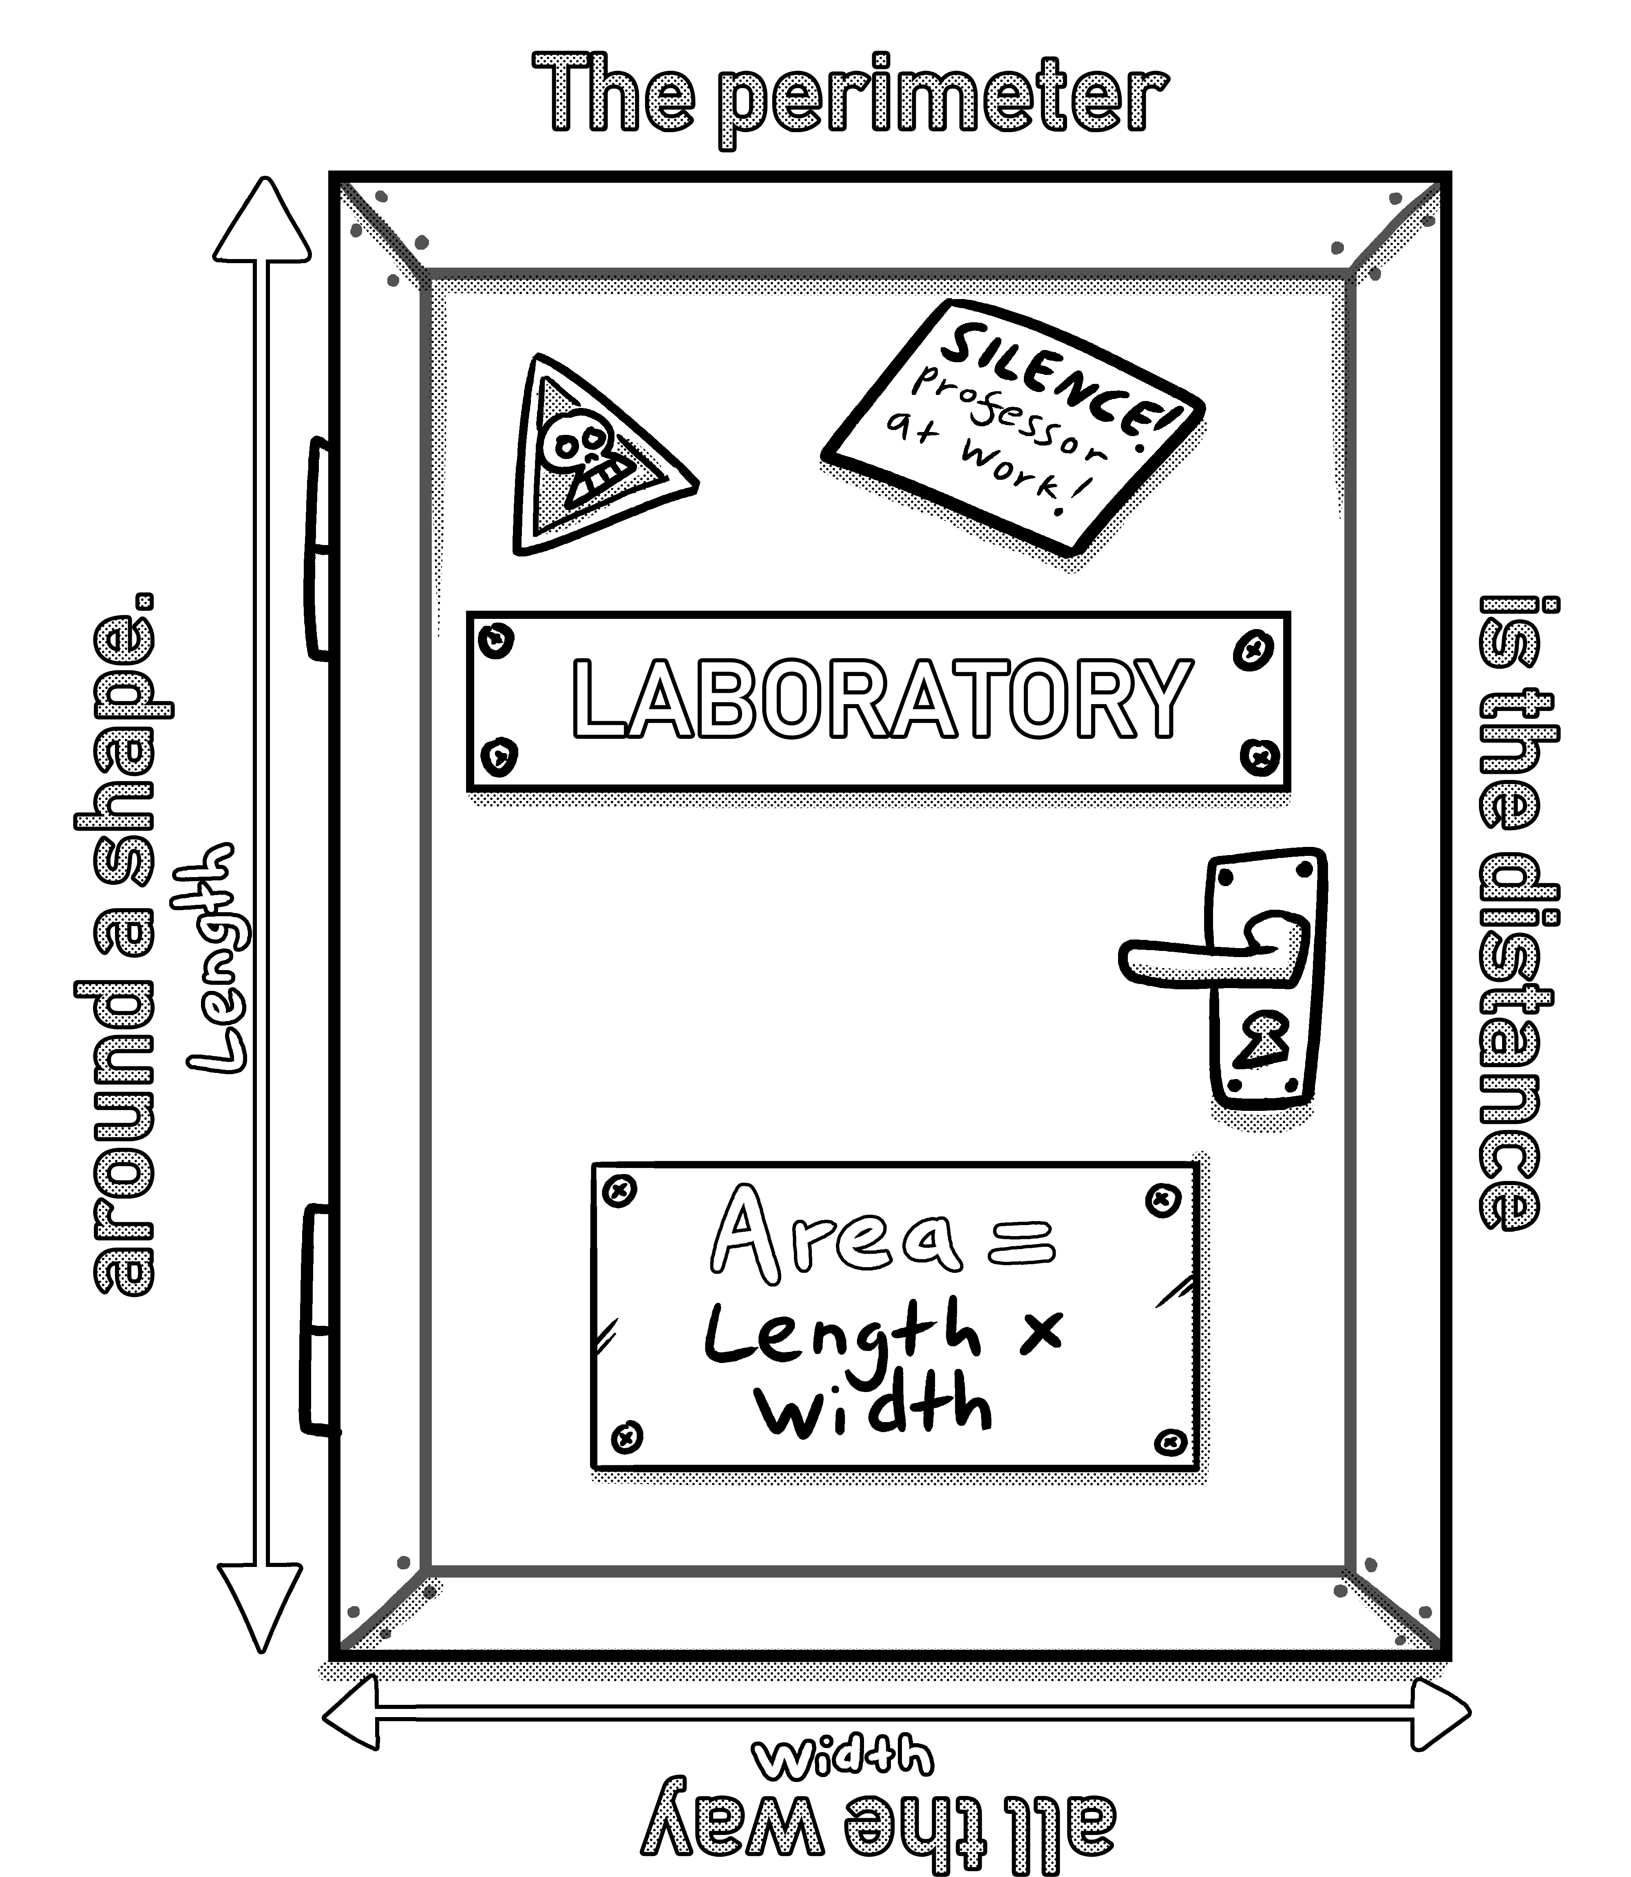
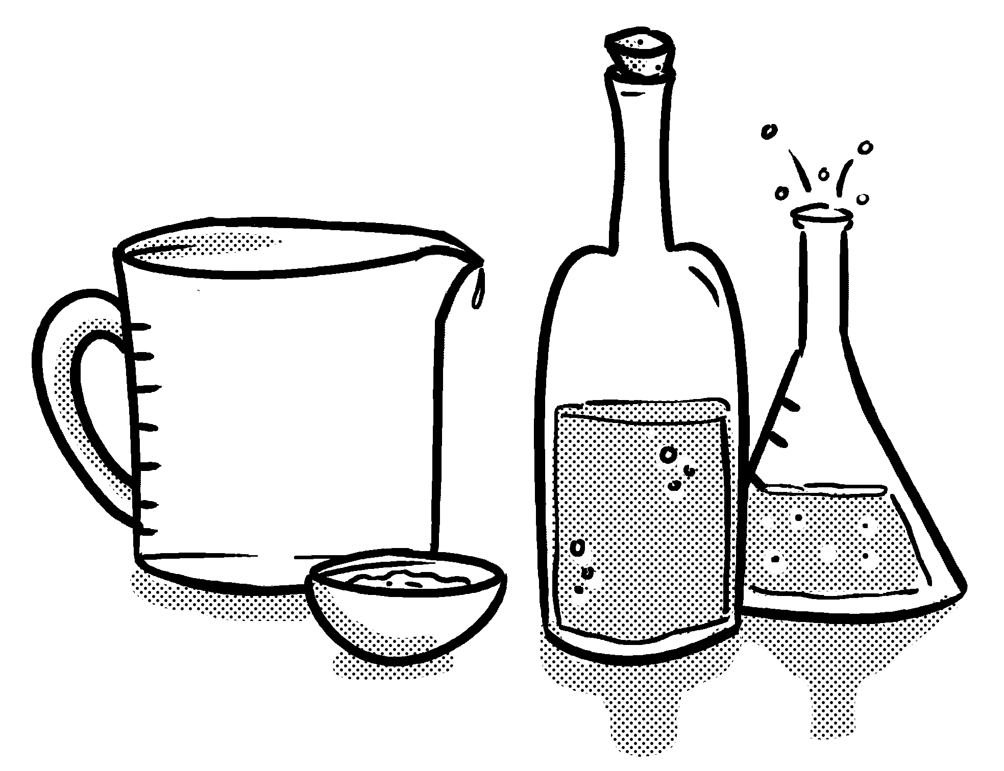
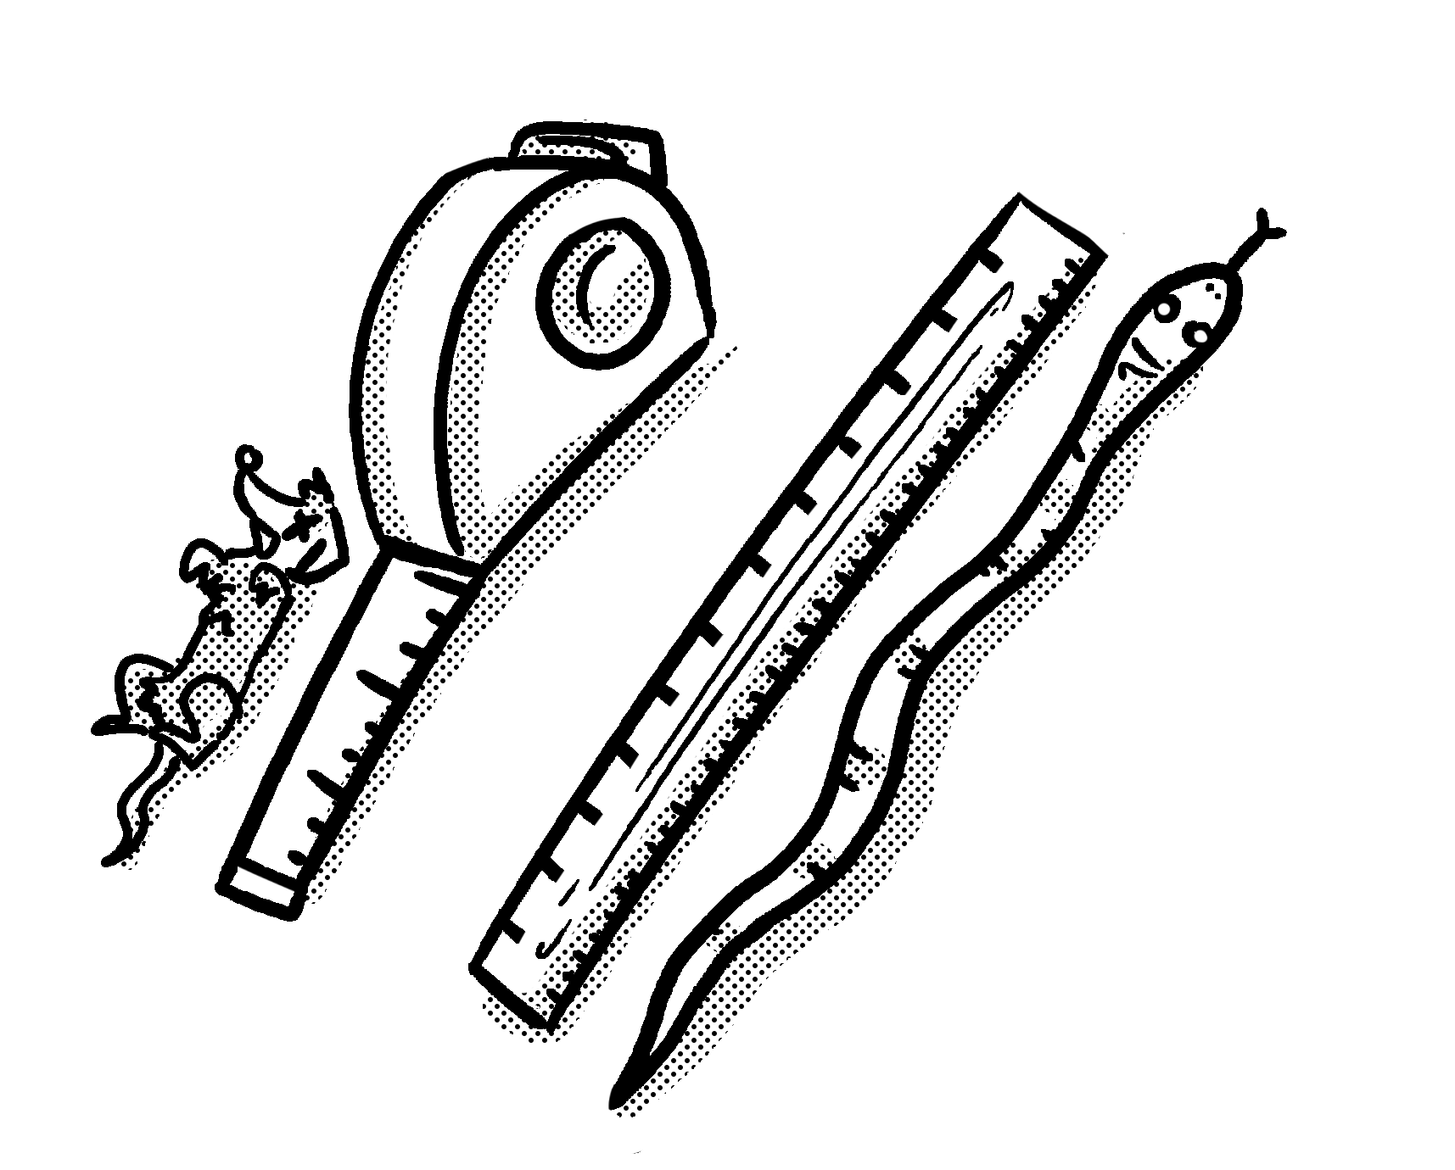
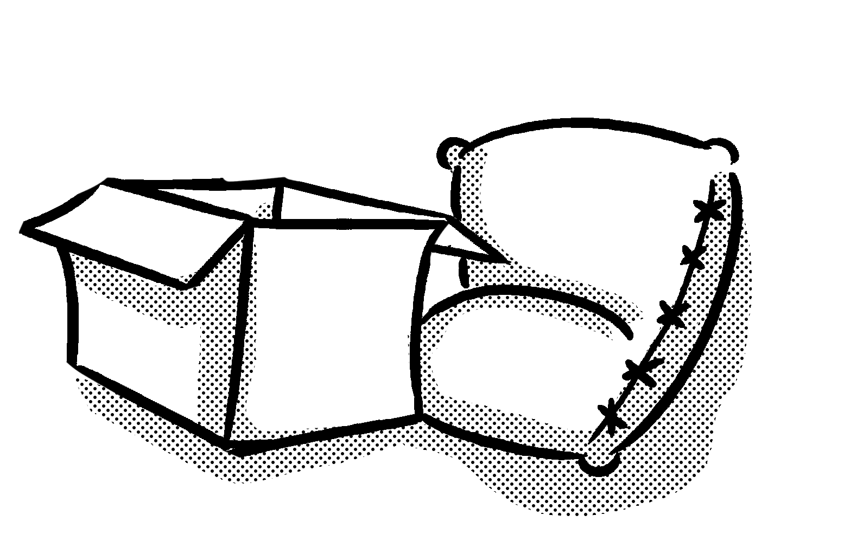

Primary Maths Measures – Years 3 and 4
Capacity
1,000ml = 1l
ml = millilitres
l = litres
Mass 1,000g = 1kg
g = grams
kg = kilograms
Length 10mm = 1cm
100cm = 1m
1,000m = 1km
mm = millimetres
cm = centimetres
m = metres
km = kilometres
© November 2018 The PiXL Club Ltd. All rights reserved.
This resource is strictly for the use of member schools for as long as they remain members of The PiXL Club Ltd.
Notes:
Explain to children that the Knowledge Mats may help them.

Slide 9


Teach
Today, we are going to estimate different lengths.
Knowing the length of certain objects can help when estimating unknown lengths.
If I know a book is 30cm in length, I can use this knowledge to estimate the length of the pencil.
I would estimate the length of the pencil is 15cm as it is roughly half the length of the book.

Slide 10
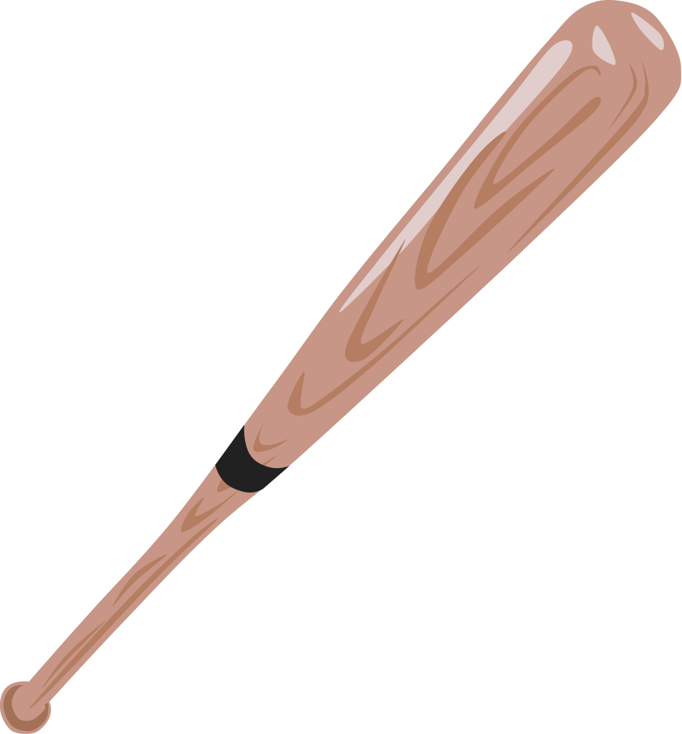
Teach
To estimate means to give a rough answer that may be a
little less or a little more than the actual result/answer.
Half way = 50cm
To estimate the length of this baseball bat, I will need to use my knowledge of length.
I can use my knowledge of half and quarter to help me to be as accurate as possible when estimating.
100cm
0cm

Slide 11
Teach
A helpful strategy to use when estimating is to annotate a scale.
First, I can mark the half way point (50cm).
I can then mark half way between 50cm and 100cm (75cm).
I can then look at the space between 50cm and 75cm.
50cm
75cm
100cm
0cm
I estimate that this baseball bat is 65cm long.

Slide 12

Model
To estimate means to give a rough answer that may be a little less or a little more than the actual result/answer.
I know the rubber is 45mm in length. I can estimate that the pencil is double the length of the rubber.
This means I need to do the following calculation:
45mm + 45mm or 45mm x 2
I estimate that the pencil is about 90mm in length.
The rubber is 45mm in length.

Slide 13
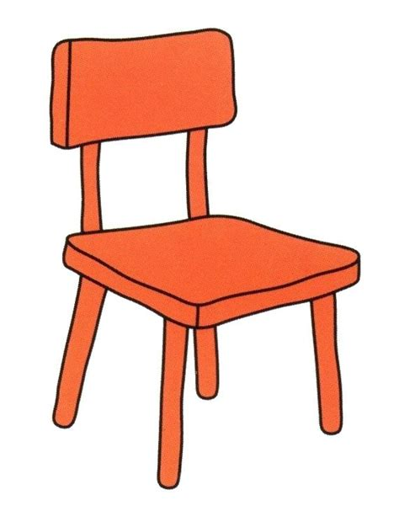
Model
To estimate means to give a rough answer that may be a little less or a little more than the actual result/answer.
I know that the chair is less than 100cm in height.
75cm
I know that half way between 0cm and 100cm is 50cm.
100cm
0cm
50cm
I think the chair is half way between 50cm and 100cm.
So, I estimate that the height of the chair is 75cm.

Slide 14

Model
I know that the rugby ball is less than 1,000mm in height.
I can also tell that it is less than 500mm as half of 1,000mm is 500mm and it is not past this point.
To estimate means to give a rough answer that may be a little less or a little more than the actual result/ answer.
I can now make some smaller divisions on my scale to help me estimate its height.
1,000mm
0mm
500mm
400mm
By using the scale, I can see it is nearer to 500mm than 0mm. I know it is past the half way mark between them (250mm).
I estimate the rugby ball is 400mm in height.
300mm
200mm
100mm

Slide 15
Apply
The book is 220mm in height.
Estimate the height of the pencil in mm.

Slide 16
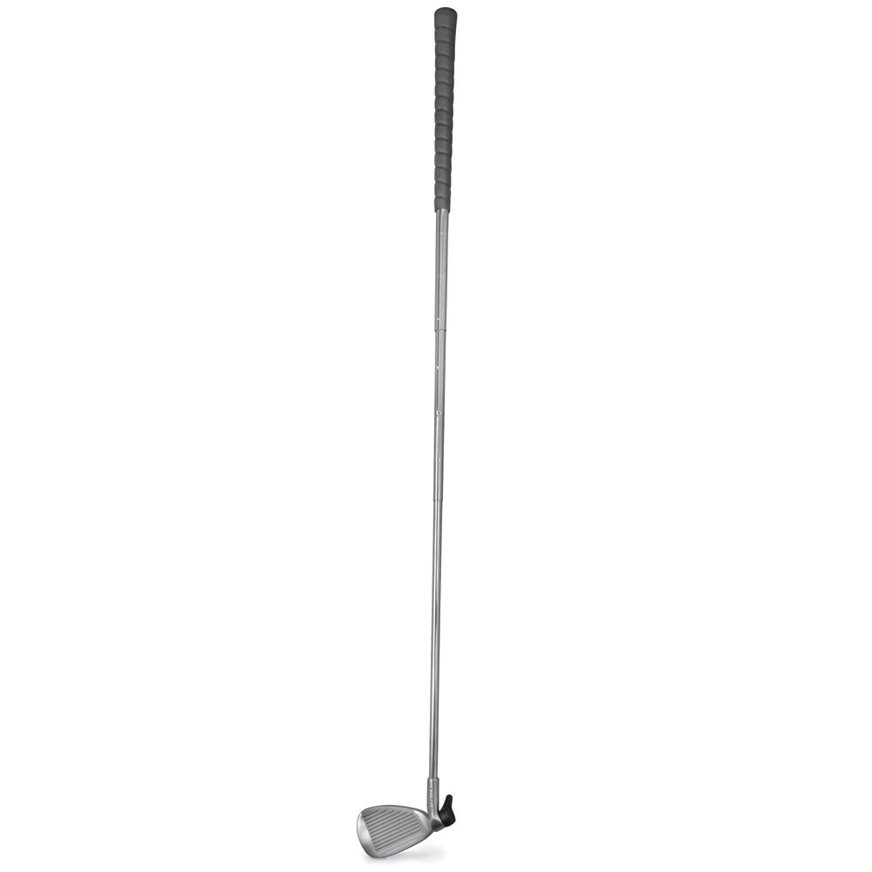
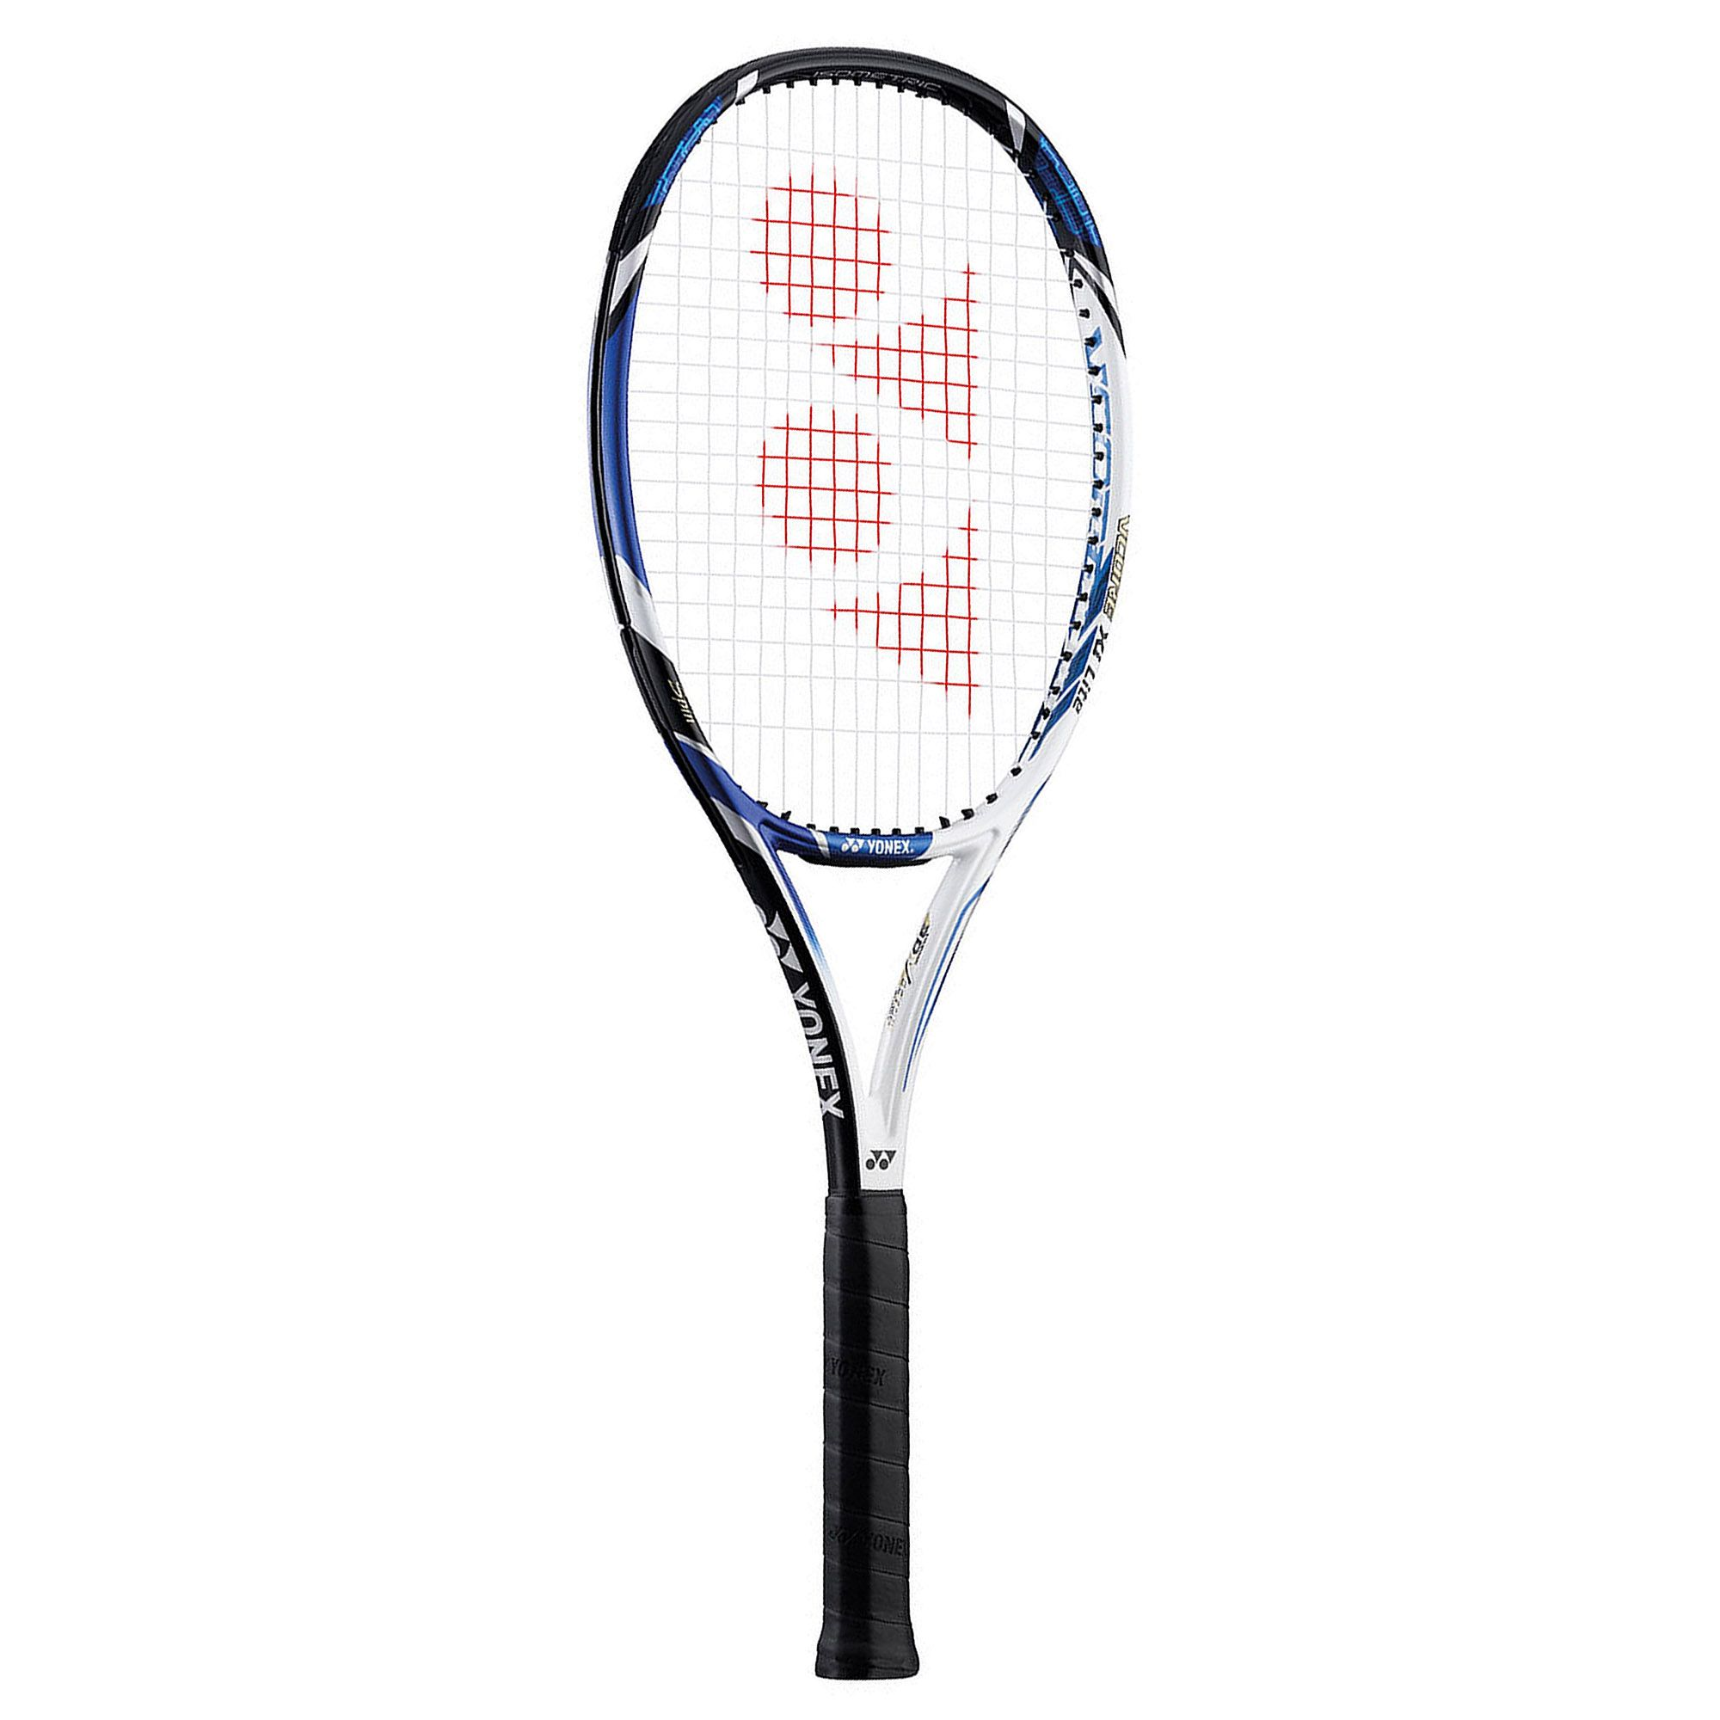
Apply
Using the same scale, estimate the length of each object. Remember to use the strategy of annotating the scale. Explain your reasoning.
100cm
0cm

Slide 17
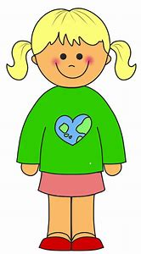
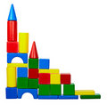
Apply – Problem Solving
Penny is 110cm tall.
She built a brick tower.
In cm, estimate the height of her brick tower.
Challenge: Give your answer using metres.

Slide 18
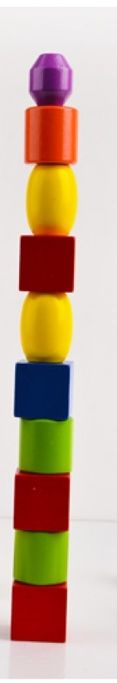

Apply – Reasoning
Callum is 90cm tall. He built a brick tower. He estimates that the brick tower is 150cm tall. Is he correct?
Explain your reasoning.

Slide 19
Apply – Practical Activity
Measure the length of your mathematics book.
Use this information to help you to estimate the length of 3 other objects in the classroom.
Now measure them – how accurate were you?

