Slide 1


.
Y4 M5g Can estimate mass
Commissioned by The PiXL Club Ltd.
November 2019
This resource is strictly for the use of member schools for as long as they remain members of The PiXL Club. It may not be copied, sold nor transferred to a third party or used by the school after membership ceases. Until such time it may be freely used within the member school.
All opinions and contributions are those of the authors. The contents of this resource are not connected with nor endorsed by any other company, organisation or institution.
PiXL Club Ltd endeavour to trace and contact copyright owners. If there are any inadvertent omissions or errors in the acknowledgements or usage, this is unintended and PiXL will remedy these on written notification.
© Copyright The PiXL Club Limited, 2019

Slide 2
Teachers’ Notes
The PiXL therapies can be taught to a whole class or a target group. Year 3-5 therapies are designed to take approximately 30-40 minutes. However, this is flexible: it may be that only part of the therapy is taught or it could, of course, be adapted or extended.
Each therapy begins with a LORIC activity to develop relevant learning behaviours.
This is followed by a vocabulary task, which uses the PiXL 5-phase approach to teach key mathematical vocabulary. Further resources to develop vocabulary can be found in the Whole School area.
Each therapy adopts the ‘Teach, model and apply’ process with opportunities for pupils to demonstrate the taught skill independently.
Problem solving and reasoning activities are an integral part of each therapy.

Slide 3
Progress across amber – the 4-stage model
The three therapy tests which accompany this resource can be used to revisit the taught skill to check that the pupil is able to perform it independently and consistently.
A
A child has successfully completed a therapy test independently, following a set of therapy sessions.
A child has successfully completed a therapy test independently, a period after the relevant therapy sessions – we would advise about 2 weeks.
A child has successfully applied their knowledge or skill in an unfamiliar context. This may be application across the curriculum or in a problem.
A pupil has successfully re-visited the skills at a later point, and applies these in an unfamiliar context or problem, or across the curriculum.
A
DA
G

Slide 4

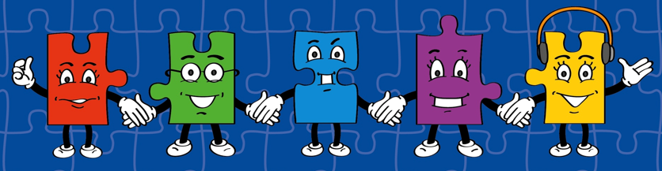
LORIC task
Our Primary Edge attributes help us to become better learners and today is no exception. Before you start this activity, here are some ideas for how you will need your Olly Organisation skills today:
Make decisions
Problem solve
Think strategically

Slide 5

LORIC task
Organise these different objects into groups.
Label each group and explain why you have
selected each object.
football jug book pencil bottle of water
chair glasses cup table ball of string
candle bat cushion jumper bag of pasta

Slide 6
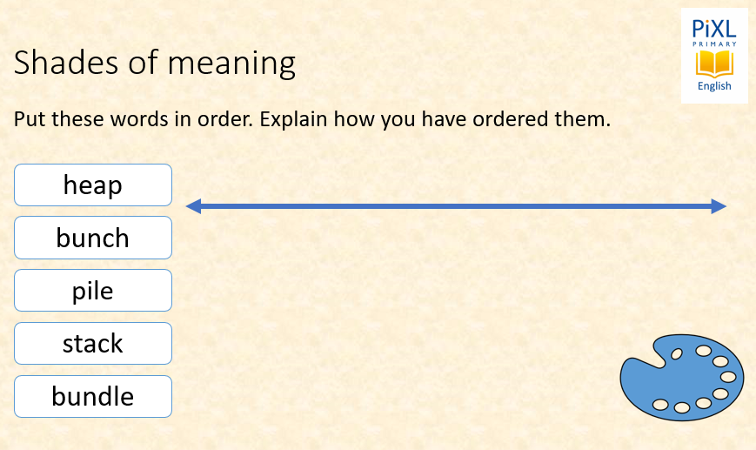
Vocabulary activity
mass
bunch
pile
heap
stack
bundle
LINK IT / USE IT
Notes:
Give pupils 5 or 6 words with similar meaning and a blank continuum. In pairs, ask them to order the words on their continuum, explaining how they have chosen to order them. Share and discuss differences in how pupils have organised their words.
For pupils who find this difficult, the activity can be made more structured by outlining how the words should be ordered.
For example: Order these verbs from fastest to slowest: ambled hastened sauntered trotted sprinted

Slide 7
Teach
Today, we are going to estimate different masses.
To do this, we also need to recap on our knowledge of measures:
1,000g = 1kg
g = grams
kg = kilograms

Slide 8
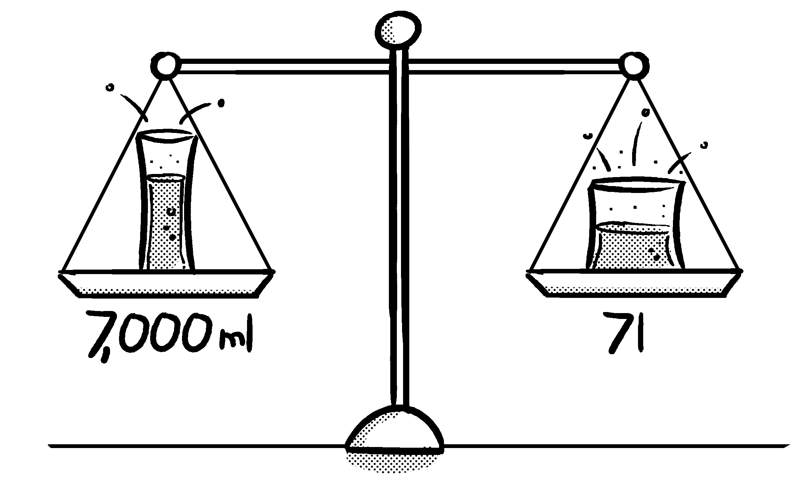
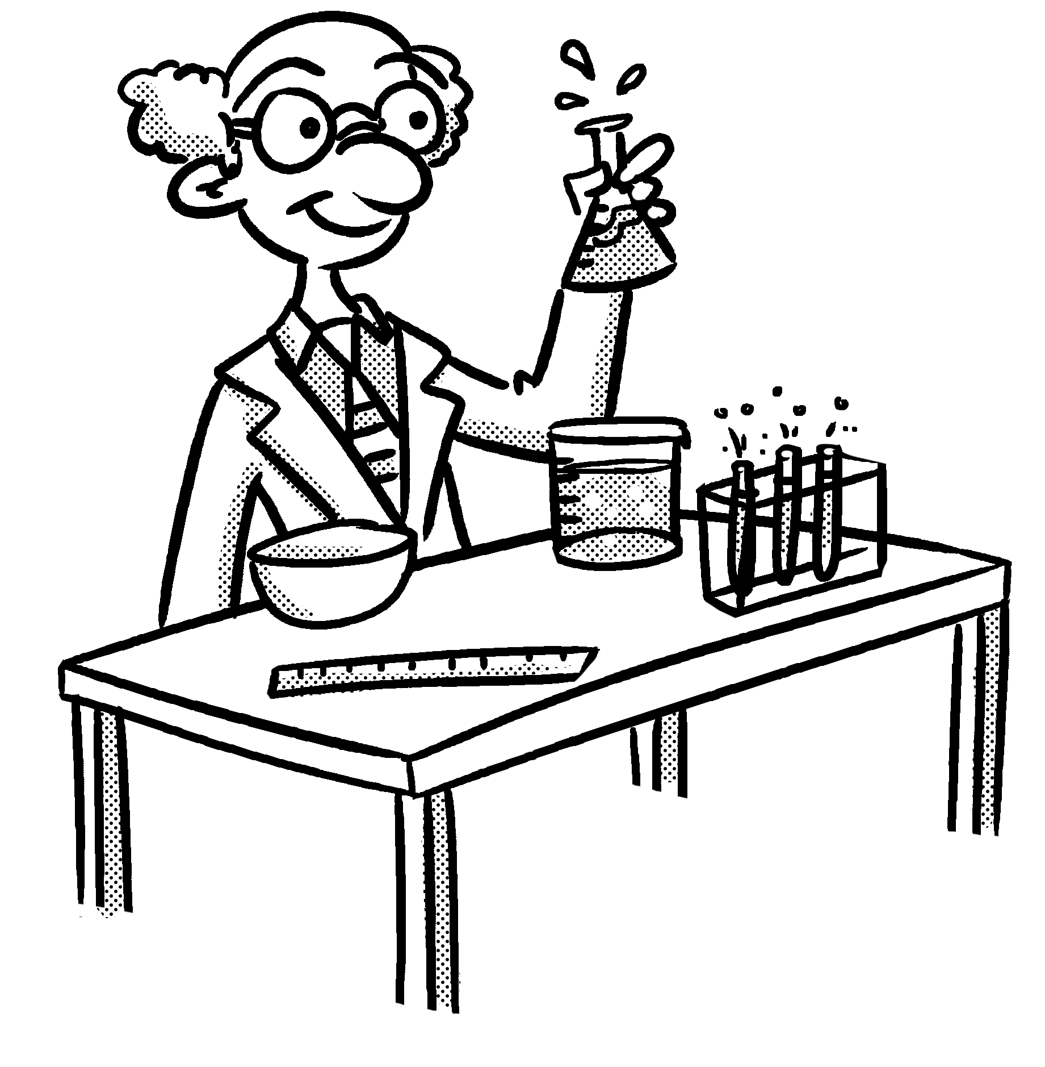
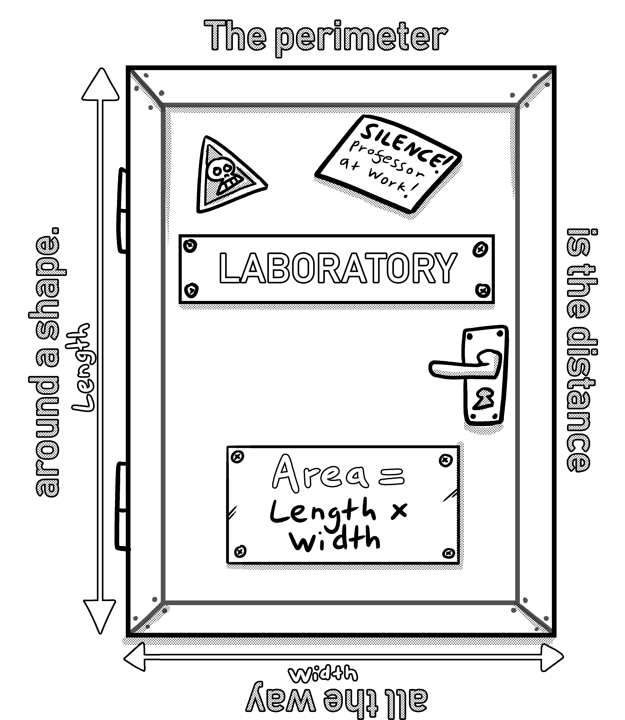
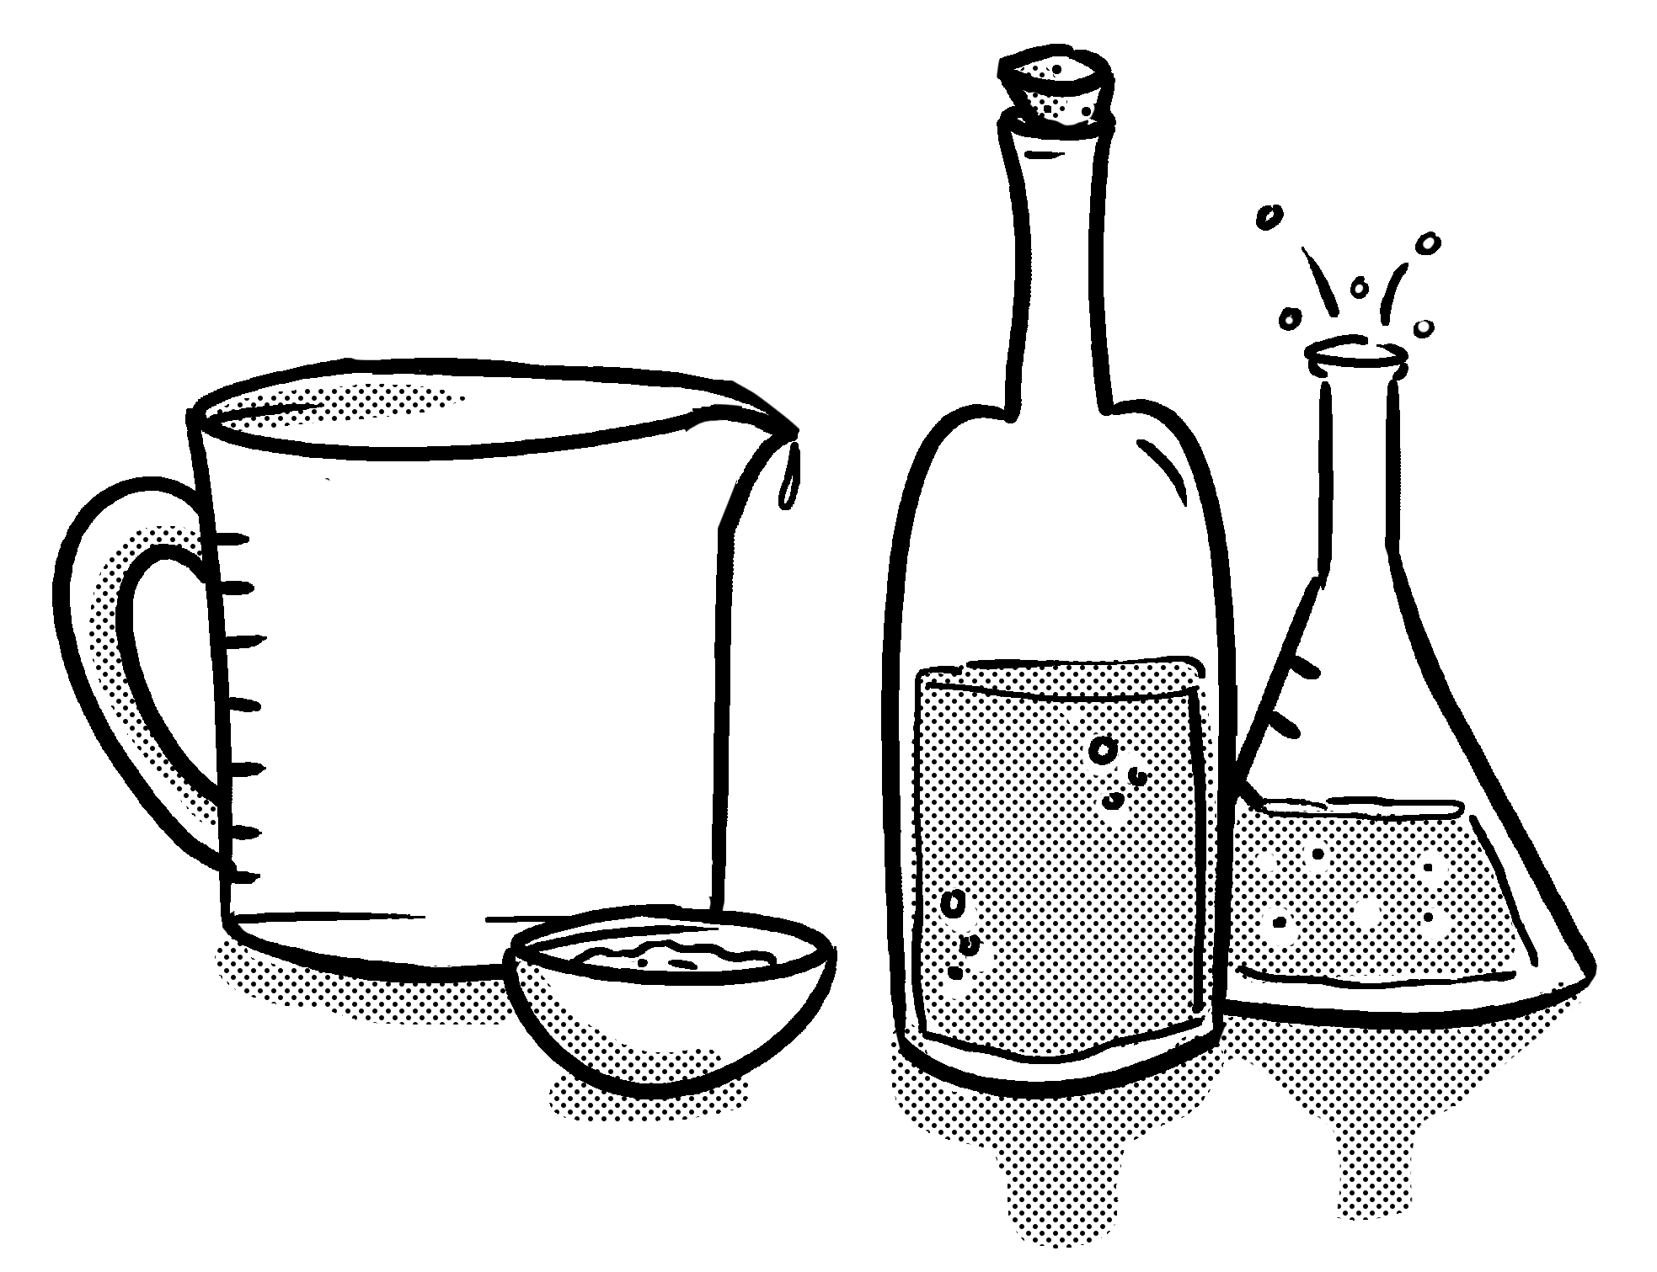
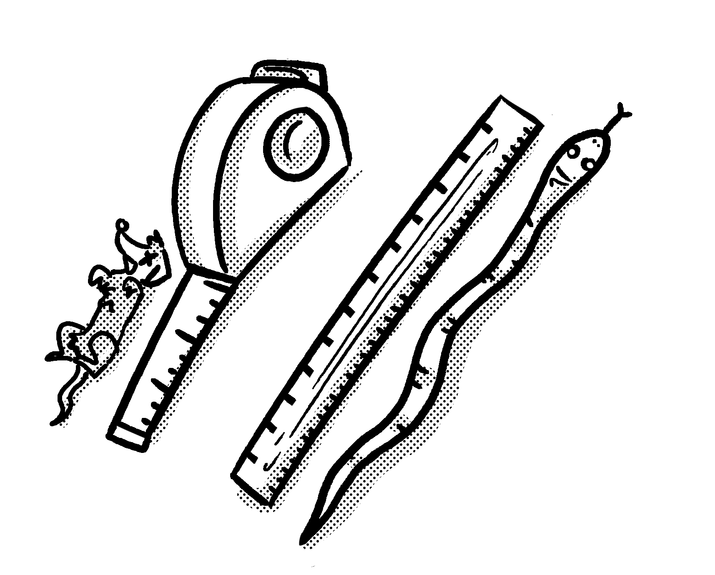
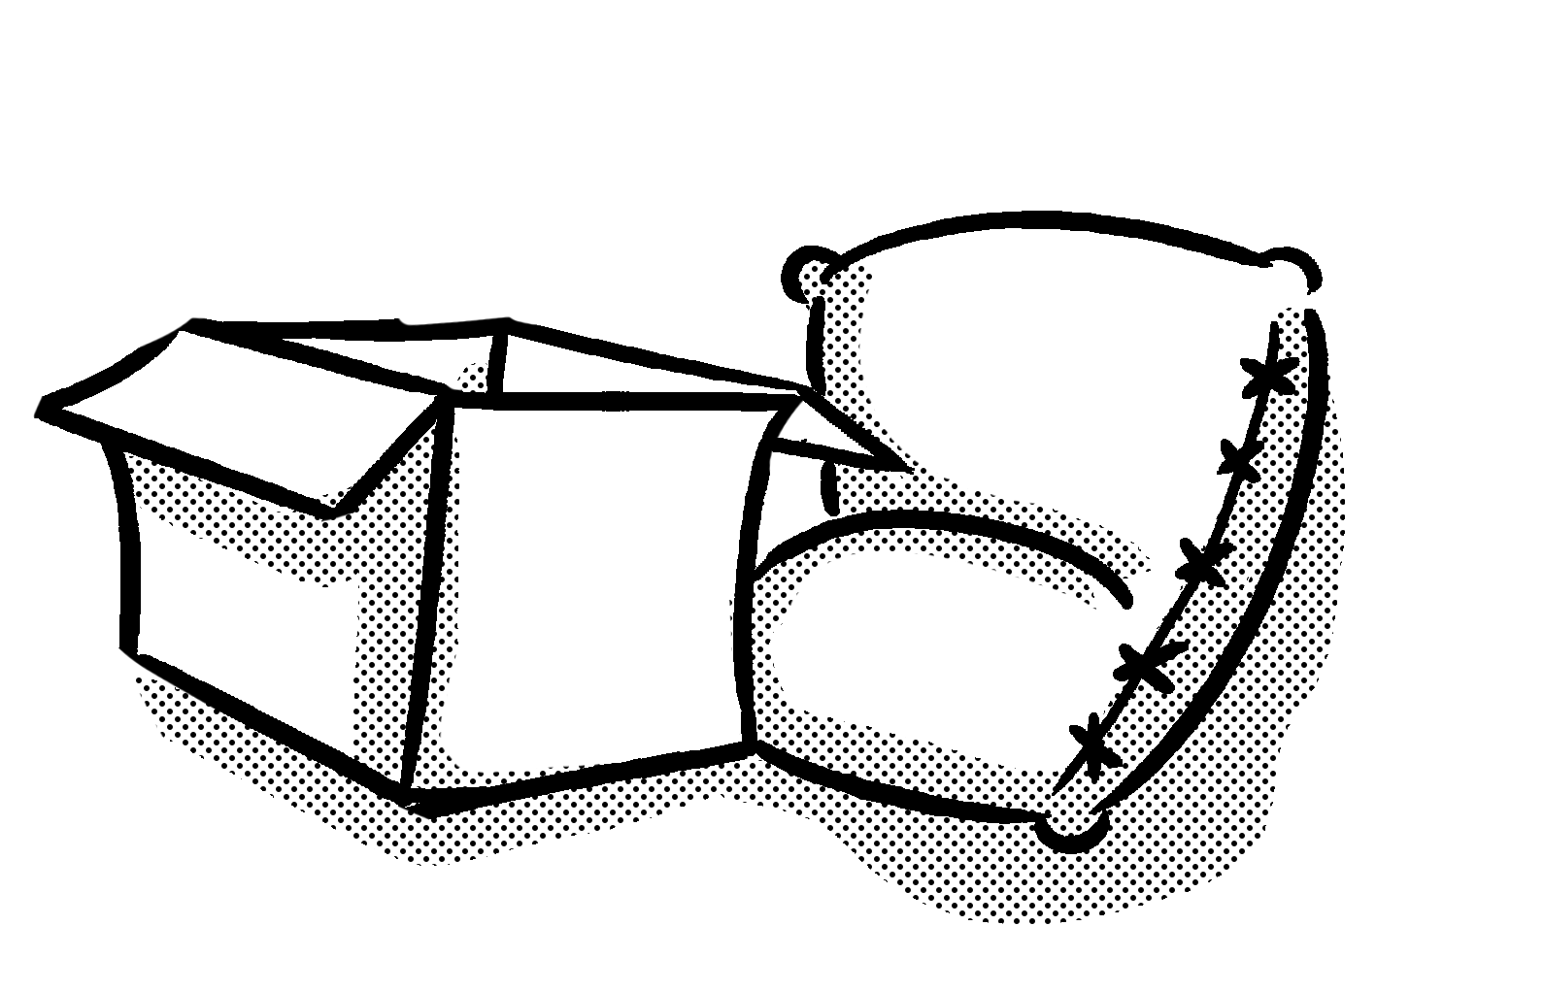

Primary Maths Measures – Years 3 and 4
Capacity
1,000ml = 1l
ml = millilitres
l = litres
Mass 1,000g = 1kg
g = grams
kg = kilograms
Length 10mm = 1cm
100cm = 1m
1,000m = 1km
mm = millimetres
cm = centimetres
m = metres
km = kilometres
© November 2018 The PiXL Club Ltd. All rights reserved.
This resource is strictly for the use of member schools for as long as they remain members of The PiXL Club Ltd.
Notes:
Explain to children that the Knowledge Mats may help them.

Slide 9
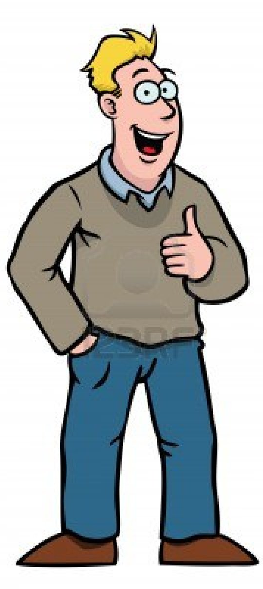
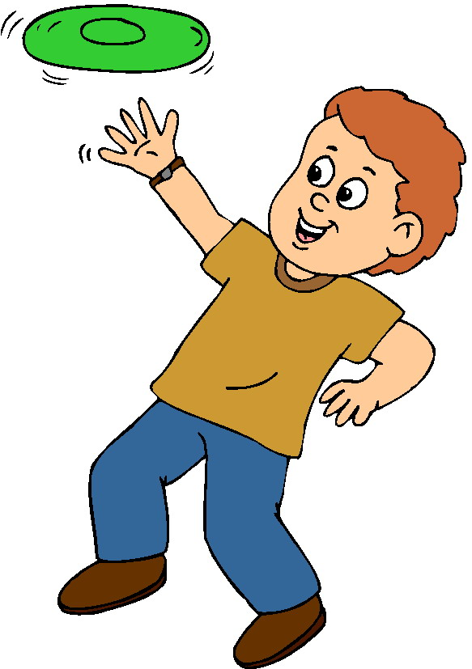
Teach
Today, we are going to estimate different masses.
Knowing the mass of certain objects can help when estimating other unknown masses.
If I know the mass of the man, I can use this knowledge to estimate the mass of the child.

Slide 10
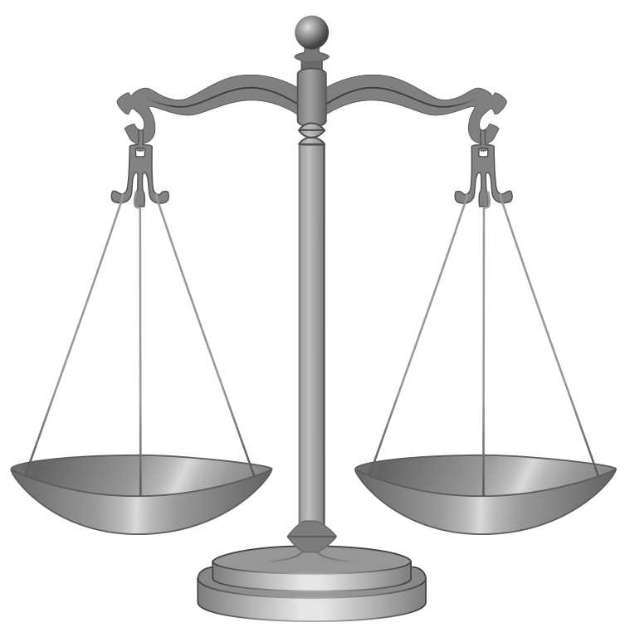
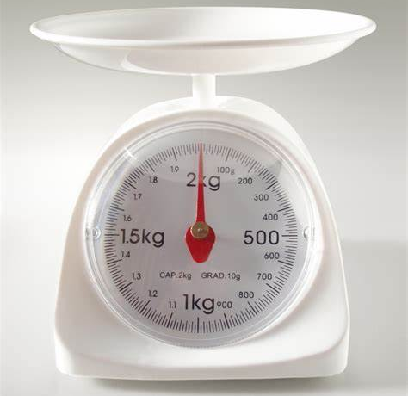
Teach
To estimate means to give a rough answer that may be a little less or a little more than the actual result/answer.
This means using knowledge of mass to work out a rough estimation.

Slide 11
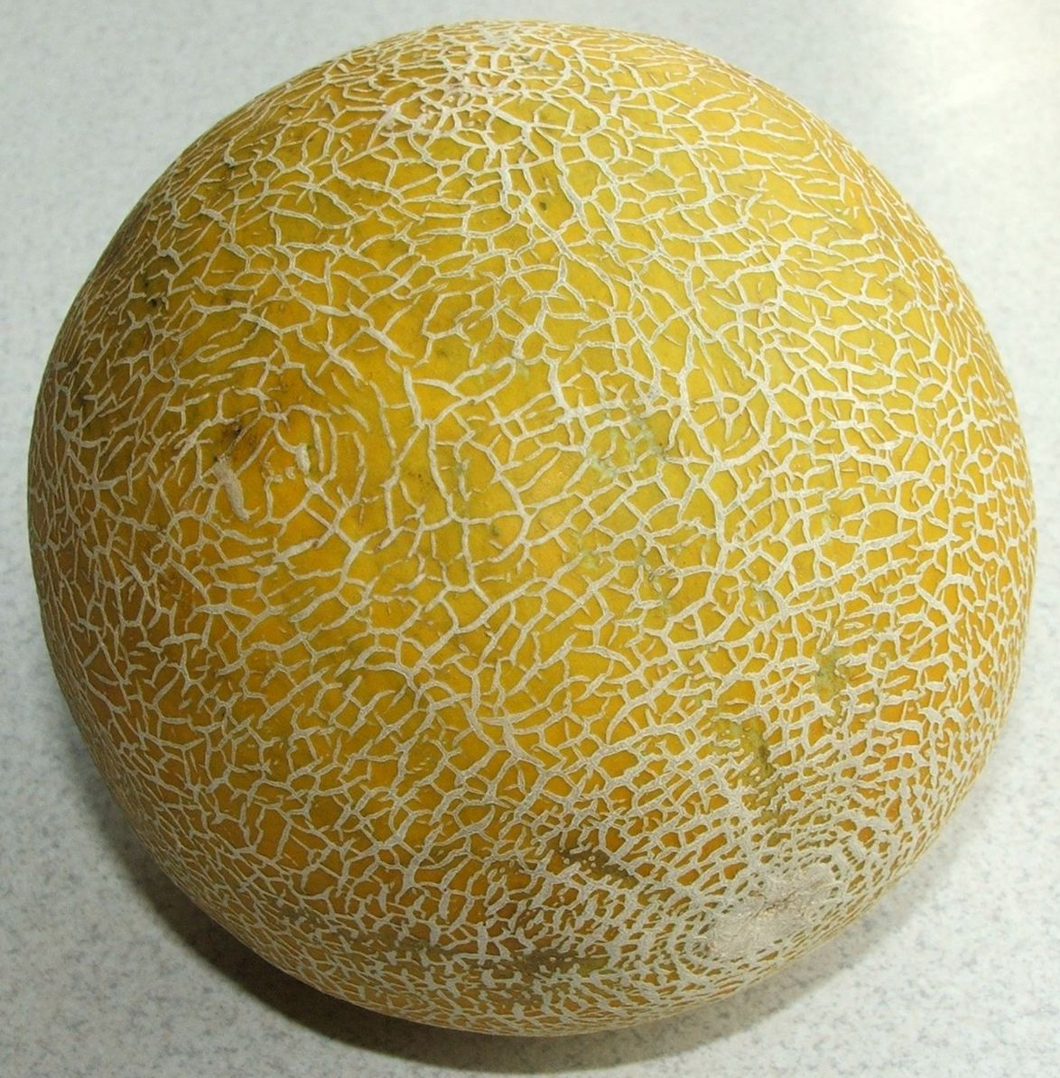
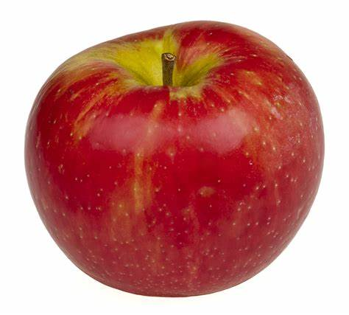
Teach
To estimate means to give a rough answer that may be a little less or a little more than the actual result/answer.
I know the apple weighs 90g.
I estimate that the mass of the melon is approximately 10 times greater.
10 x 90 = 900 so I estimate that the mass of the melon is 900g.

Slide 12
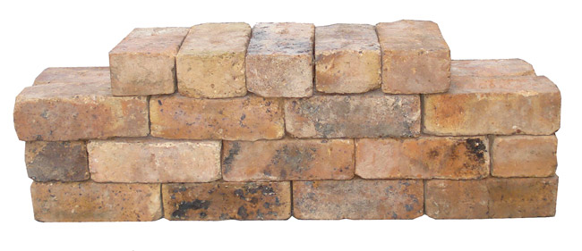
Model
To estimate means to give a rough answer that may be a little less or a little more than the actual result/answer.
The mass of one brick is 3kg.
I estimate the pile of bricks has approximately 30-40 bricks.
This means I can multiply 3kg by 30-40 to get an estimation.
3 x 30 = 90kg.
4 x 30 = 120kg.
I estimate the mass of the bricks is 100kg.

Slide 13
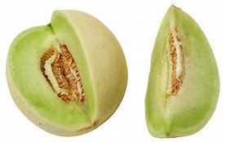
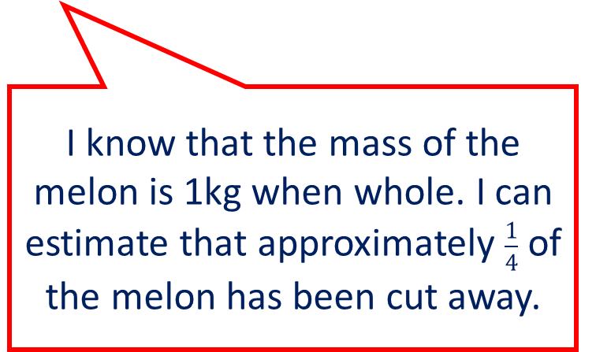
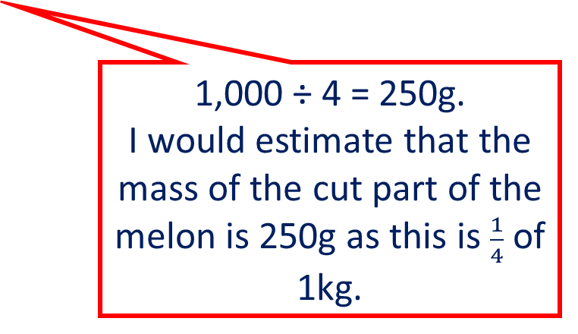
Model
One galia melon weighs approximately 1kg.
What is the mass of the cut part of the melon?
To estimate means to give a rough answer that may be a little less or a little more than the actual result/answer.
I know that the mass of the melon is 1kg when whole. I can estimate that approximately $\frac{1}{4}$ of the melon has been cut away.
1,000 ÷ 4 = 250g.
I would estimate that the mass of the cut part of the melon is 250g as this is $\frac{1}{4}$ of 1kg.

Slide 14
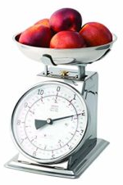
Model
To estimate means to give a rough answer that may be a little less or a little more than the actual result/answer.
I can see that the mass of all the apples is approximately 2kg.
To estimate the mass of one apple, I first need to work out that there are 5-7 apples on the scales. That means I will roughly work out 2,000g ÷ 7.
So I can estimate that each apple is approximately 300g in weight.

Slide 15
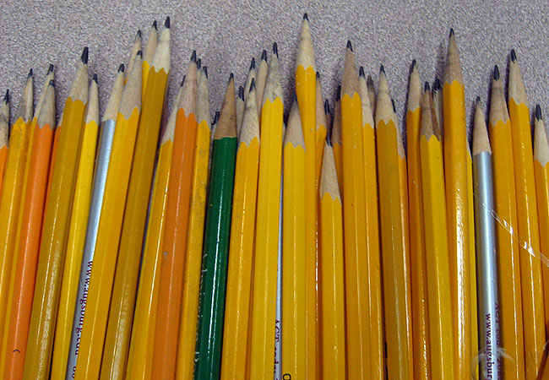
Apply
The mass of one pencil is 8g.
In grams, estimate the total mass of the pencils.

Slide 16
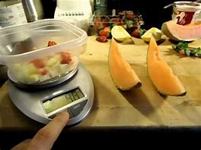
Apply
The scales show some chopped up melon.
In grams, estimate the total mass of the remaining slices of melon.

Slide 17

Apply – Problem Solving
Milly sends two parcels. The smaller parcel weighs 750g. Estimate the mass of the larger parcel.
Challenge: Convert your answer to kilograms.

Slide 18
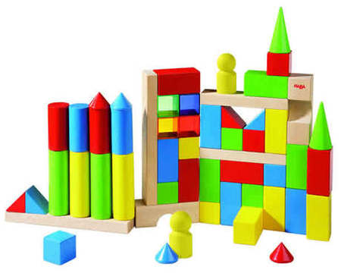
Apply – Reasoning
Eddie’s brick tower has a mass of 700g. He builds a tower nearly twice as big using the same building blocks. He estimates that the mass of the new brick tower is 2,000g.
Is he correct?
Explain your reasoning.

Slide 19
Apply – Practical Activity
Weigh your mathematics book.
Use this information to help you to estimate the mass of 3 other objects in the classroom.
Now measure them – how accurate were you?

