Slide 1


.
Y4 M5h Can estimate capacity
Commissioned by The PiXL Club Ltd.
November 2019
This resource is strictly for the use of member schools for as long as they remain members of The PiXL Club. It may not be copied, sold nor transferred to a third party or used by the school after membership ceases. Until such time it may be freely used within the member school.
All opinions and contributions are those of the authors. The contents of this resource are not connected with nor endorsed by any other company, organisation or institution.
PiXL Club Ltd endeavour to trace and contact copyright owners. If there are any inadvertent omissions or errors in the acknowledgements or usage, this is unintended and PiXL will remedy these on written notification.
© Copyright The PiXL Club Limited, 2019

Slide 2
Teachers’ Notes
The PiXL therapies can be taught to a whole class or a target group. Year 3-5 therapies are designed to take approximately 30-40 minutes. However, this is flexible: it may be that only part of the therapy is taught or it could, of course, be adapted or extended.
Each therapy begins with a LORIC activity to develop relevant learning behaviours.
This is followed by a vocabulary task, which uses the PiXL 5-phase approach to teach key mathematical vocabulary. Further resources to develop vocabulary can be found in the Whole School area.
Each therapy adopts the ‘Teach, model and apply’ process with opportunities for pupils to demonstrate the taught skill independently.
Problem solving and reasoning activities are an integral part of each therapy.

Slide 3
Progress across amber – the 4-stage model
The three therapy tests which accompany this resource can be used to revisit the taught skill to check that the pupil is able to perform it independently and consistently.
A
A child has successfully completed a therapy test independently, following a set of therapy sessions.
A child has successfully completed a therapy test independently, a period after the relevant therapy sessions – we would advise about 2 weeks.
A child has successfully applied their knowledge or skill in an unfamiliar context. This may be application across the curriculum or in a problem.
A pupil has successfully re-visited the skills at a later point, and applies these in an unfamiliar context or problem, or across the curriculum.
A
DA
G

Slide 4
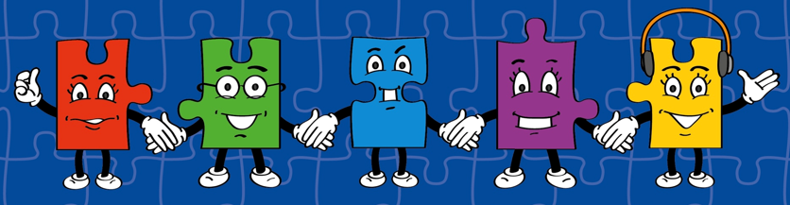
LORIC task
Our Primary Edge attributes help us to become better learners and today is no exception. Before you start this activity, here are some ideas for how you will need your Charlie Communication skills today:
Speak clearly
Discuss ideas by taking turns
Listen carefully

Slide 5


LORIC task
Today we are going to discuss a range of different topics.
These include:
How do we measure capacity?
List a range of different everyday items/objects that measure capacity.
Discuss the differences in measuring capacity, e.g. why we do have pints of milk but a litre bottle of drink?

Slide 6
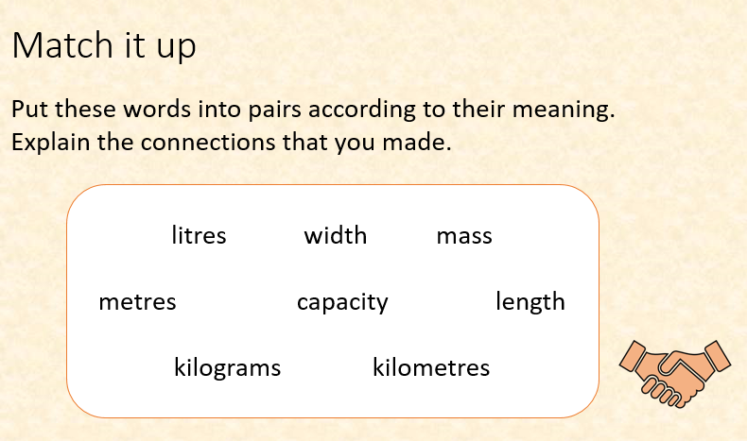
Vocabulary activity
capacity
litres
millilitres
estimate
LINK IT

Slide 7
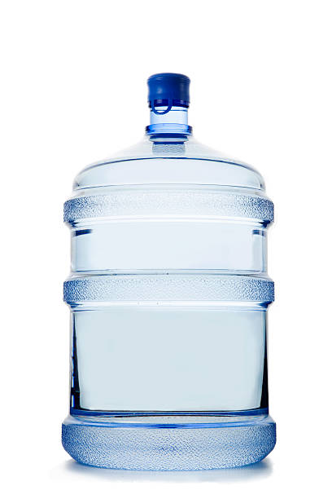
Teach
Today, we are going to estimate capacity.
Capacity means the maximum amount something can contain.

Slide 8
Teach
Capacity can be measured in millilitres and litres.
ml = millilitres
l = litres
1,000ml = 1l

Slide 9
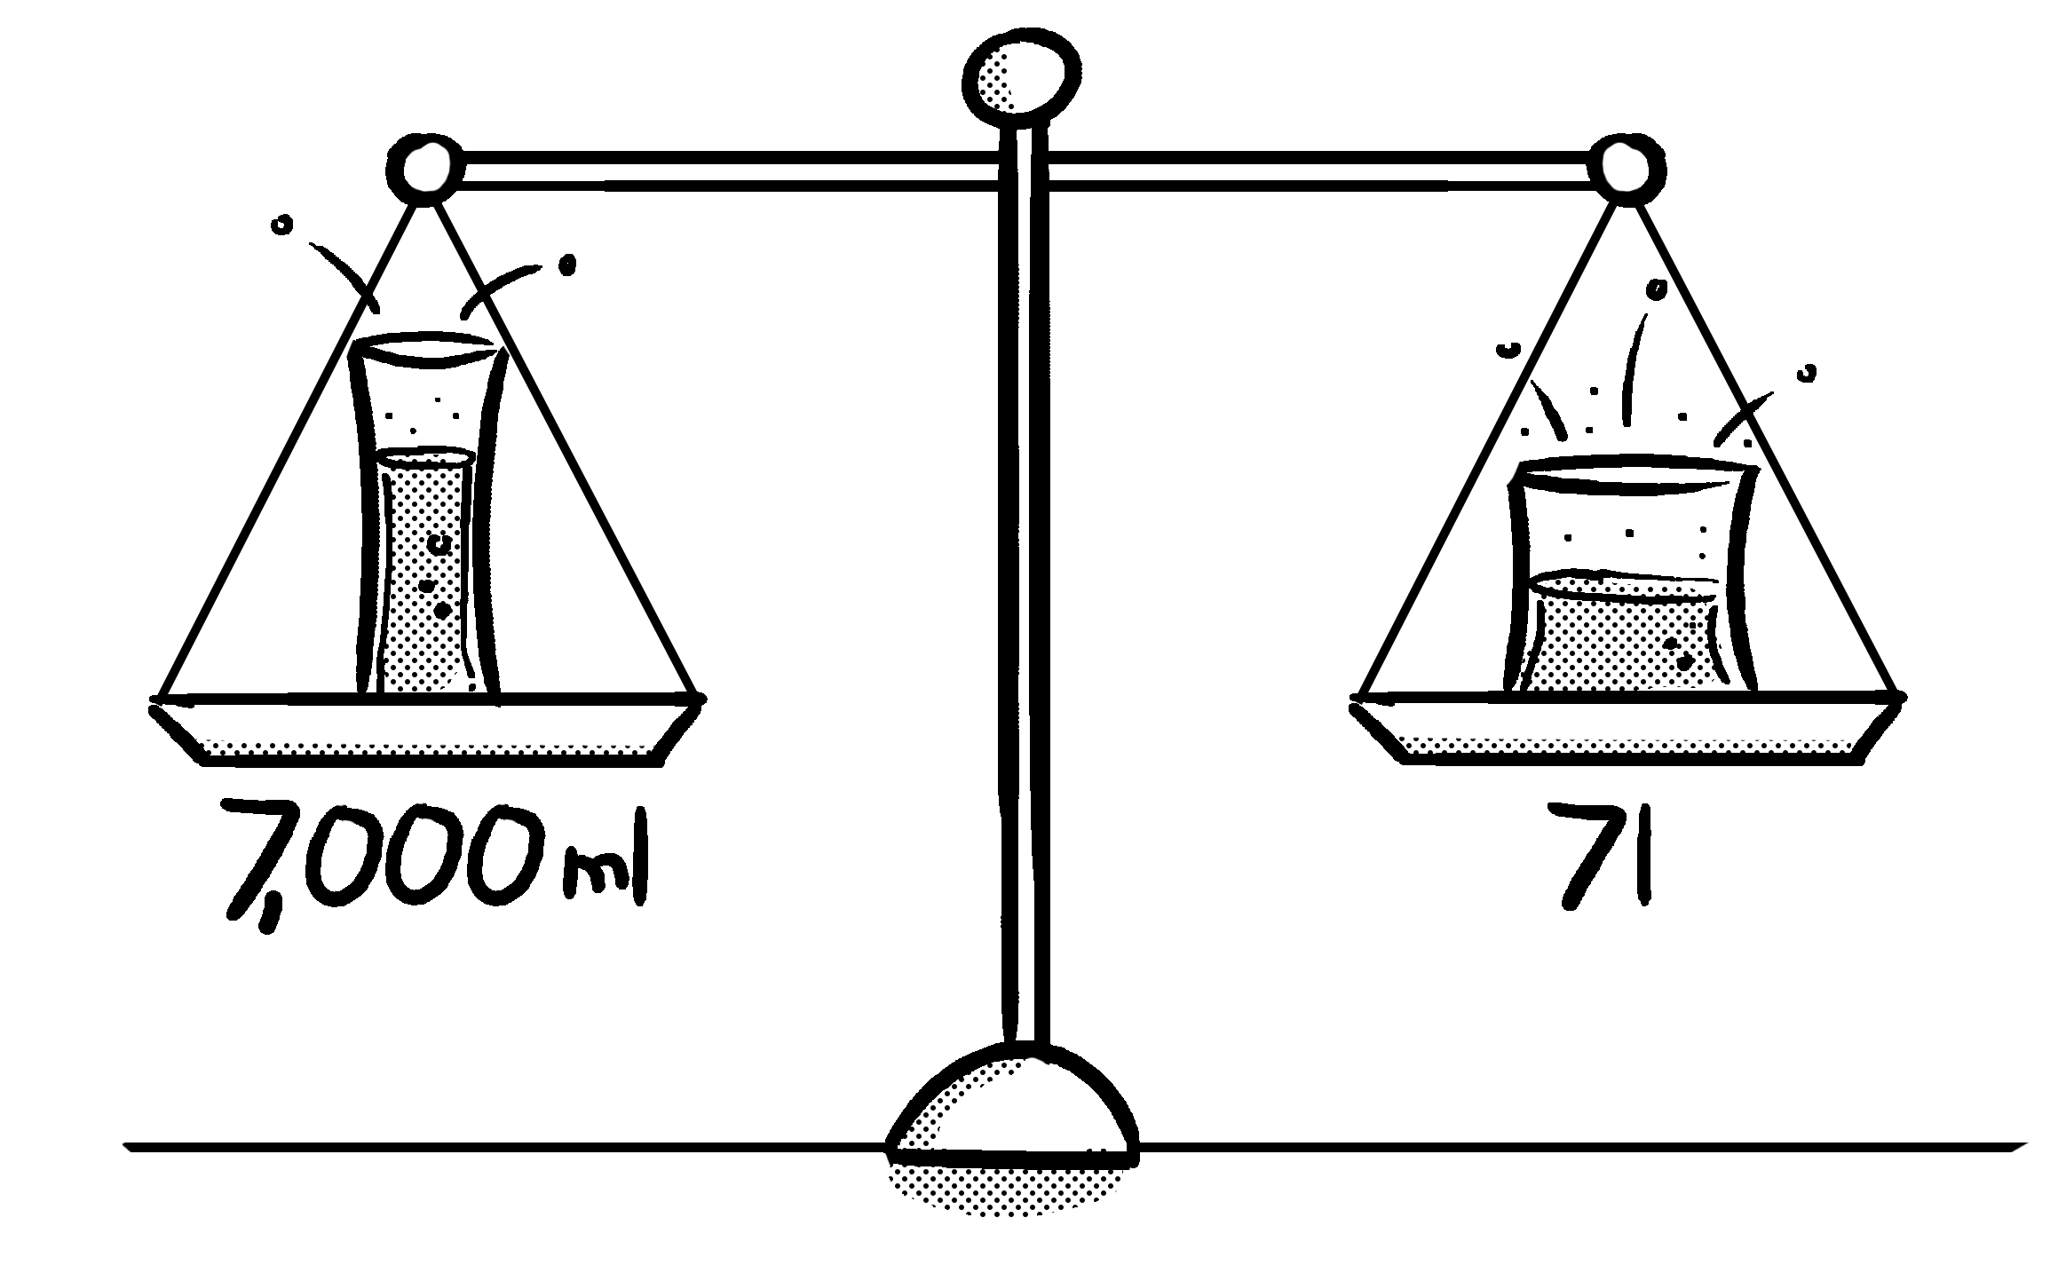
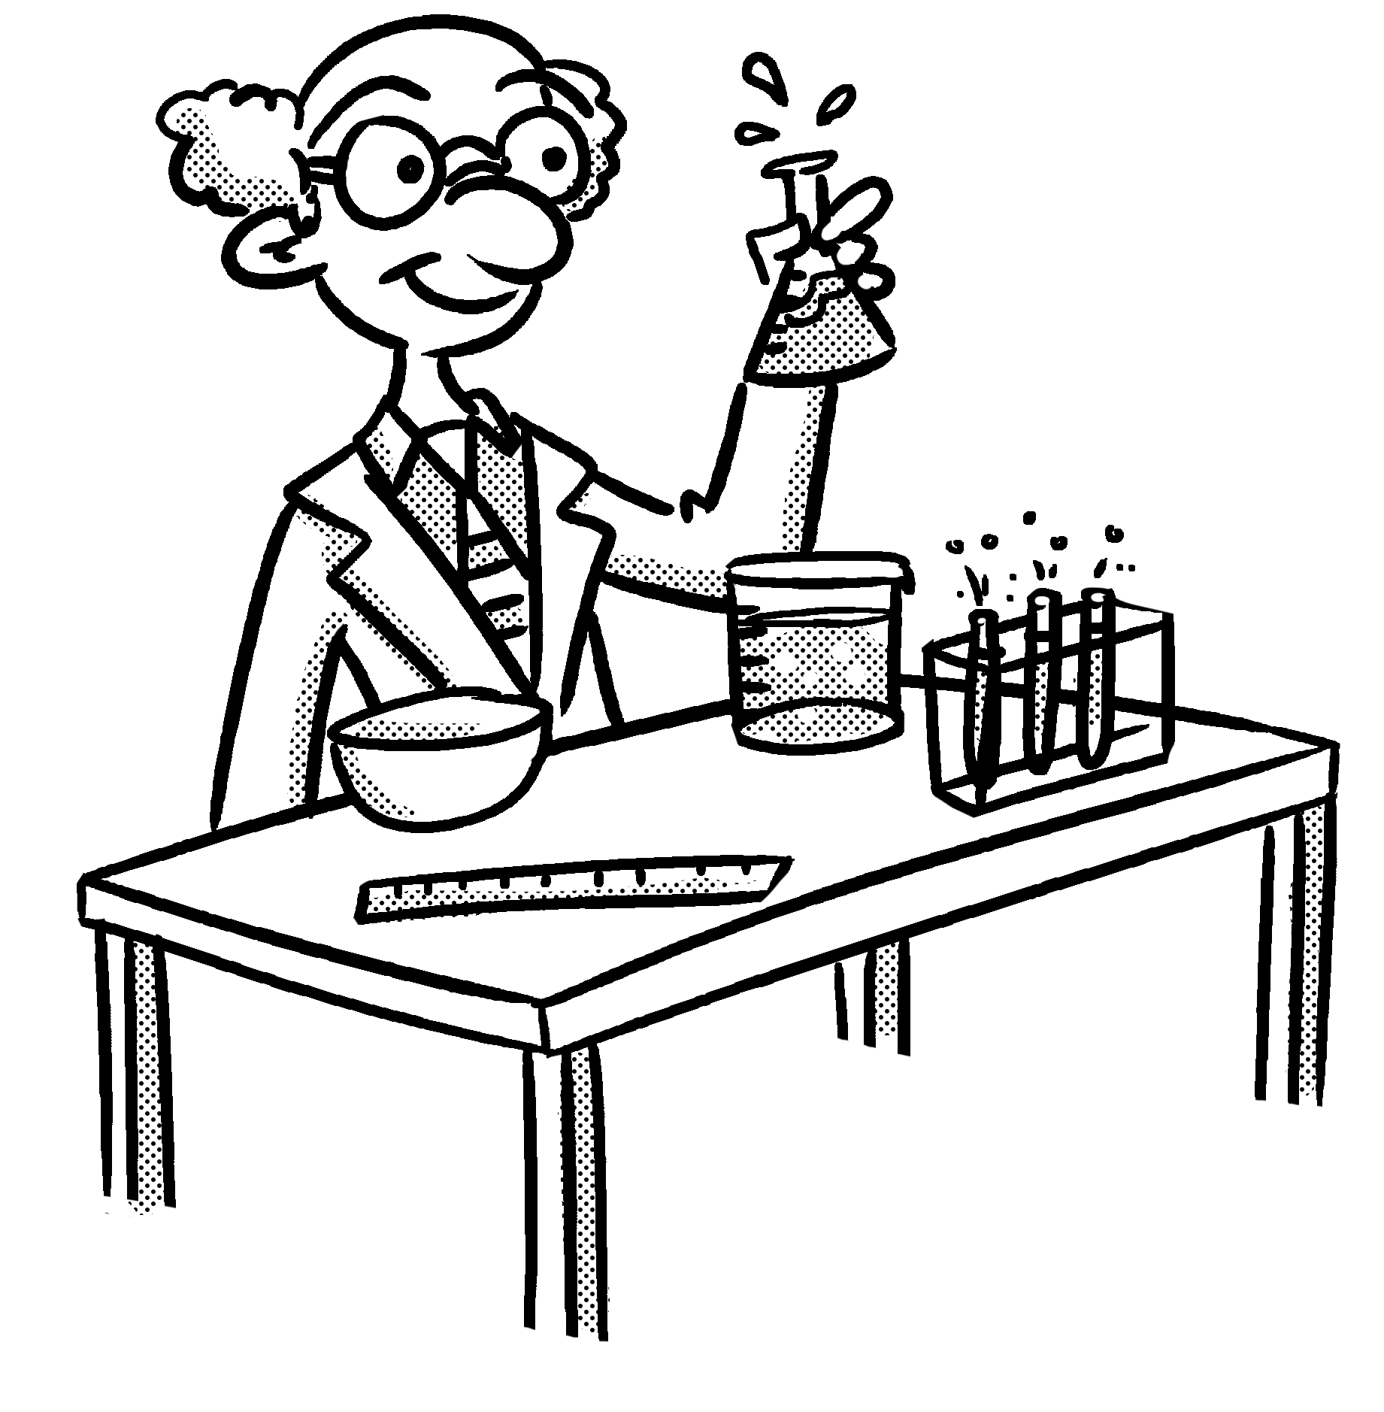
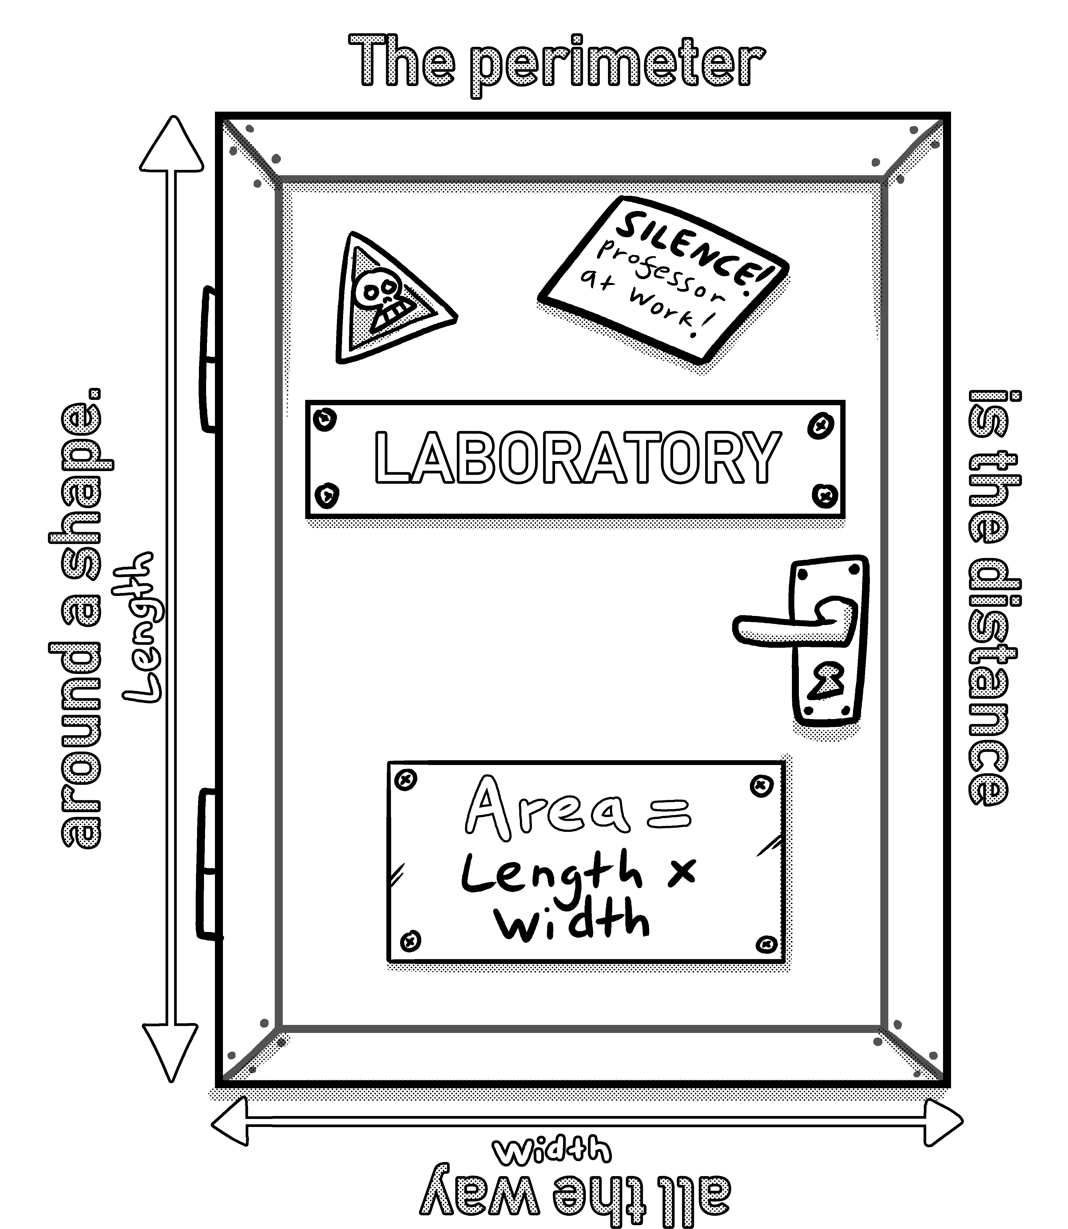
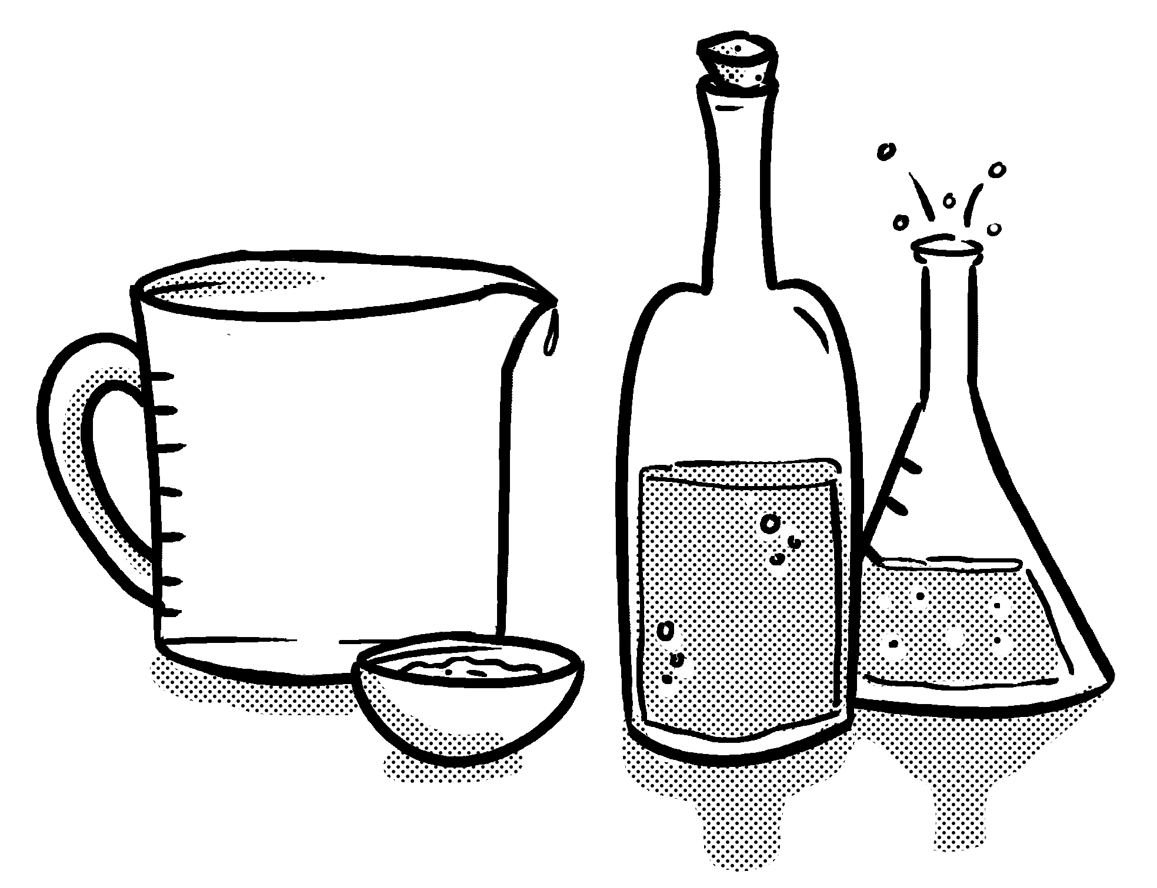
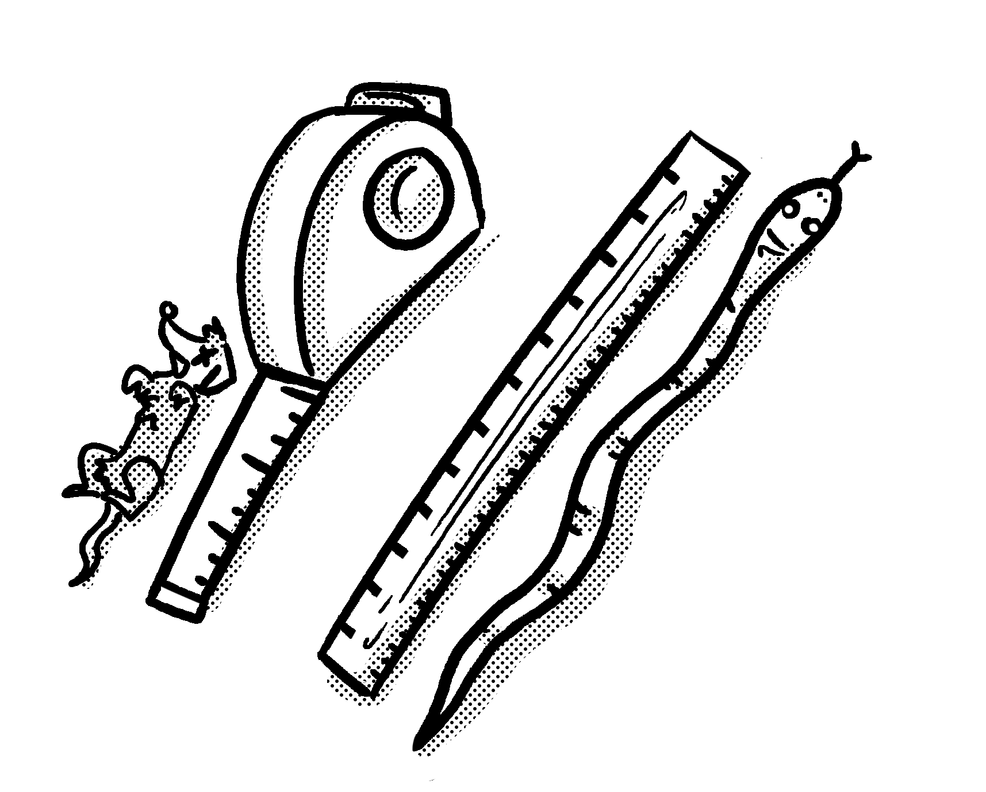
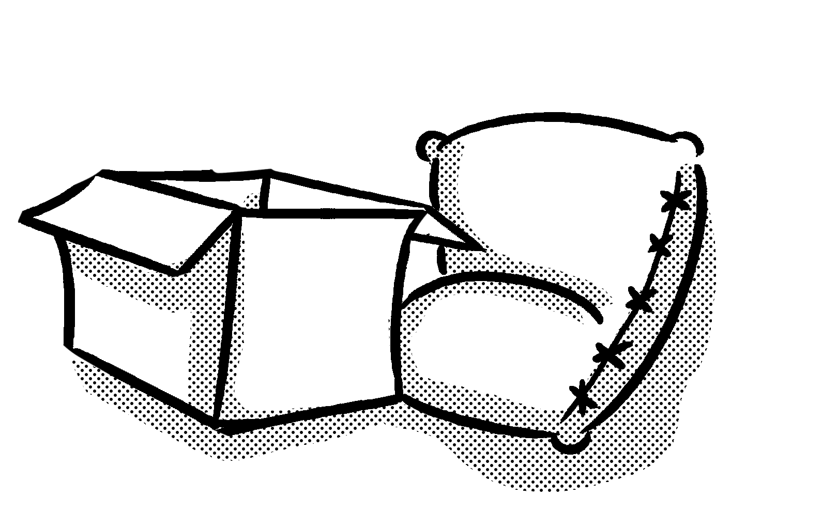

Primary Maths Measures – Years 3 and 4
Capacity
1,000ml = 1l
ml = millilitres
l = litres
Mass 1,000g = 1kg
g = grams
kg = kilograms
Length 10mm = 1cm
100cm = 1m
1,000m = 1km
mm = millimetres
cm = centimetres
m = metres
km = kilometres
© November 2018 The PiXL Club Ltd. All rights reserved.
This resource is strictly for the use of member schools for as long as they remain members of The PiXL Club Ltd.
Notes:
Explain to children that the Knowledge Mats may help them.

Slide 10
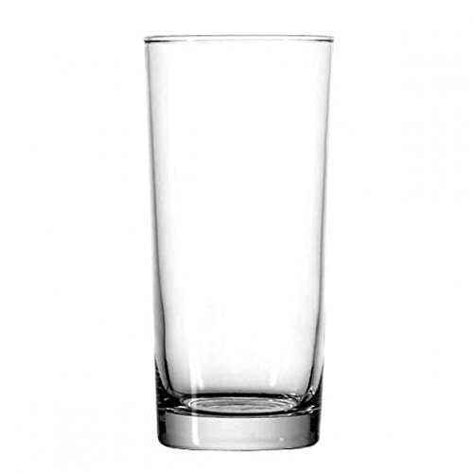
Teach
Today, we are going to estimate capacity.
Knowing the capacity of certain objects can help when estimating unknown amounts.
If I know that the larger glass has a capacity of 500ml, I can use this knowledge to estimate the capacity of the smaller glass.
By using annotations, I estimate that the capacity of the smaller glass is about 400ml.
500ml
400ml
0ml

Slide 11
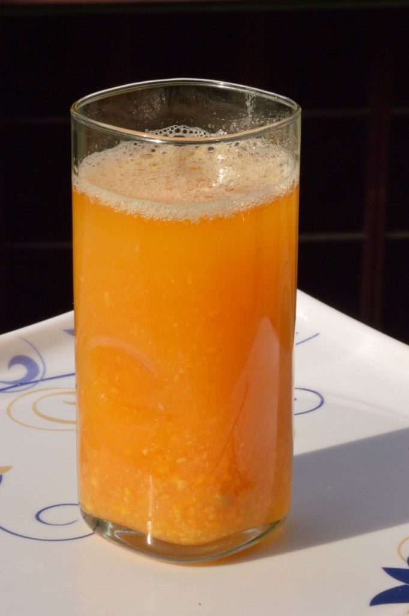
Teach
Estimate the amount of liquid in the glass.
This means using my knowledge of capacity to work out a rough estimation.
I can use my knowledge of half and quarter to help me be as accurate as possible when estimating.
I know when the glass is full, it contains 600ml of liquid.
Full = 600ml
Half way =
300ml
Empty = 0ml

Slide 12
Teach
First, I can mark the half way point (300ml) to help me estimate.
I can then mark half way between 300ml and 600ml which is 450ml.
Full = 600ml
500ml
450ml
Half way =
300ml
The liquid is about a third of the way between 450 and 600, so I estimate that the amount of liquid in the glass is 500ml.
Empty = 0ml

Slide 13

Model
Half of 800ml is 400ml. I know that the amount of liquid is more than this.
Full = 800ml
Estimate the amount of liquid in the test tube.
I know that the container holds 800ml of liquid when full.
I have put a marker at the half way point to help with my estimation.
600ml
Using my ‘markers’, I know the liquid is between 400ml and 600ml. I think it is slightly below 500ml.
Therefore, I estimate the amount shown is about 475ml.
Half way
= 400ml

Slide 14
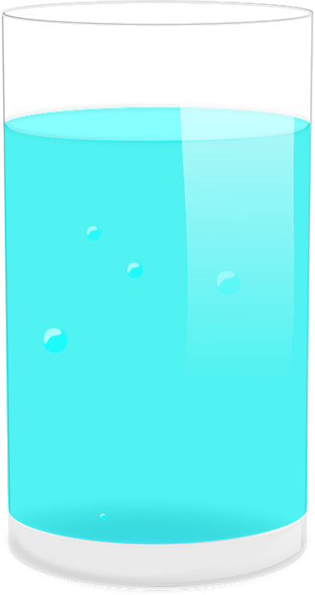

Model
I know Glass B has a capacity of 900ml. This means I can use ‘markers’ to help me estimate the amount of liquid in Glass A
Estimate the amount of liquid in Glass A.
Using my ‘markers’, I think the liquid in Glass A is roughly half way between 450ml and 900ml.
Half of 900ml is 450ml.
Half of 450ml is 225ml.
450ml + 225ml = 675ml
900ml
675ml
450ml
A
B
Therefore, I estimate the amount of liquid in Glass A is 675ml.

Slide 15
Apply
The capacity of the glass is 800ml.
Estimate the amount of liquid in the glass.

Slide 16
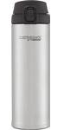
Apply
The capacity of a full bottle is 820ml.
Estimate the amount of liquid (shown by the red line) in each bottle.

Slide 17
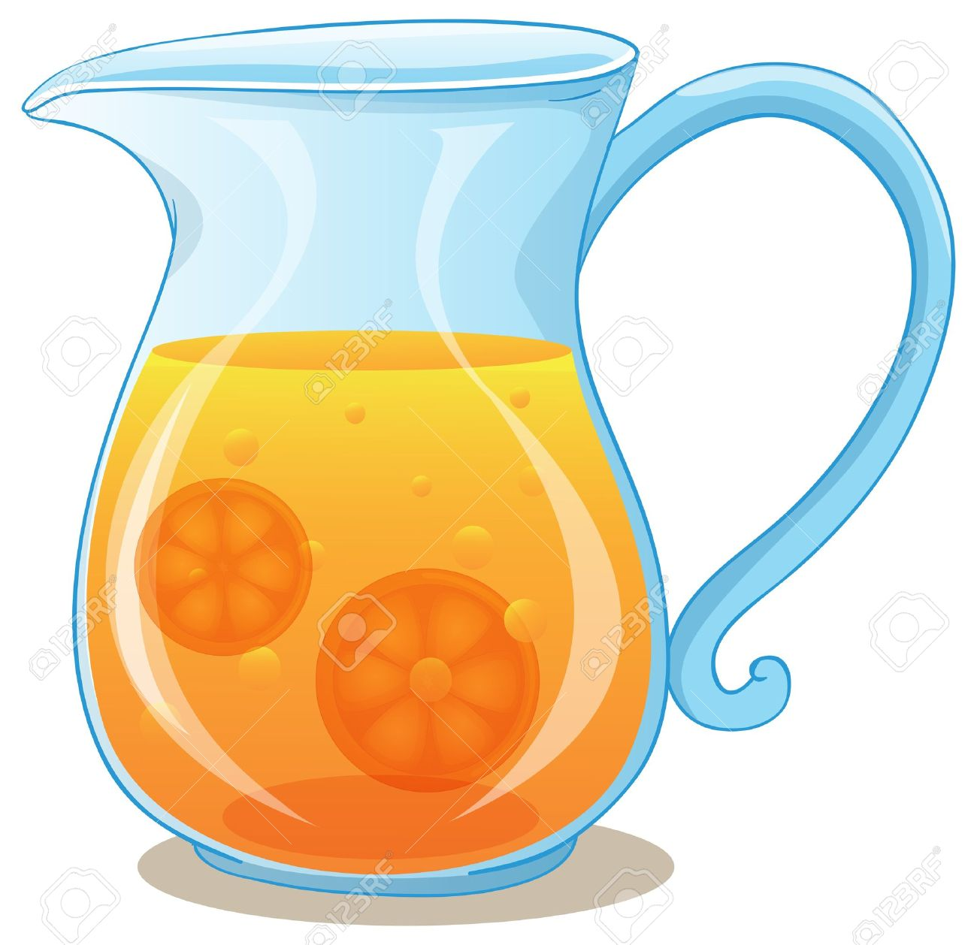
Apply – Problem Solving
Sarah has a 1l jug of orange juice. She pours some drinks for her friends.
Look how much is left in the jug.
Sarah estimates she has 400ml orange juice left. Is she correct?
Explain how you know.

Slide 18

Apply – Reasoning
Phoebe knows that jug A has a capacity of 1.2l. She estimates that the capacity of jug B is 4l. Do you think she is correct?
Explain your reasoning.
A
B

Slide 19
Apply – Practical Activity
Measure the capacity of a water bottle.
Use this information to help you to estimate the capacity of 3 other bottles in the classroom.
Now measure them – how accurate were you?

