Slide 1


.
Y4 M5j Can find the area by counting squares
Commissioned by The PiXL Club Ltd.
November 2019
This resource is strictly for the use of member schools for as long as they remain members of The PiXL Club. It may not be copied, sold nor transferred to a third party or used by the school after membership ceases. Until such time it may be freely used within the member school.
All opinions and contributions are those of the authors. The contents of this resource are not connected with nor endorsed by any other company, organisation or institution.
PiXL Club Ltd endeavour to trace and contact copyright owners. If there are any inadvertent omissions or errors in the acknowledgements or usage, this is unintended and PiXL will remedy these on written notification.
© Copyright The PiXL Club Limited, 2019

Slide 2
Teachers’ Notes
The PiXL therapies can be taught to a whole class or a target group. Year 3-5 therapies are designed to take approximately 30-40 minutes. However, this is flexible: it may be that only part of the therapy is taught or it could, of course, be adapted or extended.
Each therapy begins with a LORIC activity to develop relevant learning behaviours.
This is followed by a vocabulary task, which uses the PiXL 5-phase approach to teach key mathematical vocabulary. Further resources to develop vocabulary can be found in the Whole School area.
Each therapy adopts the ‘Teach, model and apply’ process with opportunities for pupils to demonstrate the taught skill independently.
Problem solving and reasoning activities are an integral part of each therapy.

Slide 3
Progress across amber – the 4-stage model
The three therapy tests which accompany this resource can be used to revisit the taught skill to check that the pupil is able to perform it independently and consistently.
A
A child has successfully completed a therapy test independently, following a set of therapy sessions.
A child has successfully completed a therapy test independently, a period after the relevant therapy sessions – we would advise about 2 weeks.
A child has successfully applied their knowledge or skill in an unfamiliar context. This may be application across the curriculum or in a problem.
A pupil has successfully re-visited the skills at a later point, and applies these in an unfamiliar context or problem, or across the curriculum.
A
DA
G

Slide 4

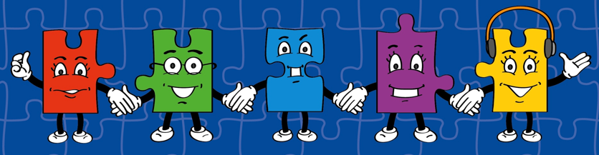
LORIC task
Today our LORIC task will focus on your Izzy Initiative skills:
This means you will have to:
Be resourceful
Think as someone who can collaborate to achieve a goal
Use all skills available to overcome a problem

Slide 5
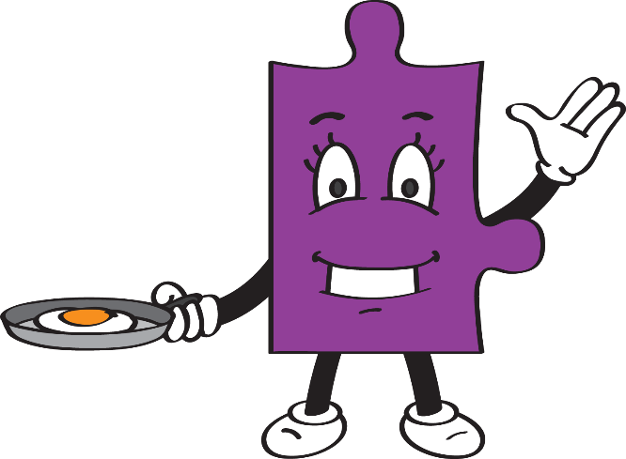
LORIC task
We have to be confident in all times tables up
to 12 x 12, including corresponding division facts.
There may be some that you still find tricky
so this is your opportunity to practise.
Write down the times tables and practise recalling them with a partner. Then see if you can write down corresponding division facts too.

Slide 6
Vocabulary activity
area
width
length
ALL PHASES
The word is…
Act it out
Give a definition or use it in a sentence
Suggest a synonym and an antonym
Draw a picture of it
Describe it without saying the word itself
Give examples of similar spellings/ rhyming words
Notes:
This game requires pupils to manipulate and demonstrate their understanding of the same word in lots of different ways. Print copies of the wheel (laminated, these can be reused multiple times). Give pupils a wheel between 2 or 3 and ask them to select a word from a given list (see Vocabulary Mats or Statutory words lists). Pupils should then spin the wheel and represent the new vocabulary using the method the wheel lands on.

Slide 7
Teach
Today, we are going to calculate the area of shapes by counting squares.
The area of a shape is the surface space taken up by that shape.
For example, the area of a playing field or a given object is the total surface space taken up by the field or object.
width
length

Slide 8
Teach
Today, we are going to calculate the area of shapes by counting squares.
Sometimes, we are simply asked to calculate areas by counting squares.
The unit we use for area is mm², cm² or m².

Slide 9
Teach
Sometimes, we are simply asked to calculate areas by counting squares.
The unit we use is mm², cm² or m².
 | 1 | 2
 | 3 | 4
The shape is drawn on centimetre squared paper. We can calculate the area simply by counting the squares..
It has 4 whole squares so it has an area
of 4 cm² (we read this as ‘4 square centimetres’).

Slide 10
Model
The shape is drawn on centimetre squared paper.
We can calculate the area simply by counting the squares.
Counting and numbering each square is a helpful strategy to work out the area.
 | 1
 | 2 | 3 | 4
5 | 6 | 7
 |  | 8
It has 8 whole squares so it has an area of 8 cm² (we read this as ‘8 square centimetres’).

Slide 11
Model
The shape is drawn on millimetre squared paper.
We can calculate the area simply by counting the squares.
Counting and numbering each square is a helpful strategy to work out the area.
1 | 2 | 3 | 4
5 | 6 | 7 | 8
 | 9 | 10 | 11 | 12
 | 13 | 14 | 15 | 16
17 | 18 | 19
It has 19 whole squares so it has an area of 19mm² (we read this as ‘19 square millimetres’).

Slide 12
Model
If I had to create a shape with a given area, on centimetre squared paper, I would count the correct number of squares and shade them. For example, if I had to create a shape with an area of 5cm²
I could shade or number 5 squares in a variety of ways.
 | 1 | 2 | 3
 | 4 | 5
 |  | 1
 | 2 | 3
 | 4 | 5
1
2
3
4 | 5
 |  | 1
 |  | 2 | 3
 | 4 | 5

Slide 13
Apply
Calculate the area of each shape. Give each answer in cm²:

Slide 14
Apply – Problem Solving
In mm², what is the area of this shape?

Slide 15
Apply – Problem Solving
Which shapes have an area of 9cm²?
A
B
C
D

Slide 16
Apply – Problem Solving
Using squared paper, draw a shape with an area of 10cm². How many different shapes can you make with the same area?

Slide 17
Apply – Reasoning
Mark says the area of this shape is 12cm².
Is he correct?
Explain how you know.

