Slide 1


.
Y4 M6a Can compare and classify geometric shapes, including quadrilaterals and triangles, based on their properties
Commissioned by The PiXL Club Ltd.
January 2020
This resource is strictly for the use of member schools for as long as they remain members of The PiXL Club. It may not be copied, sold nor transferred to a third party or used by the school after membership ceases. Until such time it may be freely used within the member school.
All opinions and contributions are those of the authors. The contents of this resource are not connected with nor endorsed by any other company, organisation or institution.
PiXL Club Ltd endeavour to trace and contact copyright owners. If there are any inadvertent omissions or errors in the acknowledgements or usage, this is unintended and PiXL will remedy these on written notification.
© Copyright The PiXL Club Limited, 2019

Slide 2
Teachers’ Notes
The PiXL therapies can be taught to a whole class or a target group. Year 3-5 therapies are designed to take approximately 30-40 minutes. However, this is flexible: it may be that only part of the therapy is taught or it could, of course, be adapted or extended.
Each therapy begins with a LORIC activity to develop relevant learning behaviours.
This is followed by a vocabulary task, which uses the PiXL 5-phase approach to teach key mathematical vocabulary. Further resources to develop vocabulary can be found in the Whole School area.
Each therapy adopts the ‘Teach, model and apply’ process with opportunities for pupils to demonstrate the taught skill independently.
Problem solving and reasoning activities are an integral part of each therapy.

Slide 3
Progress across amber – the 4-stage model
The three therapy tests which accompany this resource can be used to revisit the taught skill to check that the pupil is able to perform it independently and consistently.
A
A child has successfully completed a therapy test independently, following a set of therapy sessions.
A child has successfully completed a therapy test independently, a period after the relevant therapy sessions – we would advise about 2 weeks.
A child has successfully applied their knowledge or skill in an unfamiliar context. This may be application across the curriculum or in a problem.
A pupil has successfully re-visited the skills at a later point, and applies these in an unfamiliar context or problem, or across the curriculum.
A
DA
G

Slide 4

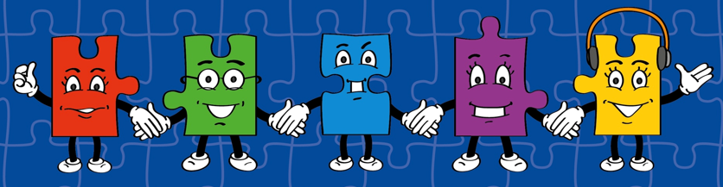
LORIC task
Our Primary Edge attributes help us to become better learners and today is no exception. Before you start this activity, here are some ideas for how you will need your Raj Resilience skills today:
Do not be put off by a difficult task.
Keep going – persevere.
Think about ways you can help yourself and others.

Slide 5

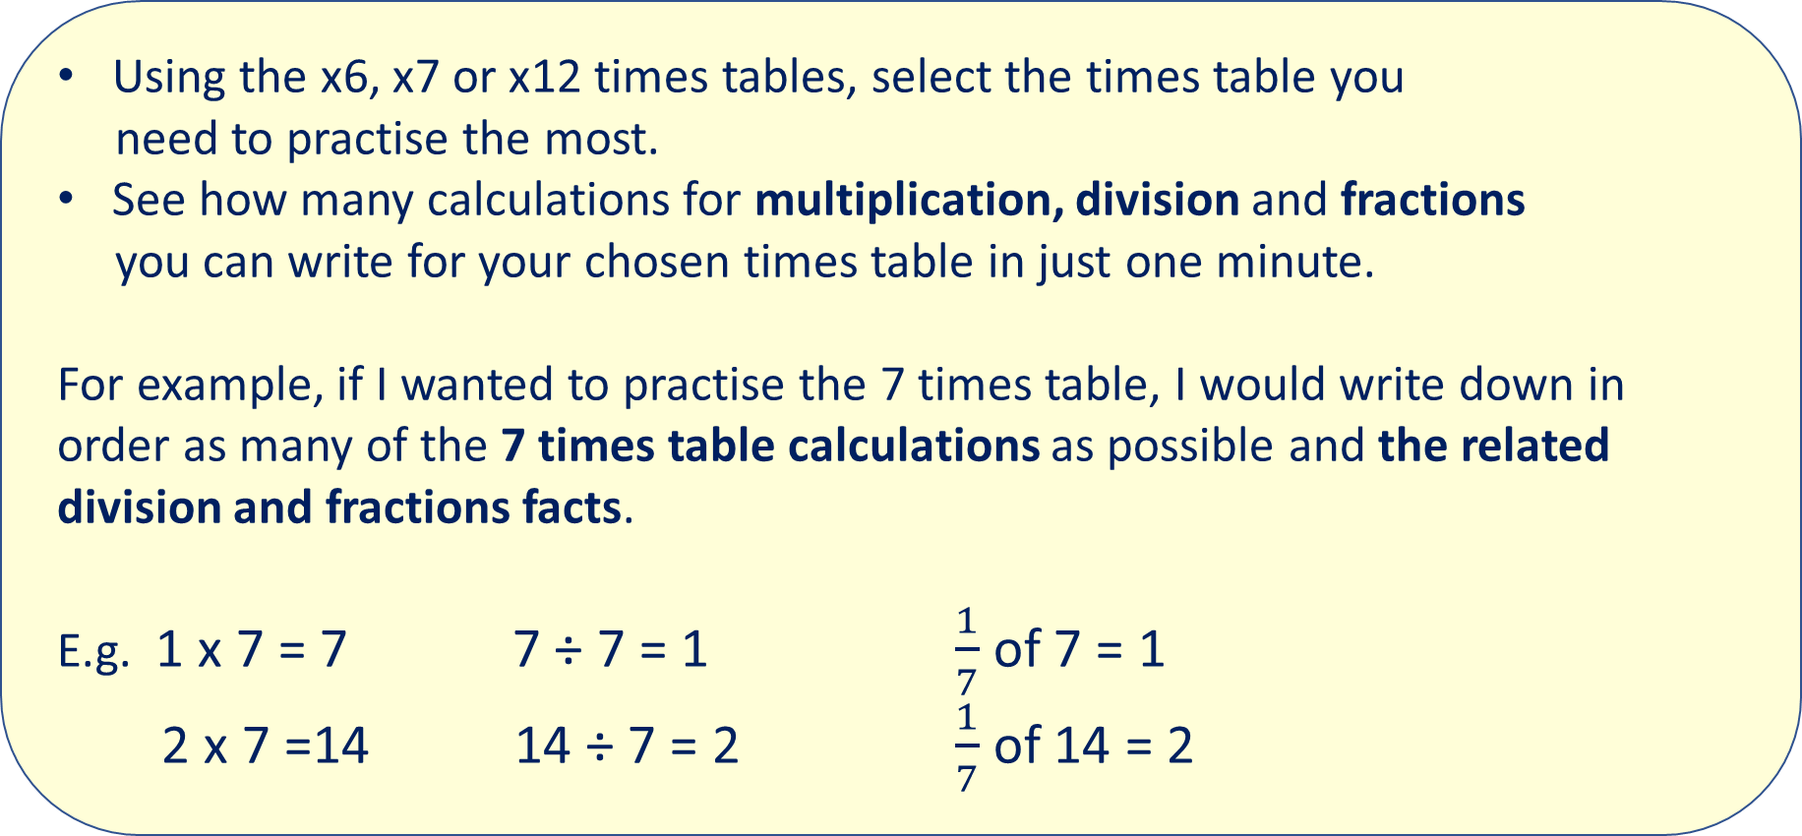
LORIC task
Using the x6, x7 or x12 times tables, select the times table you
need to practise the most.
See how many calculations for multiplication, division and fractions
you can write for your chosen times table in just one minute.
For example, if I wanted to practise the 7 times table, I would write down in order as many of the 7 times table calculations as possible and the related division and fractions facts.
E.g. 1 x 7 = 7 7 ÷ 7 = 1 $\frac{1}{7}$ of 7 = 1
2 x 7 =14 14 ÷ 7 = 2 $\frac{1}{7}$ of 14 = 2

Slide 6
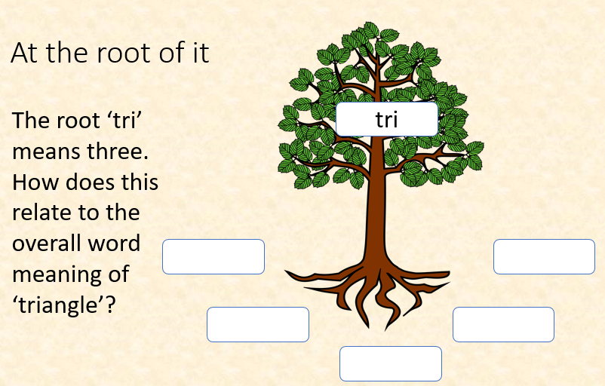
Vocabulary activity
triangle
quadrilateral
DECONSTRUCT IT
Notes:
Can repeat with ‘quad’

Slide 7
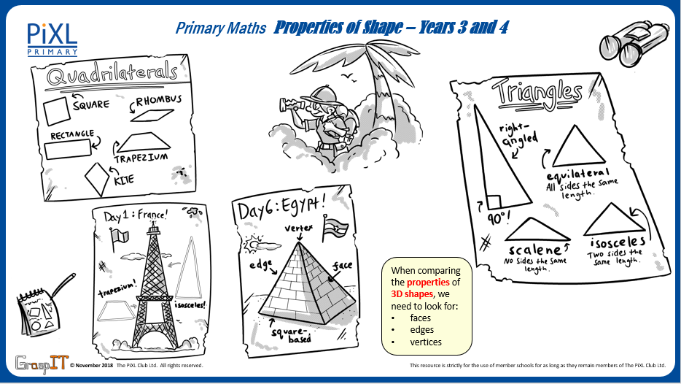
Notes:
Knowledge Mats can be helpful to support learning.

Slide 8
Teach
A 2-D shape is a form or an outline which is flat.
The ‘D’ stands for the word dimensional.

Slide 9
Teach
A 2D shape is a form or an outline which is flat.
The ‘D’ stands for the word dimensional.
circle
rectangle
square
triangle
pentagon
hexagon
octagon

Slide 10
Teach
A 2-D shape can sometimes be described as a polygon and/or a quadrilateral.
A polygon is the name given to all 2-D shapes with straight sides that are fully closed (all of the sides are joined up). The sides must be straight.
A quadrilateral is the name given to all 2-D shapes with four straight sides and four vertices (corners).

Slide 11
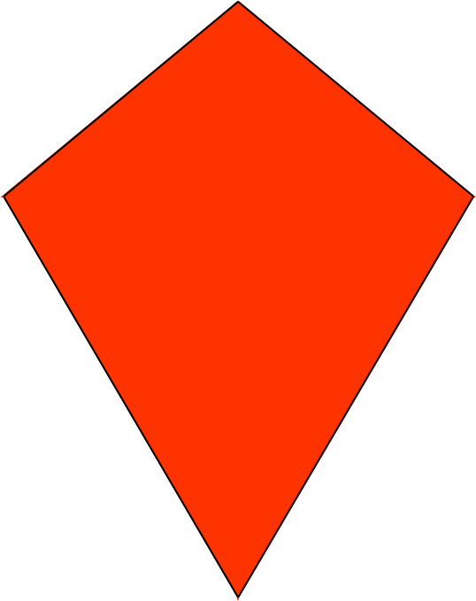
Teach
A quadrilateral is the name given to all 2-D shapes with four straight sides and four vertices (corners).
square
rhombus
kite
trapezium
rectangle
parallelogram

Slide 12
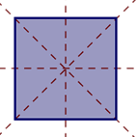
Teach
A 2-D shape can be compared or classified in a range of ways. One way is by identifying lines of symmetry.
Symmetry is where one half of the shape is the reflection of the other half. This means you could fold the shape and have both halves match exactly.

Slide 13
Teach
A 2-D shape can be compared or classified in a range of ways. Another way is by identifying angles.
An angle that is less than a right angle will be less than 90⁰ (degrees).
A right angle is an angle of exactly 90⁰ (degrees).
An angle that is greater than a right angle will be more than 90⁰ (degrees).

Slide 14
Teach
A 2-D shape can be compared or classified in a range of ways. We can also classify shapes by identifying parallel lines.
Parallel lines are two straight lines that do not meet at any point.
A parallelogram has 2 pairs of parallel lines (the red lines and the green lines).

Slide 15
Model
A quadrilateral is the name given to all 2-D shapes with four straight sides and four vertices (corners).
square
  Properties of a square include:
  4 equal sides
  4 right angles
  4 lines of symmetry

Slide 16
Model
A quadrilateral is the name given to all 2-D shapes with four straight sides and four vertices (corners).
rectangle
  Properties of a rectangle include:
  2 sets of equal length sides
  4 right angles
  2 lines of symmetry
  2 pairs of parallel lines

Slide 17
Model
A quadrilateral is the name given to all 2-D shapes with four straight sides and four vertices (corners).
rhombus
  Properties of a rhombus include:
  4 equal length sides
  2 pairs of parallel lines
  Opposite angles are equal

Slide 18
Apply – speaking task
Now select 2 shapes to compare. Use the following properties to support your discussions:
  sides
  angles
  symmetry
  parallel lines
I am going to compare a square to a rectangle.
A square has 4 equal sides.
On the other hand, a rectangle can have 2 pairs of sides with different lengths. However, a property common to both is that they have 2 pairs of parallel lines.
Use conjunctions to support your discussion.
E.g. but, on the other hand, however, although, despite, furthermore etc.

Slide 19
Model
A quadrilateral is the name given to all 2-D shapes with four straight sides and four vertices (corners).
kite
  Properties of a kite include:
  4 sides
  2 pairs of equal length sides
  1 set of opposite angles are equal

Slide 20
Model
A quadrilateral is the name given to all 2-D shapes with four straight sides and four vertices (corners).
  Properties of a parallelogram include:
  2 pairs of parallel lines
  Opposite angles are equal
  Opposite sides are equal
  No lines of symmetry
parallelogram

Slide 21
Model
A quadrilateral is the name given to all 2-D shapes with four straight sides and four vertices (corners).
trapezium
  Properties of this trapezium include:
  1 pair of parallel lines
  2 sets of equal angles
  1 line of symmetry

Slide 22
Apply
The properties for 2-D shapes include parallel lines and right angles.
Complete the following table (answering Yes or No) to describe each shape:
Shape | Quadrilateral | Parallel lines | Right angle
 | No | No | Yes

Slide 23
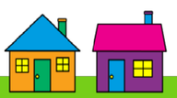
Apply – Problem Solving
  Sam lives next door to Katie. He says his roof has a right angle in it and Katie’s does not.
  Which house does Sam live in? Which one does Katie live in? Explain how you know.

Slide 24
Model
There are also four different types of triangles to compare.
  Properties of an equilateral triangle include:
  All 3 sides equal in length
  All angles are equal

Slide 25
Model
There are also four different types of triangles to compare.
  Properties of an isosceles triangle include:
  2 sides of equal length
  2 equal angles

Slide 26
Model
There are also four different types of triangles to compare.
  Properties of a scalene triangle include:
  All lengths are different
  All angles are different

Slide 27
Model
There are also four different types of triangles to compare.
  Properties of a right-angled triangle include:
  Can be an isosceles triangle or a scalene triangle
  Has one 90⁰ angle

Slide 28
Apply – Reasoning
Which of these triangles is the odd one out? Explain your reasons by describing the properties of the shape.
Notes:
There is more than one answer to this – it is about them justifying their response.

Slide 29
Apply
Name the 2-D shapes being described:
A triangle with no lengths the same.
A quadrilateral with no right angles but 2 pairs of parallel lines.
A quadrilateral with 1 set of parallel lines and 1 line of symmetry.

