Slide 1


.
Y4 M6b Can identify regular or irregular polygons
Commissioned by The PiXL Club Ltd.
January 2020
This resource is strictly for the use of member schools for as long as they remain members of The PiXL Club. It may not be copied, sold nor transferred to a third party or used by the school after membership ceases. Until such time it may be freely used within the member school.
All opinions and contributions are those of the authors. The contents of this resource are not connected with nor endorsed by any other company, organisation or institution.
PiXL Club Ltd endeavour to trace and contact copyright owners. If there are any inadvertent omissions or errors in the acknowledgements or usage, this is unintended and PiXL will remedy these on written notification.
© Copyright The PiXL Club Limited, 2019

Slide 2
Teachers’ Notes
The PiXL therapies can be taught to a whole class or a target group. Year 3-5 therapies are designed to take approximately 30-40 minutes. However, this is flexible: it may be that only part of the therapy is taught or it could, of course, be adapted or extended.
Each therapy begins with a LORIC activity to develop relevant learning behaviours.
This is followed by a vocabulary task, which uses the PiXL 5-phase approach to teach key mathematical vocabulary. Further resources to develop vocabulary can be found in the Whole School area.
Each therapy adopts the ‘Teach, model and apply’ process with opportunities for pupils to demonstrate the taught skill independently.
Problem solving and reasoning activities are an integral part of each therapy.

Slide 3
Progress across amber – the 4-stage model
The three therapy tests which accompany this resource can be used to revisit the taught skill to check that the pupil is able to perform it independently and consistently.
A
A child has successfully completed a therapy test independently, following a set of therapy sessions.
A child has successfully completed a therapy test independently, a period after the relevant therapy sessions – we would advise about 2 weeks.
A child has successfully applied their knowledge or skill in an unfamiliar context. This may be application across the curriculum or in a problem.
A pupil has successfully re-visited the skills at a later point, and applies these in an unfamiliar context or problem, or across the curriculum.
A
DA
G

Slide 4

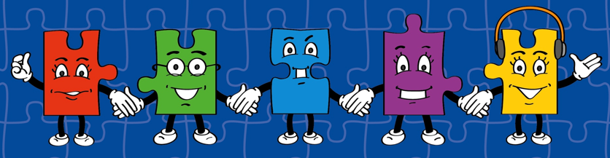
LORIC task
The LORIC task will focus on your Raj Resilience skills today:
Do not be put off by a difficult task.
Keep going – persevere.
Think about ways you can help yourself and others.

Slide 5

LORIC task
Using the numbers 6, 7 and 8, work out
the multiplication calculation which will
give the answer closest to 600.
?
?
x
?

Slide 6
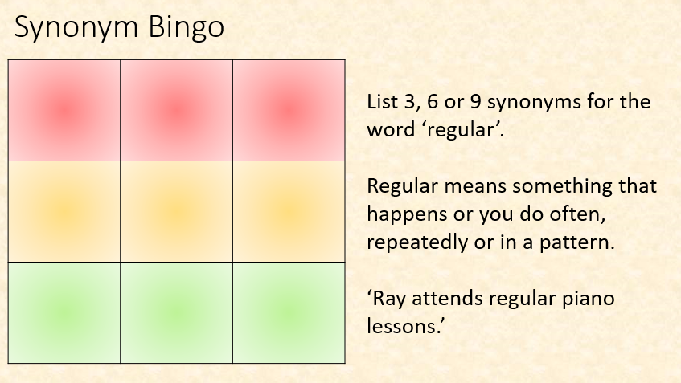
Vocabulary activity
regular
irregular
LINK IT
Notes:
Give pupils a new and challenging word. Discuss the meaning in isolation and give examples of the word in context. Ask pupils to list 3, 6 or 9 synonyms or near synonyms (depending on the level of challenge you want to give). Read out your own list of synonyms and near synonyms, asking pupils to tick them off as you go. First to tick them all off shouts ‘Bingo’!

Slide 7
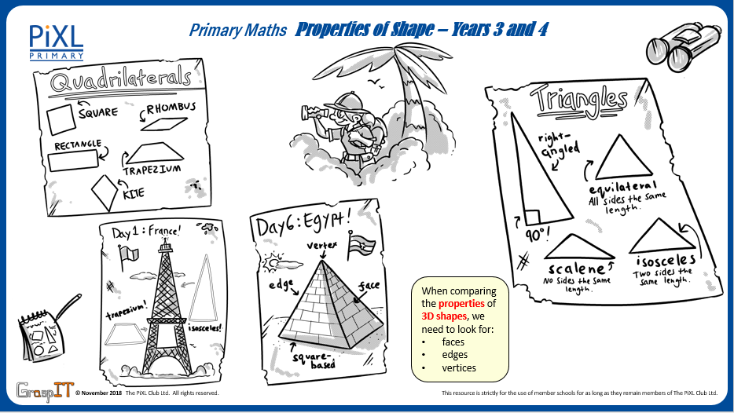
Notes:
Knowledge Mats can be helpful to support learning.

Slide 8
Teach
A 2-D shape is a form or an outline which is flat.
The ‘D’ stands for the word dimensional.
circle
rectangle
square
triangle
pentagon
hexagon
octagon

Slide 9
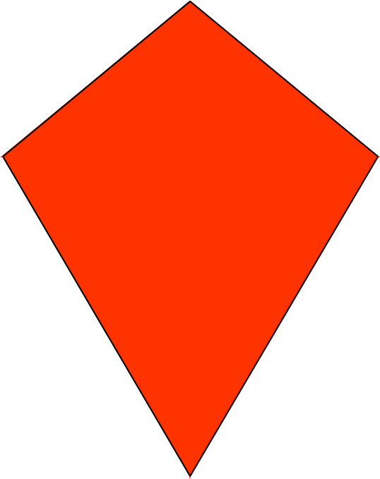
Teach
A quadrilateral is the name given to all 2-D shapes with four straight sides and four vertices (corners).
square
rhombus
kite
trapezium
rectangle
parallelogram

Slide 10
Teach
A 2-D shape can sometimes be described as a polygon.
Term | Definition
Polygon | A flat, 2-D shape with straight sides that are joined up.
Regular polygon | A shape where all angles and sides are equal.
Irregular polygon | A shape that does not have equal sides and angles.

Slide 11
Teach
A polygon is a flat, 2-D shape with straight sides that are joined up.
A regular polygon is a shape where all angles and sides are equal.
A circle is not a polygon as it has no straight sides.
An irregular polygon is a shape that does not have equal sides and angles.

Slide 12
Model
A polygon is a flat, 2-D shape with straight sides that are joined up.
A regular polygon is a shape where all angles and sides are equal.
An irregular polygon is a shape that does not have equal sides and angles.
pentagon
(5 sides)
irregular
regular

Slide 13
Model
A polygon is a flat, 2D shape with straight sides that are joined up.
A regular polygon is a shape where all angles and sides are equal.
An irregular polygon is a shape that does not have equal sides and angles.
hexagon
(6 sides)
irregular
regular

Slide 14
Model
A polygon is a flat, 2D shape with straight sides that are joined up.
A regular polygon is a shape where all angles and sides are equal.
An irregular polygon is a shape that does not have equal sides and angles.
heptagon
(7 sides)
irregular
regular

Slide 15
Model
A polygon is a flat, 2D shape with straight sides that are joined up.
A regular polygon is a shape where all angles and sides are equal.
An irregular polygon is a shape that does not have equal sides and angles.
octagon
(8 sides)
regular
irregular

Slide 16
Model
A polygon is a flat, 2D shape with straight sides that are joined up.
A regular polygon is a shape where all angles and sides are equal.
An irregular polygon is a shape that does not have equal sides and angles.
decagon
(10 sides)
regular
irregular

Slide 17
Apply
Explain whether each shape is a regular polygon or irregular polygon.

Slide 18
Apply
Complete the following table (answering Yes or No) to describe each shape:
Shape | Quadrilateral | Regular Polygon
 | No | No

Slide 19
Apply – Problem Solving
Circle the correct shape based on the following description:
It has 4 sides.
The diagonals intersect at a right angle.

Slide 20
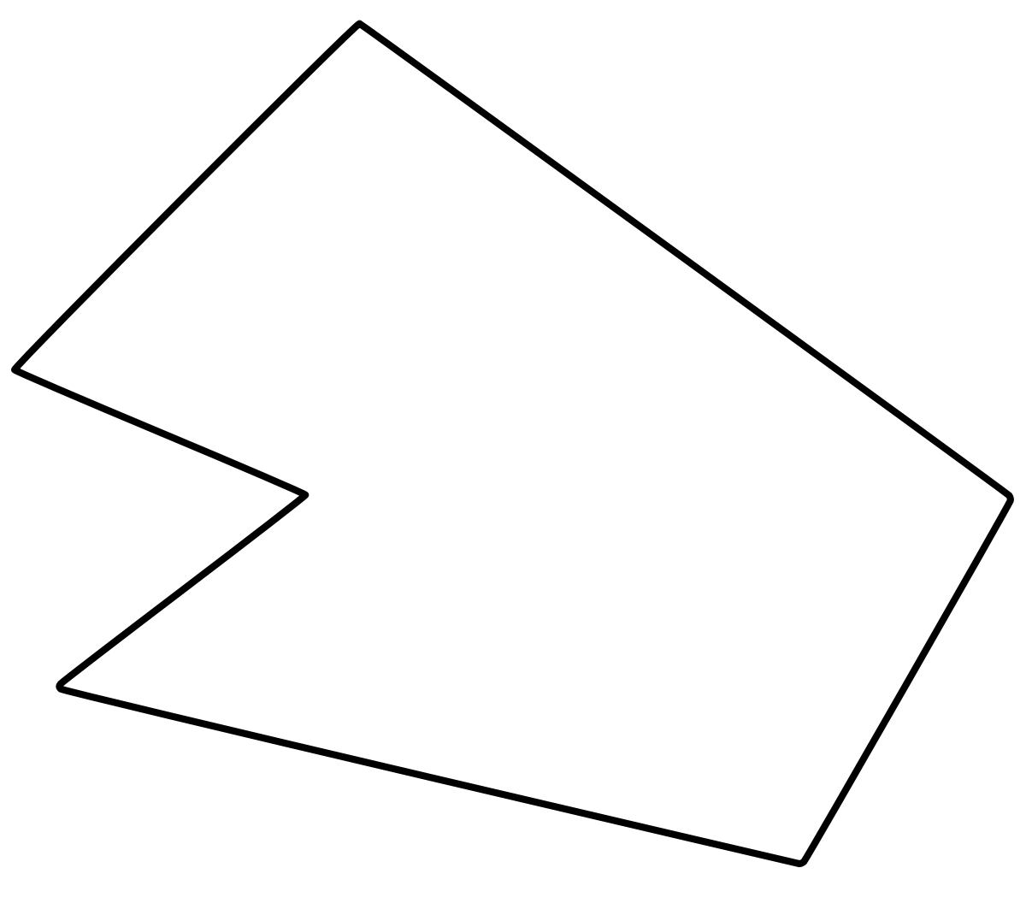
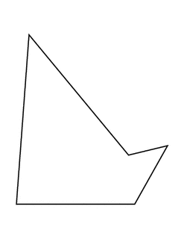
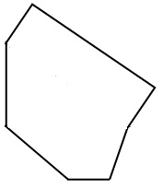
Apply – Reasoning
Which of these polygons is the odd one out? Explain your reasons by describing the properties of the shape.
Notes:
There is more than one answer to this – it is about them justifying their response.

