Slide 1


.
Y4 M6e Can identify lines of symmetry in 2-D shapes presented in different orientations
Commissioned by The PiXL Club Ltd.
January 2020
This resource is strictly for the use of member schools for as long as they remain members of The PiXL Club. It may not be copied, sold nor transferred to a third party or used by the school after membership ceases. Until such time it may be freely used within the member school.
All opinions and contributions are those of the authors. The contents of this resource are not connected with nor endorsed by any other company, organisation or institution.
PiXL Club Ltd endeavour to trace and contact copyright owners. If there are any inadvertent omissions or errors in the acknowledgements or usage, this is unintended and PiXL will remedy these on written notification.
© Copyright The PiXL Club Limited, 2019

Slide 2
Teachers’ Notes
The PiXL therapies can be taught to a whole class or a target group. Year 3-5 therapies are designed to take approximately 30-40 minutes. However, this is flexible: it may be that only part of the therapy is taught or it could, of course, be adapted or extended.
Each therapy begins with a LORIC activity to develop relevant learning behaviours.
This is followed by a vocabulary task, which uses the PiXL 5-phase approach to teach key mathematical vocabulary. Further resources to develop vocabulary can be found in the Whole School area.
Each therapy adopts the ‘Teach, model and apply’ process with opportunities for pupils to demonstrate the taught skill independently.
Problem solving and reasoning activities are an integral part of each therapy.

Slide 3
Progress across amber – the 4-stage model
The three therapy tests which accompany this resource can be used to revisit the taught skill to check that the pupil is able to perform it independently and consistently.
A
A child has successfully completed a therapy test independently, following a set of therapy sessions.
A child has successfully completed a therapy test independently, a period after the relevant therapy sessions – we would advise about 2 weeks.
A child has successfully applied their knowledge or skill in an unfamiliar context. This may be application across the curriculum or in a problem.
A pupil has successfully re-visited the skills at a later point, and applies these in an unfamiliar context or problem, or across the curriculum.
A
DA
G

Slide 4

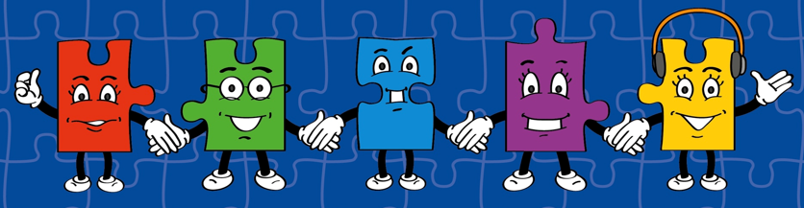
LORIC task
Our Primary Edge attributes help us to become better learners and today is no exception. Before you start this activity, here are some ideas for how you will need your Olly Organisation skills today:
Make decisions.
Problem solve.
Think strategically.

Slide 5
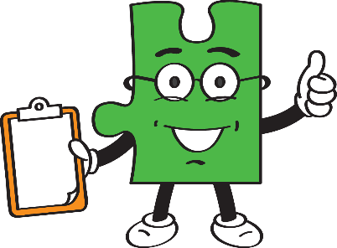
LORIC task
Create your own Venn or Carroll diagram to sort
the following shapes using a range of properties:
square circle triangle trapezium
pentagon octagon rhombus kite
rectangle hexagon parallelogram
Can you think of any more to add to your categories?

Slide 6
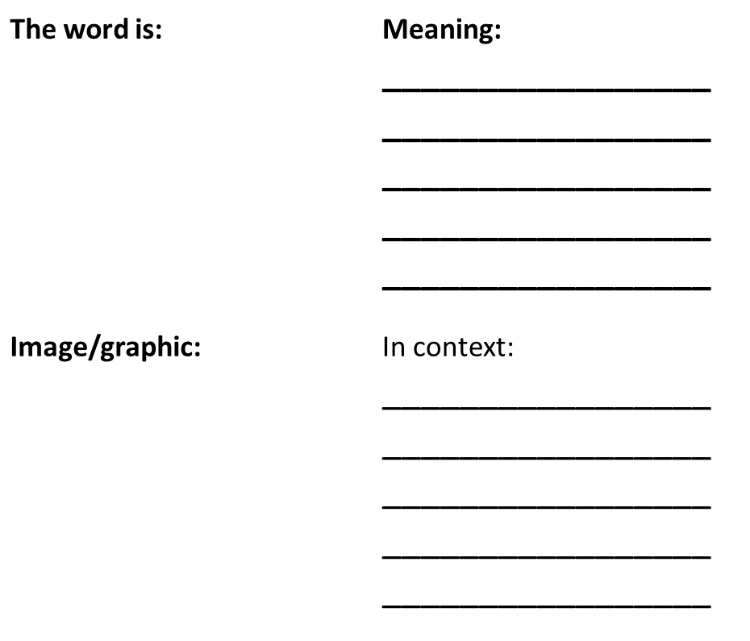
Vocabulary activity
horizontal
vertical
symmetry
orientation
DEFINE IT/USE IT

Slide 7
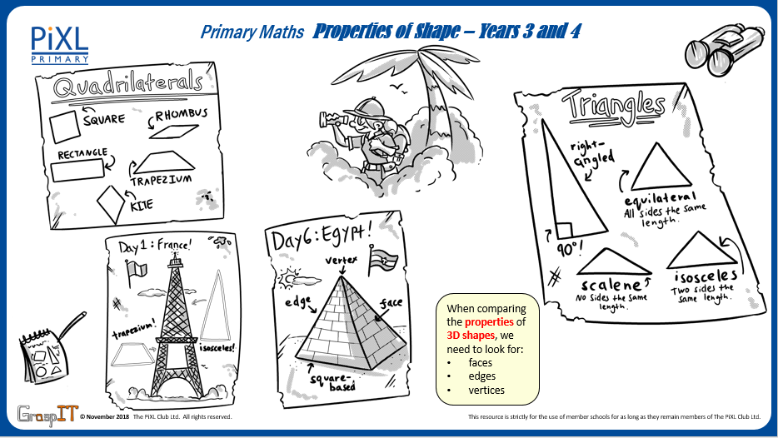
Notes:
Knowledge Mats can be helpful to support learning.

Slide 8

Teach
To identify lines of symmetry, it is important to understand key vocabulary.
A horizontal line is a line that runs right to left across the page.
It comes from the word ‘horizon’, in the sense that horizontal lines are parallel to the horizon.

Slide 9
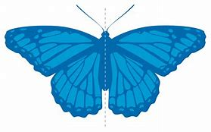
Teach
To identify lines of symmetry, it is important to understand key vocabulary.
A vertical line is a line that goes straight up and down.
A vertical line has no slope.

Slide 10
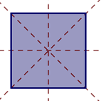
Teach
To identify lines of symmetry, it is important to understand key vocabulary.
Symmetry is where one half of the shape is the reflection of the other half. This means you could fold the shape and have both halves match exactly.

Slide 11
Teach
Symmetry is where one half of the shape is the reflection of the other half. This means you could fold the shape and have both halves match exactly.
This is an example of a horizontal line and a vertical line of symmetry in a circle.

Slide 12
Teach
Symmetry is where one half of the shape is the reflection of the other half. This means you could fold the shape and have both halves match exactly.
This is an example of a diagonal line of symmetry as both halves match exactly.
This is an example of a diagonal line which does not show symmetry as both halves do not match exactly.

Slide 13
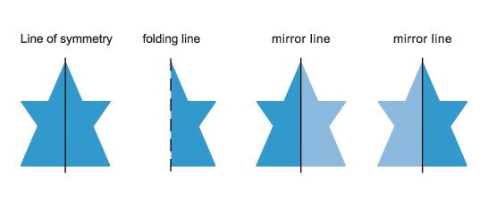
Model
A mirror can also be used to identify a line of symmetry.
These are examples of horizontal lines of symmetry in a 2-D shape.
The lighter blue side shows the mirrored reflection.

Slide 14
Model
A mirror can also be used to identify a line of symmetry.
These are examples of vertical lines of symmetry in a 2-D shape.
The lighter blue side shows the mirrored reflection.

Slide 15
Model
Regular polygons (where all of the sides are equal in length) will always have at least one line of symmetry.
Here are some examples of regular polygons with a horizontal and a vertical line of symmetry.

Slide 16
Model
Regular polygons (where all of the sides are equal in length) will always have at least one line of symmetry.
Sometimes, shapes will only have one line of symmetry – either a horizontal line or a vertical line of symmetry.

Slide 17



Apply
Identify and draw the horizontal lines, vertical lines and diagonal lines of symmetry in each of these shapes.

Slide 18
Apply
Henry has drawn a shape with only a vertical line of symmetry.
Draw your own shape with only a vertical line of symmetry.

Slide 19
Apply – Problem Solving
Tick whether each statement is true (T) or false (F).
 | T | F
All regular polygons have at least one line of symmetry.
A regular hexagon has a horizontal and a vertical line of symmetry.
A vertical line of symmetry can slope.

Slide 20
Apply – Problem Solving
Matthew writes his name in capital letters. He says that each letter has at least one line of symmetry.
Identify all the lines of symmetry in his name.
MATTHEW
Now try your own name using capital letters.

Slide 21
Apply – Reasoning
Zara draws a range of 2-D shapes that she says all have more than one line of symmetry.
Is she correct? Explain how you know.

