Slide 1
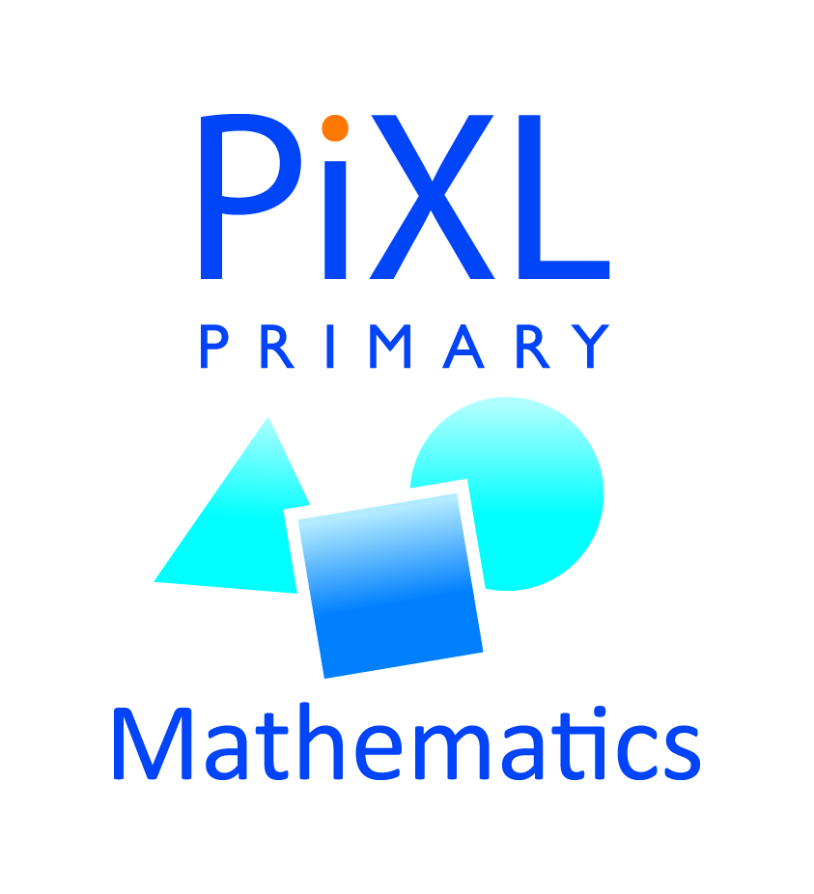

.
Y4 M6f Can complete a simple shape or diagram with respect to a specific line of symmetry
Commissioned by The PiXL Club Ltd.
January 2020
This resource is strictly for the use of member schools for as long as they remain members of The PiXL Club. It may not be copied, sold nor transferred to a third party or used by the school after membership ceases. Until such time it may be freely used within the member school.
All opinions and contributions are those of the authors. The contents of this resource are not connected with nor endorsed by any other company, organisation or institution.
PiXL Club Ltd endeavour to trace and contact copyright owners. If there are any inadvertent omissions or errors in the acknowledgements or usage, this is unintended and PiXL will remedy these on written notification.
© Copyright The PiXL Club Limited, 2019

Slide 2
Teachers’ Notes
The PiXL therapies can be taught to a whole class or a target group. Year 3-5 therapies are designed to take approximately 30-40 minutes. However, this is flexible: it may be that only part of the therapy is taught or it could, of course, be adapted or extended.
Each therapy begins with a LORIC activity to develop relevant learning behaviours.
This is followed by a vocabulary task, which uses the PiXL 5-phase approach to teach key mathematical vocabulary. Further resources to develop vocabulary can be found in the Whole School area.
Each therapy adopts the ‘Teach, model and apply’ process with opportunities for pupils to demonstrate the taught skill independently.
Problem solving and reasoning activities are an integral part of each therapy.

Slide 3
Progress across amber – the 4-stage model
The three therapy tests which accompany this resource can be used to revisit the taught skill to check that the pupil is able to perform it independently and consistently.
A
A child has successfully completed a therapy test independently, following a set of therapy sessions.
A child has successfully completed a therapy test independently, a period after the relevant therapy sessions – we would advise about 2 weeks.
A child has successfully applied their knowledge or skill in an unfamiliar context. This may be application across the curriculum or in a problem.
A pupil has successfully re-visited the skills at a later point, and applies these in an unfamiliar context or problem, or across the curriculum.
A
DA
G

Slide 4

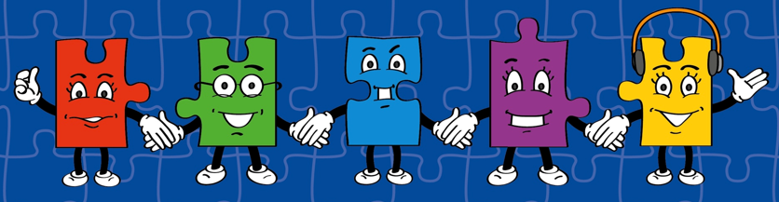
LORIC task
Today the LORIC task will focus on your Izzy Initiative skills:
This means you will have to:
Be resourceful.
Think as someone who is part of a team.
Use all skills available to overcome the problem.

Slide 5
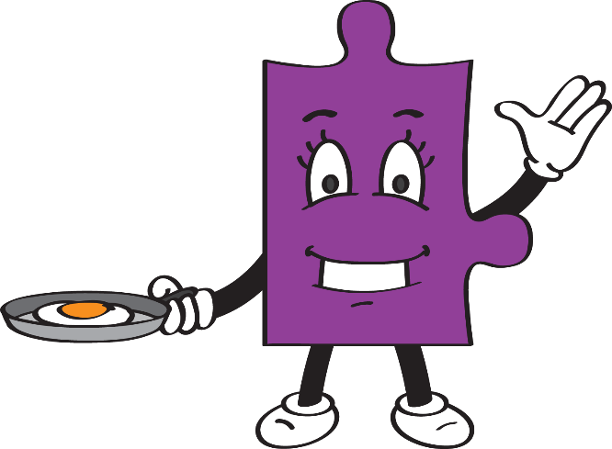
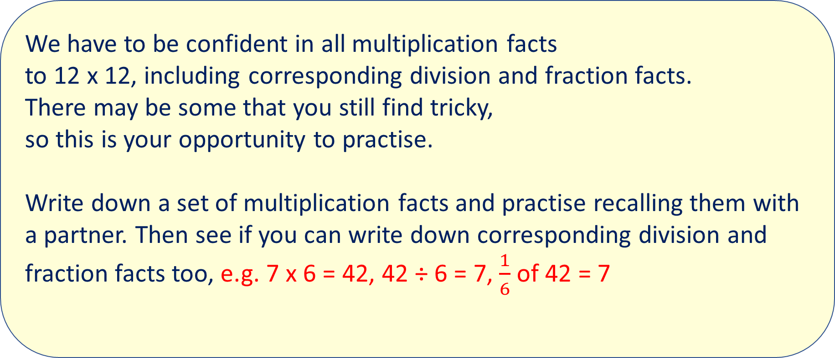
LORIC task
We have to be confident in all multiplication facts
to 12 x 12, including corresponding division and fraction facts.
There may be some that you still find tricky,
so this is your opportunity to practise.
Write down a set of multiplication facts and practise recalling them with a partner. Then see if you can write down corresponding division and fraction facts too, e.g. 7 x 6 = 42, 42 ÷ 6 = 7, $\frac{1}{6}$ of 42 = 7

Slide 6
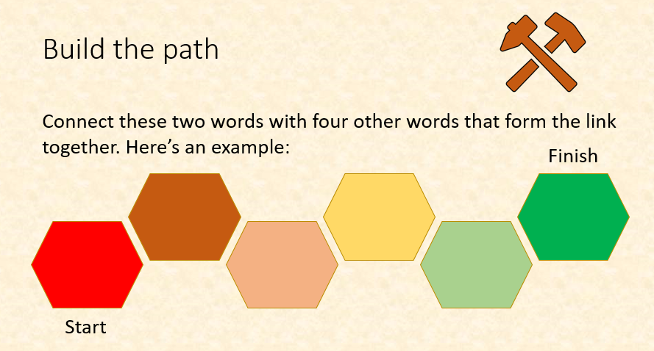
Vocabulary activity
begin
complete
LINK IT
Notes:
In this activity, pupils will be asked to reason about vocabulary. Teachers may wish to award points or rewards for ambitious choices or excellent explanations. Pupils should be encouraged to think creatively about how to ‘build the path’ between the two words. Perhaps this could be through spelling patterns, word meaning or association, words with the same roots or another pattern that they outline themselves.

Slide 7
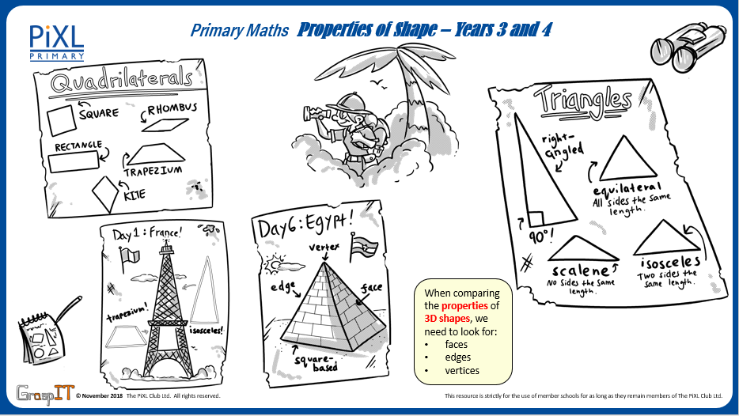
Notes:
Knowledge Mats can be helpful to support learning.

Slide 8
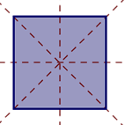
Teach
Symmetry is where one half of a shape is the reflection of the other half. This means you could fold the shape and have both halves match exactly.
Lines of symmetry can be horizontal, vertical or diagonal.

Slide 9


Teach
A horizontal line is a line that runs right to left across the page.
It comes from the word ‘horizon’, in the sense that horizontal lines are parallel to the horizon.
A vertical line is a line that goes straight up and down.
A vertical line has no slope.

Slide 10
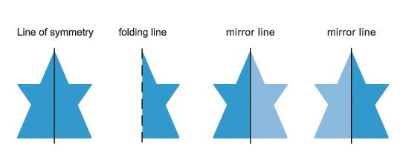
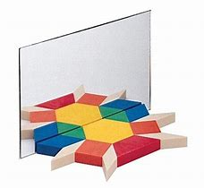
Teach
A mirror can also be used to identify a line of symmetry.
These are examples of vertical lines of symmetry in a 2-D shape.
The lighter blue side shows the mirrored reflection.

Slide 11


Model
A mirror can also be used to identify a line of symmetry.
This shape needs to be completed. I can identify that the line of symmetry is a vertical line.
This means I need to reflect the shape exactly as it is shown but on the opposite side.

Slide 12
Model
I have identified each vertex and the shape (as shown by the red dots).
I have then identified each reflected vertex so I can see the how to draw the rest of the shape (as shown by the green dots). I know I can use the squares to help me by counting to help the positioning.

Slide 13
Model
To reflect the shape accurately, plot each vertex at a time. For example, Point A is 3 squares from the line of symmetry. So, I count 3 squares away from the line of symmetry on the opposite side and plot the reflected vertex at A’.
A’
A
Do this for each vertex so that you have plotted all the vertices of the reflected shape. Then join them up.

Slide 14

Model
The completed shape looks like this. I can check the accuracy of my drawing by placing a mirror on the line. I have used a pencil and a ruler to complete the shape.

Slide 15

Model
A mirror can also be used to identify a line of symmetry.
This shape needs to be completed. I can identify that the line of symmetry is a horizontal line.
This means I need to reflect the shape exactly as it is shown but on the opposite side, in the space below the horizontal line.

Slide 16

Model
To complete the shape, I need to use the horizontal line and reflect the shape exactly as it is.
The completed shape looks like this. I can check the accuracy of my drawing by placing a mirror on the line. I have used a pencil and a ruler to complete the shape.

Slide 17

Apply
Ethan has drawn a shape with only a vertical line of symmetry.
Complete the shape using the vertical line of symmetry.

Slide 18



Apply – Problem Solving
Complete the shapes.

Slide 19




Apply – Problem Solving
A pupil has written her name in capital letters. Work out her name using the lines of symmetry to complete each letter.

Slide 20



Apply – Reasoning
Ryan says that this image can be replicated using both a horizontal line and a vertical line of symmetry. Is he correct? Explain how you know.

Slide 21



Apply – Practical task
Draw a symmetrical image or pattern for a partner.
Fold your image in half along the symmetrical line and see if your partner can replicate the rest of the image.
Good examples include butterflies, flowers and rockets.

