Slide 1


Slide 3


Complete the subtractions
22 $−$ 1 $=$ 22$−$ 2 $=$
22 $−$ 3 $=$ 22 $−$4 $=$
2) Complete the subtractions
10 $−$ 5 $=$ 10 $−$ 9 $=$
20 $−$ 5 $=$ 60 $−$ 9 $=$
16 | 17 | 18 | 19 | 20 | 21 | 22 | 23 | 24

Slide 4
Complete the subtractions
22 $−$ 1 $=$ 22$−$ 2 $=$
22 $−$ 3 $=$ 22 $−$4 $=$
2) Complete the subtractions
10 $−$ 5 $=$ 10 $−$ 9 $=$
20 $−$ 5 $=$ 60 $−$ 9 $=$
16 | 17 | 18 | 19 | 20 | 21 | 22 | 23 | 24
21
20
19
18
5
1
15
51

Slide 6


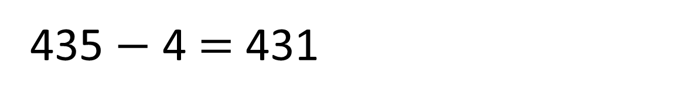
How many pencils will be left?
10 pencils
435 $−$ 4 $=$ 431
100
pencils
100
pencils
10 pencils
100
pencils
100
pencils
10 pencils
I’ve been sent to fetch 4 pencils

Slide 7

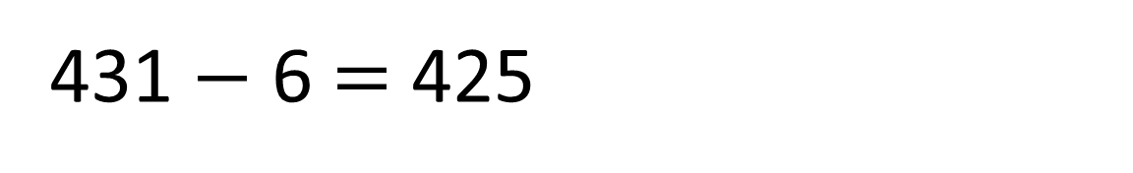
How many pencils will be left?
10 pencils
100
pencils
100
pencils
10 pencils
100
pencils
100
pencils
431 $−$ 6 $=$ 425
10 pencils
Please can I have 6 pencils?

Slide 8




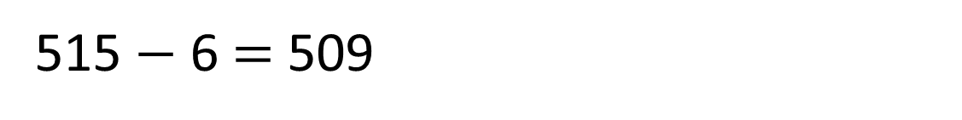
Work out 515 $−$ 6
Hundreds | Tens | Ones
515 $−$ 6 $=$ 509

Slide 9

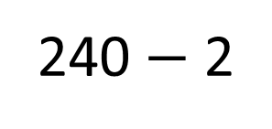
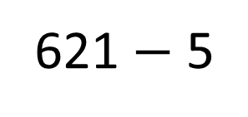
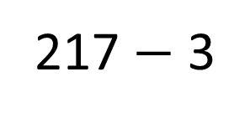
Have a think
217 $−$ 3
621 $−$ 5
240 $−$ 2
Exchange not needed | Exchange needed

Slide 10
Have a go at questions
1 - 3 on the worksheet

Slide 11

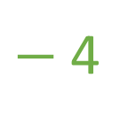

233 – 8
Use 2 jumps on the number line
$−$4
$−$4
223
224
225
226
227
228
229
230
231
232
233
We could jump back 4 and then another 4

Slide 12
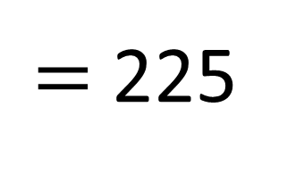
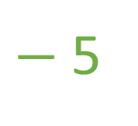
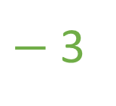
$=$ 225
233 – 8
Use 2 jumps on the number line
$−$5
$−$3
223
224
225
226
227
228
229
230
231
232
233
First jump back 3
Then jump back 5
Oooh now I see what to do.

Slide 13

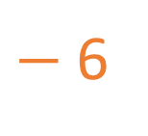
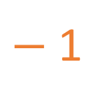
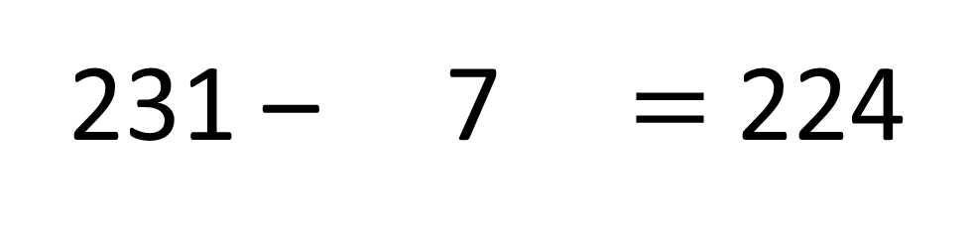
What number is Froggy hiding?
231 – 7 $=$ 224
$−$6
$−$1
223
224
225
226
227
228
229
230
231
232
233

Slide 14
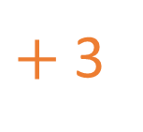

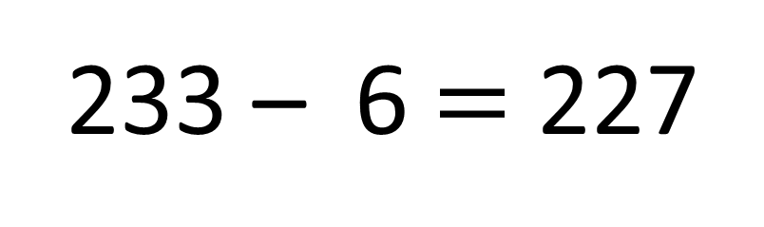
What number is Froggy hiding?
233 – 6 $=$ 227
$+$3
$+$3
223
224
225
226
227
228
229
230
231
232
233

Slide 15
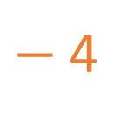

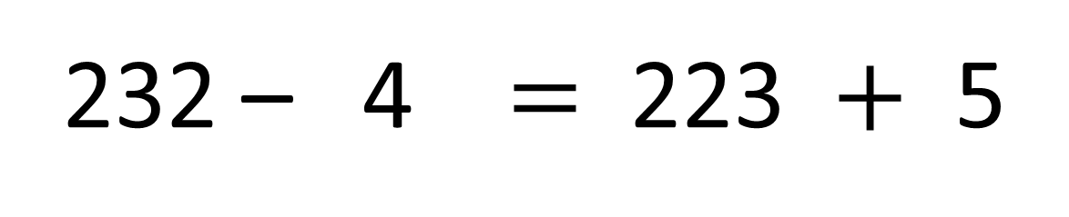
What number is Froggy hiding?
228
228
232 – 4 $=$ 223 $+$ 5
$+$5
$−$4
223
224
225
226
227
228
229
230
231
232
233

Slide 16
Have a go at the rest of the worksheet

