Slide 1


Slide 3
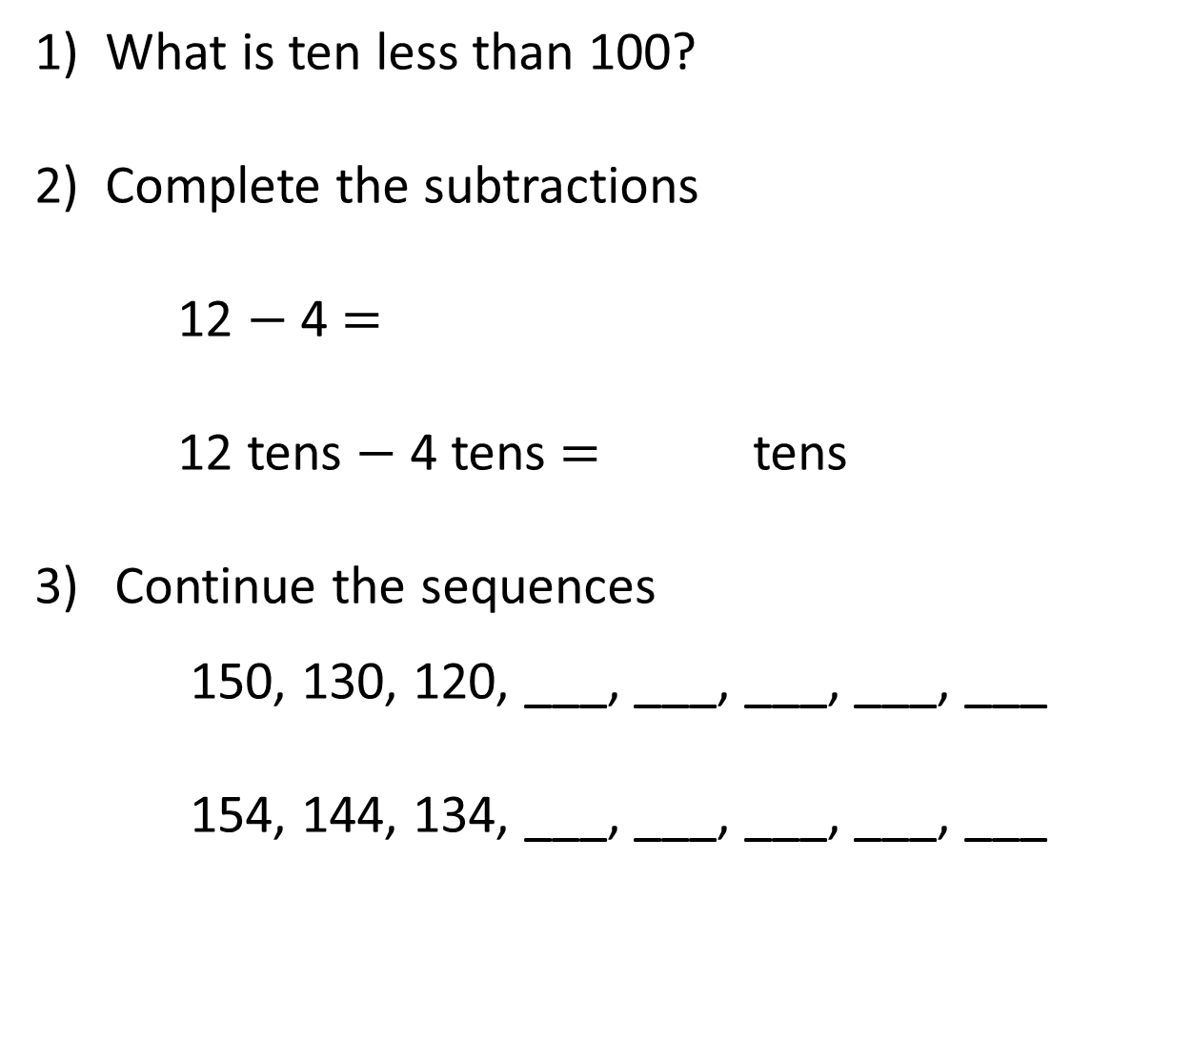
1) What is ten less than 100?
2) Complete the subtractions
12 $−$ 4 $=$
12 tens $−$ 4 tens $=$ tens
Continue the sequences
150, 130, 120, ___, ___, ___, ___, ___
154, 144, 134, ___, ___, ___, ___, ___

Slide 4
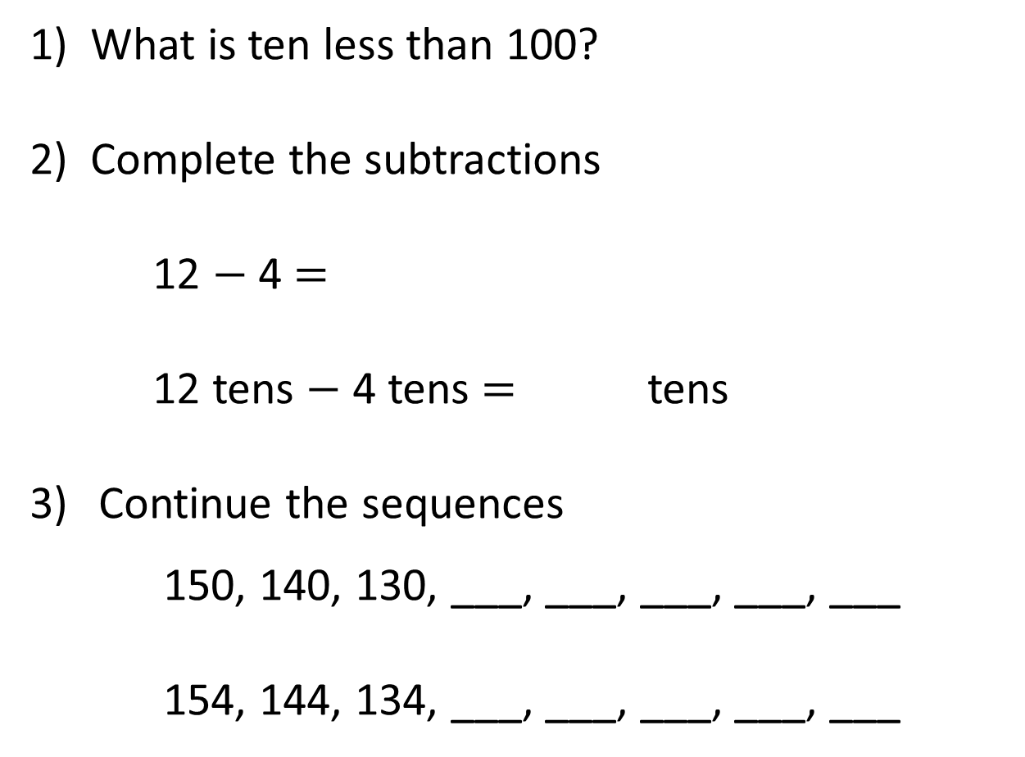
1) What is ten less than 100?
2) Complete the subtractions
12 $−$ 4 $=$
12 tens $−$ 4 tens $=$ tens
Continue the sequences
150, 140, 130, ___, ___, ___, ___, ___
154, 144, 134, ___, ___, ___, ___, ___
90
8
8
120
110
100
90
80
124
114
104
94
84

Slide 6
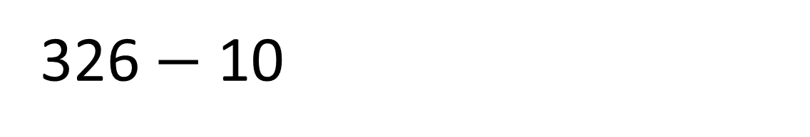
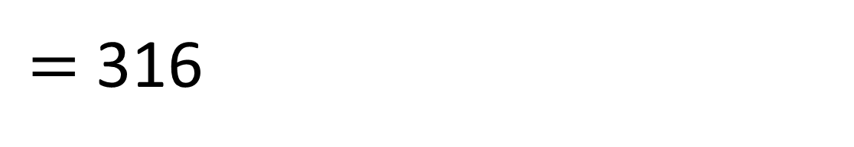
$=$ 316
326 $−$ 10

Slide 7
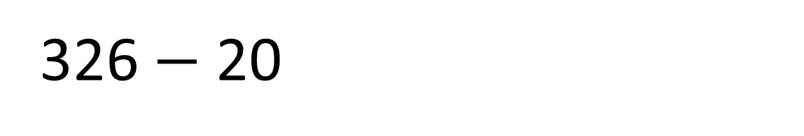
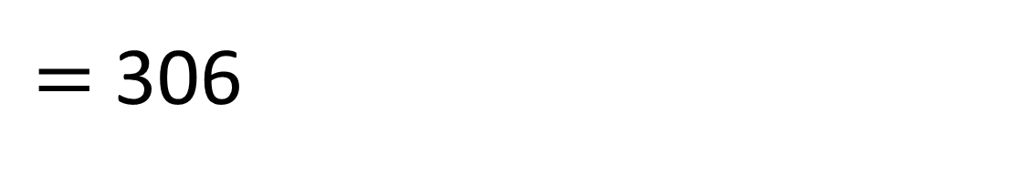
$=$ 306
326 $−$ 20

Slide 8

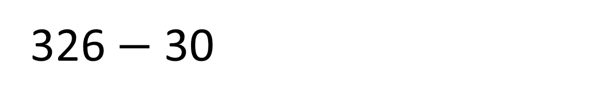
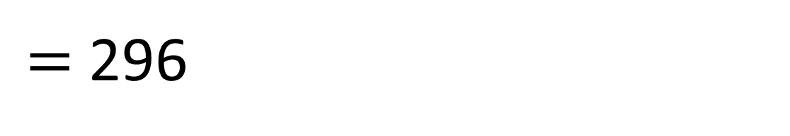
$=$ 296
326 $−$ 30
You can exchange 100 for ten 10s

Slide 9



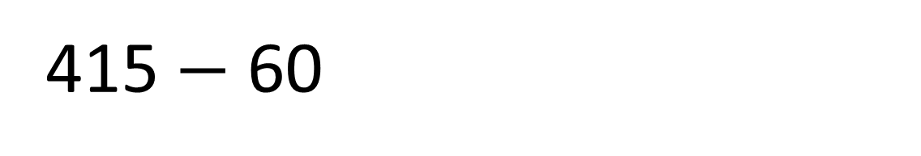
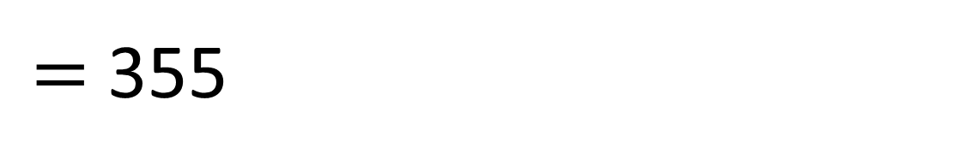
$=$ 355
415 $−$ 60
Hundreds | Tens | Ones

Slide 10

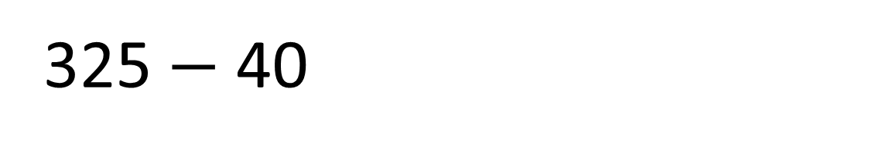
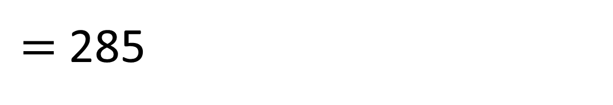
$=$ 285
325 $−$ 40
Have a think
Hundreds | Tens | Ones

Slide 11
Have a go at questions 1 - 4 on the worksheet

Slide 12

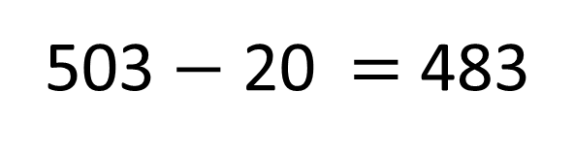
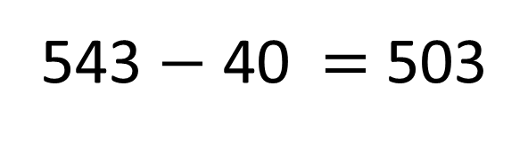
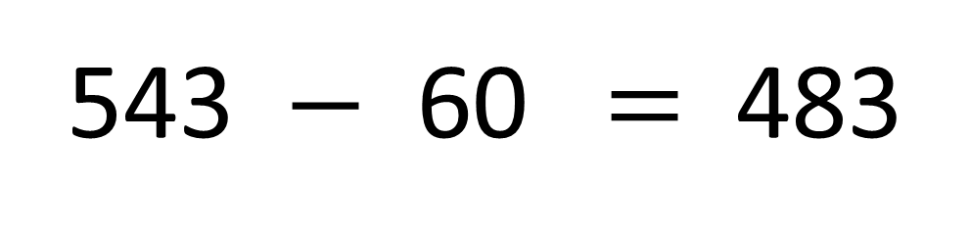
What number is Froggy hiding?
543 $−$ 60 $=$ 483
543 $−$ 40 $=$ 503
503 $−$ 20 $=$ 483
Have a think

Slide 13
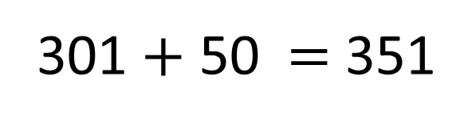
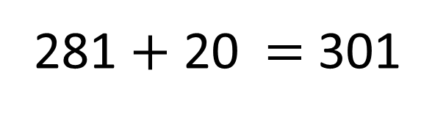
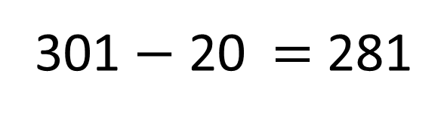
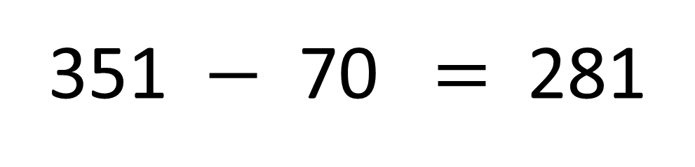
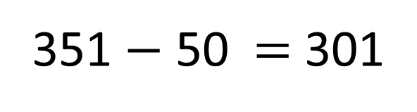
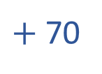
What number is Froggy hiding?
351 $−$ 70 $=$ 281
$+$ 70
281 $+$ 20 $=$ 301
351 $−$ 50 $=$ 301
301 $+$ 50 $=$ 351
301 $−$ 20 $=$ 281
Have a think

Slide 14
Have a go at the rest of the questions on the worksheet

