Slide 1


Slide 3
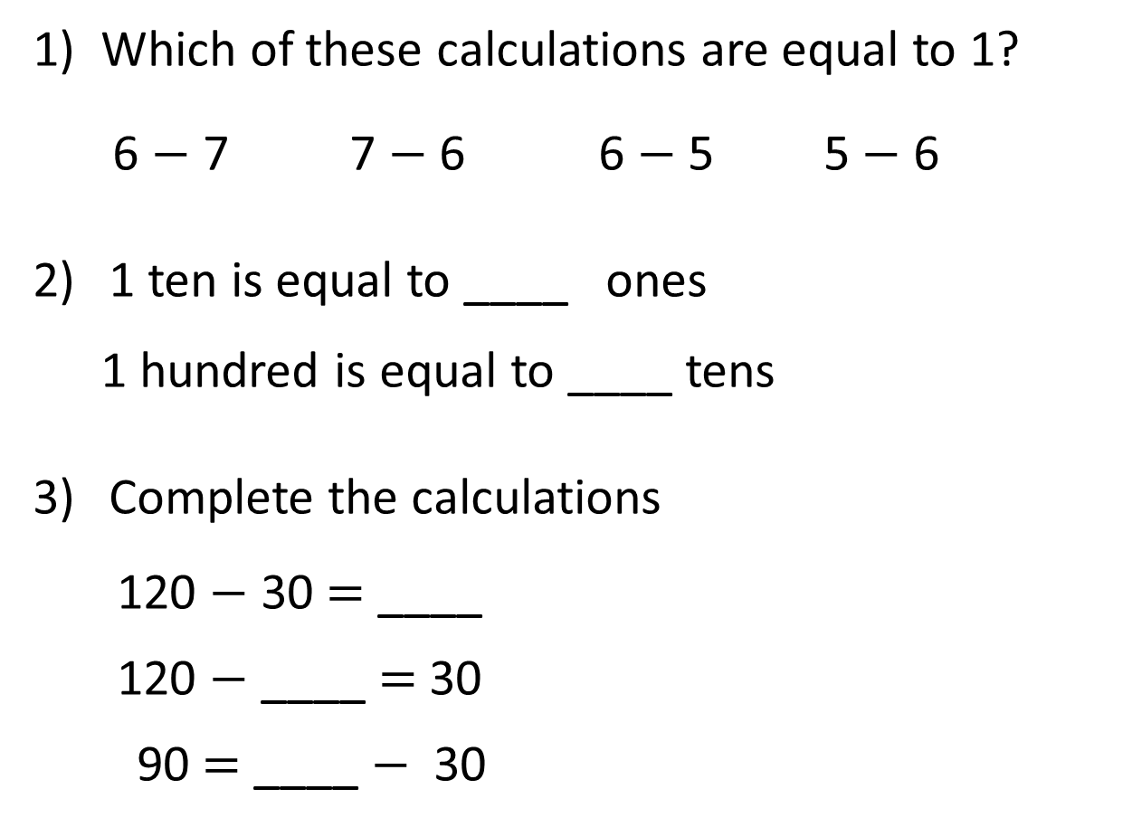
1) Which of these calculations are equal to 1?
6 $−$ 7 7 $−$ 6 6 $−$ 5 5 $−$ 6
1 ten is equal to ____ ones
1 hundred is equal to ____ tens
Complete the calculations
120 $−$ 30 $=$ ____
120 $−$ ____ $=$ 30
90 $=$ ____ $−$ 30
30 | 90
120

Slide 4
1) Which of these calculations are equal to 1?
6 $−$ 7 7 $−$ 6 6 $−$ 5 5 $−$ 6
1 ten is equal to ____ ones
1 hundred is equal to ____ tens
Complete the calculations
120 $−$ 30 $=$ ____
120 $−$ ____ $=$ 30
90 $=$ ____ $−$ 30
10
10
90
30 | 90
120
90
120

Slide 6
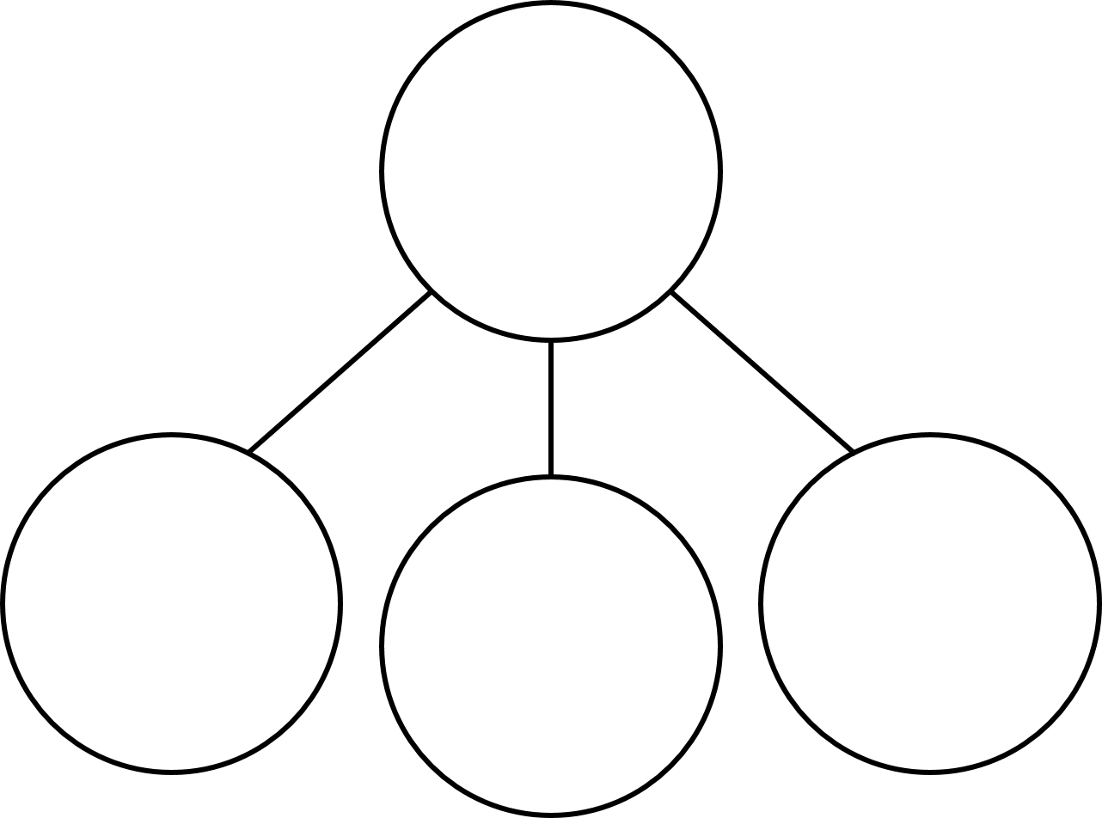

Hundreds | Tens | Ones
H | T | O
3 | 6 | 4
 | 3 | 8
5
1
$$−$$
3
2
6
364
300
50
14

Slide 7


Hundreds | Tens | Ones
H | T | O
2 | 1 | 1
 | 6 | 5
1
1
0
1
$$−$$
1
4
6
Have a think
Notes:
Can we simplify?
Discuss reduction structure – take away

Slide 8

Hundreds | Tens | Ones
H | T | O
2 | 0 | 4
 | 2 | 5
9
1
1
1
$$−$$
1
7
9
Notes:
Can we simplify?
Discuss reduction structure – take away

Slide 9
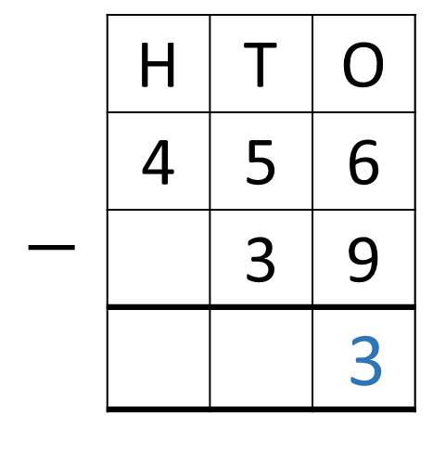
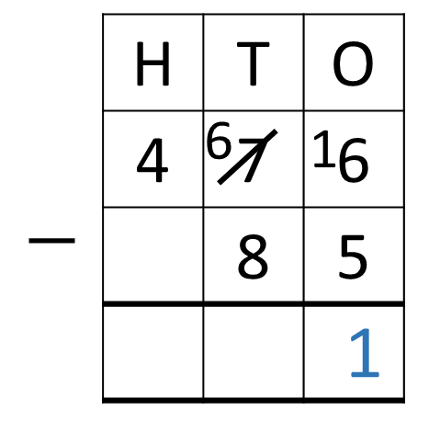
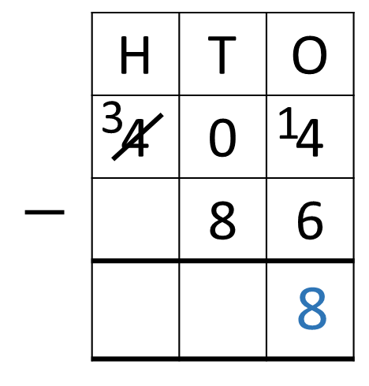
Have a think
Notes:
Can we simplify?
Discuss reduction structure – take away

Slide 10
Have a go at questions 1 – 3 on the worksheet
Notes:
Can we simplify?
Discuss reduction structure – take away

Slide 11





How much more money does Whitney have than Ron?
?
Ron
£42
Whitney
£117
H | T | O
1 | 1 | 7
 | 4 | 2
Whitney has £75 more
0
1
$$−$$
$$−$$
£42
$$−$$
7
5
£117

Slide 12
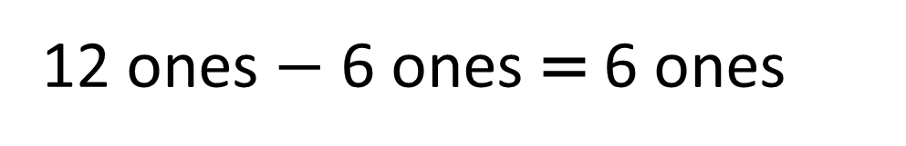
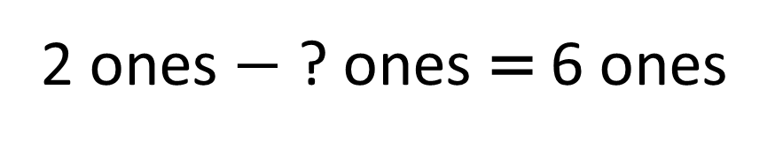

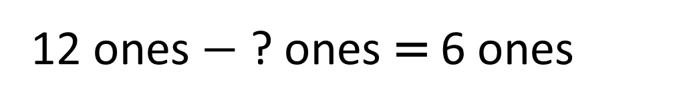
H | T | O
 | 3 | 2
 | 2
5 |  | 6
5
2
1
$$−$$
6
1
0
12 ones $−$ ? ones = 6 ones
2 ones $−$ ? ones = 6 ones
12 ones $−$ 6 ones = 6 ones

Slide 13
Have a go at the rest of the questions on the worksheet
Notes:
Can we simplify?
Discuss reduction structure – take away

