Slide 1
18/12/2020
L.I: To Divide by 8

Slide 3
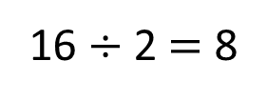
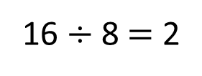
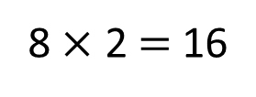
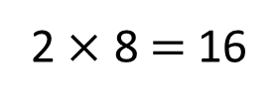
Here is an 8 by 2 array
1) Draw an 8 by 4 array
2) How many counters are there in your array?
3) Write 2 multiplication equations to match your array.
4) Write 2 division equations to match your array.
2 $×$ 8 $=$ 16
8 $×$ 2 $=$ 16
16 $÷$ 8 $=$ 2
16 $÷$ 2 $=$ 8

Slide 4
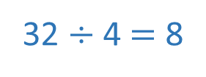
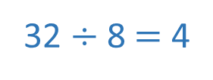
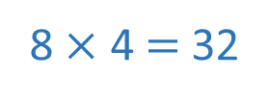
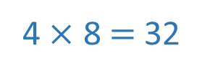
Here is an 8 by 2 array
1) Draw an 8 by 4 array
2) How many counters are there in your array?
3) Write 2 multiplication equations to match your array.
4) Write 2 division equations to match your array.
2 $×$ 8 $=$ 16
8 $×$ 2 $=$ 16
16 $÷$ 8 $=$ 2
16 $÷$ 2 $=$ 8
32
4 $×$ 8 $=$ 32
8 $×$ 4 $=$ 32
32 $÷$ 8 $=$ 4
32 $÷$ 4 $=$ 8

Slide 6




Here are 24 flowers.
How could we divide the flowers by 8?
Have a think
We could share the flowers equally between 8 pots.
We could group the flowers into pots of 8

Slide 7

There are 3 flowers in each pot.
24 $÷$ 8 $=$ 3
The flowers are shared equally between 8 pots.
How many flowers will be in each pot?

Slide 8

The flowers are grouped into pots of 8
How many pots can we fill?
There are 3 pots of 8
24 $÷$ 8 $=$ 3

Slide 9
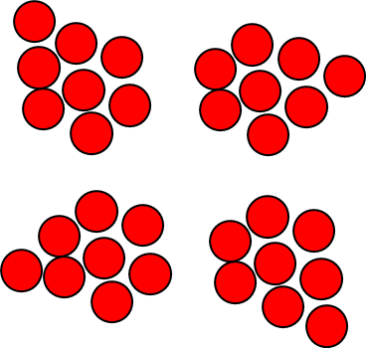
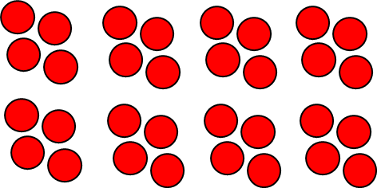
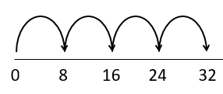
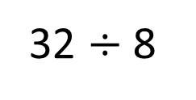
Shared into 8 equal groups
32 $÷$ 8
Grouped
into 8s
8 | 8 | 8 | 8
4 | 4 | 4 | 4 | 4 | 4 | 4 | 4

Slide 10





48 children go camping.
Each tent holds 8 children.
How many tents are needed?
Have a think
1 tent 8 children
2 tents 16 children
3 tents 24 children
4 tents 32 children
8
16
24
32
40
48
5 tents 40 children
6 tents 48 children
0
8
16
24
32
40
48
How could you represent this problem?

Slide 11
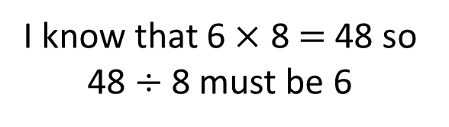
48 children go camping.
There are 8 tents.
How many children will sleep in each tent?
Have a think
I know that 6 $×$ 8 $=$ 48 so 48 $÷$ 8 must be 6
48
6 | 6 | 6 | 6 | 6 | 6 | 6 | 6
How could you represent this problem?

Slide 12


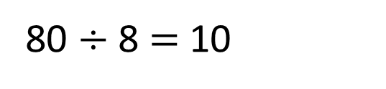






To divide by 8, take the number you are dividing and divide it by 2 four times.
80 $÷$ 8 $=$ 10
Have a think
80
$÷$ 2
40
$÷$ 2
20
$÷$ 2
10
$÷$ 2
$÷$ 2
$÷$ 2
I think you only need to divide by 2 three times.

Slide 13
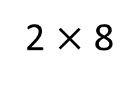
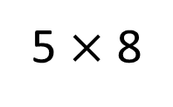
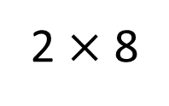
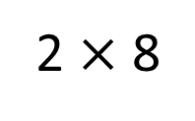
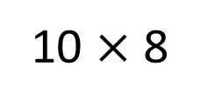
One of these numbers will not divide exactly by 8
16
56
86
96
2 $×$ 8
80
6
40
16
80
16
5 $×$ 8
2 $×$ 8
10 $×$ 8
2 $×$ 8
Have a think

Slide 14
Have a go at the questions on the worksheet

