Slide 1
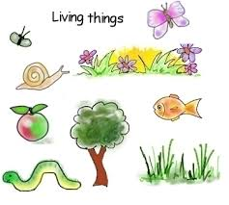

ANIMALS INCLUDING HUMANS
LI :To identify that animals, including humans, need the right types and amount of nutrition.
.

Slide 2
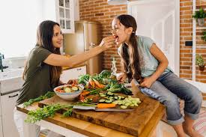
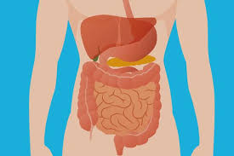
NUTRITION
Nutrition is the process of eating and digesting.
Nutrients are the foods we eat and our body absorbs to be healthy.
Why do we eat? To create glucose (a kind of sugar)for Energy.
The Digestive System

Slide 3
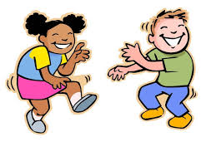



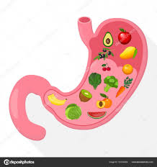
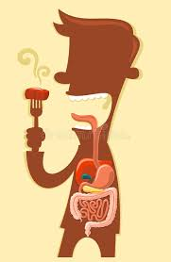
ENERGY
What do animals use energy for?
The body converts food to energy through digestion and chemical processes called Metabolism!
Moving
Maintaining Temperature
Growing
Digestion

Slide 4
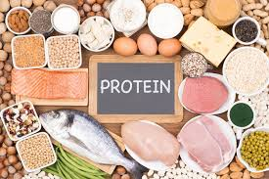

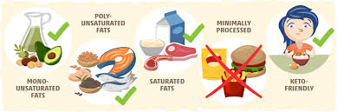
NUTRITION
What are the macronutrients?
What foods can you see?

Slide 5

How do Macronutrients help us?
Click to find out!

Slide 6
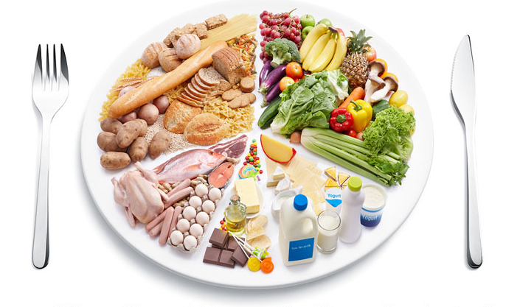
NUTRITION
How do we balance our diet so that we are healthy?
Click the plate to find out!

Slide 7
NUTRITION
How do we balance our diet so that we are healthy?
Click the plate to find out!

Slide 8
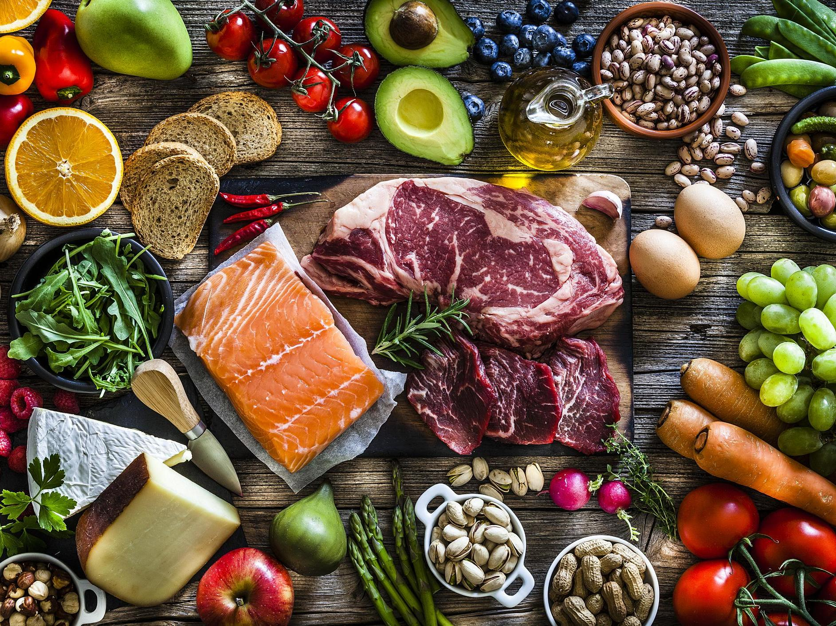


TASK: What’s on your plate?
Draw a food plate and fill it with examples of different types of healthy macronutrients. Show the portions for a balanced diet and give reasons why it is healthy example.

Slide 9
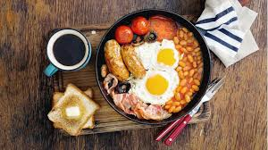

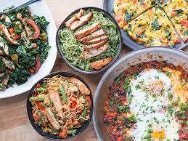

Tell the class
What did you have for breakfast or lunch today?
What macronutrients did it have?
Was it healthy? Why? Why not?
Discuss how healthy your last meal was.

Slide 10
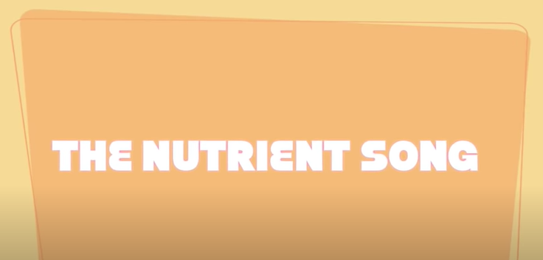
How do Macronutrients help us?
https://encrypted-tbn0.gstatic.com/images?q=tbn:ANd9GcQhJdAWl6NKHXN7pjBTqnFiLQ-pb3KQtSkzkw&usqp=CAU

