Slide 1
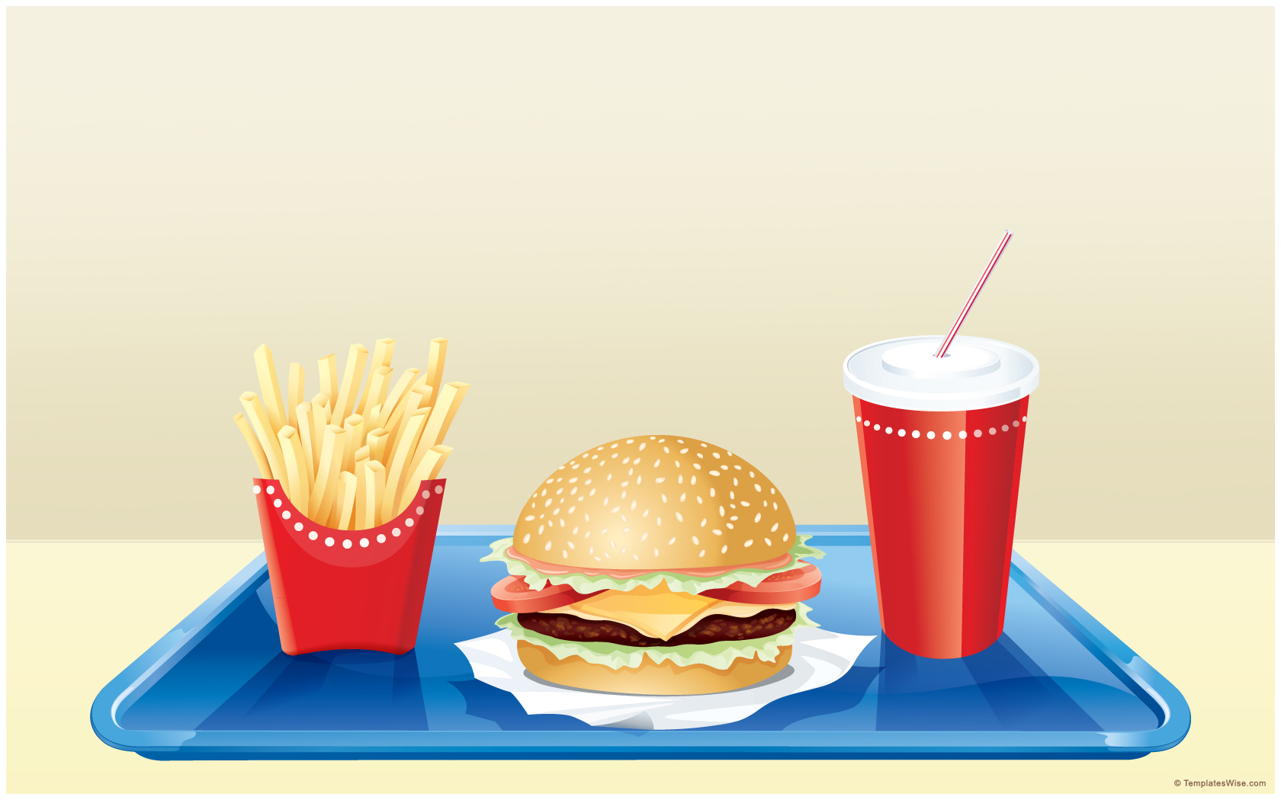

Teeth and Eating
Learning Objective
To sort foods into groups

Slide 2




Steps to Success
3) Know the names of the main food groups.
2) Understand what foods are unhealthy.
1) Think of ways we can group food.

Slide 3

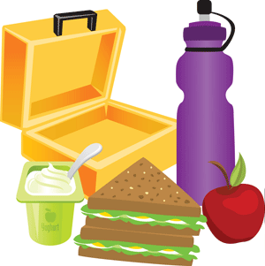

What’s in your lunch box?
Can you put the foods on your table into groups?
Like / Dislike
Hot / Cold
Soft / hard
Can you spot anything unhealthy?

Slide 4

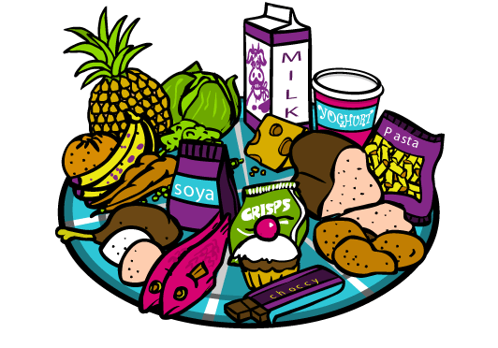

Food Groups
Here’s another way of grouping foods:
Click me to learn more
Click the plate
to learn more

Slide 5

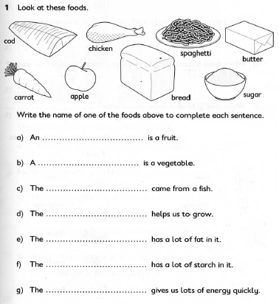
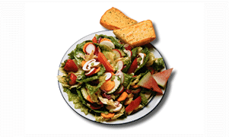
Your task
1) Complete these questions:
2) Click the plate to check your knowledge.

Slide 6

Final thing
Click the bowl to see the food groups

