Slide 1
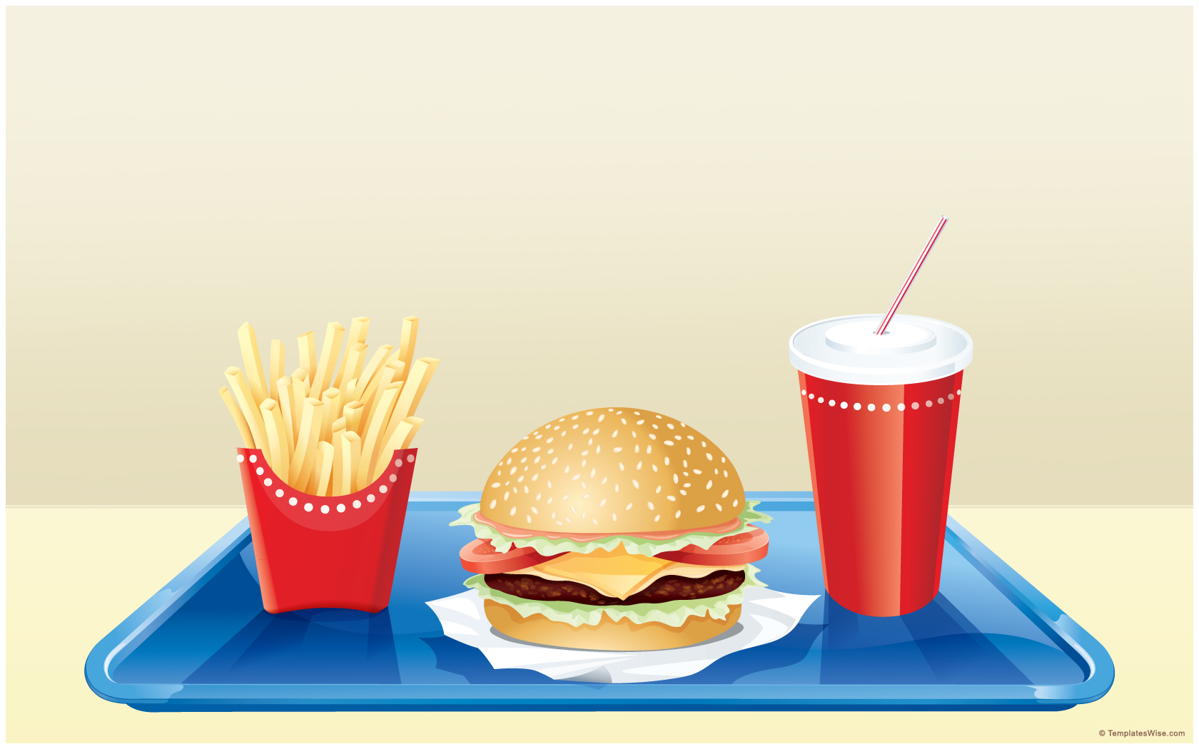
Teath and Eating
Learning Objective
To identify what different animals eat?

Slide 2




Steps to Success
3) Link animals to the type of food they eat
1) Know if all animals eat the same things
2) Say what you think different animals eat.

Slide 3


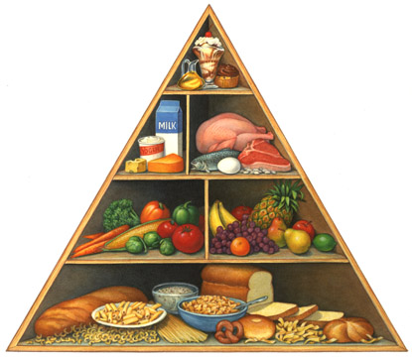
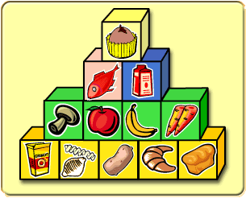
Click on a pyramid to review your knowledge?

Slide 4


What pets do you
have at home?
Carnivore | Herbivore | Omnivore

Slide 5

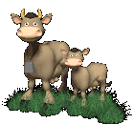
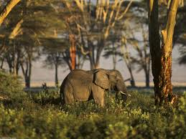
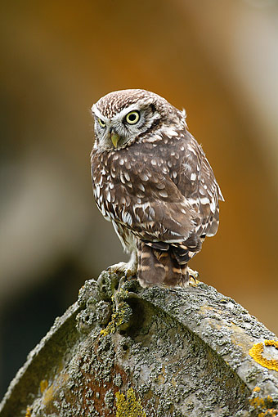
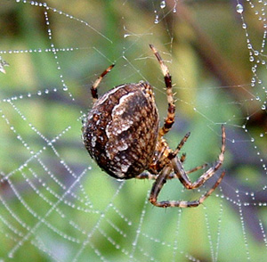
What about these animals?
Click here for a trip to the zoo
What do you think they eat?

Slide 6
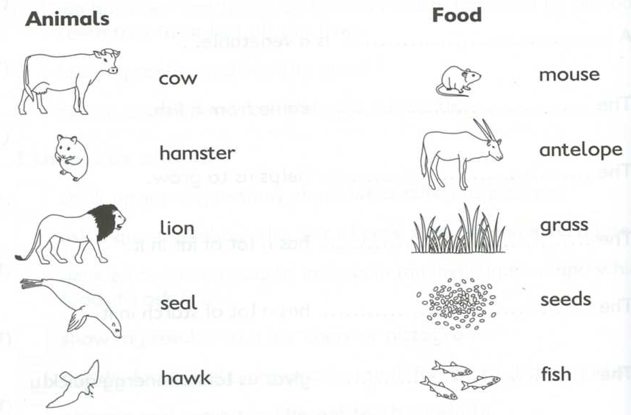

Your task
Extension: Click me to see some more
Match the animal to its food

