Slide 1
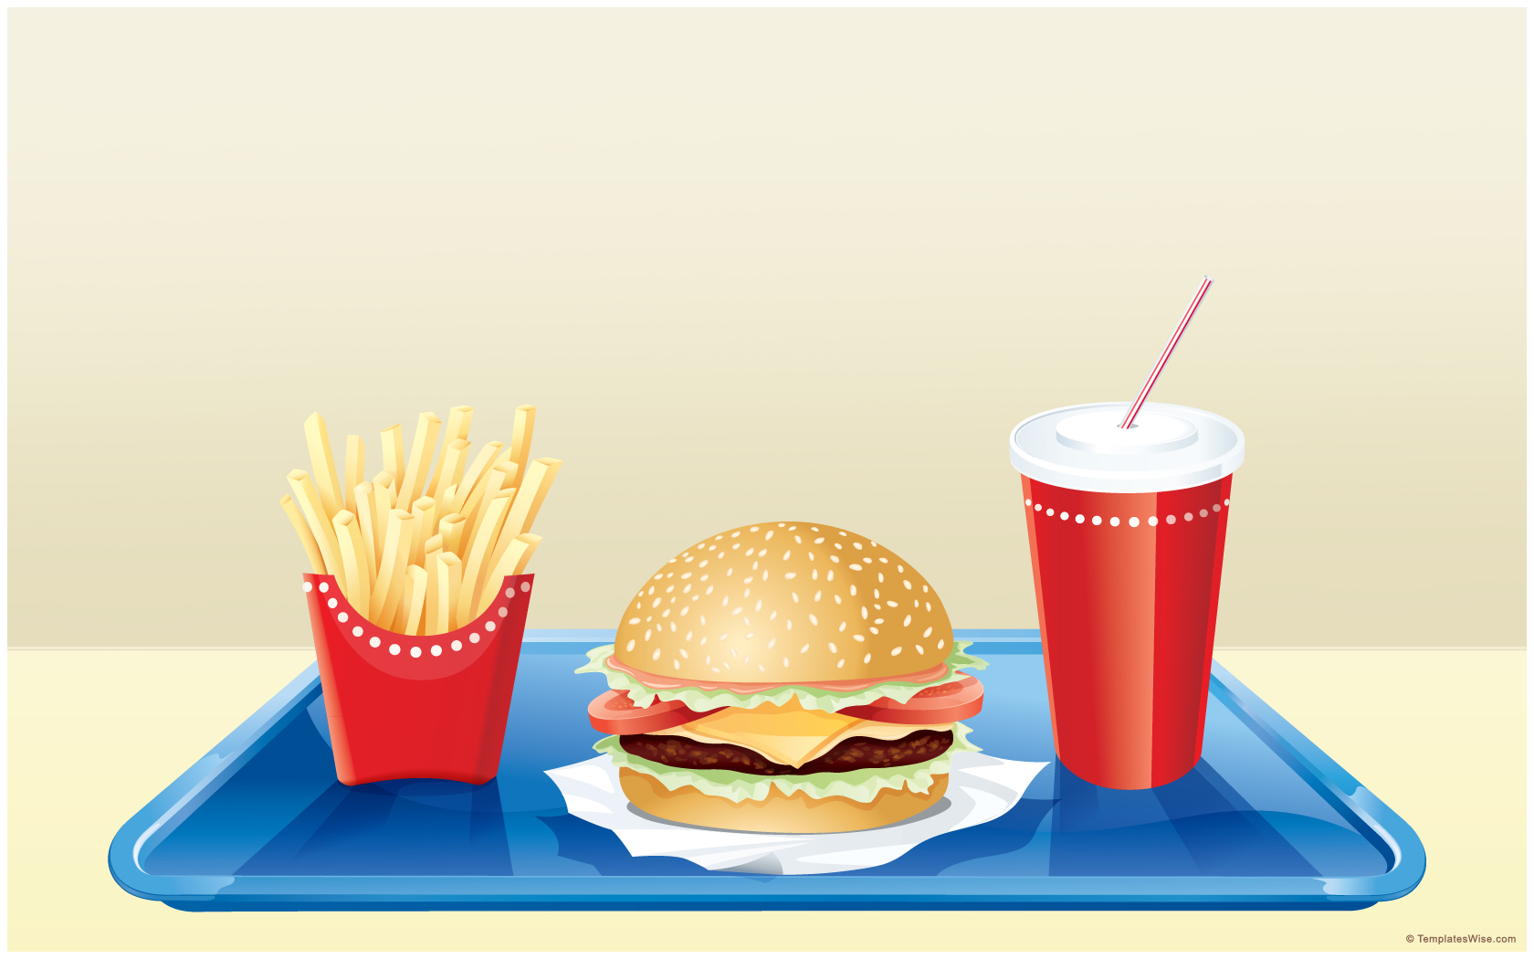
Teeth and Eating
Learning Objective
To Investigate animal foods

Slide 2




Steps to Success
2) Ask questions and record answers.
1) Think about what animals eat.
3) Create a graph using recorded answers.

Slide 3



He looks hungry! What do animals eat? Click on him to find out!

Slide 4

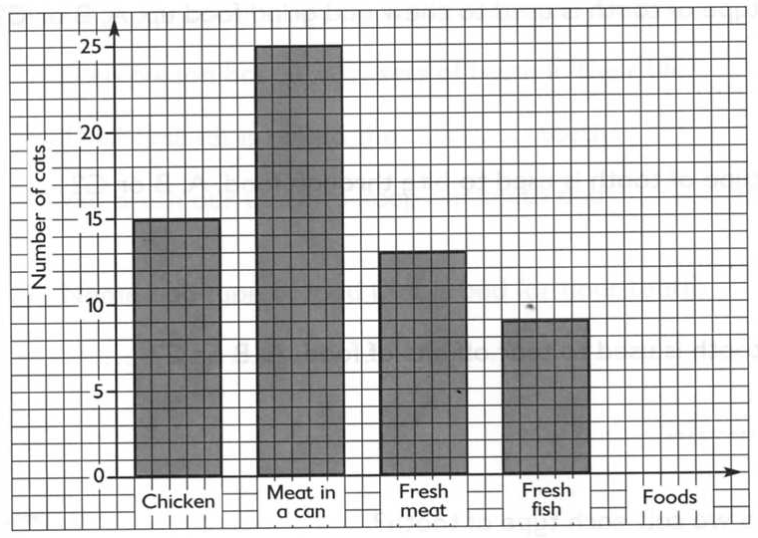
A cats favourite food?
How many more
votes for meat in a
can than fresh meat?
What is the cat’s
favourite food?
What is the difference
between chicken and fish?
What is the least
favourite food?

Slide 5

What does a ____ like to eat?
Find out what 12 children think about your animal’s food?
Type of food | Number of votes

Slide 6
Making a graph
Complete the graph

