Slide 1
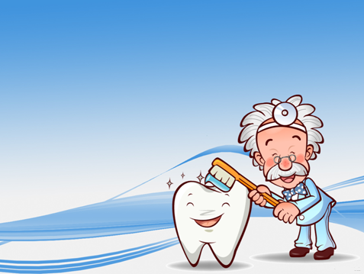
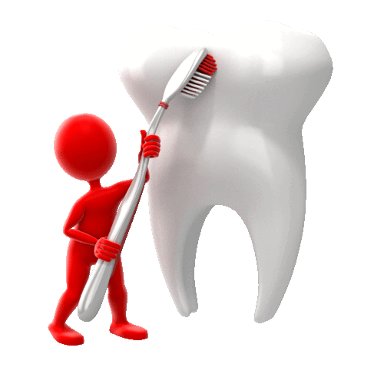
Teeth and Eating
To know what types of
teeth we have?

Slide 2




Steps to Success
1) To know how many sets of teeth we have.
2) To know the names of each set.
3) To know what types of teeth we have.

Slide 3
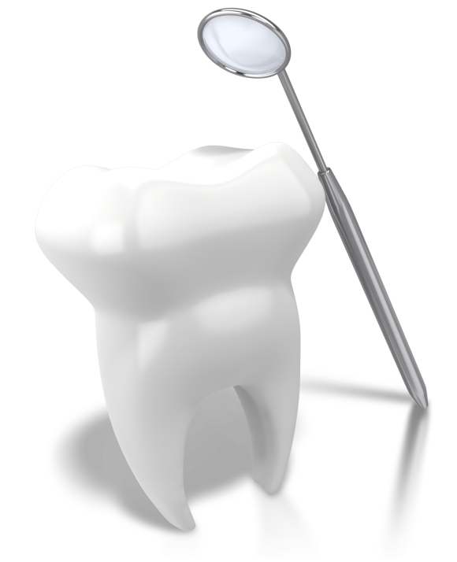
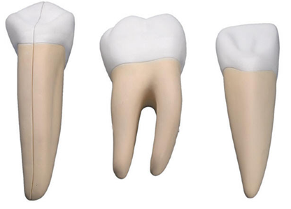

What’s in your mouth?
Where do you
see these teeth?
Use a mirror to look
in your partners mouth!
Do all the teeth
look the same?

Slide 4
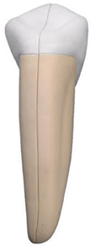
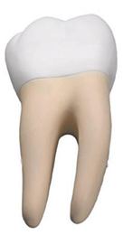

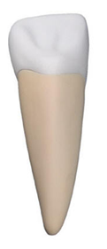
Match the name
to the tooth?
Click the molar to find out more!
Incisor
Canine
Molar

Slide 5
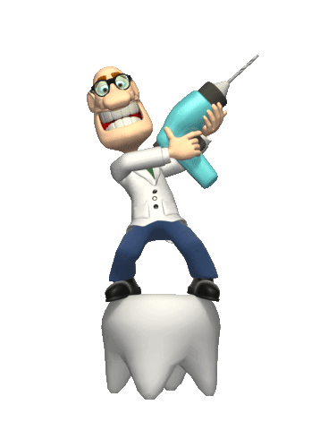
Your Task
Click here for
a little extra
Humans have ________ sets of teeth in their lifetime.
The first set of teeth is called ____________________ and there are a total of ________.
The second set of teeth is called ____________________. This set has up to ________ teeth.
There are _____ main types of teeth. These are called
____________________________
____________________________
____________________________
Use the words in the box to help!

Slide 6

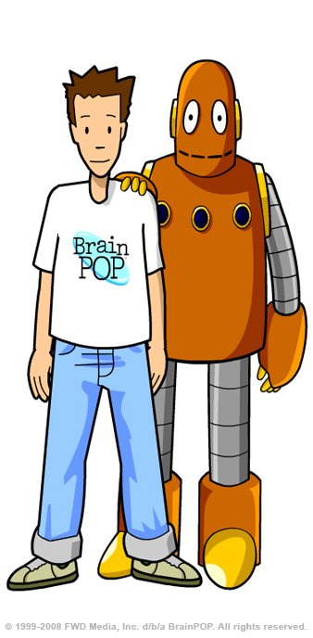

Final thing
Some animals have teeth that grow back all the time!
Why is that helpful?
Click us to learn more!

