Slide 1
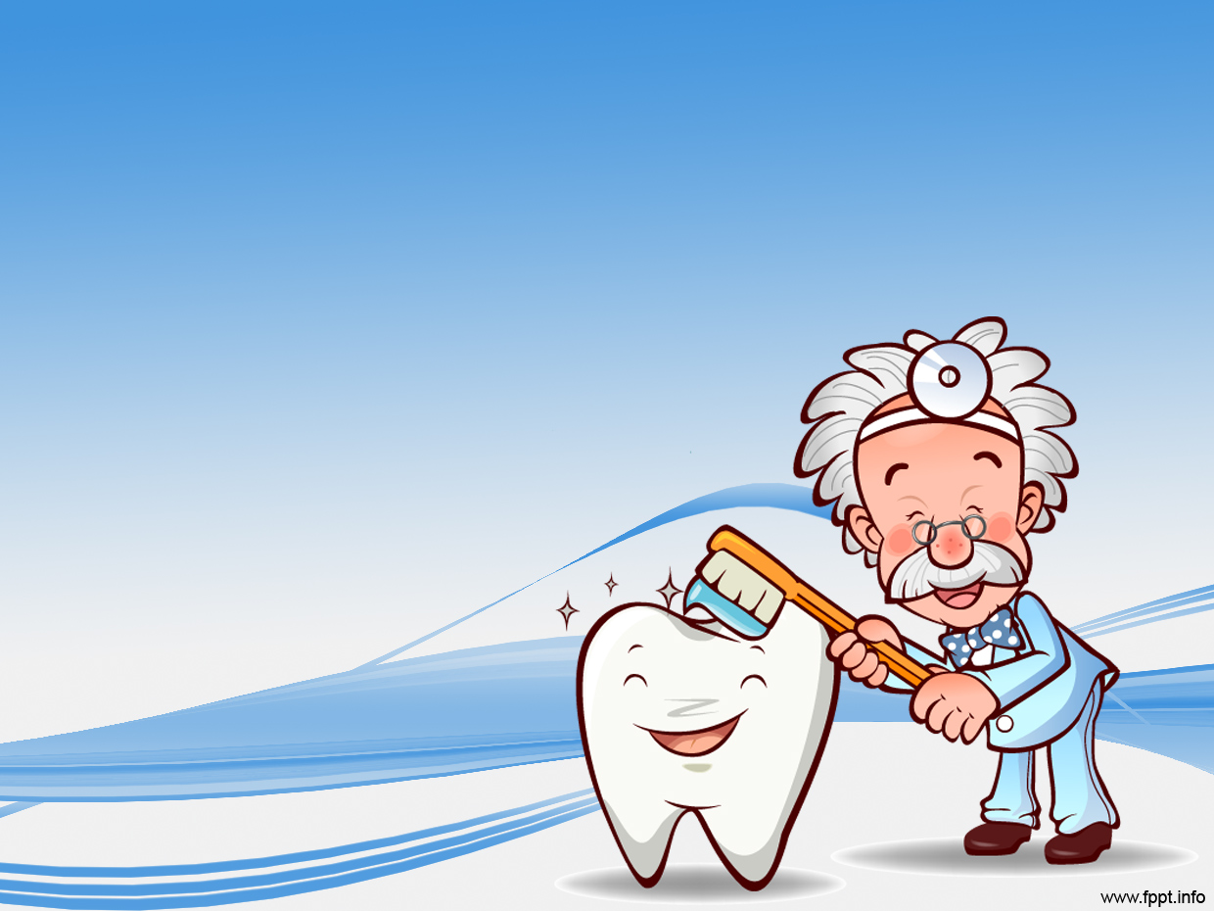
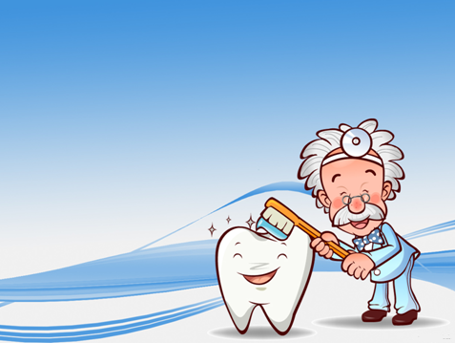
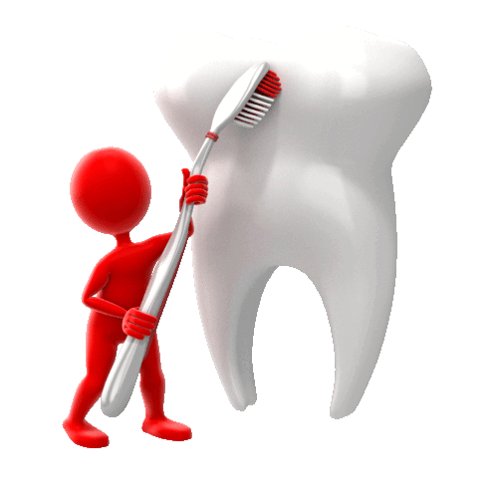
Teeth and Eating
To know what different teeth do.

Slide 2




Steps to Success
3) To explain why each tooth is a different shape.
1) To know the name of each tooth type.
2) To understand what each tooth does.

Slide 3

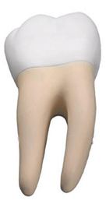
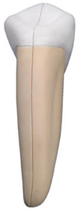
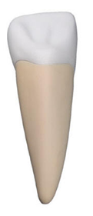
Can you remember?
Who can give a tooth name without using your eyes and the feely bag?
How many different types of teeth do we have?
What are their names?
Can you join them?
Incisor
Canine
Molar

Slide 4



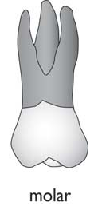
But what do they do?
This tooth helps us to tear things! They are responsible for ripping the food.
Cut and paste each tooth and join it to it´s job.
Can you match each tooth to what it does?
These grind the food. They are responsible for chewing up food to make it easier to swallow.
These teeth cut food. They are responsible for slicing through food to help put it in our mouth.

Slide 5
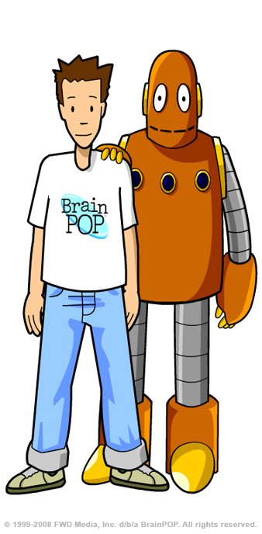
Final Thing
Click us to see the rest!
Draw a cartoon strip to show how a child loses a milk tooth. The last picture should show what has happened a few weeks later.
1
2
3
4

