Slide 1
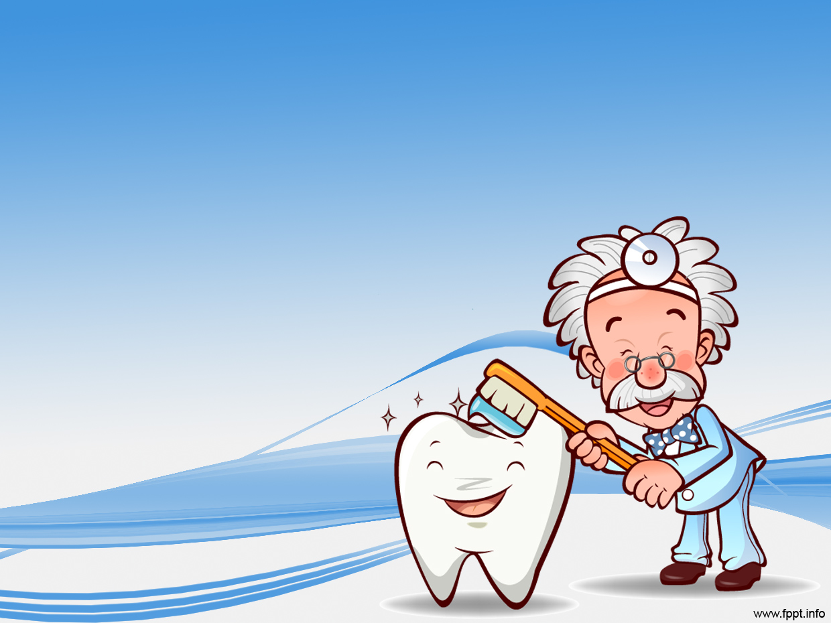
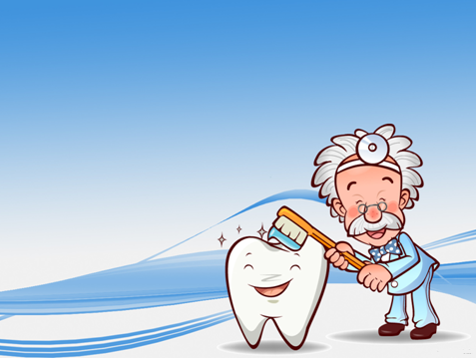
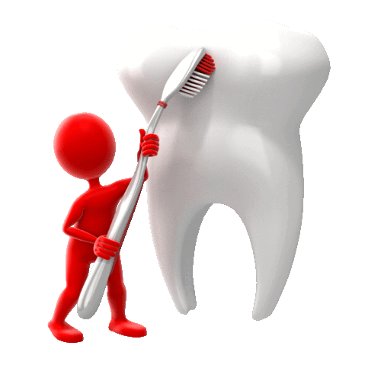
Teeth and Eating
To know how to take care of teeth

Slide 2




Steps to Success
1) To know things that can help protect teeth.
2) To understand why keeping teeth healthy is important.
3) To create a model set of adult teeth.

Slide 3
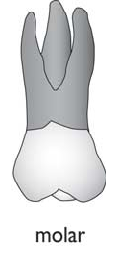


Can you remember?
This tooth helps us to tear things! They are responsible for ripping the food.
These tear grind the food. They are responsible for chewing up food to make it easier to swallow.
These teeth cut food. They are responsible for slicing through food to help put it in our mouth.

Slide 4
True or false?
It’s ok to lose an adult tooth because another will grow!
When we eat food some stuff called plaque stays on our teeth.
If we get a hole (cavity) in our teeth it will heal itself
If we do not brush our teeth then they get dirty.
We must clean the front and back of our teeth to keep them healthy.

Slide 5
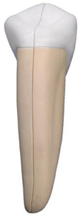
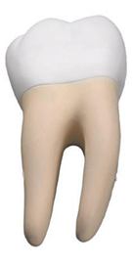
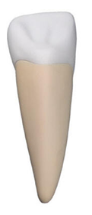


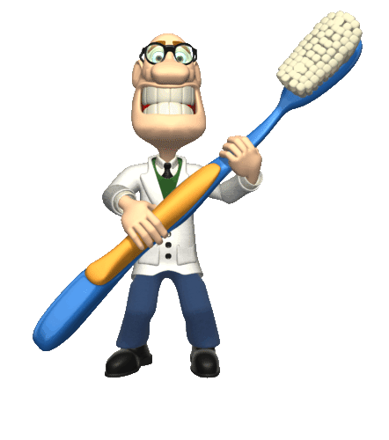
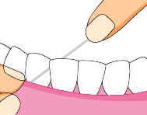
How can we protect them?
Click the incisor to find out more
Mouthwash
Brushing
Flossing

Slide 6
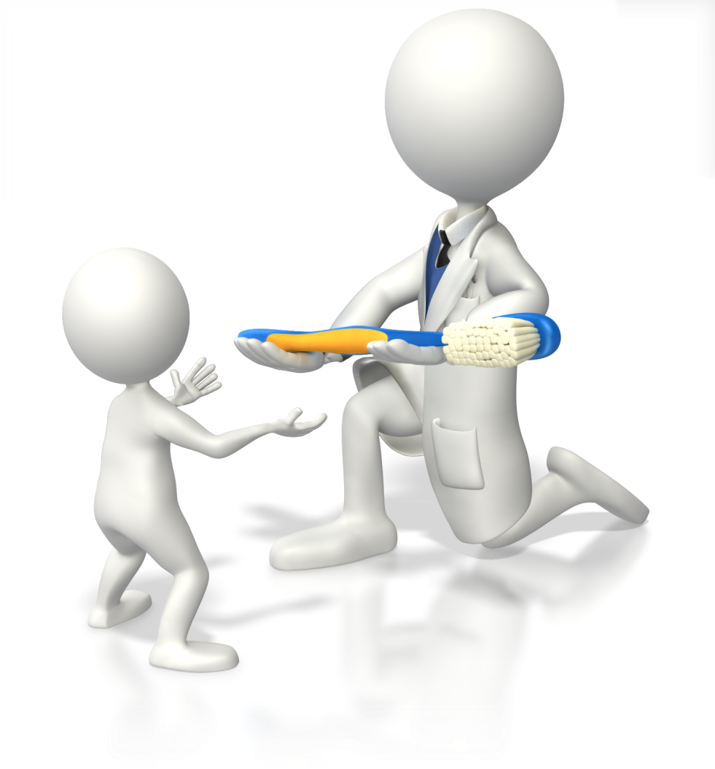
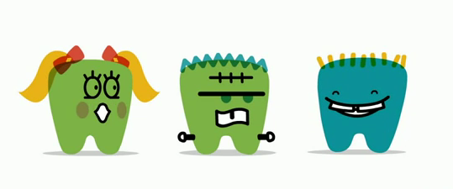
Let´s practice
Time to brush, floss and use some mouthwash!
Click us for a little brushing information!

