Slide 1


KS2 Cross-curricular Task
Commissioned by The PiXL Club Ltd.
February 2018
This resource is strictly for the use of member schools for as long as they remain members of The PiXL Club. It may not be copied, sold nor transferred to a third party or used by the school after membership ceases. Until such time it may be freely used within the member school.
All opinions and contributions are those of the authors. The contents of this resource are not connected with nor endorsed by any other company, organisation or institution.
© Copyright The PiXL Club Limited, 2017

Slide 2
Year 3 & 4 WORKING SCIENTIFICALLY
Assessment Focus
1d. I can set up simple practical tests.
1k. Report on findings using written methods.
1p. I can evaluate by suggesting a simple improvement.
1q. I can raise further questions.

Slide 3
Year 3 & 4 WORKING SCIENTIFICALLY
Assessment Focus
1b. I can explain my predictions with an explanation using scientific concepts.
1g. I can select the appropriate equipment for an investigation.
1l. I can present my findings in a variety of different ways.
1o. I can use test results to make predictions to set up further comparative.

Slide 4
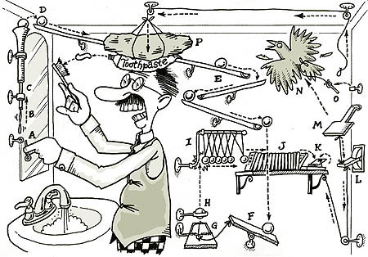
Science Task
Design and build a crazy contraption.
Build together to make an amazing device to creatively solve the challenge and be part of an amazing invention.

Slide 5

What is Mission Possible?
What is Mission Impossible?
Design, build and test a Rube Goldberg-like device.
The device will be made of a series of consecutive tasks.
The device must run on its own.
Have a specific start and end task.
Click here to see a ‘Rube-Goldberg’ machine in action
https://www.chroniclelive.co.uk/news/motoring/motoring-features/inside-greatest-car-adverts-hondas-9906371
5

Slide 6
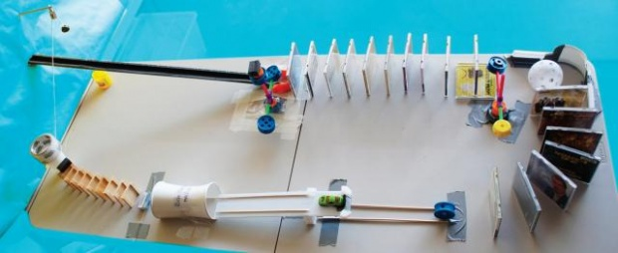
Requirements
Maximum Size of Machine (100cm x 100cm x 100cm).
Start and finish tasks required.
Earn extra points by adding other tasks.
6

Slide 7

Requirements - Start Task
Device must be started by:
dropping a ball from above the device
that will begin the chain of events leading to the final task.
7

Slide 8

Requirements - Final Task
Raise a flagpole:
With rectangular flag that is at least 5 cm x 10 cm.
The bottom of the flag must be at least 30 cm higher than all original parts of the device.
8

Slide 9
Device Operation - Timing
Timing begins when ball dropped into device to start.
Clock does not stop until maximum time limit of 3 minutes.
Tasks completed after 3 minutes will not be allowed.
Timing stops when:
Device fails to operate;
Device completes final task;
3 minutes have elapsed.
9

Slide 10
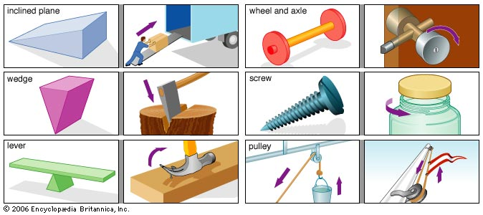
Tips
Plan your machine on paper first!
Begin with the last step and work backwards.
Play with the stuff and see what you can knock over or make happen.
Don’t worry if an idea seems crazy…Try it out! The idea is to look at it in a new way.
Gravity is your friend…Use it!
Remember levers, gears, wheels, pulley…

Slide 11

Judging will be based on 100 points scoring system:
Complete first and final task (10).
Additional steps to your machine (up to 8 more can be added to the first and final task) (10 marks per step).
Objects leaving machine (-5).
Creativity using scientific and mathematic knowledge and skills (0 -10).

Slide 12

Writing Task

Slide 13

LORIC
Our Primary Edge attributes help us to become better learners and today is no exception.
Command words:
Create
Communicate clearly
Convince
Persuade

Slide 14


Developing Communication Skills
Use this activity to help children develop their communication skills before you begin the task.
Match It!
Have a list (or a set of cards) of science key words relating to working scientifically.
The first person chooses one of these and has to match it with its definition and see how many they can get in 30 seconds. Swap over and see who is the quickest.

Slide 15

3c. Can select and use the appropriate structure and features for a text type.
Writing Task
Using your findings
write a scientific recount for an exhibition showcasing your invention.

Slide 16
3c. Can select and use the appropriate structure and features for a text type.
Key questions before writing:
What is the PURPOSE of my writing?
Who is the AUDIENCE for my writing?
How will I ORGANISE it?
How will I make it ENGAGING for the reader?

Slide 17
Your turn: Look at the text below and highlight the features of a report:
What happens when vinegar is put on rock?
My results show me that fizzing only occurs with those minerals that contain chalk, marble or limestone. The results also show that it doesn’t matter what type of vinegar you use.
I conclude that chalk, limestone and marble react with vinegar to produce a fizz. You could use vinegar to test whether rocks contain these or not.
Clear chronological order
Past tense
Technical vocabulary
Diagrams and pictures
First person

Slide 18
3c. Can select and use the appropriate structure and features for a text type.
Structure
Introduction to problem
Section 1: Materials
Section 2: Procedure
Section 3: Analysis of results
Project conclusion
Greater Depth
Can you include an informal paragraph to contrast with the formality of your text?
Greater Depth
Can you use a range of punctuation to add detail and clarify meaning?
Remember to make sure you use accurate punctuation to communicate your ideas clearly!

Slide 19
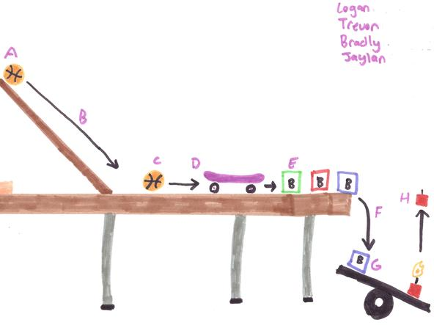
Support Mat: Sentence openers and scientific vocabulary.
Sentence Openers
To begin with . . .
As a result of . . .
Consequently . . .
Subsequently . . .
As a result of …
Because …
First . . .
Next . . .
After . . .
Meanwhile . . .
Finally . . .
Scientific Vocabulary
accuracy
gravity
friction
energy transfer
balanced forces unbalanced forces
pulley
gears
levers
pivots
increase
decrease

Slide 20

Maths Task

Slide 21
LORIC
Our Primary Edge attributes help us to become better learners and today is no exception. Before you start this activity, here are some ideas for how you will need your skills today: Olly Organisation.
Command words:
Plan Systematic
Create Organise
Construct Methodical

Slide 22

Developing Organisation Skills
Use this activity to help children develop their organisational skills before you begin the task.
Order! Order!
Give pupils a list of decimal values (vary the number of places according to ability). Can you organise them into ascending/descending order in 1 minute?
Sort It!
Give the children a list of steps to draw a graph and get them to put them in the appropriate order in two minutes.
or

Slide 23
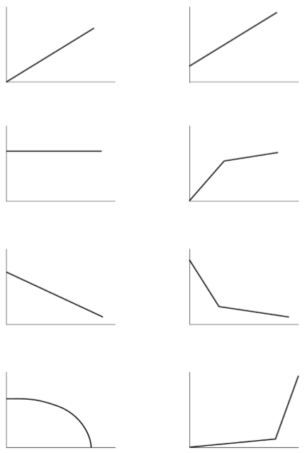
11b. Can construct and interpret line graphs.
Discussion
Could you tell the story of these lines?
Discussion
What is missing?

Slide 24
11b. Can construct and interpret line graphs.
Distance travelled by toy car down a ramp
What is the graph telling you?
How do you know?
Will the times continue to get faster or is there a limit? What is that limit?

Slide 25
11b. Can construct and interpret line graphs.
Distance travelled by toy car down a ramp
Use the graph to answer these questions:
What was the distance at 2 seconds?
How long did it take to travel 12 metres?

Slide 26
11b. Can construct and interpret line graphs.
Distance travelled by toy car down a ramp
Discussion
What would be on your checklist for drawing a line graph?

Slide 27
11b. Can construct and interpret line graphs.
Check list for a line graph
Axes labelled at regular intervals.
Axes labelled with units of measurement.
Points plotted precisely.
Points connected precisely.
A clear title to explain the content.

Slide 28
11b. Can construct and interpret line graphs.
Your turn
Use the data from your testing of the device to construct line graphs for your recount showing measurements you made to help ensure the task took 30 seconds.
Make sure you are organised and methodical.

