Slide 1

Home Learning Year 5
A selection of Show Me tasks: Science

Slide 2


4b. I can describe the movement of the Earth, and other planets, around the Sun in the solar system.
4c. I can use the idea of the Earth’s rotation to explain day and night.
Are these statements true or false?
True
Mercury is the planet closest to the Sun.
True
The Earth rotates once every 24 hours.
False
The Sun disappears at night.
False
The Earth’s rotation around the Sun causes night and day.
False
The Sun goes around the Earth in less than a year.
True
The Earth is tilted on its axis.
True
There are 8 planets in the Solar System.

Slide 3
Use this animation/model to evidence that: a) the planets orbit the Sun b) the Earth rotates to give day and night
4b. I can describe the movement of the Earth, and other planets around the Sun in the solar system.
4c. I can use the idea of the Earth’s rotation to explain day and night.

Slide 4
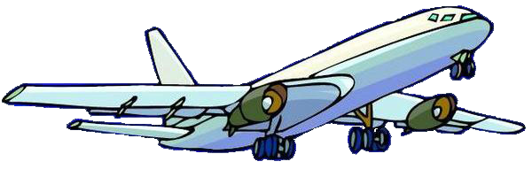


5b. I can identify the effects of air resistance on moving objects.
Hippo has jumped out of an aeroplane. Even though he has a parachute, he is moving faster and faster!
What could
save Hippo?
Use your understanding of gravity and air resistance to help!

Slide 5
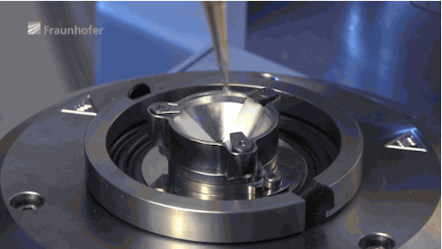
5c. I can identify the effects of friction on moving objects
How would adding oil, like in the video, help this machine work more efficiently?

Slide 6
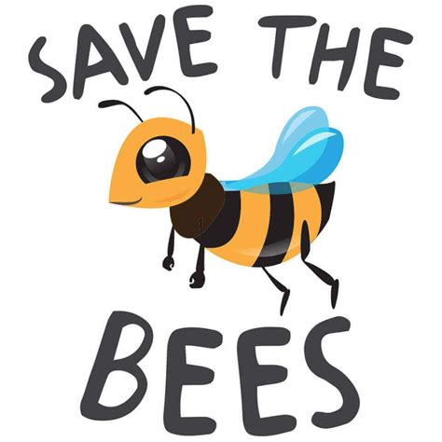
2a. I can describe the life process of reproduction in plants.
Over the last 20 years, people that keep bees around the world have seen the curious and rapid disappearance of bees, and report high rates of decline in honeybee colonies*.
Why do we need to ‘Save the bees’ with regards to reproduction in plants and food chains?
* http://sos-bees.org/situation/

Slide 7
2b. I can describe the life processes of reproduction in animals.
Can you match the organism to the correct animal reproduction process?
 | Fertilisation | Embryo development | Cares for young | Number of offspring
A | Internal | Internal | Yes | 1
B | External | External | No | 100
C | Internal | Internal | Yes | 1/2
D | Internal | Internal | Yes | 4-12
E | External | External | No | 1000000
F | Internal | External | No | 500
TUNA
HUMANS
FRUIT FLIES
FROG
RABBITS
PENGUINS

Slide 8
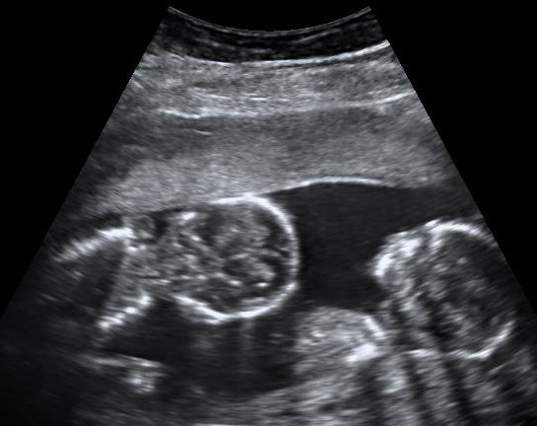
2b. I can describe the life processes of reproduction in animals.
What is going on in this picture?
What do you see that makes you say that?
What more do we need to know?

Slide 9
3f. I can explain that some changes create new materials, and this is sometimes irreversible. (Including changes with burning and acid on bicarbonate of soda).
Watch these clips. Describe and explain what happens, including what evidence there is that these are chemical reactions.
Substances added together | What happened? | Evidence for chemical change
Vinegar and bicarbonate of soda (acetic acid)
Baking powder and water
Plaster of Paris and water
Potassium Permanganate and Sodium hydroxide and caustic soda/sugar solution

Slide 10
Can you sort these changes into reversible or irreversible?
3g. I can identify if a change is reversible or irreversible.
Striking a match
Reversible
Car rusting
Cutting paper
Irreversible
Evaporation
Irreversible
Irreversible
Reversible
Reversible
Melting chocolate
Irreversible
Reversible
Freezing
Baking bread
Making a salt solution
Reversible
Burning a candle
Irreversible
Boiling water in a kettle
Irreversible
Crushing a can
Popping popcorn
Reversible
All changes in state are physical changes.

Slide 11

3h,i,j. I can separate mixtures using filtering, sieving and evaporating.
You are stranded on desert island surrounded by sea water.
How could you separate a mixture of sand salt and water to get drinking water?
Clue: Remember your water cycle from Year 4!

