Slide 1

Home Learning Year 1
A selection of Show Me tasks: Science

Slide 2






Can you draw the following body parts to make a new alien?
Show Me Tasks:
2d. I can identify, name, draw and label the basic parts of the human body and say which part of the body is associated with each sense
I’ve got one eye and a small nose.
I’ve got three legs and 4 arms.
I have a large mouth.
2. Explain what senses are.
3. Draw a picture in the box that show the sense you would use.
 |  |  | Sense

Slide 3

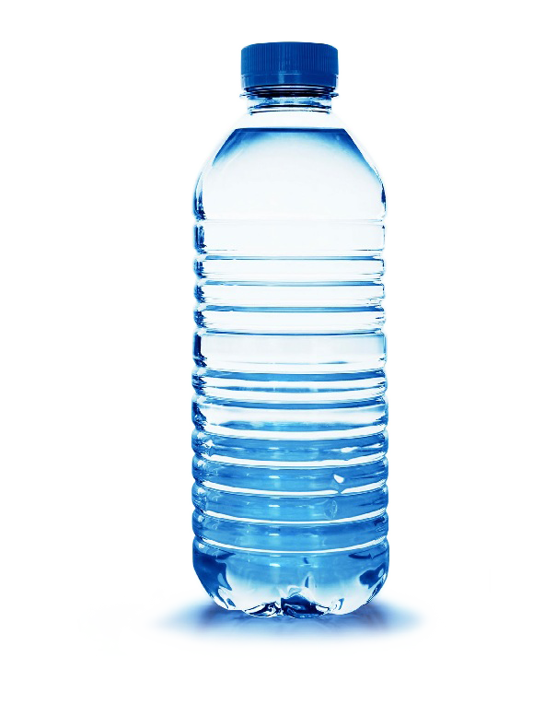
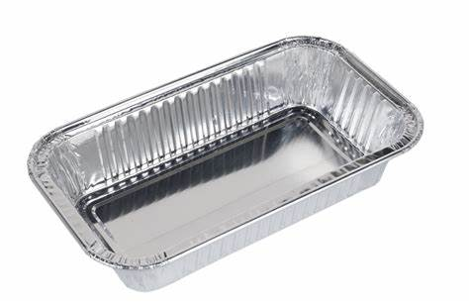


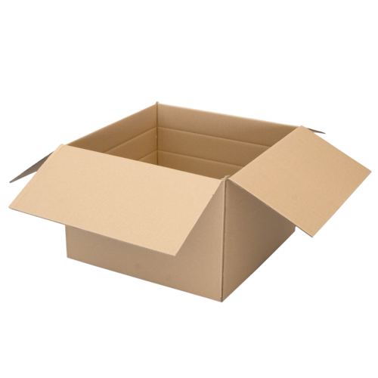
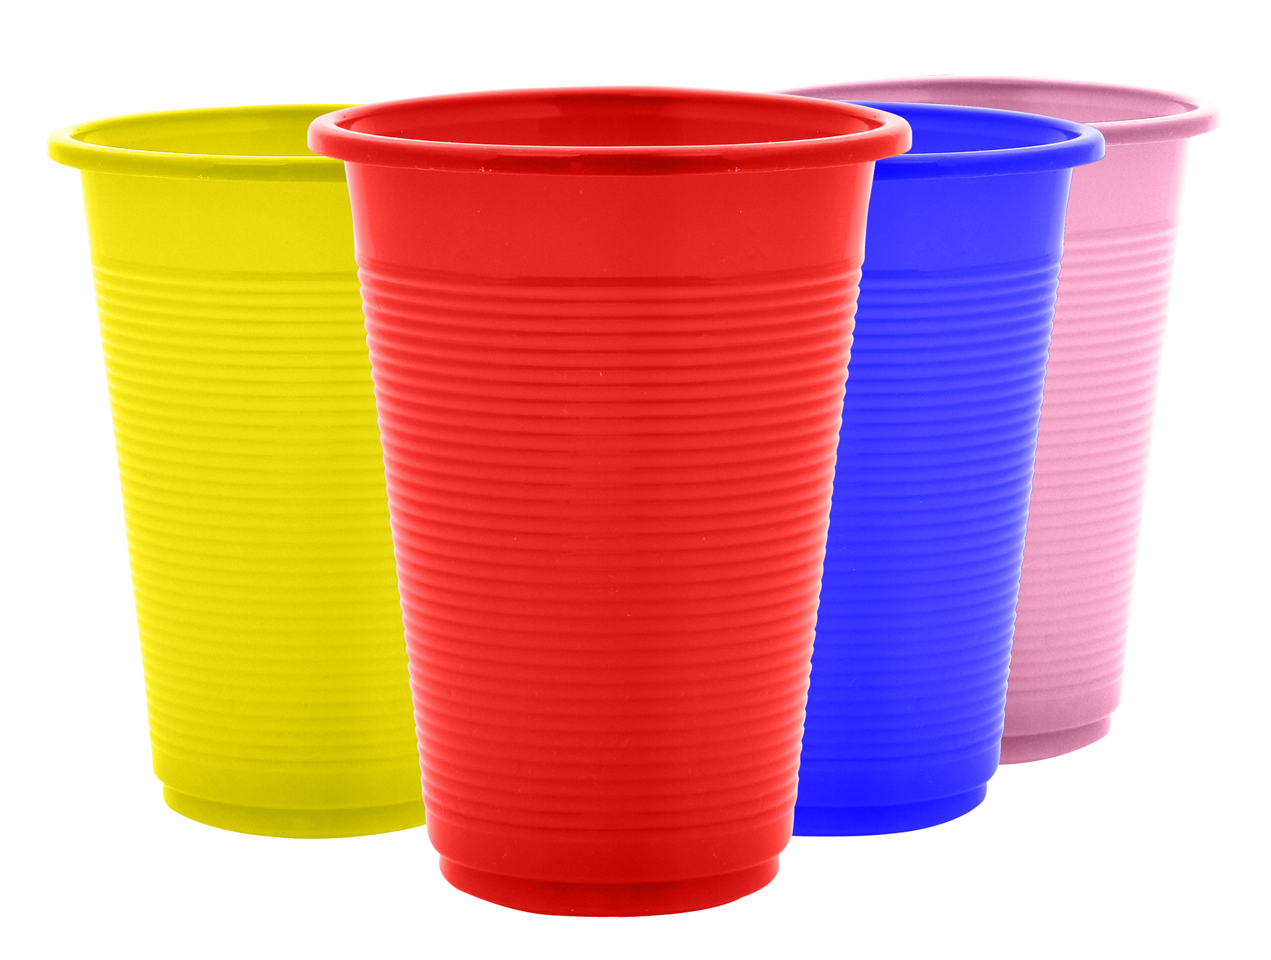
Look at the objects below. How would you sort them into the correct recycling bin?
Show Me Tasks:
4a. I can distinguish between an object and the material from which it is made
4c. I can describe the simple physical properties of a variety of everyday materials
Plastic
Paper
Metal
2. Match the materials (a) to their properties (b) and uses (c).
3. Draw a picture in the box of an object and write about the materials that are combined to make it.
a) Metal | b) Malleable Tough Waterproof | c) Window
a) Glass | b) Stiff Waterproof Shiny | c) Toy
a) Plastic | b) Rigid Transparent Hard | c)Fork
Object | Materials

Slide 4
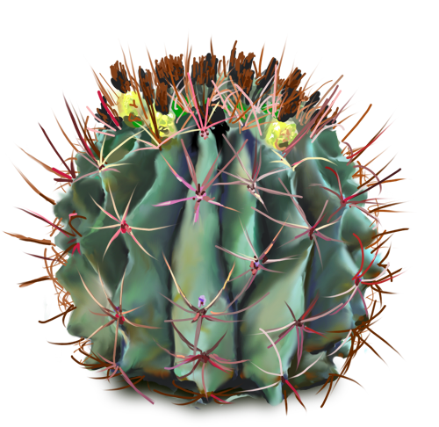
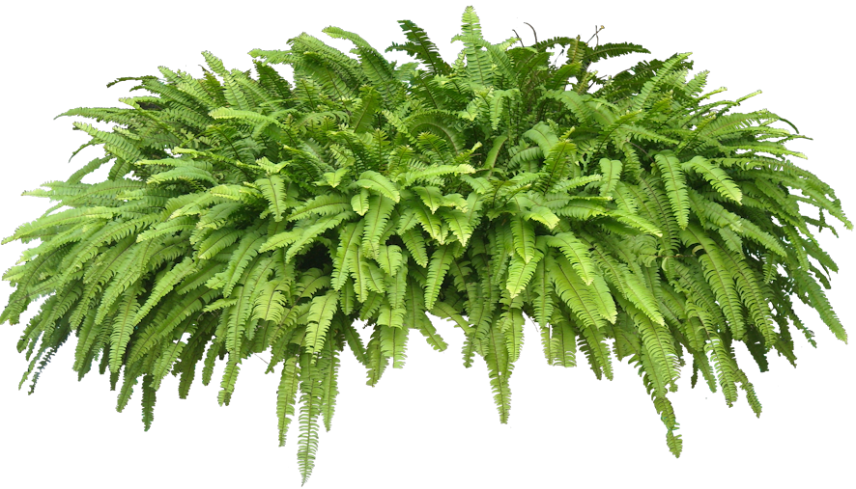
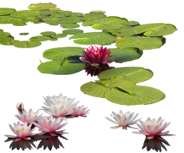
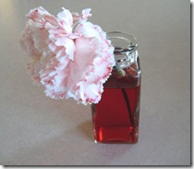



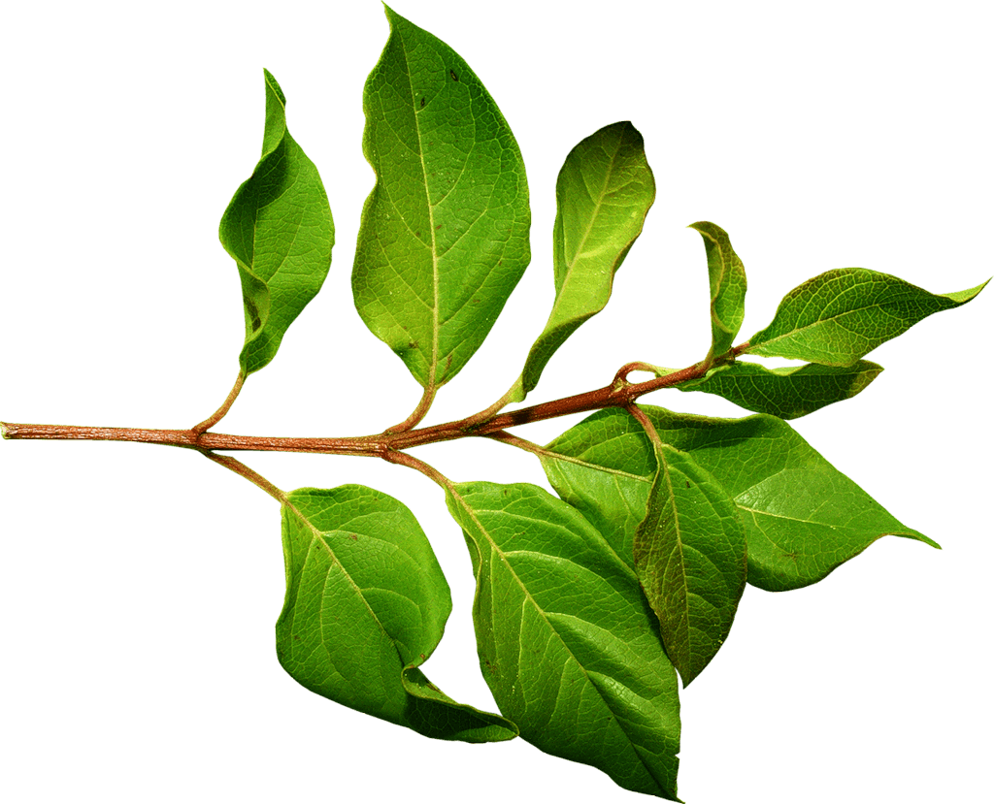
How are these plants similar to each other? Different?
Show Me Tasks:
3b. I can identify and describe the basic structure of a variety of common flowering plants, including trees.
Cactus
Fern
Water Lily
2. Draw lines to match the part of the plant to its picture and its job.
3. Explain why this flower is turning pink.
Plant part | Function | Picture
Flower | Holds plant to ground
Leaves | Holds up the flower and leaves
Roots | Makes food for the plant
Stem | Makes new seeds

Slide 5
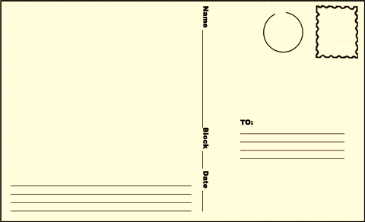
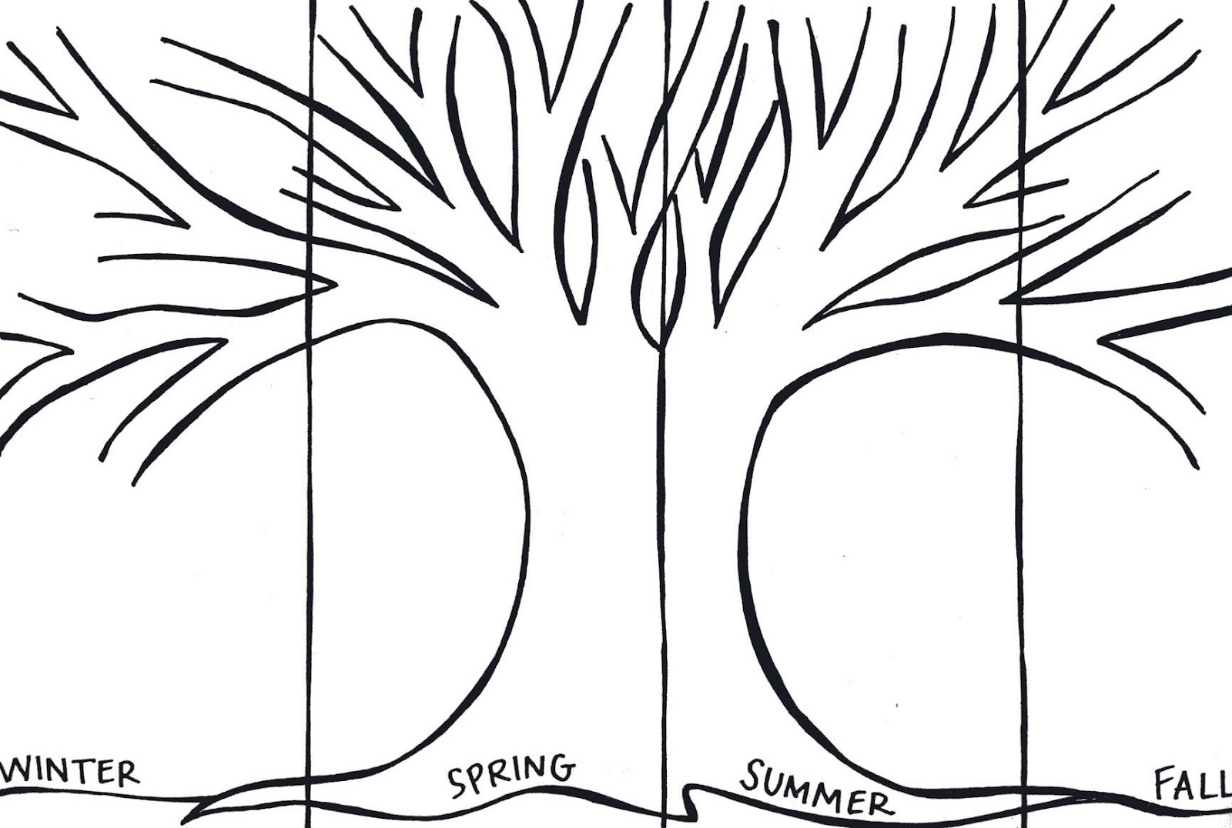
Can you write a postcard to a friend describing what the weather was like? You can choose any season.
Show Me Tasks:
5b. I can observe and describe weather associated with the seasons
5c. I can observe and describe how day length varies
2. Complete the diagram to show how the tree would look in each season.
3. Explain how day length changes with each season.

