Slide 1

Home Learning Year 3
A selection of Show Me tasks: Science

Slide 2


3d. I know humans have muscles for support, protection and movement.
Activity | Parts of the body where the muscles are used | How do skeletons and muscles help movement in these different sports?
Walking | Arms , shoulders, top of the leg, bottom of the leg.
Sprinting
Playing tennis
Weightlifting
Playing football

Slide 3
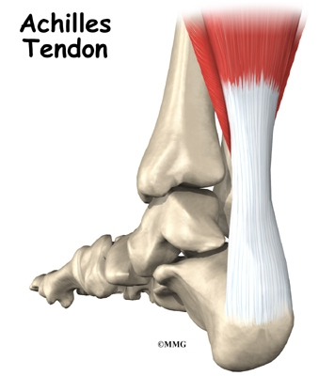
3d. I know humans have muscles for support, protection and movement.
Andrew was playing tennis last year and jumped up to reach the ball and landed on his ankle.
He visited the doctor who said he had torn his Achilles tendon. Why couldn’t Andrew walk on his foot?

Slide 4





4d. I can compare and group together materials based on whether they are attracted to a magnet.
Some metals are magnetic but some are not magnetic.
Can you use this information to group together and identify which of these objects are magnetic or non-magnetic?
Object | Magnetic | Non-magnetic
Paper clip | ☺ | ☹
Building brick | ☺ | ☹
Nail | ☺ | ☹
Coin | ☺ | ☹
Can | ☺ | ☹
Metals
Magnetic | Non-magnetic
Iron Steel Nickel Bronze Cobalt | Copper Aluminium Brass Tin Gold Silver
☺
☹
☺
☹
☹

Slide 5
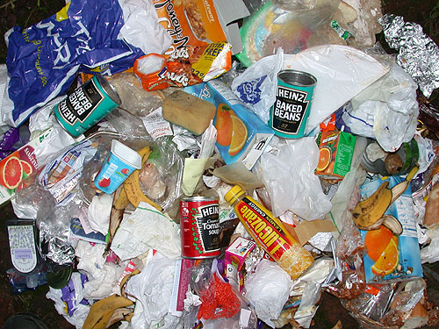
4d. I can compare and group together materials based on whether they are attracted to a magnet.
In 2014, the waste generated by UK homes was 26.8 million tonnes.
Under half of this was recycled.
Think about the different items made from cardboard, plastic, metal and aluminium that are thrown away daily as rubbish. Suggest a way to separate the materials into groups.
How could you use the following to help separate them?
Magnet
Water tank

Slide 6
5e. I can find patterns in the way that the sizes of shadows change.
Can you finish off the graph by drawing a line which correctly shows the relationship between the size of shadow and the distance the object is from the light source?
Size of shadow (cm)
0
0
Distance from the light source (cm)

Slide 7



5e. I can find patterns in the way that the sizes of shadows change.
Do shadows change in size during the day?
The first picture has been drawn for you.
Can you complete the sequence?
8.00
10.00
12.00
14.30
17.00
When was the shadow at its shortest?
Why do you think that was?

Slide 8
2d. I know what plants need for life and growth and how they vary from plant to plant.
Statement | True or false
The sun provides warmth and light for plants.
A seed will not produce a plant at all if it is kept too cold.
Plants needs plant food to grow.
Plants need soil to make their own food energy (photosynthesis).
A plant that is watered will have a weak stem, so that it can’t stand properly.
A plant that is kept in the dark will become weak and die.
True
True
False
False
False
True

Slide 9
2d. I know what plants need for life and growth and how they vary from plant to plant.
Many years ago a scientist called Jan Van Helmont had an theory that for a tree to get bigger, it must get food from somewhere else.
To begin with he weighed a tree and the soil that he wanted to plant the tree in. He let the tree grow for several years and then reweighed the tree and the soil.
The soil weighed the same amount and the tree had got bigger.
Explain to your partner
Challenge 1
Explain why the plant couldn’t be gaining mass from the soil. What’s your evidence?
Challenge 2
What could you do next to prove what the plant was consuming for food?

Slide 10
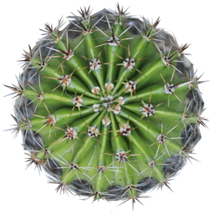
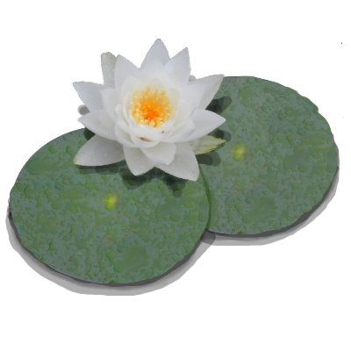
2d. I know what plants need for life and growth and how they vary from plant to plant.
The cactus and water lily plants are different to each other because they have adapted to survive in their own environments.
Use the words and phrases below to make two lists describing the different plants and their differing environments.
Water
Poor soil
Floats
Thorny leaves
Stem stores water
No soil
Thin, large leaves
Waxy coat
Spiky
Pond
Dry
No thorns
Hot
CACTUS | WATER LILY

Slide 11

2d. I know what plants need for life and growth and how they vary from plant to plant.
What might have sparked the changes for some plants to become carnivorous and eat insects as a source of energy?
Discuss your ideas
with a partner.

Slide 12
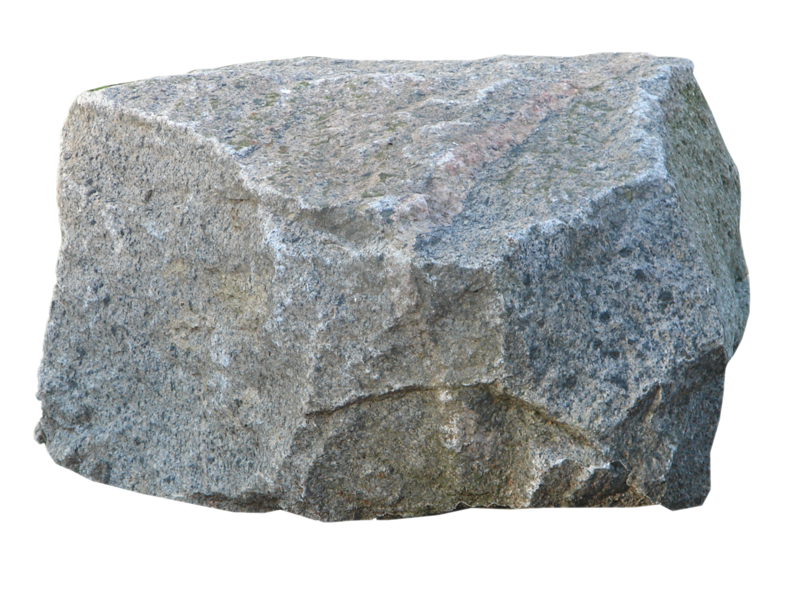
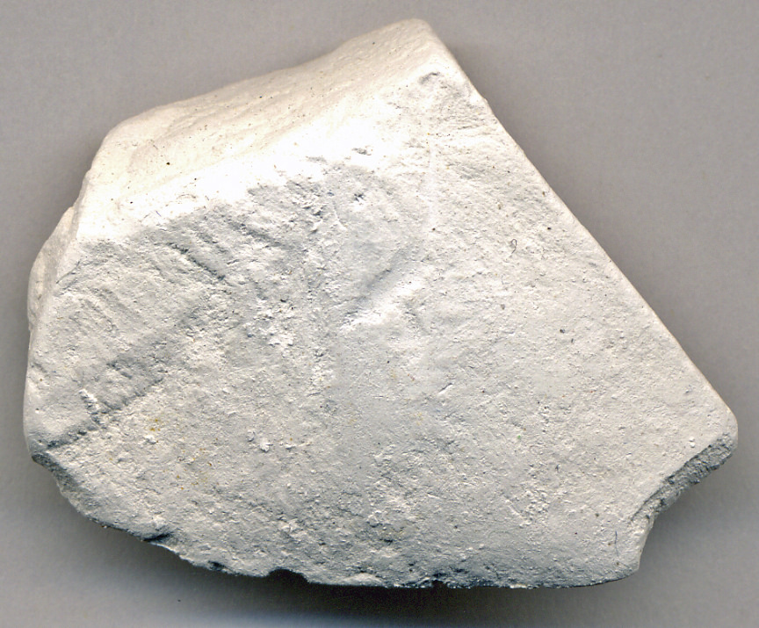
6b. I can compare and group together different kinds of rocks on the basis of their appearance and physical properties.
Comparing granite and chalk
 | Hardness
 | Permeability/ Layers
 | Do they contain fossils?
 | Appearance
 | Structure
 | Your choice
Granite
(Igneous rock)
Chalk
(Sedimentary rock)

Slide 13
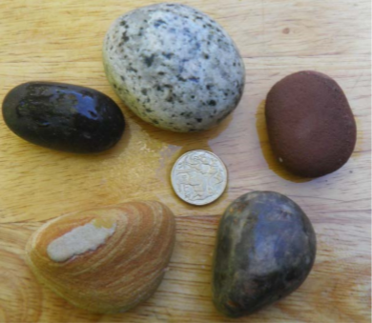
6b. I can compare and group together different kinds of rocks on the basis of their appearance and physical properties.
Using evidence, state if each of the following three statements are true or false. Provide evidence to support your decision.
C
A. Basalt pebble, Scotland (Atlantic Ocean)
B. Sandstone pebble, Australia (Coral Sea)
C. Granite pebble, Australia (Antarctic Ocean)
D. Rhyolite pebble, New Zealand (Antarctic Ocean)
E. Limestone pebble, Latvia (Baltic Sea)
These five pebbles have been collected from around the world.
A
D
B
E
All the pebbles are from modern beaches so the rocks must be the same age.
All the pebbles must have travelled about the same distance from their source rock, as they are similar sizes.
We can tell which rocks are igneous rocks because their minerals are harder and will be more difficult to wear away. Larger less rounded pebbles come from igneous rocks.
.

