Slide 1

Home Learning Year 4
A selection of Show Me tasks: Science

Slide 2


2a. I can describe the simple functions of the basic parts of the digestive system in humans.
The body’s digestive system completes four tasks:
Ingestion – take in food
Digestion – breakdown food
Absorption – absorption into blood stream
Elimination – remove waste
Can you identify which parts of the digestive system are involved in each of the tasks?
Large intestine
Small intestine
Stomach
Anus
Mouth
Oesophagus
Mouth

Slide 3
2a. I can describe the simple functions of the basic parts of the digestive system in humans.
Digestive system
Can you complete the diagram below?
Parts of the system
Oesophagus
Anus
What would happen if this part was missing?
Food couldn’t get to the stomach

Slide 4

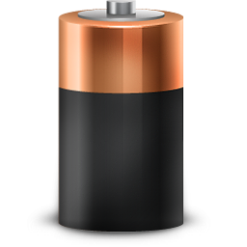
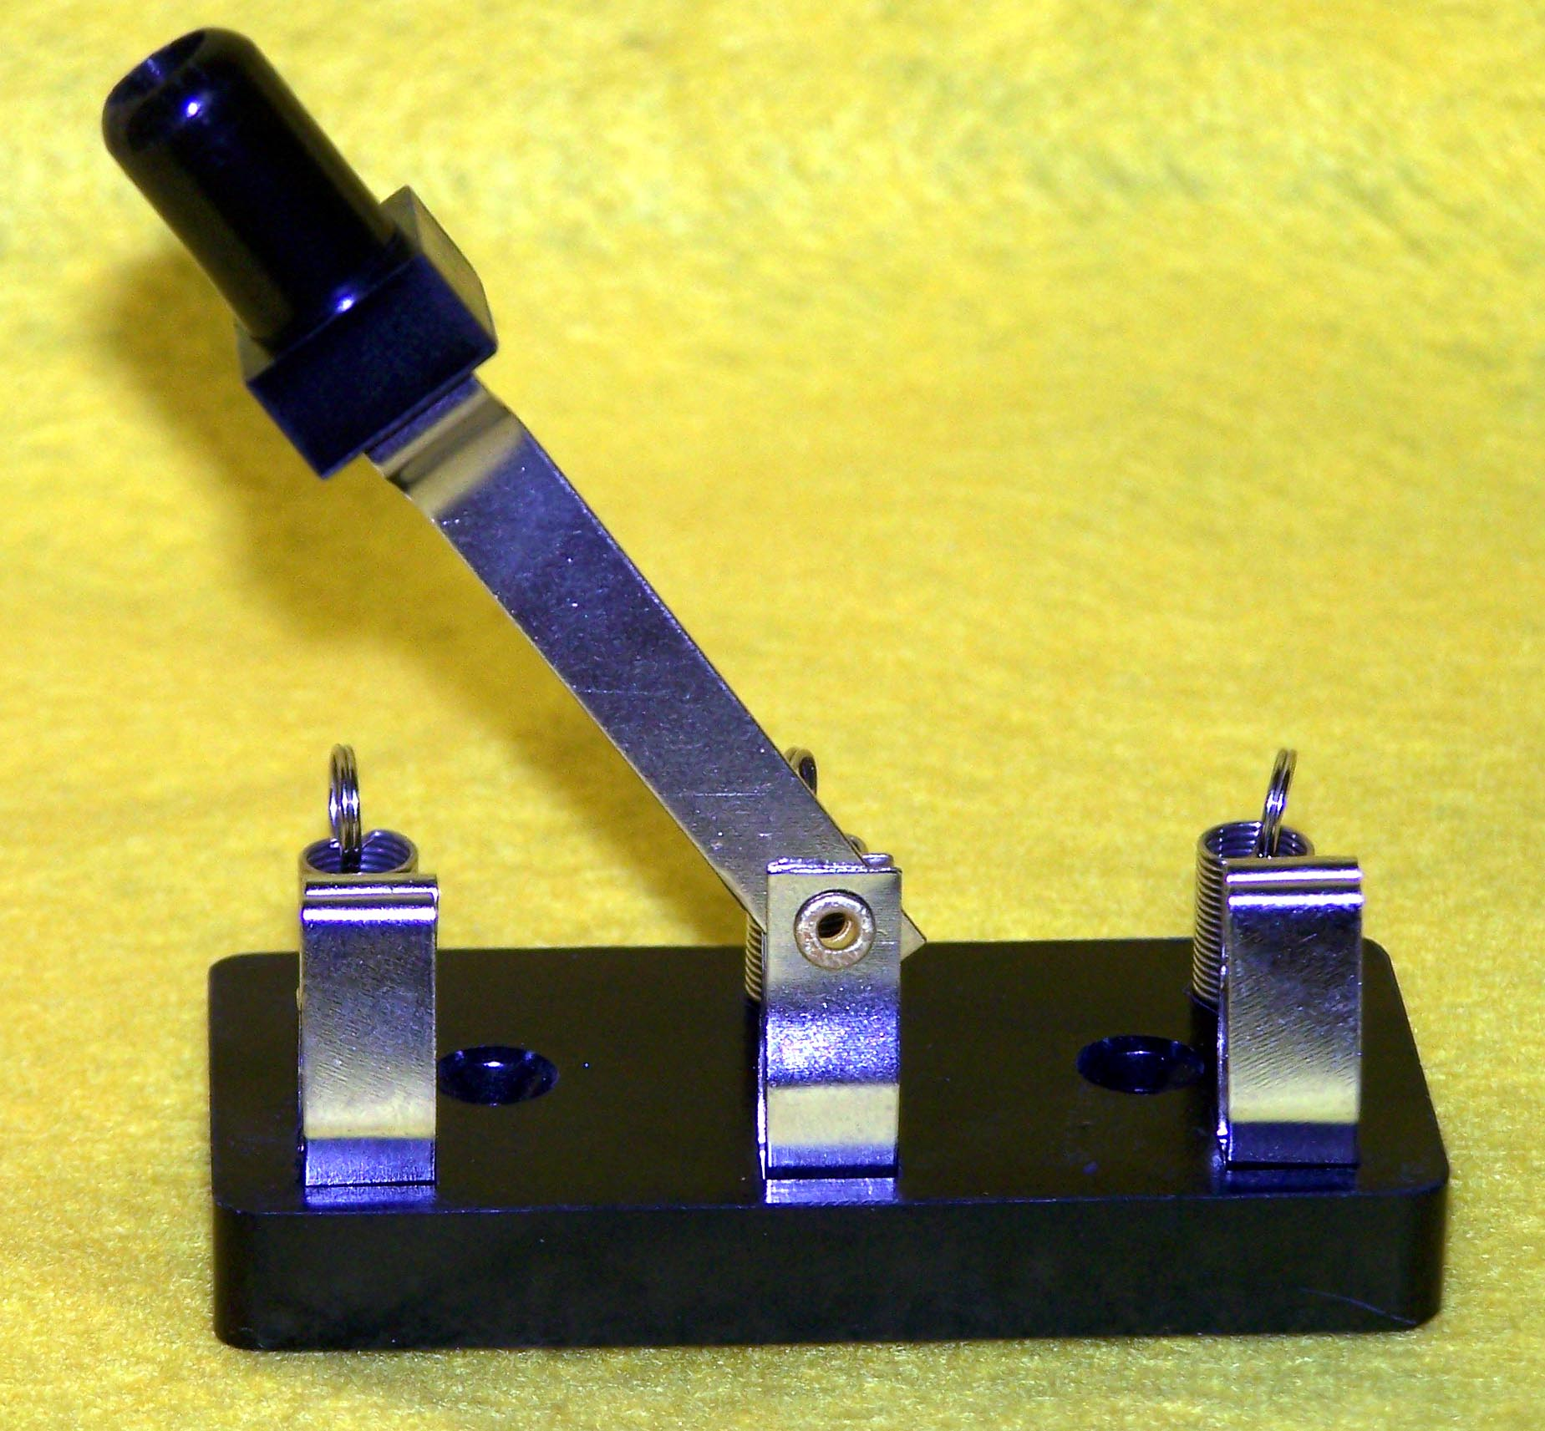
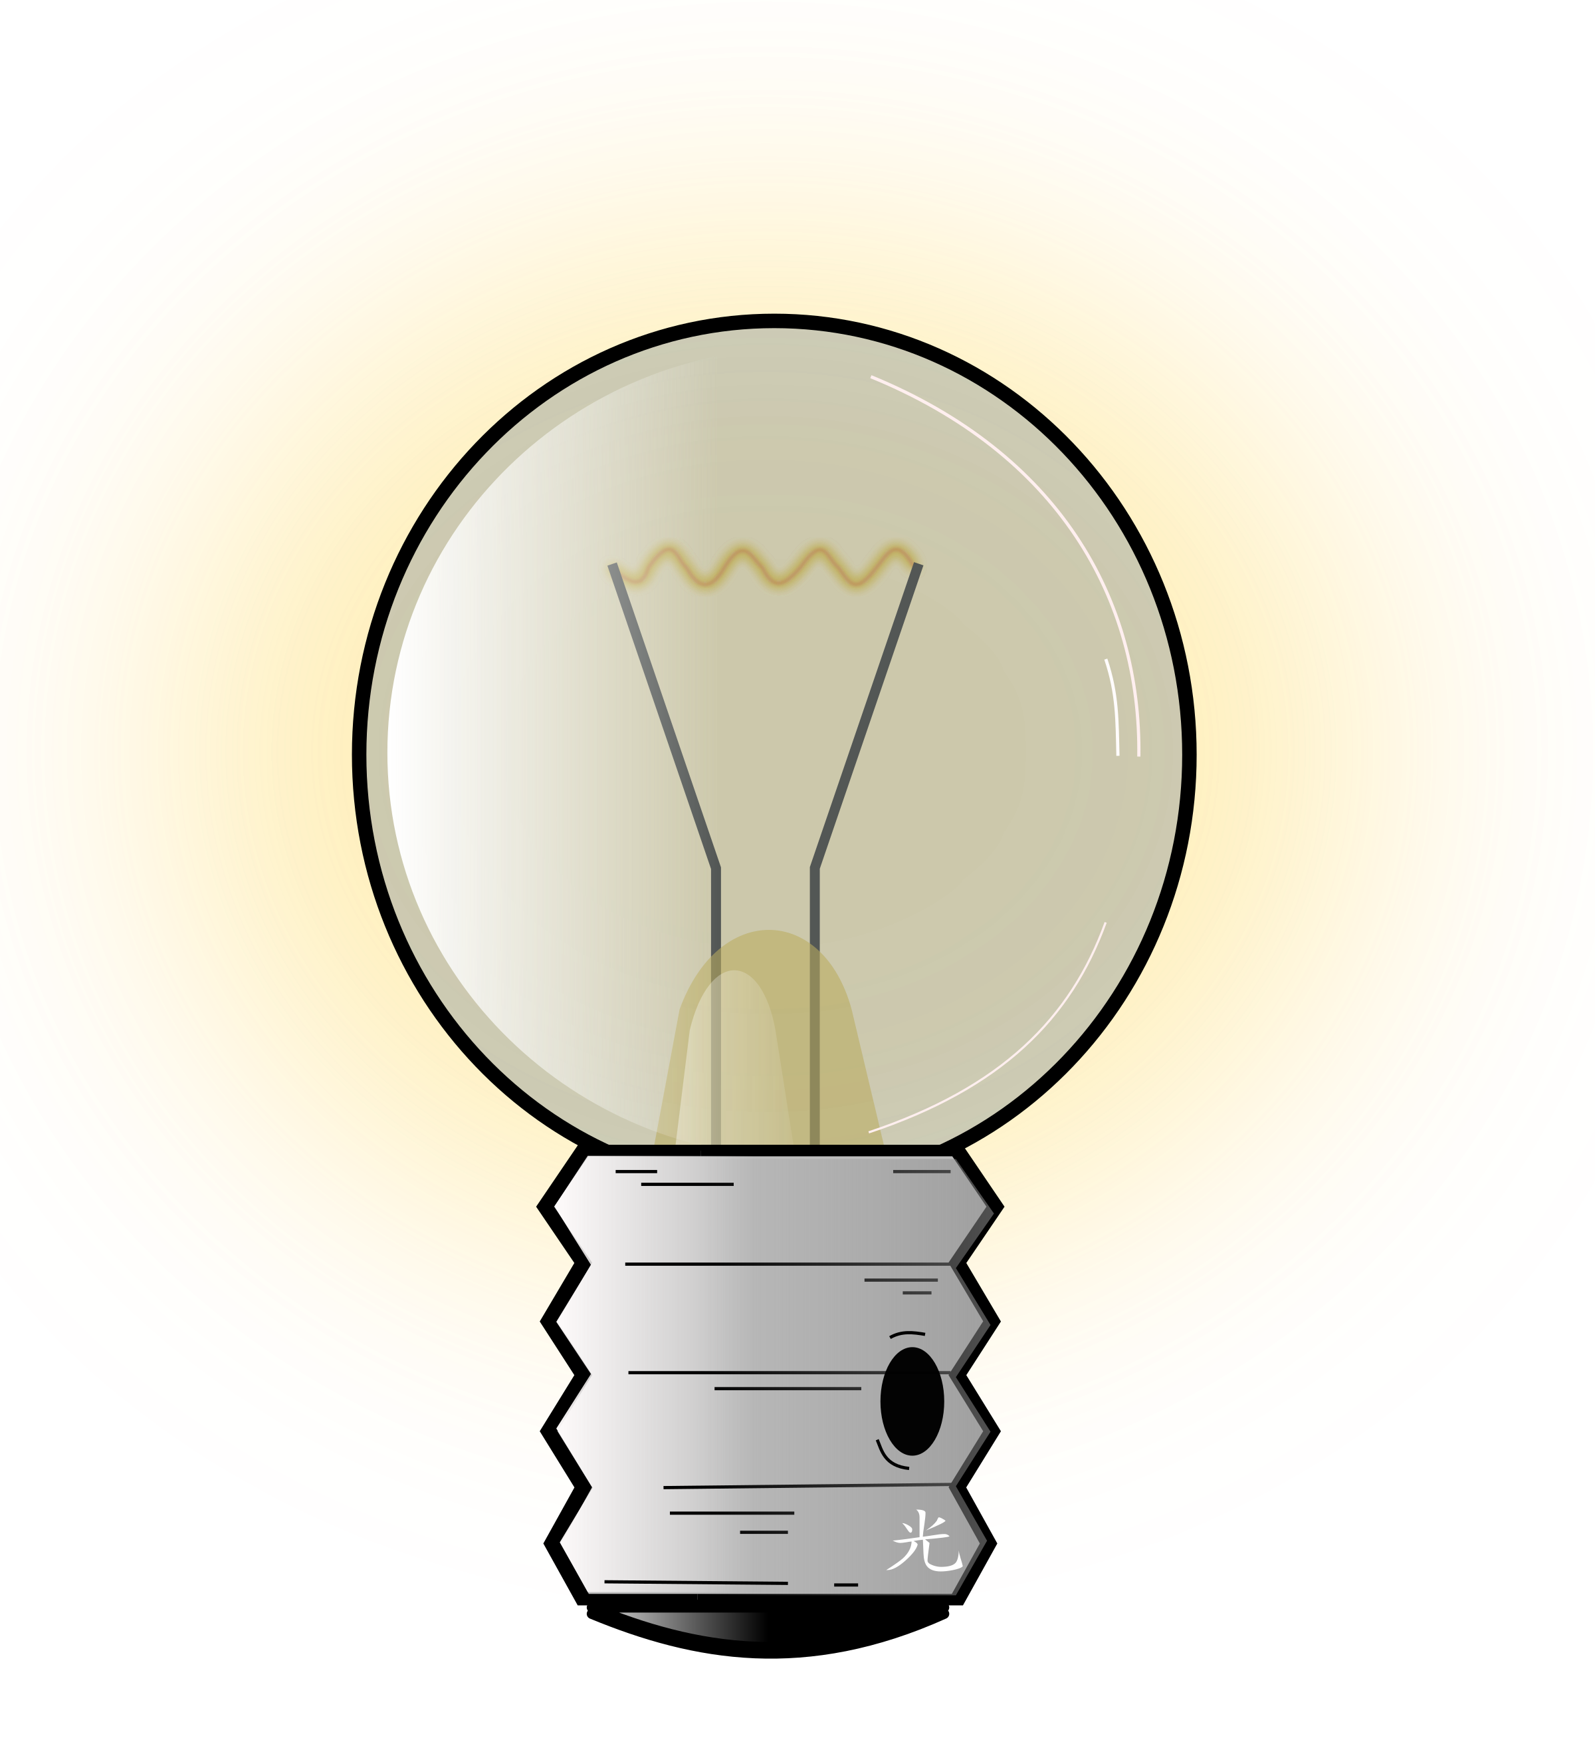
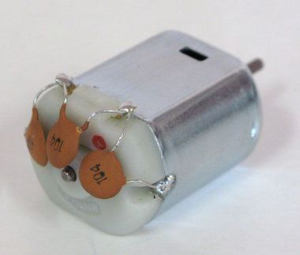
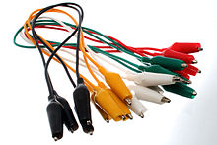
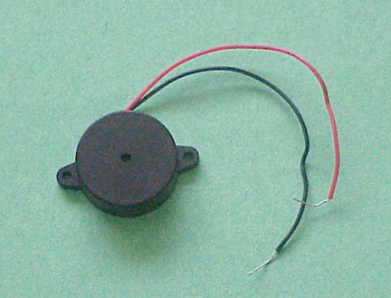

5b. I can construct a simple series electrical circuit, identifying and naming its basic parts (cells, wires, bulbs, switches and buzzers).
Can you match the picture to the correct part name and job?
Switch
Connects components and passes electricity from one part of the circuit to another.
Bulb
Supplies electrical energy.
Cell
Converts electrical energy to light.
Bell/buzzer
Converts electrical energy to movement.
Motor
Converts electrical energy to sound.
Wire
Allows electricity to flow when closed.

Slide 5
5b. I can construct a simple series electrical circuit, identifying and naming its basic parts (cells, wires, bulbs, switches and buzzers).
Which of these is the odd one out?
Bulbs, crocodile leads, cell
Crocodile leads, bulbs, switch, buzzer
Cell, switch, buzzer, crocodile leads
Wires, bulb, cell

Slide 6
6b. I can recognise that vibrations from sounds travel through a material or substance to the ear (air).
Questions
What happens when you change the material through which the sound travels?
Through which material does sound move faster?
Why do you think it is faster? Use your knowledge of ‘States of Matter’.
Material | Speed of Sound
Rubber | 60 m/s
Air at 40ºC | 355 m/s
Air at 20 ºC | 343 m/s
Lead | 1210 m/s
Gold | 3240 m/s
Glass | 4540 m/s
Copper | 4600 m/s
Aluminum | 6320 m/s

Slide 7


6b. I can recognise that vibrations from sounds travel through a material or substance to the ear (air).
Share your ideas
Why does the second tuning fork vibrate even when it not hit by the hammer?

Slide 8
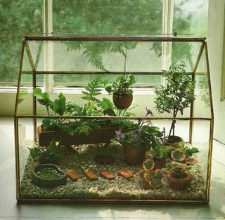
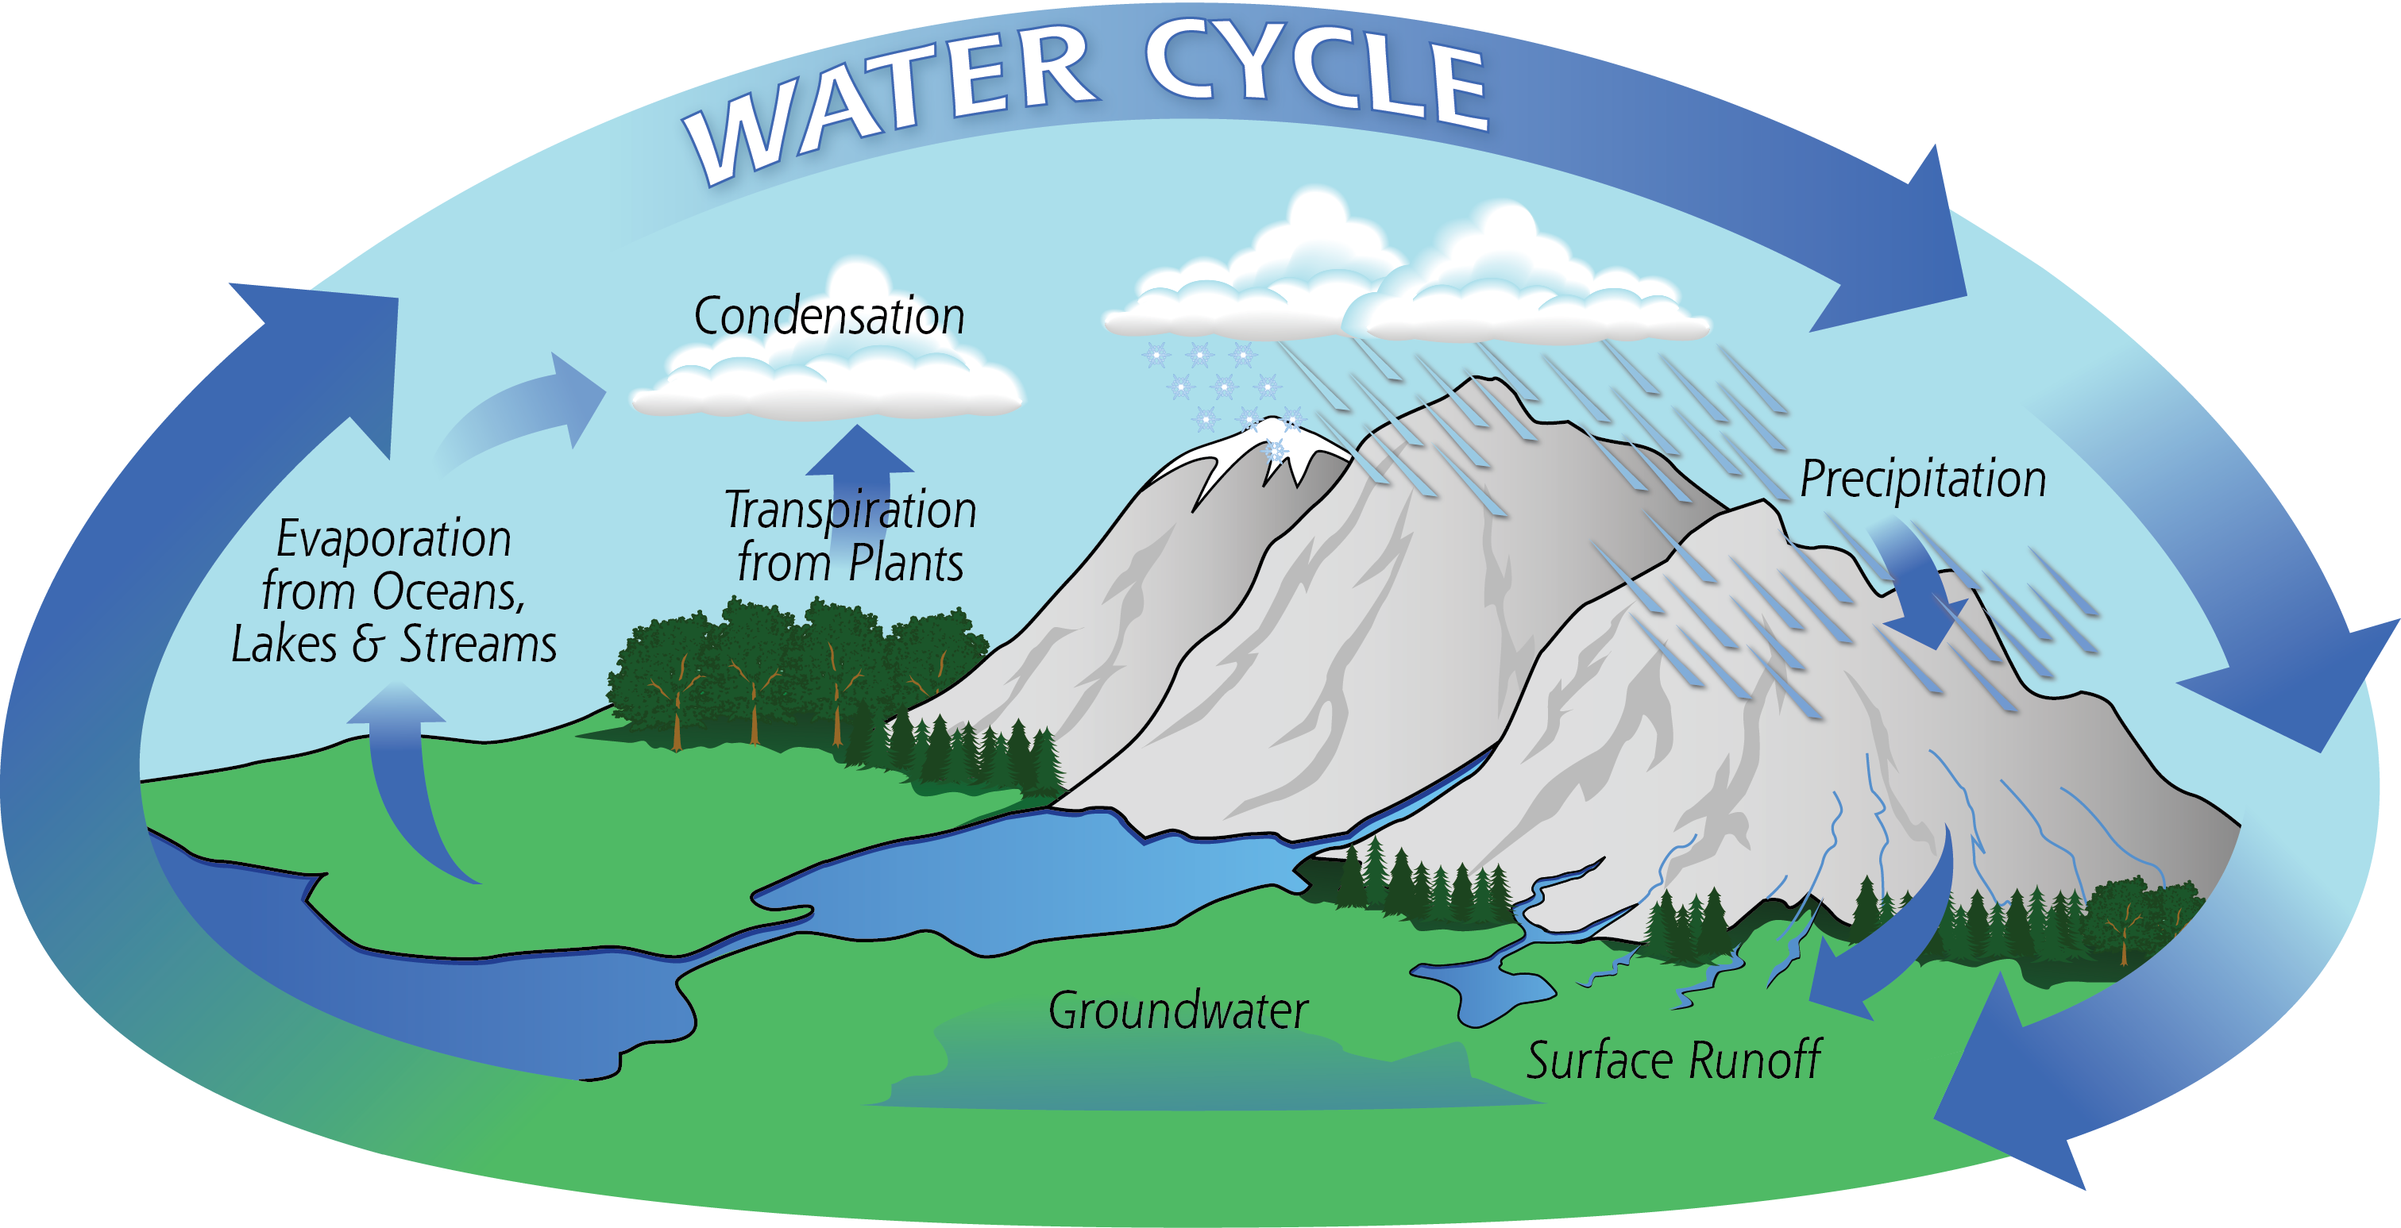
3c. I can identify the part played by evaporation and condensation in the water cycle and associate the rate of evaporation with temperature.
A terrarium is like the water cycle because:
1.
2.
3.

Slide 9
3c. I can identify the part played by evaporation and condensation in the water cycle and associate the rate of evaporation with temperature.
We wanted to find out what happened to the rate of evaporation when we changed the temperature. We measured 20ml of water and placed these sample in dishes at different temperatures. We found out how much water evaporated after 12hrs.
Temperature (ºC) | How much water evaporated? (ml)
15 | 0.1
25 | 0.3
35 | 0.5
45 | 1
55 | 1.8
Some of these sentences match the results. Which ones?
The most water evaporated at 45ºC.
The water at 55ºC evaporated the fastest.
Even the water at 15ºC evaporated a bit.
Can you make up some sentences of your own?

