Slide 1
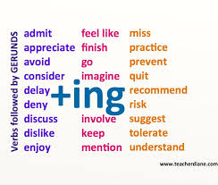
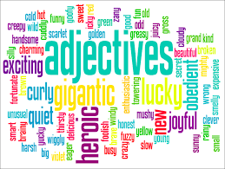
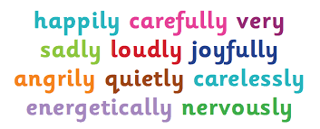

SPAG: How can I make the start of my sentence more interesting?
Use an adjective
Use an adverb
Use an –ing verb

Slide 2
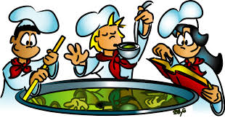
How do we use these?

Slide 3
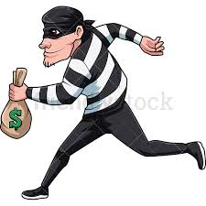
First, let’s use a VERB: RUN
Add the suffix –ing to it: RUNNING
Then write it as your first word!
Running quickly along the alley, the thief escaped with the money.
Notice the comma to show that this is a subordinate clause!
It’s extra , interesting information about the thief.
The main idea is the thief escaped with the money!
Thief

Slide 4

Next, let’s use an ADJECTIVE: Terrified!
Write it as your first word!
Terrified, the shopkeeper hid under the counter, sweating in fear.
Notice the comma to show that this is a subordinate clause!
It’s extra , interesting information about how the shopkeeper felt.
The main idea is they hid under the counter!
Shopkeeper

Slide 5

Finally, let’s use an ADVERB: quickly
Write it as your first word!
Quickly, the police chased after the thief in their superfast police car!
Notice the comma to show that this is a subordinate clause!
It’s extra , interesting information about the police.
The main idea is the police chased after the thief.
Police

Slide 6

Try making your own exciting sentences by starting them using verbs, adjectives and adverbs!
Try these at the start of your sentences and make an interesting mini-story of your own!
Verbs: Galloping, Gobbling up, Grabbing
Adverbs: Slowly, Cautiously, Suddenly, sleepily
Adjectives: Petrified, Annoyed, Amused, Astounded

