Slide 1


W2a. Can show some variety in sentence structure e.g. using a mixture of short sentences with long ones.
Commissioned by The PiXL Club Ltd.
Example 2017
This resource is strictly for the use of member schools for as long as they remain members of The PiXL Club. It may not be copied, sold nor transferred to a third party or used by the school after membership ceases. Until such time it may be freely used within the member school.
All opinions and contributions are those of the authors. The contents of this resource are not connected with nor endorsed by any other company, organisation or institution.
© Copyright The PiXL Club Limited, 2017

Slide 2
Teachers’ Notes
This therapy highlights the importance of creating interest in writing through sentence variety.
It begins by modelling how short sentences can be used to create impact or urgency in writing.
This is followed by the exemplification of how long sentences can be used to give detail to the reader (or to suggest the passage of time).
Finally, it models how a mixture of the above can achieve more impact for the reader.
Throughout the therapy, pupils are given the opportunity to practise the skills themselves.

Slide 3
To be great writers, it is important to use different types of sentences. If we use the same types or lengths of sentence, our writing can lack interest for the reader.
When would we use short sentences?
To create impact or give the writing a ‘punch’
Then I saw it.
Because it is short, this sentence grabs our attention. It is like being given a short, sharp shock! Also, the ‘empty’ word ‘it’ makes us wonder what the character has seen, so we read on.

Slide 4
When would we use short sentences?
To show urgency
“Let’s go!”
The longer version of this sentence might be:
“Let’s go now because the library will be shut in half an hour!”
By using the shorter version, the message sounds more urgent to the reader.

Slide 5
Your turn: decide on the purpose of each short sentence. Is it for a) impact or b)urgency?
It was right there.
a
“Go now!”
b
She had found the treasure!
a
“Don’t keep doing that. I’m serious.”
b

Slide 6
When would we use long sentences?
Long sentences can be used to write a detailed description. Often, they slow the writing down to allow the reader to focus on the detail, or to create a feeling of time passing.
The sparkling, ocean waves rolled gently onto the golden beach.
In this longer sentence, the writer is trying to describe a setting so that the reader can picture it. The adjectives give more detail and the adverb tells us HOW the waves are rolling. There is no need to create a ‘punch’ for the reader, so we can almost relax and enjoy the writing!

Slide 7
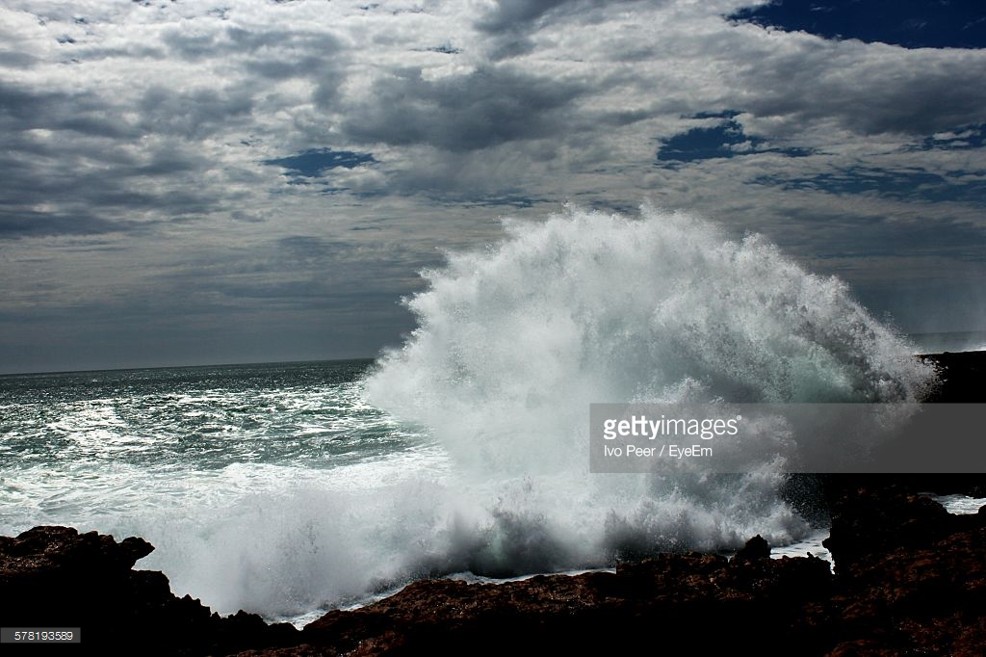
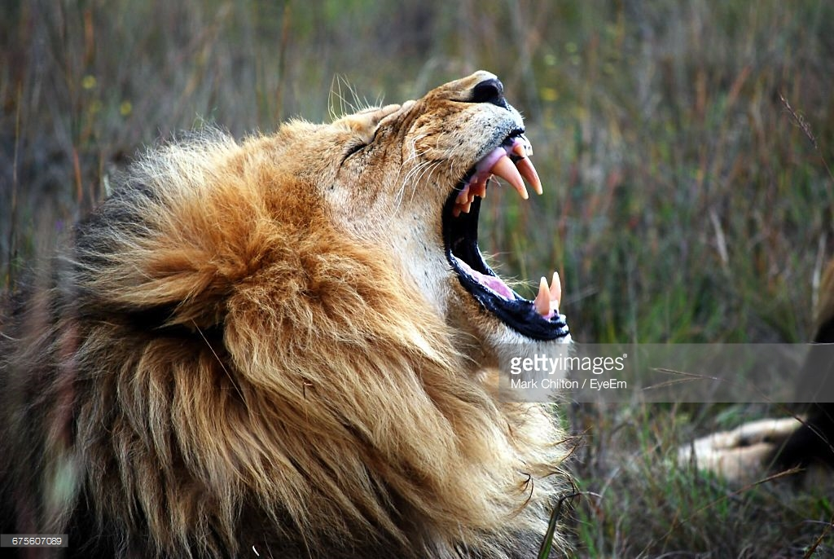
Your turn: can you write a long sentence to match each picture?

Slide 8
Now that we know the different reasons for using short and long sentences, let’s look at how we can mix them up to give our writing interest for the reader.
Imagine we are writing about this lion in a story. We might want to describe the creature in detail using long sentences. However, we might include a section where we want our writing to have some impact – for this we could use short sentences.

Slide 9
Imagine if we ONLY used short sentences.
They were out in the hot sun all day. They went round a corner. They found what they had been looking for. The lion was in the shade. It had a golden mane. It had a huge face. It roared. Then it opened its mouth. The razor-sharp teeth glinted. Nervously, they edged backwards. The lion slowly stood up.
Discussion
What is wrong with the writing? How could it be improved?
By ONLY using short sentences, the writing seems very jumpy. When we finally want the writing to have some ‘punch’ (when the lion roars), it seems no different to the previous sentences, so it loses the impact we want.

Slide 10
Imagine if we ONLY used long descriptive sentences.
After being out all day in the hot sun, they finally turned a corner and found what they had been looking for. The giant beast was lying in the shade of a leafy tree. Its golden mane hung in folds and surrounded its huge face. As they were watching, it roared and its huge mouth opened, showing razor-sharp teeth. Nervously, they edged backwards into the cover of the trees.
Discussion
What is wrong with the writing? How could it be improved?
By ONLY using long, descriptive sentences, there is no impact or sense of danger when the lion roars. If we included some short, punchy sentences here, we would grab our reader’s attention more.

Slide 11
Varying the length of sentences to give interest to our writing
After being out all day in the hot sun, they finally turned a corner and found what they had been looking for. The giant beast was lying in the shade of a leafy tree. Its golden mane hung in folds and surrounded its huge face. Without warning, it roared! Its massive mouth opened. Its razor-sharp teeth glinted. Nervously, they edged backwards as it slowly stood up.
Your turn: can you identify the short sentences which are there to give impact?

Slide 12
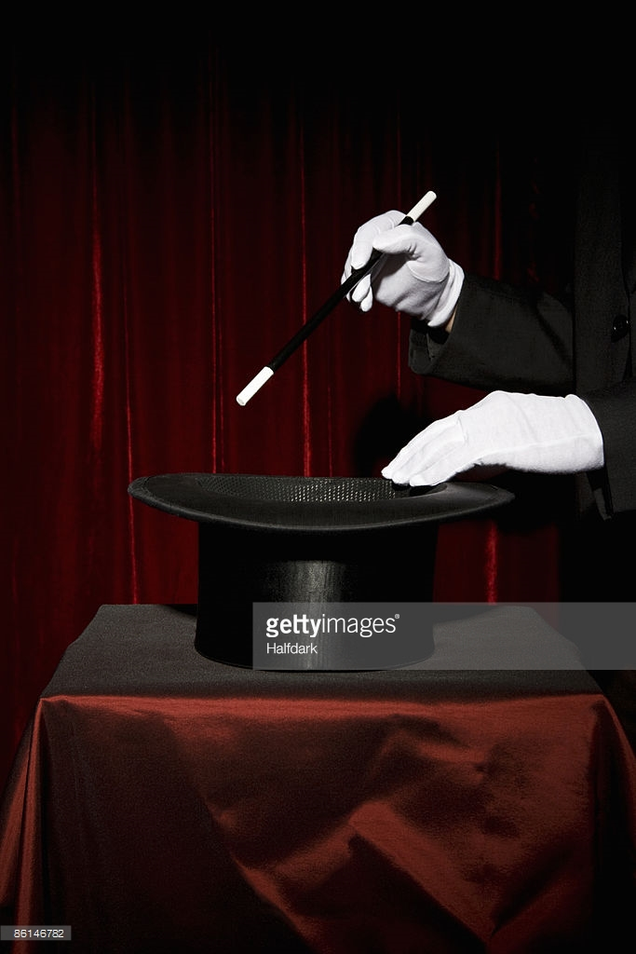
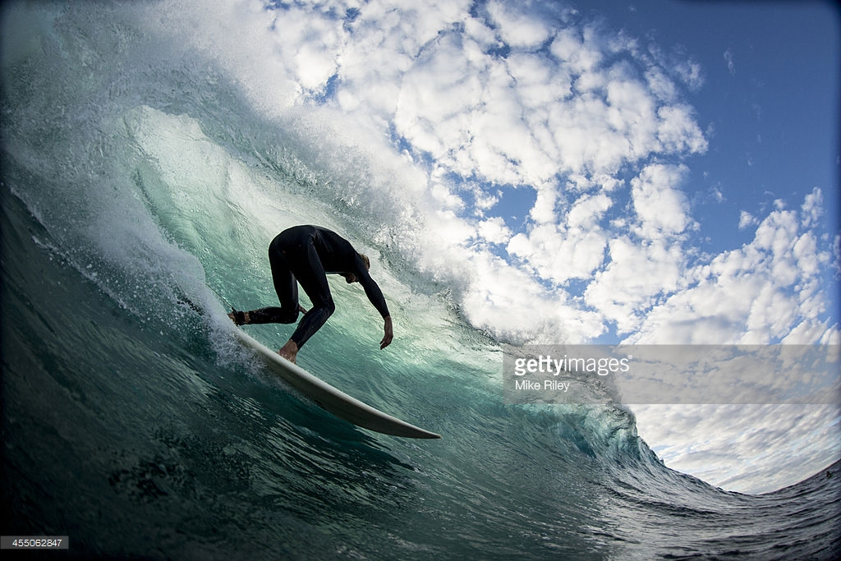
Your turn: use one of the pictures. Write a paragraph which includes some long, descriptive sentences AND some short sentences for impact (or urgency).

Slide 13
So, to be GREAT writers we need to try to vary the types of sentences which we use.
SHORT sentences for IMPACT or to suggest URGENCY.
LONG sentences to add DETAIL or create a feeling of TIME passing.

