Slide 1


W2d. Uses a wide range of co-ordinating and subordinating conjunctions to develop and extend their ideas.
Commissioned by The PiXL Club Ltd.
Example 2017
This resource is strictly for the use of member schools for as long as they remain members of The PiXL Club. It may not be copied, sold nor transferred to a third party or used by the school after membership ceases. Until such time it may be freely used within the member school.
All opinions and contributions are those of the authors. The contents of this resource are not connected with nor endorsed by any other company, organisation or institution.
© Copyright The PiXL Club Limited, 2017

Slide 2
Teachers’ Notes
This therapy begins by clarifying types of co-ordinating and subordinating conjunctions.
The use of the comma with subordinating conjunctions is exemplified with a reminder that no comma is needed if the subordinating conjunction follows the main clause.
An extract with the repetitive use of ‘then’ is used to exemplify the need for variety in conjunction selection.
Finally, reference is made to relative pronouns as a further form of conjunction.

Slide 3
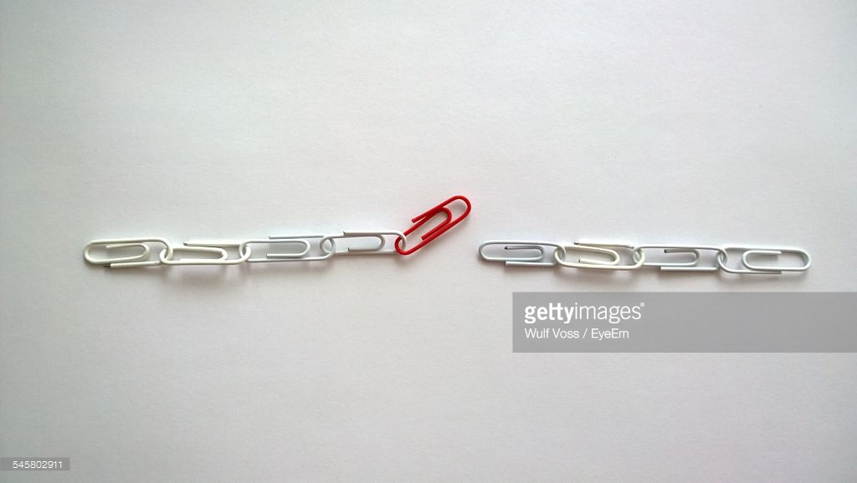
Conjunctions are used to join clauses in a sentence.
We can think of them as LINKING ideas.
By using them, our writing flows better and the reader can make connections between ideas.

Slide 4
Conjunctions can link ideas between two main clauses. In this case, they are called co-ordinating conjunctions.
Remember – a main clause makes sense on its own.
The brown cat was scared.
It hid behind the sofa.
The brown cat was scared SO it hid behind the sofa.
Two main clauses linked by a co-ordinating conjunction.

Slide 5
CO-ORDINATING CONJUNCTIONS
F
for
A
and
A good way to remember what these are is FANBOYS.
N
nor
B
but
O
or
Y
yet
S
so

Slide 6
Now we are going to look at SUBORDINATING CONJUNCTIONS.
These are conjunctions which join a MAIN CLAUSE and a SUBORDINATE CLAUSE.
Even though it was raining, we went outside.
Even though
This is the subordinating conjunction.
Even though it was raining
This is the subordinate clause (it doesn’t make sense on its own).
we went outside
This is the main clause (it makes sense on its own).

Slide 7
So our multi-clause sentence looks like this:
SUBORDINATE CLAUSE
,
MAIN CLAUSE
. ? or !
Although the skill was difficult, she practised it again and again.
Subordinating conjunction
Subordinate clause
Main clause

Slide 8
Some subordinating conjunctions are:
Although …
Even though …
Unless…
Because …
When …
While …
Firstly …
After …

Slide 9
Your turn: identify the conjunctions in each sentence. Decide if they are co-ordinating or subordinating.
Although the creature looked terrifying, James approached it.
She had worked hard so she felt she deserved a treat!
Unless he concentrated harder, he would never solve the puzzle.
It was raining hard yet it was sunny at the same time.

Slide 10
Your turn: identify the conjunctions in each sentence. Decide if they are co-ordinating or subordinating.
Although the creature looked terrifying, James approached it.
subordinating
conjunction
She had worked hard so she felt she deserved a treat!
co-ordinating
conjunction
Unless he concentrated harder, he would never solve the puzzle.
subordinating
conjunction
It was raining hard yet it was sunny at the same time.
co-ordinating
conjunction

Slide 11
Using the comma with subordinating conjunctions
If a subordinate clause begins a sentence, a comma is placed at the end of the clause. However, if the subordinate clause follows the main clause, there is no comma (the conjunction takes its place).
Unless he concentrated harder, he would never solve the puzzle.
He would never solve the puzzle unless he concentrated harder.

Slide 12
Your turn: swap the clauses around in these sentences. Decide whether or not a comma is needed.
Although it was raining, she went outside.
Shall we have one more turn before we go home?
During break time, Kate played basketball.
Can you go to the school council meeting after your lunch?

Slide 13
How did you do?
She went outside although it was raining.
Before we go home, shall we have one last go?
Kate played basketball during break time.
After your lunch, can you go to the school council meeting?

Slide 14
Your turn: use four of these conjunctions in sentences of your own. Two of them need to begin with the conjunction (place a comma). In the other two, the conjunction follows the main clause (no comma).
Although …
Even though …
Unless…
Because …
When …
While …
During …
After …

Slide 15
Sometimes we can use the same conjunction repetitively. Interesting writing uses a variety of conjunctions.
Discussion
What is wrong with this writing? How would you improve it?
When we visited the Roman fort, we started off looking at the ruins of the great hall. Then we went to see the site of the Roman toilets! Then we were shown the foundations of the soldiers’ sleeping quarters. Then we went to the shop.
Clearly, this writer has used conjunctions but the repetition of ‘then’ makes it very dull to read! Can you think of some alternative conjunctions?

Slide 16
When we visited the Roman fort, we started off looking at the ruins of the great hall. After that, we went to see the site of the Roman toilets! Next, we were shown the foundations of the soldiers’ sleeping quarters. Finally, we went to the shop.
Your turn: write a short paragraph about the sequence of events you went through before you came to school this morning. Use a variety of conjunctions.

Slide 17
Conjunctions can also be used to develop ideas.
One reason why cars should be banned from city centres is that they cause congestion. Furthermore, the slow-moving traffic means a great deal of wasted fuel, which is bad for the environment. In addition, the pollution caused by numerous vehicles is the cause of increased illnesses, especially for cyclists and pedestrians.
In this paragraph, conjunctions have been used both to link ideas and to add further points. The use of the conjunctions ‘furthermore’ and ‘in addition’ are more formal ways of saying ‘and another thing is …’. The conjunctions allow the writer to develop the points in detail, in a formal way.

Slide 18
Your turn: imagine you are writing to persuade your Headteacher to have more trips for Year 5 pupils. Write a paragraph using a variety of conjunctions to link and develop ideas. Here are some ideas:
Although …
Unless …
Because …
Despite the fact that …
Highlight the subordinating and co-ordinating conjunctions. Is there a variety?

Slide 19
Subordinating conjunctions can also be relative pronouns. For example, which, who, where, when and that. Sometimes they are used in a relative clause (the extra information between the commas).
When I tackled the player, I fell over.
I noticed the strange figure who was standing in the doorway.
It was obvious that the crocodiles, which were snapping hungrily, were dangerous.
In Antarctica, where it is very cold, very few plant species survive.

Slide 20
Your turn: write your own version of sentences which use these relative pronouns as conjunctions. Remember to place commas where they are needed.
When …
I noticed ___________________ who _______________________.
_________________ ,which were dangerous, ___________________.
In the desert, where it is very hot, _____________________.

Slide 21


Your turn: use one of the pictures as a stimulus to write a description. In your writing, try to use a range of co-ordinating and subordinating conjunctions. Highlight them.

Slide 22
So, remember that conjunctions can be used to link your ideas, as well as to add detail to your writing.
Co-ordinating conjunctions link two main clauses.
Subordinating conjunctions link a main clause and a subordinate clause.
A comma is placed after the subordinate clause if it comes before the main clause.
Relative pronouns (such as which, who and where) can be used as conjunctions.

