Slide 1

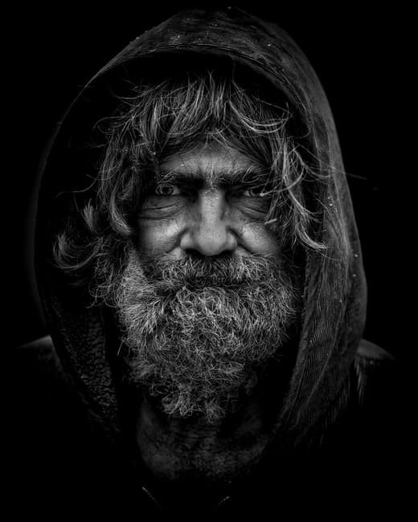
Task 1: The Hooded Man
The deep furrows beneath his piercing eyes told of a long life of servitude and hardship.
“Look closely my friend … ” he whispered hoarsely.

Slide 2
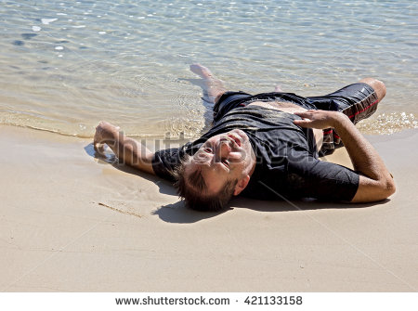
Task 3: Saved?
My feet hit the rough sand. I gasped. Weak from hours of treading water, my leaden legs dragged behind me in the salty sea. Finally, I had made it to safety. With the last vestiges of my strength, I launched myself forwards. Safety, warmth and shelter were my final thoughts before I passed out.

Slide 3
Task 3: Saved?
Mission: Take this opener. Write the next part of the story, introducing the setting and the character. Suggest something mysterious or dangerous but don’t tell the reader what it is. Leave them on a cliff hanger.
Before you write:
Where has the character arrived? What can you tell the reader about it?
Who is the character? How can you suggest ideas about him without giving away too much?
What will your mystery or danger be? How can you give your reader clues about this?

Slide 4

Task 3: Saved?
After you have written:
Read your story opening aloud to a partner. Does it make them want to read on? What can they guess about the story from your subtle suggestions?
Look carefully at the different types of punctuation in your writing. Is it placed and used accurately?
Notice the detail you have included in your writing. Is there enough to interest the reader without giving away your whole story?
Identify examples where you have chosen precise vocabulary to build up a picture for the reader. Have you experimented with the order of words in your sentences?

Slide 5
Task 3: Saved?
Before writing:
Think about the possibilities for the character and setting. Write notes to help yourself and don’t forget it is ok to write something and then cross it out if it doesn’t fit.
Draw a timeline or story map to help yourself.
Dup a plan, including key language that will help them structure their writing.
Orally rehearse what you are going to write before you commit it to paper.

Slide 6
Task 3: Saved?
Key questions during writing:
What are you trying to suggest to the reader about the character/setting/ mystery/danger? How have you done this? What information have you included/omitted to help you?
Explain what you have included in each paragraph. Why have you organised your writing in this way? Why does the reader need to know ... at this point?
Does your writing ‘flow’ when it is read aloud? How does the punctuation you have used help the reader to understand your writing?
What sentence types are you going to use in your writing? How will this help to build intrigue and engage the reader?
What language have you used to give precise detail about your story? What alternatives did you consider?
What tense/perspective are you writing in/from? Have you maintained it consistently throughout your text?
Would you want to read the rest of the story? Why? How are you going to leave the reader on a cliff hanger?

