Slide 1


R4 Summarise main ideas from more than one paragraph.
R4d. Can accurately order summaries of different paragraphs within a text.
Commissioned by The PiXL Club Ltd.
May 2019
This resource is strictly for the use of member schools for as long as they remain members of The PiXL Club. It may not be copied, sold nor transferred to a third party or used by the school after membership ceases. Until such time it may be freely used within the member school.
All opinions and contributions are those of the authors. The contents of this resource are not connected with nor endorsed by any other company, organisation or institution.
PiXL Club Ltd endeavour to trace and contact copyright owners. If there are any inadvertent omissions or errors in the acknowledgements or usage, this is unintended and PiXL will remedy these on written notification.
© Copyright The PiXL Club Limited, 2019

Slide 2


Vocabulary:
Read it:
order
Define it
Use it
Link it
Deconstruct it

Slide 3
R4d. Can accurately order summaries of different paragraphs within a text.
We will practise the skill of being able to order summaries of paragraphs across a whole text.
We will use our scanning and text marking skills to locate specific information within the whole text.
Notes:
* Note: Students will need copies of the texts ‘Thrown’ and ‘Where the Grass is Greener’ from the R4d. Folder.

Slide 4
R4d. Can accurately order summaries of different paragraphs within a text.
Why do we need to summarise?
Summarising teaches us how to recognise the most important ideas in a text and how to ignore information that is not important. Summarising improves our ability to remember what we have read.

Slide 5
R4d. Can accurately order summaries of different paragraphs within a text.
When do we use summarising in everyday life?
Summarising helps us with our research skills. For example, if we were looking for information about Space for a project, we would read lots of texts about Space to find ideas for our writing. It would be impossible to include every detail we read, therefore we would select the most important ideas and summarise these in our own words.

Slide 6
Top tips for general summarising:
R4d. Can accurately order summaries of different paragraphs within a text.
Steps to successful summarising
Read and understand the text carefully.
Think about the purpose of the text.
Scan and select the relevant information.
Find the main ideas – what is important?
Rewrite the main ideas in complete sentences in your own words.
Check that you have summarised accurately.

Slide 7
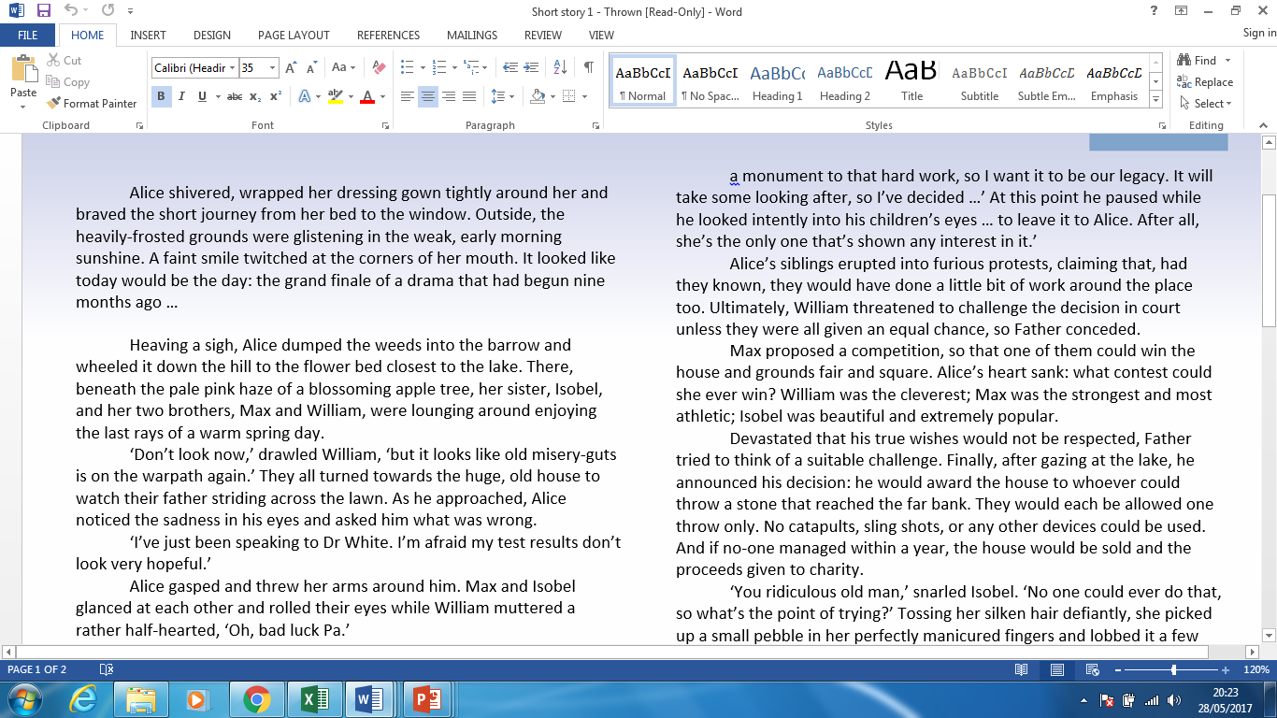
Using our summarising skills
Using the steps from the last slide – summarise the following paragraph:

Slide 8
Summary of the paragraph
Their dad will leave the house to whoever can throw a stone to the far bank.
They can’t use anything to help them.
If no one can do it, the house will be given to charity.

Slide 9
Ordering summaries of different paragraphs
It is essential that we have the skills to summarise. However, sometimes we need to answer questions where someone has already summarised the text for us and we need to put their summaries in order.

Slide 10
How do we approach this style of question?
To answer this type of question, we need to use our scanning and text marking skills.
Specific information
Highlighting
Scanning means to read a text quickly in order to find specific information.
Text Marking
Circling
Underlining

Slide 11
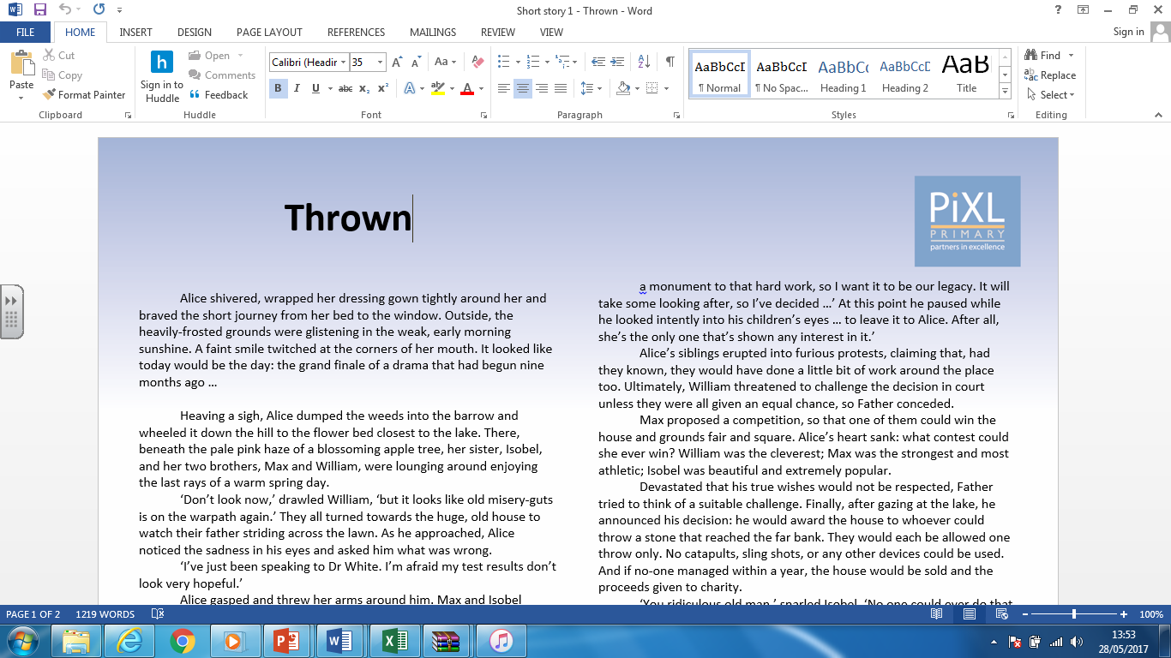
Ordering summaries of different paragraphs
You will need a copy of the text ‘Thrown’.
Notes:
Print copes of the text ‘Thrown’ in advance.

Slide 12
Ordering summaries of different paragraphs
On the next slide there are some summaries of different paragraphs from the text.
Number them 1 – 5 to show the order in which events happen in the text.
The first one has been done for you.

Slide 13
Ordering summaries of different paragraphs
It is suggested that there should be a contest to
win the house.
William is caught cheating in the challenge.
Alice uses the ice to defeat her siblings.
They receive some bad news about their father.
There is a discussion about what will happen to
the house.
1

Slide 14
The first thing we must do is find the paragraphs that the summaries are about.
Once we have found these we scan the text and text mark them. We should do this for all of the paragraphs before deciding on the right order.
We will now go through each of the summaries in the question, one by one.

Slide 15
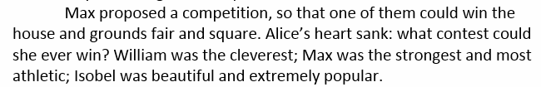
Summary 1 – It is suggested that there should be a contest.
Scan and text mark
We know that this is the correct paragraph as it says: Max proposed a competition and we know that proposed means the same as suggested. We also know that competition means the same as contest. The paragraph also contains the word contest which gives us a clue, but it is always important to check the information surrounding this, to check we have got it right.

Slide 16
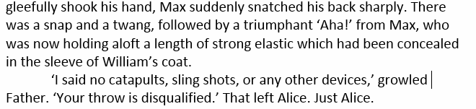
Summary 2 – William is caught cheating in the challenge.
Scan and text mark
We know we have found the correct paragraph as it says: ‘Aha!’ from Max, who was now holding aloft a length of strong elastic which had been concealed in the sleeve of William’s coat. It also says: ‘… no catapults, sling shots, or any other devices’ as well as ‘Your throw is disqualified.’ All of this tells us that William has cheated by using some elastic as a sling shot/catapult.

Slide 17
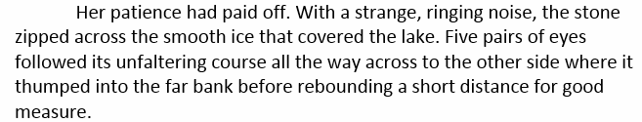
Summary 3 – Alice uses the ice to defeat her siblings.
Scan and text mark
We know that this is the correct paragraph as she uses the ice to slide the stone into the bank and win the house. It says: the stone zipped across the smooth surface of the ice that covered the lake… it also says …where it thumped into the far bank. We know she had to get the stone to the far bank to beat her siblings and win the house.

Slide 18
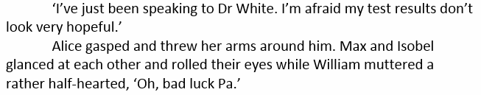
Summary 4 – They receive some bad news about their father.
Scan and text mark
We know that they have received some bad news about their father in this paragraph as it says: his test results don’t look very hopeful. We can also tell this by the way the characters act e.g. Alice gasped and threw her arms around him and William muttered ‘Oh, bad luck Pa.’

Slide 19
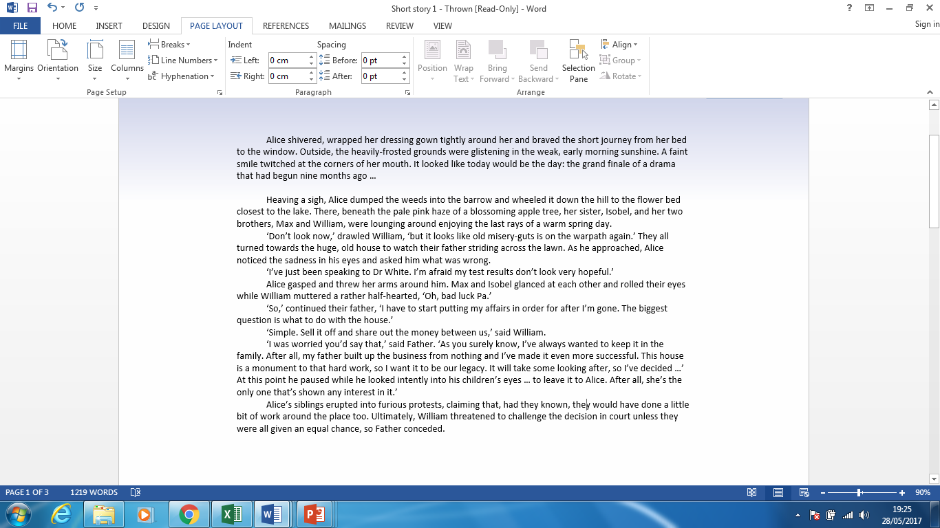
Summary 5 – There is a discussion about what will happen to the house.
Scan and text mark
We know this is the right paragraph as their father says: ‘The biggest question is what to do with the house.’ William also says: ‘Simple. Sell it off...’ There is also further discussion about their father wanting to keep the house in the family and that he wants it to be their legacy.

Slide 20
Using what we have done…
So far we have:
scanned the whole text
found the paragraphs that the summaries are about
text marked all of the summaries.
Next, we simply number them in the order in which they appear in the text…

Slide 21

The answer…
Here are some summaries of different paragraphs from the text.
Number them 1 – 5 to show the order in which they appear in the text.
The first one has been done for you.
It is suggested that there should be a contest to win the house.
William is caught cheating in the challenge.
Alice uses the ice to defeat her siblings.
They receive some bad news about their father.
There is a discussion about what will happen to the house.
3
4
5
1
2

Slide 22
Practise
You will need a copy of the text ‘Astronuts’.
Scan the whole text.
Find the paragraphs that the summaries are about.
Text mark all of the summaries.
Number the paragraphs in the order in which they appear in the text.

Slide 23
Practise
The spacecraft disappeared before the farm hand could speak to them.
One evening, Alan and Beth took their parents’ vehicle for a drive.
A farm hand stood, ready for his dinner, after a day’s work.
Beth and Alan both had fun at the other species’ expense, believing they were far superior.
Beth and Alan decided to travel to
the planet and be mischievous.
Here are some summaries of different paragraphs from the text.
Number them 1 – 5 to show the order in which they appear in the text.

Slide 24
Summary 1 – The spacecraft left before the farm hand could speak to them.
Scan and text mark
Thaddeus fell to his knees, begging, ‘Take me with you, enlightened ones,’ but they were gone. Still trying to make sense of what he had seen, he sprinted home and telephoned everyone he knew and some he didn’t, including the local radio station.
We know that this is the correct paragraph as it says that he called out, ‘Take me with you’ but that ‘they were gone.’ ‘Left’ and ‘gone’ mean the same thing.

Slide 25
Summary 2 – One evening, Alan and Beth took their parents’ vehicle for a drive.
Scan and text mark
In a star system many, many light-years away, Alan and Beth, a couple of young Zarkians (alien beings, for want of a better term), were taking their parents’ Galaxy Hopper spacecraft for a quick spin before supper.
We know that this is the correct paragraph as it says they ‘were taking their parents’ … spacecraft for a quick spin’. A ‘quick spin’ means a drive and a spacecraft is a type of vehicle. Also we know that you eat supper in the evening so the time of day is correct.

Slide 26
Summary 3 – Beth and Alan both had fun at the other species’ expense, believing they were far superior.
Scan and text mark
‘They then seem to believe that it’s some profound message. Simple really – just like them.’ Still howling with laughter, they star-jumped all the way back to their home system.
We know that this is the correct paragraph as they refer to the species as ‘simple’, which implies they think they are much more complex, clever or superior. We know they are having fun as we read they are ‘howling with laughter’.

Slide 27
Summary 4 – A farm hand stood, ready for his dinner, after a day’s work.
Scan and text mark
Resting on his pitchfork under a vast prairie sky, Thaddeus Jackson wiped his hands on his denim dungarees, tipped back the brim of his straw hat and glanced towards the western horizon. Night was falling – time to head back to the farm. Tuesday night was bean stew night!
We know that this is the correct paragraph because we read he is thinking of dinner as it says ‘Tuesday night was bean stew night.’ Also we know he’s been working because he has a pitchfork and he ‘wiped his hands on his denim dungarees.’

Slide 28
Summary 5 – Beth and Alan decided to travel to the planet and be mischievous.
Scan and text mark
‘Anyway, want to take a closer look at the planet? We just have to be a little careful of all the junk they leave orbiting the place, messy creatures, then we can have a little fun with one of them.’
We know that this is the correct paragraph because Beth says ‘…want to have a closer look at the planet?’ and also we know they're planning on being mischievous as she says ‘then we can have a little fun with one of them.’

Slide 29
So far we have:
scanned the whole text
found the paragraphs that the summaries are about
text marked all of the summaries.
Next, we simply number them in the order in which they appear in the text…

Slide 30
Practise
The spacecraft disappeared before the farm hand could speak to them.
One evening, Alan and Beth took their parents’ vehicle for a drive.
A farm hand stood, ready for his dinner, after a day’s work.
Beth and Alan both had fun at the other species’ expense, believing they were far superior.
Beth and Alan decided to travel to
the planet and be mischievous.
4
Here are some summaries of different paragraphs from the text.
Number them 1 – 5 to show the order in which they appear in the text.
1
3
5
2

Slide 31
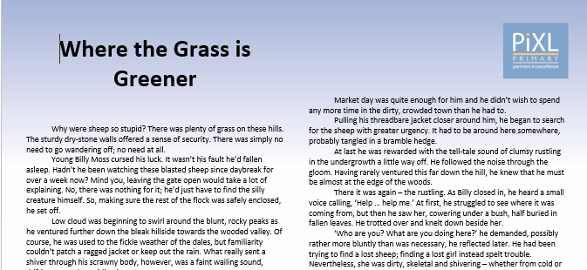
Your turn
You will need a copy of the text ‘Where the Grass is Greener’ for this task.
Notes:
Have a copy of this printed for the adults.

Slide 32
Your turn
Billy thinks about what he should do with Alice.
He wonders what the noise on
the dales is.
He encounters men from the Mill.
Billy is annoyed with himself.
Alice explains what has happened to her.
Here are some summaries of different paragraphs from the text.
Number them 1 – 5 to show the order in which they appear in the text.
The first one has been done for you.
1

Slide 33
Your turn
Remember to do the following:
Scan the whole text.
Find the paragraphs that the summaries were about.
Text mark all of the summaries.
Number the paragraphs in the order in which they appear in the text.

Slide 34
How did you do?
Billy thinks about what he should do with Alice.
He wonders what the noise on the dales is.
He encounters men from the Mill.
Billy is annoyed with himself.
Alice explains what has happened to her.
Here are some summaries of different paragraphs from the text.
Number them 1 – 5 to show the order in which they appear in the text.
The first one has been done for you.
4
2
5
1
3

Slide 35

Are you confident in accurately ordering summaries of different paragraphs within a text?
I am confident with …
I would like more practice with …

