Slide 1


R4: Summarise main ideas from more than one paragraph
R4e. Can identify the main message in a poem/story
= teacher notes
Commissioned by The PiXL Club Ltd.
May 2019
This resource is strictly for the use of member schools for as long as they remain members of The PiXL Club. It may not be copied, sold nor transferred to a third party or used by the school after membership ceases. Until such time it may be freely used within the member school.
All opinions and contributions are those of the authors. The contents of this resource are not connected with nor endorsed by any other company, organisation or institution.
PiXL Club Ltd endeavour to trace and contact copyright owners. If there are any inadvertent omissions or errors in the acknowledgements or usage, this is unintended and PiXL will remedy these on written notification.
© Copyright The PiXL Club Limited, 2019

Slide 2

Teacher notes
These slides focus on the skill of being able to summarise whole texts, identifying the main meaning/message they are trying to give.
A modelled example and guided questions give some tips for scanning and text marking. Practice questions allow children to apply their skills.
* Note: Children will need a copy of the poem ‘Vocation’ and ‘Where the Grass is Greener’ from the R4e. folder.

Slide 3

Vocabulary:
Read it:
message
Define it
Use it
Link it
Deconstruct it

Slide 4
Often poems or stories have a main message or meaning to share with us.
Discuss the texts listed below with your partner.
Do you know the main idea/message/meaning behind them?
Ring a Ring ‘o Roses
Cinderella
Beauty and the Beast
Rapunzel
Little Red Riding Hood

Slide 5
What is the main message behind these texts?
Cinderella acts appropriately even when surrounded by bad behaviour. The message is that kindness pays.
Rapunzel appears to have no escape. The message is to think ‘outside the box’ to solve problems.
Little Red Riding Hood was tricked. The message is to be careful who you trust – stranger danger.
Beauty and the Beast expresses the message that the behaviour and personality of someone is more important than their external looks.
Ring a Ring ‘o Roses is linked to the Great Plague. The 'ring' was the ring of sores around the mouths of victims, who subsequently sneezed and fell down dead.

Slide 6
Practise
We will now read a text together and identify the main message within it. The text is a poem called Vocation by Rabindranath Tagore.
Notes:
Pupils would benefit from having the poem printed out.

Slide 7
When the gong sounds ten in the morning and I walk to school by our lane, Every day I meet the hawker crying, "Bangles, crystal bangles!" There is nothing to hurry him on, there is no road he must take, no place he must go to, no time when he must come home. I wish I were a hawker, spending my day in the road, crying, "Bangles, crystal bangles!"

Slide 8
When at four in the afternoon I come back from the school, I can see through the gate of that house the gardener digging the ground. He does what he likes with his spade, he soils his clothes with dust, nobody takes him to task if he gets baked in the sun or gets wet.

Slide 9
I wish I were a gardener digging away at the garden with nobody to stop me from digging.
Just as it gets dark in the evening and my mother sends me to bed, I can see through my open window the watchman walking up and down.

Slide 10
The lane is dark and lonely, and the street-lamp stands like a giant with one red eye in its head. The watchman swings his lantern and walks with his shadow at his side, and never once goes to bed in his life. I wish I were a watchman walking the streets all night, chasing the shadows with my lantern.

Slide 11
A range of question types could be used to assess our ability to identify the main message in this poem.
The example we will practise is a multiple choice question.
This is a question type which appears frequently in the Reading paper.

Slide 12
Example Question
The watchman has the best vocation.
The person in the poem needs to get a job.
There is no need to be in a hurry.
The person in the poem is keen to grow up.
What is revealed throughout the poem?
Tick one.

Slide 13
How do we approach this style of question?
To answer this type of question we need to use our scanning skills to scan the whole poem.
Scanning means to read a text quickly in order to find specific information.
To answer the question we must go through each statement one by one to check whether or not they summarise the main message of the poem.

Slide 14
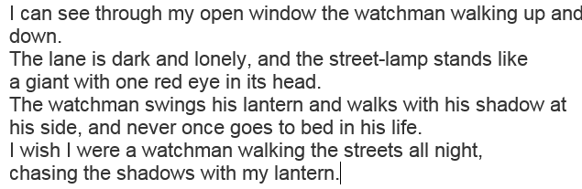
Statement 1 – The watchman has the best vocation.
I know that vocation means the same as job. I scan the text to see if it says anything about the watchman having the best job. Although it says: I wish I were a watchman… it doesn’t say anything about it being the best job, or better than the other jobs, neither does it say it all of the way through the poem. This is not what is revealed throughout the poem, so I will not tick this one.

Slide 15
Statement 2 – The person in the poem needs to get a job.
When the gong sounds ten in the morning and I walk to school by our lane. Every day I meet the hawker crying, "Bangles, crystal bangles!" There is nothing to hurry him on, there is no road he must take, no place he must go to, no time when he must come home. I wish I were a hawker, spending my day in the road, crying, "Bangles, crystal bangles!"
When at four in the afternoon I come back from the school, I can see through the gate of that house the gardener digging the ground. He does what he likes with his spade, he soils his clothes with dust, nobody takes him to task if he gets baked in the sun or gets wet.
I wish I were a gardener digging away at the garden with nobody to stop me from digging.
Just as it gets dark in the evening and my mother sends me to bed, I can see through my open window the watchman walking up and down. The lane is dark and lonely, and the street-lamp stands like a giant with one red eye in its head. The watchman swings his lantern and walks with his shadow at his side, and never once goes to bed in his life. I wish I were a watchman walking the streets all night, chasing the shadows with my lantern.
No evidence that they need a job

Slide 16
Statement 2 – The person in the poem needs to get a job (continued).
We need to scan the whole poem. We use text marking to help. We can see that is says: I walk to school… therefore the person in the poem is of school age and unlikely to need a job.
We scan to look for other evidence. There is nothing in the first stanza (verse) that says they need a job. In the second stanza (verse) there is another reference to school. There is no other evidence in the poem to say they need a job.
This is not what is revealed throughout the poem, so I will not tick it.

Slide 17
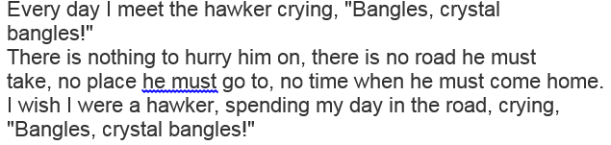
Statement 3 – There is no need to be in a hurry.
I will scan the poem for reference to hurrying. I find one reference in the first stanza (verse) as it says: There is nothing to hurry him on… when talking about the hawker. I scan the rest of the poem, but there are no other references to hurry/hurrying. This is not what is revealed throughout the poem, so I will not tick it.

Slide 18
Statement 4 – The person in the poem is keen to grow up.
When the gong sounds ten in the morning and I walk to school by our lane. Every day I meet the hawker crying, "Bangles, crystal bangles!" There is nothing to hurry him on, there is no road he must take, no place he must go to, no time when he must come home. I wish I were a hawker, spending my day in the road, crying, "Bangles, crystal bangles!"
When at four in the afternoon I come back from the school, I can see through the gate of that house the gardener digging the ground. He does what he likes with his spade, he soils his clothes with dust, nobody takes him to task if he gets baked in the sun or gets wet.
I wish I were a gardener digging away at the garden with nobody to stop me from digging.
Just as it gets dark in the evening and my mother sends me to bed, I can see through my open window the watchman walking up and down. The lane is dark and lonely, and the street-lamp stands like a giant with one red eye in its head. The watchman swings his lantern and walks with his shadow at his side, and never once goes to bed in his life. I wish I were a watchman walking the streets all night, chasing the shadows with my lantern.

Slide 19
Statement 4 – The person in the poem is keen to grow up (continued).
I know that this must be the answer, but I will check it anyway, just in case I have made a mistake.
I will scan the text for evidence that the person is keen to grow up. In each stanza (verse) the person says ‘I wish I were…’ They then tell us why they wish they were either a hawker, gardener or watchman rather than a school-aged boy or girl.
Therefore, we know that they are keen to grow up and do one of these jobs. This is what is revealed throughout the poem so I will tick it.

Slide 20
Answer
The watchman has the best vocation.
The person in the poem needs to get a job.
There is no need to be in a hurry.
The person in the poem is keen to grow up.
What is revealed throughout the poem?
Tick one.
a

Slide 21
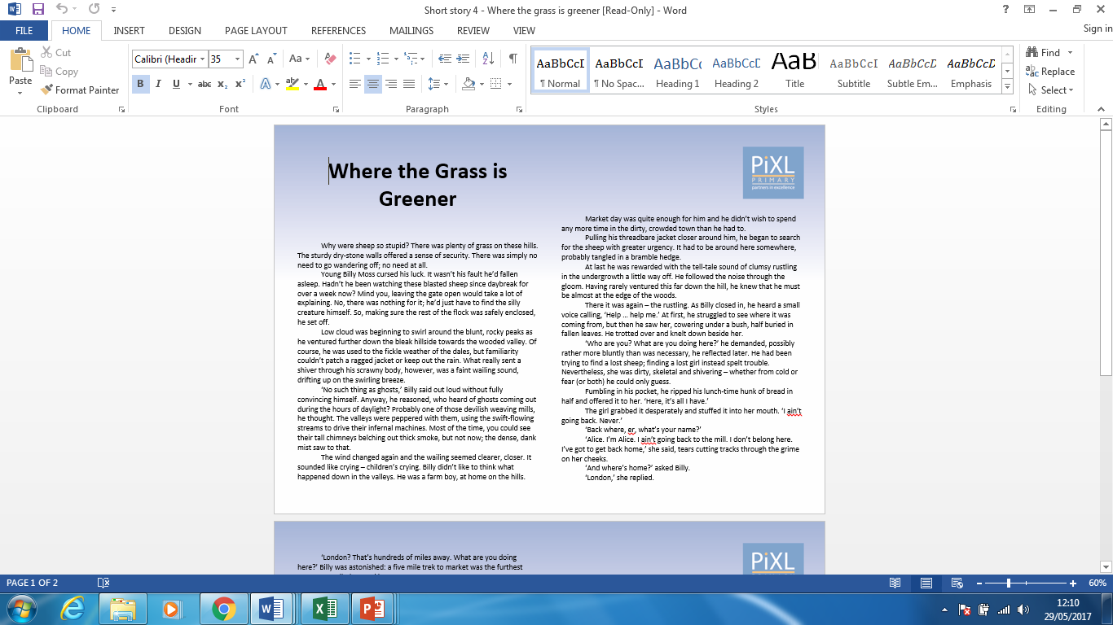
Your turn
You will need a copy of the text ‘Where the Grass is Greener’ for this task.
Notes:
Have a copy of the text ‘Where the Grass is Greener’ printed out for the pupils to access.

Slide 22
Your turn
The question you will be provided with is another multiple choice question. Apply the same method as was modelled earlier:
Scan the entire text for evidence of each statement.
Use text marking where appropriate.
Eliminate the statements you know are not correct.
Select and tick the correct answer.

Slide 23
Your turn
It is difficult to look after sheep
on your own.
It is better to work in the mill
than on the farm.
Times were hard for children
living in the area at that time.
London is a better place to live than the Dales.
What is revealed throughout the story?
Tick one.

Slide 24
Answer
It is difficult to look after sheep
on your own.
It is better to work in the mill
than on the farm.
Times were hard for children
living in the area at that time.
London is a better place to live than the Dales.
What is revealed throughout the story?
Tick one.
a
a

Slide 25

Are you confident identifying the main message in a poem or story?
I am confident with …
I would like more practice with …

