Slide 1


R4 Summarise main ideas from more than one paragraph
R4f. Can use information from the whole text to answer questions e.g. true or false.
Commissioned by The PiXL Club Ltd.
May 2019
This resource is strictly for the use of member schools for as long as they remain members of The PiXL Club. It may not be copied, sold nor transferred to a third party or used by the school after membership ceases. Until such time it may be freely used within the member school.
All opinions and contributions are those of the authors. The contents of this resource are not connected with nor endorsed by any other company, organisation or institution.
PiXL Club Ltd endeavour to trace and contact copyright owners. If there are any inadvertent omissions or errors in the acknowledgements or usage, this is unintended and PiXL will remedy these on written notification.
© Copyright The PiXL Club Limited, 2019

Slide 2


Vocabulary:
Read it: information
Define it
Use it
Link it
Deconstruct it

Slide 3

Can use information from the whole text to answer questions e.g. true or false
We will be focusing on True or False questions.
It is important to look at this question type as it appears in every SATs paper.
To successfully answer these questions you must ensure you have paid close attention to what you’ve been reading!
The wording can trick you so be careful.
The aim is to not to read too quickly, and scan carefully.

Slide 4

How do we approach this style of question?
To answer this type of question we need to use our scanning and text marking reading skills.
Specific Information
Highlighting
Scanning means to read a text quickly in order to find specific information.
Text Marking
Circling
Underlining

Slide 5
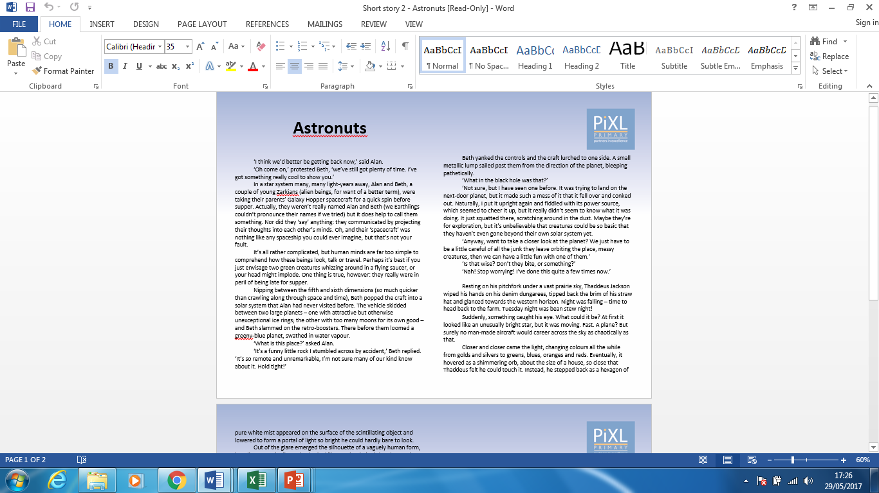
Use information from the whole text to answer questions e.g. true or false.
For this section we will be reading the text ‘Astronuts’.
Notes:
Pupils would benefit from having this text printed out.

Slide 6
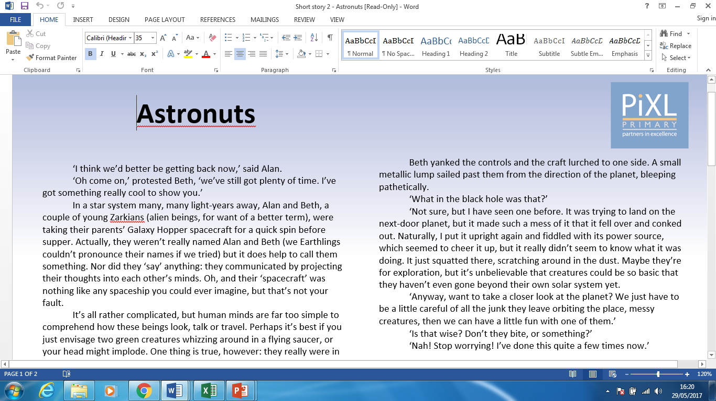
Look at this paragraph and decide whether the following statements are true or false.
Notes:
Pupils should highlight this paragraph on their printed out texts so they have it in front of them when answering the questions on the next slide.

Slide 7
Example Question
True False
1. Alan tried to persuade Beth to stay
out longer.
2. Alan and Beth don’t talk.
3. Alan and Beth are Earthlings.

Slide 8
In order to identify if these statements are true or false, we must use our scanning skills and text marking skills. We will do the following:
Carefully read the question and identify the key information in the statement provided in the question.
Scan to find this key information in the text.
Text mark this part of the text.
Read the text carefully to decide whether it is true or false.

Slide 9

Statement 1 – Alan tried to persuade Beth to stay out longer.
This part of the text shows that it is Beth that tries to persuade Alan.

Slide 10
Statement 2 – Alan and Beth don’t talk.
We need to read the text very carefully. It says “Nor did they ‘say’ anything,” which means they didn’t talk.

Slide 11
Statement 3 – Alan and Beth are Earthlings.
The text states that Alan and Beth are a couple of young Zarkians (alien beings…)

Slide 12

True False
Alan tried to persuade Beth to
stay out longer.
2. Alan and Beth don’t talk.
3. Alan and Beth are Earthlings.
a
a
a

Slide 13
We have looked carefully at how to use information from a paragraph to answer true or false questions.
We will now use information from the whole text.

Slide 14
Using the information from the text, put a tick in the correct box to show whether each statement is true or false.
 | True | False
Alan had visited Earth before.
It was morning when they arrived on Earth.
Thaddeus could not move when he encountered the spacecraft.
Beth believes that humans are clever.

Slide 15
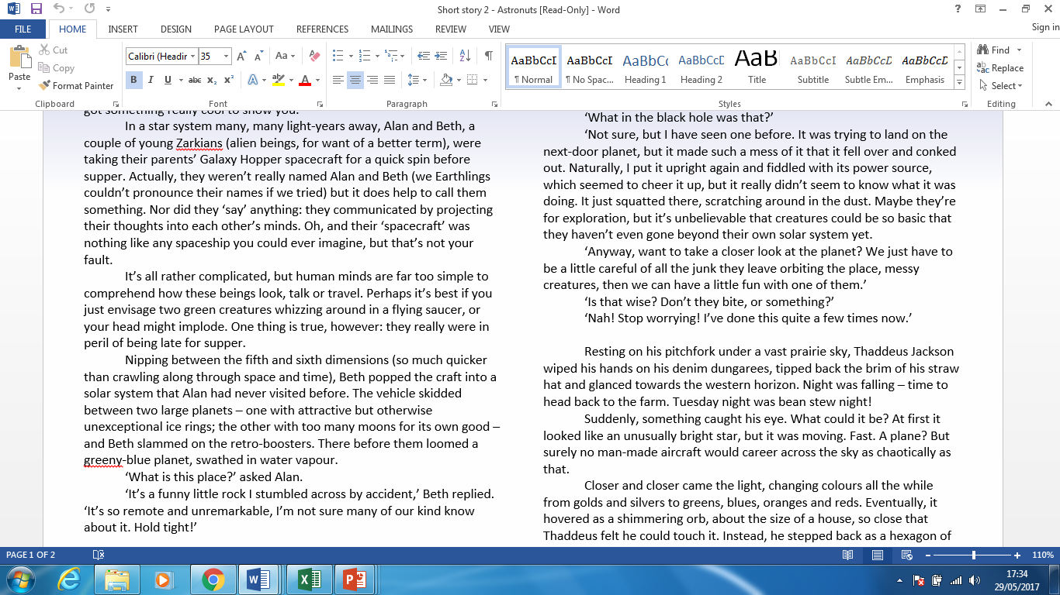
Statement 1 – Alan had visited Earth before.
I will scan the text for evidence that shows whether Alan has been to Earth before or not. I will text mark the evidence.

Slide 16
Statement 1 – Alan had visited Earth before.
I know that this is false as it says: Beth popped the craft into a solar system that Alan had never visited before. Also, after it says: There before them loomed a greeny-blue planet, swathed in water vapour (Earth). Alan says: ‘What is this place?’ which shows he has not visited/seen Earth before.

Slide 17

Statement 2 – It was morning when they arrived on Earth.
I will scan the text for evidence that shows what time of day it was on Earth. I will text mark the evidence.

Slide 18
Statement 2 – It was morning when they arrived on Earth.
I know that this is false as it says: Night was falling. It also says: Tuesday night was bean stew night. Therefore, it was not morning when they arrived on Earth.

Slide 19
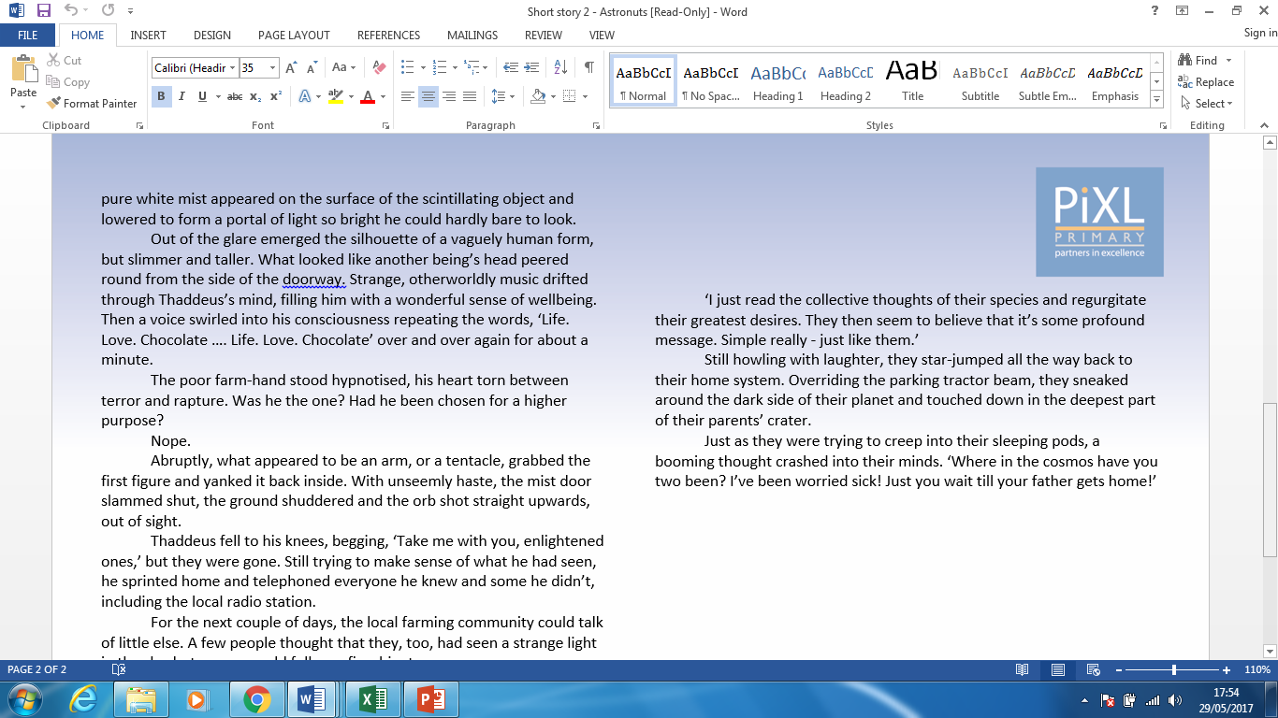
Statement 3 – Thaddeus could not move when he encountered the spacecraft.
I will scan the text for evidence that shows Thaddeus’s reaction to the spacecraft. I will text mark the evidence.

Slide 20
Statement 3 – Thaddeus could not move when he encountered the spacecraft.
I know that this is true because it says that Thaddeus stood hypnotised, which shows he couldn't move.

Slide 21
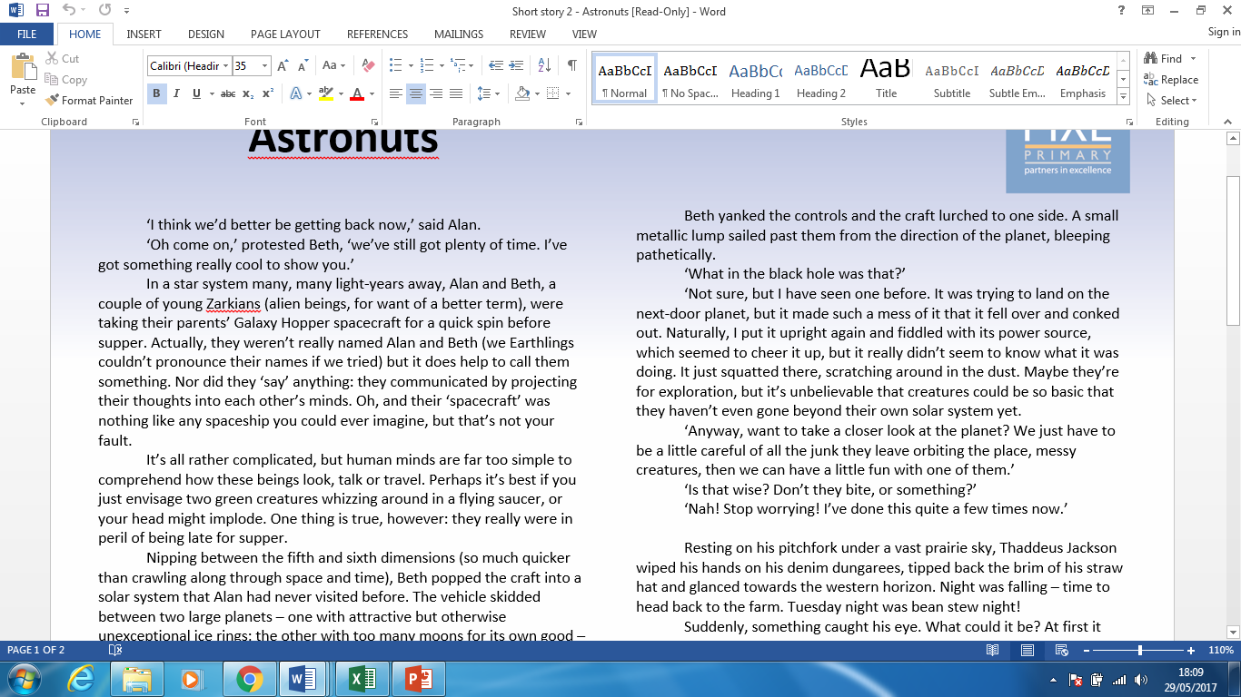
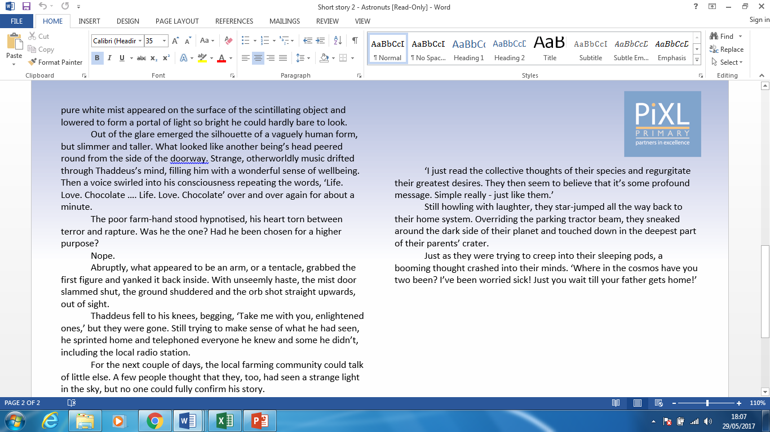
Statement 4 – Beth believes that humans are clever.
I will scan the text for evidence that shows what Beth feels about humans. I will text mark the evidence.

Slide 22
Statement 4 – Beth believes that humans are clever.
There are two pieces of text evidence I could use to answer this. I know that this is false because she first says: ‘… it’s unbelievable that creatures should be so basic that they haven’t gone beyond their own solar system yet.’ She also calls them: ‘messy creatures’.
In the second piece of text she says: ‘Simple really – just like them.’ This shows that she does not think humans are clever.

Slide 23
The answer
 | True | False
Alan had visited Earth before.
It was morning when they arrived on Earth.
Thaddeus could not move when he encountered the spacecraft.
Beth believes that humans are clever.
Using the information from the text, put a tick in the correct box to show whether each statement is true or false.
a
a
a
a

Slide 24
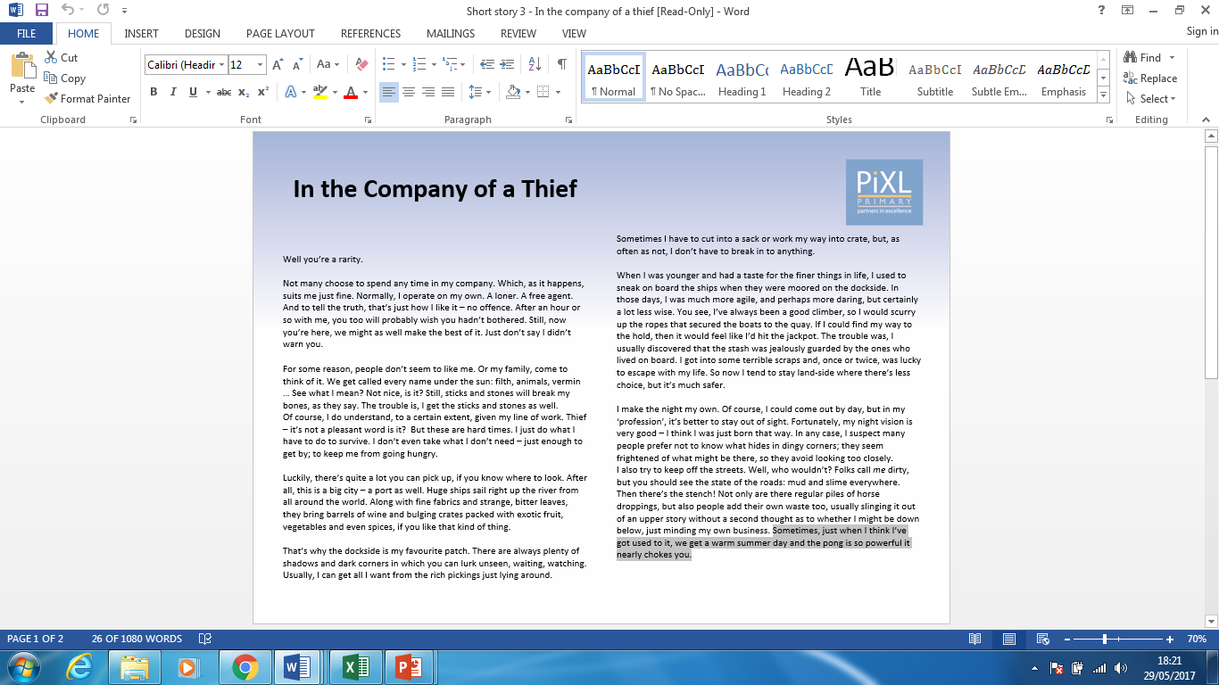
Your turn
You will need a copy of the text ‘In the Company of a Thief’ for this task.
Notes:
Pupils will need a copy of this text printed out.

Slide 25
Your turn
Remember the following steps:
Carefully read the question and identify the key information in the statement provided in the question.
Scan to find this key information in the text.
Text mark this part of the text.
Read the text carefully to decide whether it is true or false.

Slide 26
Using the information from the text, put a tick in the correct box to show whether each statement is true or false.
 | True | False
In the past, he found food aboard boats.
His ability to see at night is not good.
The residents of the cottage were no longer there.
He bites through the rope to free the dog.

Slide 27
Using the information from the text, put a tick in the correct box to show whether each statement is true or false.
 | True | False
In the past, he found food aboard boats.
His ability to see at night is not good.
The residents of the cottage were no longer there.
He bites through the rope to free the dog.
a
a
a
a

Slide 28
Are you confident using information from the whole text to answer questions e.g. true or false?
I am confident with …
I would like more practice with …

