Slide 1



LIFE/work balance
We have started a #LIFEworkbalance campaign and we need your help to complete our LIFE/work balance survey.
We hope to publish the results soon, so please give 15 minutes of your time to help us get a true picture of school life.
Want to be a part of this campaign? Take the survey on our website and share it with your colleagues!
© Classroom Secrets Limited 2019

Slide 2
Year 4 – Autumn Block 1 – Ready to Write – Clauses
About This Resource:
This PowerPoint has been designed to support your teaching of this small step. It includes a starter activity and an example of each question from the Varied Fluency and Application and Reasoning resources also provided in this pack. You can choose to work through all examples provided or a selection of them depending on the needs of your class.
National Curriculum Objectives:
  English Year 3: (3G3.4) Extending the range of sentences with more than one clause by using a wider range of conjunctions, including: when, if, because, although
More resources from our Grammar, Punctuation and Spelling scheme of work.
Did you like this resource? Don’t forget to review it on our website.
© Classroom Secrets Limited 2018

Slide 3
Year 4 – Autumn Block 1 – Ready to Write – Clauses
Notes and Guidance
Children should know that a clause is a group of words that contains a verb and a noun (or pronoun).
They should know that: a main clause can form a complete sentence; two main clauses can be joined with a co-ordinating conjunction; and a main clause can be turned into a subordinate clause by adding a subordinating conjunction. They may be able to explain that a subordinate clause relies on the main clause to make sense.
Children should be able to extend a main clause by using a range of conjunctions, such as when, if, because and although.
Focused Questions
What types of words must a clause include?
What type of clause is this?
How can you turn this main clause into a subordinate clause?
Can a main clause form a complete sentence?
Can a subordinate clause form a complete sentence?
© Classroom Secrets Limited 2018

Slide 4
Year 4 – Autumn Block 1 – Ready to Write
Step 2: Clauses
© Classroom Secrets Limited 2018

Slide 5
Introduction
Put the words below in the correct place on the table.
Noun | Verb
morning
roared
strolled
sighed
leapt
sprinted
people
house
car
darkness
cried
© Classroom Secrets Limited 2018

Slide 6
Introduction
Put the words below in the correct place on the table.
Noun | Verb
morning
people
strolled
leapt
house
darkness
roared
sighed
car
sprinted
cried
© Classroom Secrets Limited 2018

Slide 7
Varied Fluency 1
Tick the main clauses below.
the dragon flew high in the sky
flying high
quick as a flash,
the wizard cast his spell
© Classroom Secrets Limited 2018

Slide 8
Varied Fluency 1
Tick the main clauses below.
the dragon flew high in the sky. | ✓
flying high
quick as a flash,
the wizard cast his spell | ✓
© Classroom Secrets Limited 2018

Slide 9
Varied Fluency 2
Underline the main clause in each sentence below.
Pour the water over the teabag when the kettle has boiled.
If required, add milk to the cup.
© Classroom Secrets Limited 2018

Slide 10
Varied Fluency 2
Underline the main clause in each sentence below.
Pour the water over the teabag when the kettle has boiled.
If required, add milk to the cup.
© Classroom Secrets Limited 2018

Slide 11
Varied Fluency 3
Use the subordinating conjunctions to complete the sentences below.
The meerkat is part of the mongoose family _____________ it is the only member that does not have a bushy tail. _____________ it is standing upright, it uses its tail to balance. They stand in the morning sun to absorb heat _____________ nights can be long and cold.
when | because | although
© Classroom Secrets Limited 2018

Slide 12
Varied Fluency 3
Use the subordinating conjunctions to complete the sentences below.
The meerkat is part of the mongoose family although it is the only member that does not have a bushy tail. When it is standing upright, it uses its tail to balance. They stand in the morning sun to absorb heat because nights can be long and cold.
when | because | although
© Classroom Secrets Limited 2018

Slide 13
Varied Fluency 4
Match the clauses together.
Underline the subordinating conjunction in each.
She was late |  | as she slipped into the dark alley.
You can make a sandwich |  | because the bus never came.
No-one saw her |  | if we have any bread.
© Classroom Secrets Limited 2018

Slide 14
Varied Fluency 4
Match the clauses together.
Underline the subordinating conjunction in each.
She was late |  | as she slipped into the dark alley.
You can make a sandwich |  | because the bus never came.
No-one saw her |  | if we have any bread.
© Classroom Secrets Limited 2018

Slide 15
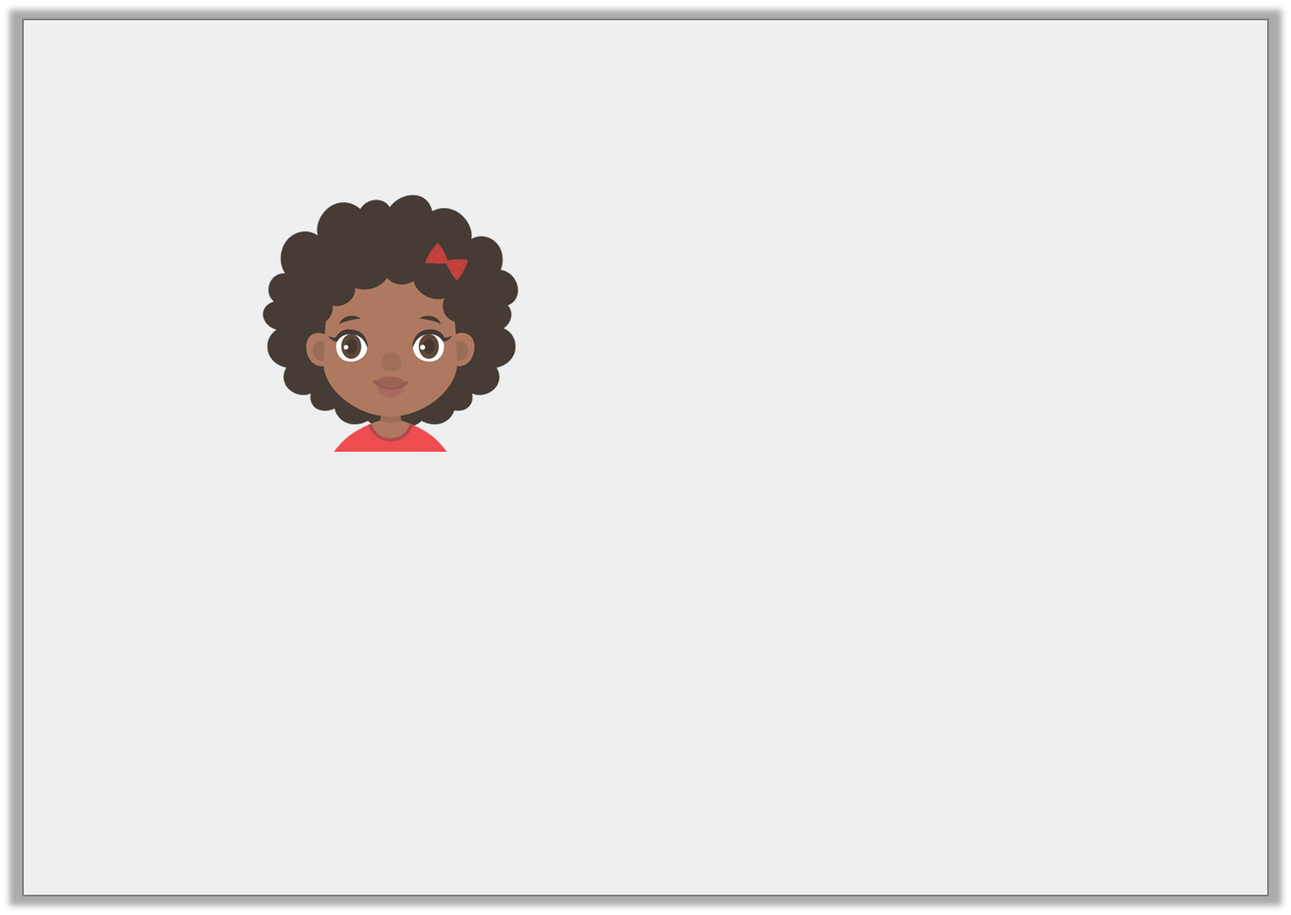
Reasoning 1
Malikah says,
True or false? Explain how you know. Give examples to prove it.
A subordinate clause does not have a verb.
© Classroom Secrets Limited 2018

Slide 16
Reasoning 1
Malikah says,
True or false? Explain how you know. Give examples to prove it.
False because...
A subordinate clause does not have a verb.
© Classroom Secrets Limited 2018

Slide 17
Reasoning 1
Malikah says,
True or false? Explain how you know. Give examples to prove it.
False because a subordinate clause can have a verb. The main clause will also have a verb. For example,
When Anne tripped, she broke her ankle.
A subordinate clause does not have a verb.
© Classroom Secrets Limited 2018

Slide 18
Application 1
Use each of the subordinating conjunctions to write three sentences by adding a subordinate clause before the main clause below.
...the horse galloped.
because | although | when
© Classroom Secrets Limited 2018

Slide 19
Application 1
Use each of the subordinating conjunctions to write three sentences by adding a subordinate clause before the main clause below.
...the horse galloped.
Various answers, for example:
Because he needed to win the race, the horse galloped.
Although he was exhausted already, the horse galloped.
When the hunting horn sounded, the horse galloped.
because | although | when
© Classroom Secrets Limited 2018

Slide 20
Reasoning 2
Look at the sentences below. What’s the same? What’s different?
Use the word bank below to help you explain your answers.
A. If he opened the door, the evil master would escape.
B. The evil master would escape when he opened the door.
subordinate clause | subordinating conjunction | main clause
© Classroom Secrets Limited 2018

Slide 21
Reasoning 2
Look at the sentences below. What’s the same? What’s different?
Use the word bank below to help you explain your answers.
A. If he opened the door, the evil master would escape.
B. The evil master would escape when he opened the door.
Various answers, for example:
Same: The main clause ‘the evil master would escape’.
Different: The subordinating conjunctions – ‘if’ and ‘when’.
The subordinate clause is at the beginning of A but is at the end of B.
There is a comma in A but not in B.
subordinate clause | subordinating conjunction | main clause
© Classroom Secrets Limited 2018

