Slide 1
Why did William Win The Battle of Hastings?
In the middle of your man – write down all the QUALITIES (good points) that William had as a leader.

Slide 2
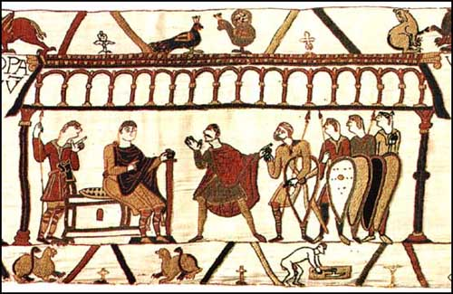
Learning Objective
To analyse the reasons why William won the Battle of Hastings.

Slide 3
Which reason was the most SIGNIFICANT?
What does this word mean?
Activate prior knowledge

Slide 4
Task – draw a line across a double page in your book like this;
Least significant
Most significant

Slide 5
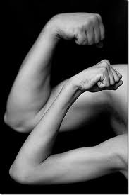
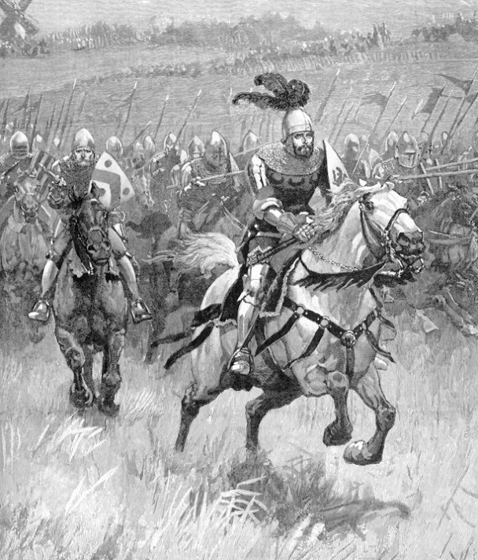
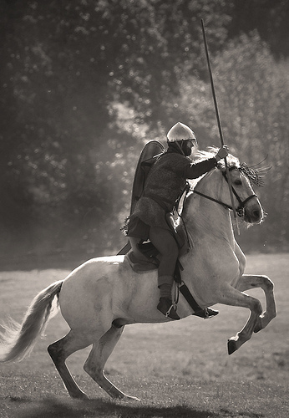
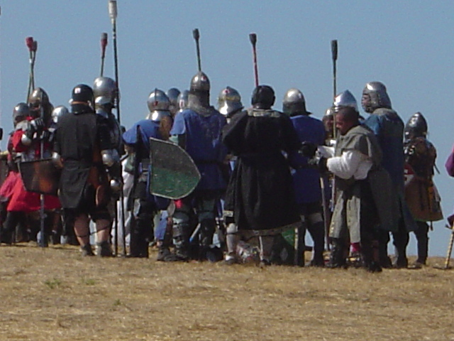
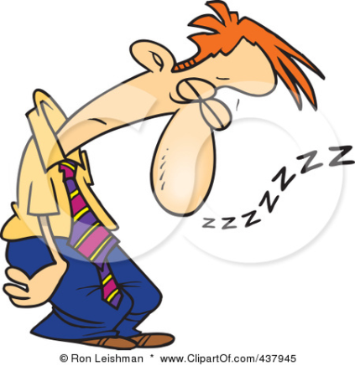
Reasons why William won
William played a clever trick on Harold.
Strength of his army
Organisation of his army
Better planning by William.
Harold and his army were tired

Slide 6
Swap books and compare with your partners.
Write down a difference or a similarity between yours and your partners.
Sign it with your name and write PA next to it (peer assessment)

Slide 7
Now add the following words to your chart;
Luck (the wind changing when Harold was in the North/Harold’s army tired from the battle with HH)
Forward planning by William
Better weapons
Better armour
Clever tricks
Better trained soldiers

