Slide 1
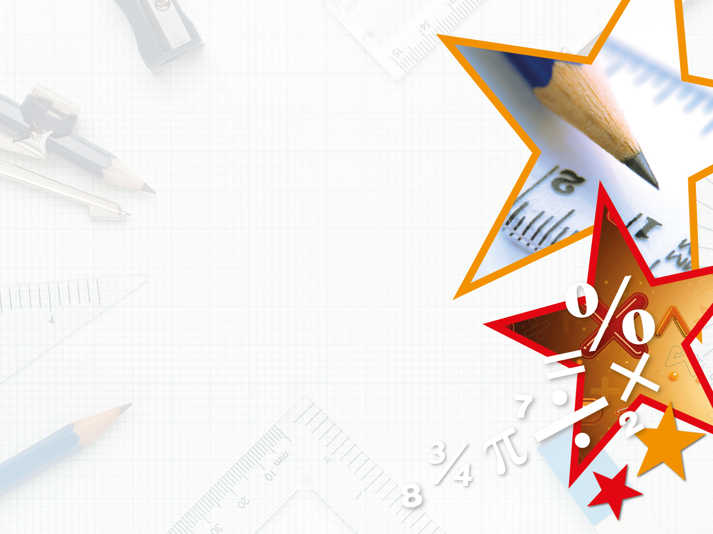

Year 1/2 – Spring Block 3 – Length and Height – Step 2
About This Resource:
This PowerPoint has been designed to support your teaching of this small step from the Mixed Age planning. It includes a starter activity suitable for each year group and an example of each question from the Varied Fluency and Reasoning and Problem Solving resources also provided in this pack (separate for each year group). Each slide has the year group identified in the bottom right-hand corner. We recommend that you look through this PowerPoint in advance and decide whether to work through all examples provided or a selection of them depending on the needs of your class.
National Curriculum Objectives:
Mathematics Year 1: (1M2) Measure and begin to record: lengths and heights
Mathematics Year 2: (2M2) Choose and use appropriate standard units to estimate and measure length/height in any direction (m/cm); mass (kg/g); temperature (°C); capacity (litres/ml) to the nearest appropriate unit using rulers, scales, thermometers and measuring vessels
More Year 1 and Year 2 Length and Height resources.
Did you like this resource? Don’t forget to review it on our website.
© Classroom Secrets Limited 2019

Slide 2
Year 1/2 – Spring Block 3 – Length and Height
Step 2
Year 1: Measure Length 1
Year 2: Measure Length
(cm)
© Classroom Secrets Limited 2019

Slide 3
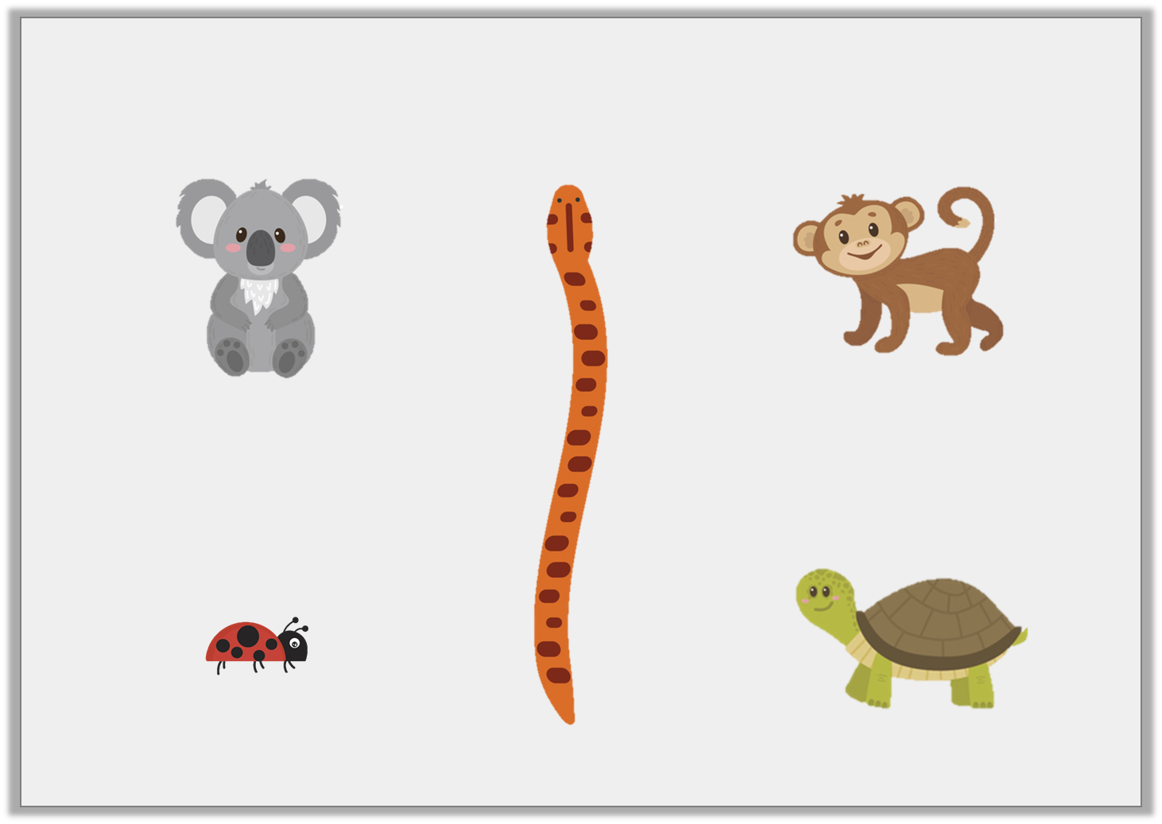
Introduction
Circle the shortest animal.
Y1
© Classroom Secrets Limited 2019

Slide 4
Introduction
Circle the shortest animal.
Y1
© Classroom Secrets Limited 2019

Slide 5
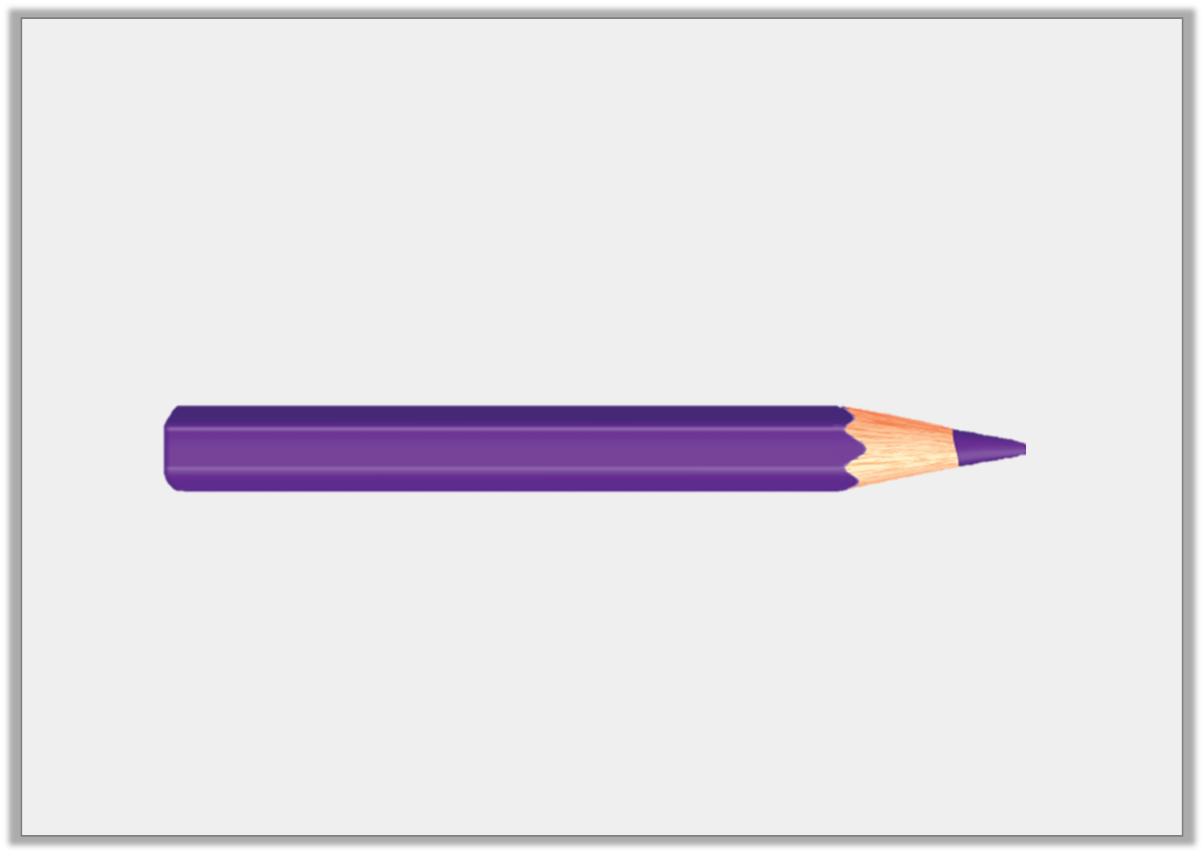
Introduction
What would you use to measure a pencil?
Y2
© Classroom Secrets Limited 2019

Slide 6
Introduction
What would you use to measure a pencil?
A ruler or a tape measure.
Y2
© Classroom Secrets Limited 2019

Slide 7

Varied Fluency 1
How many cubes long is the submarine?
Y1
© Classroom Secrets Limited 2019

Slide 8
Varied Fluency 1
How many cubes long is the submarine?
5
Y1
© Classroom Secrets Limited 2019

Slide 9
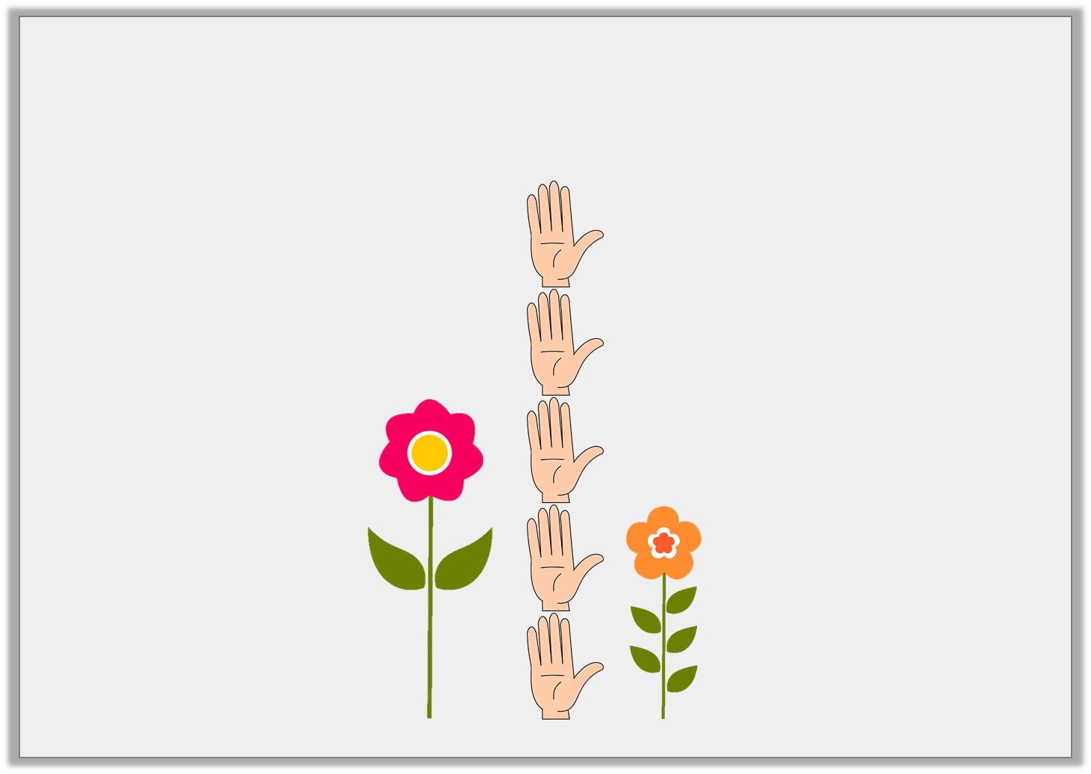
Varied Fluency 2
How many hands is the tallest flower?
Y1
© Classroom Secrets Limited 2019

Slide 10
Varied Fluency 2
How many hands is the tallest flower?
3
Y1
© Classroom Secrets Limited 2019

Slide 11
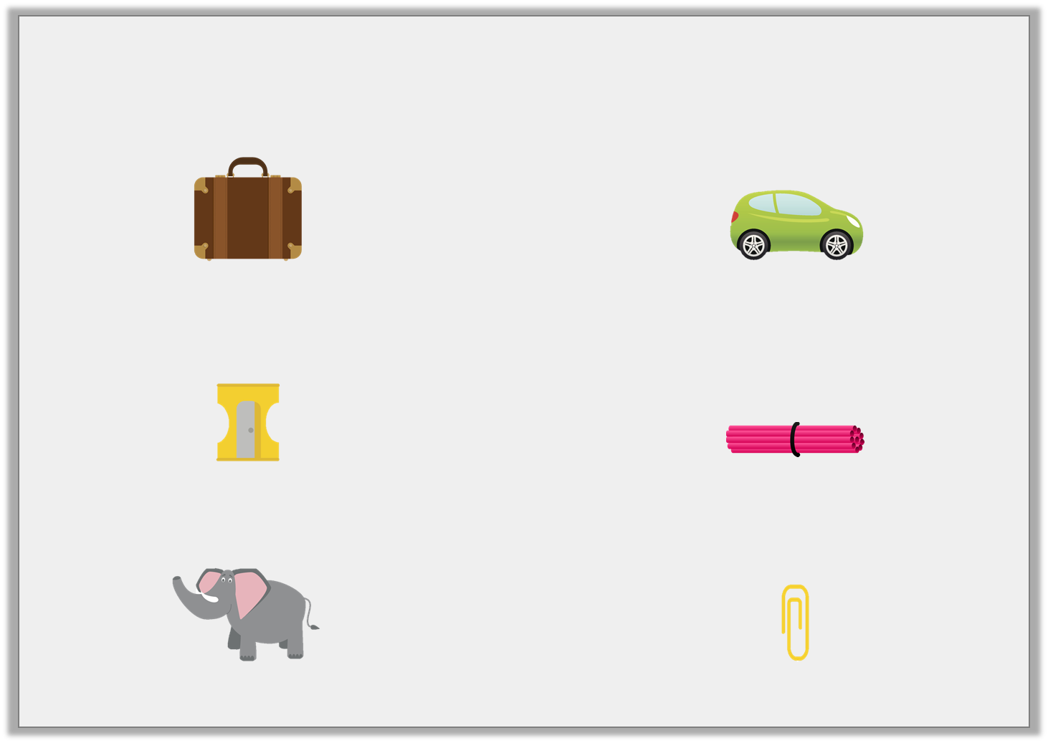
Varied Fluency 3
Match each object to the best non-standard unit of measurement.
suitcase |  | car lengths
sharpener |  | straws
elephant |  | paper clips
Y1
© Classroom Secrets Limited 2019

Slide 12
Varied Fluency 3
Match each object to the best non-standard unit of measurement.
suitcase |  | car lengths
sharpener |  | straws
elephant |  | paper clips
Y1
© Classroom Secrets Limited 2019

Slide 13
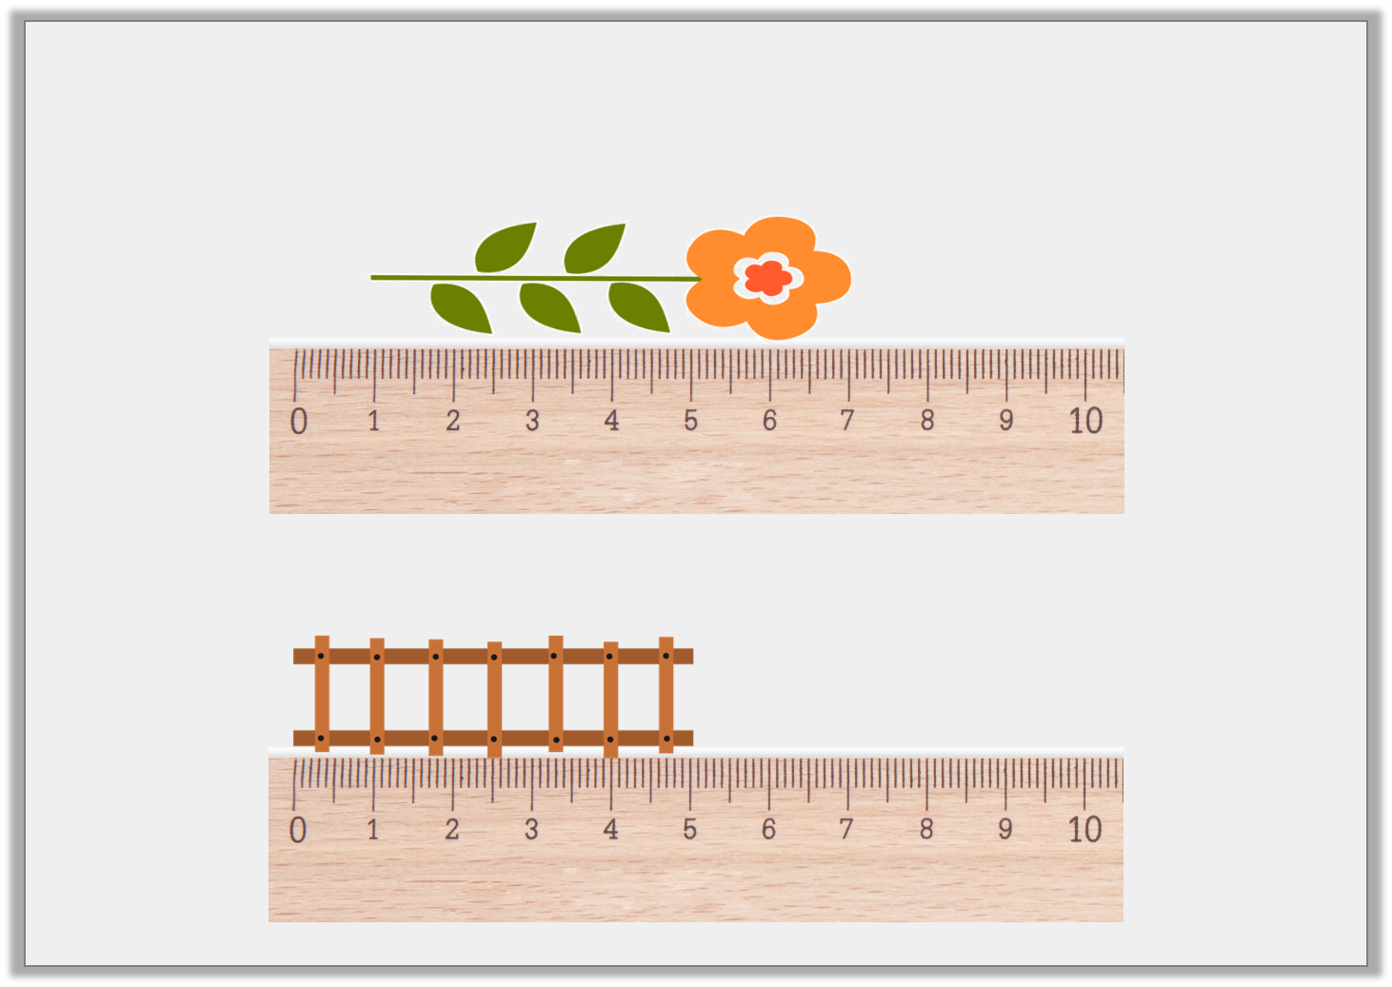
Varied Fluency 1
How long are these objects in centimetres?
A.
B.
Y2
© Classroom Secrets Limited 2019

Slide 14
Varied Fluency 1
How long are these objects in centimetres?
A.
6cm
B.
5cm
Y2
© Classroom Secrets Limited 2019

Slide 15
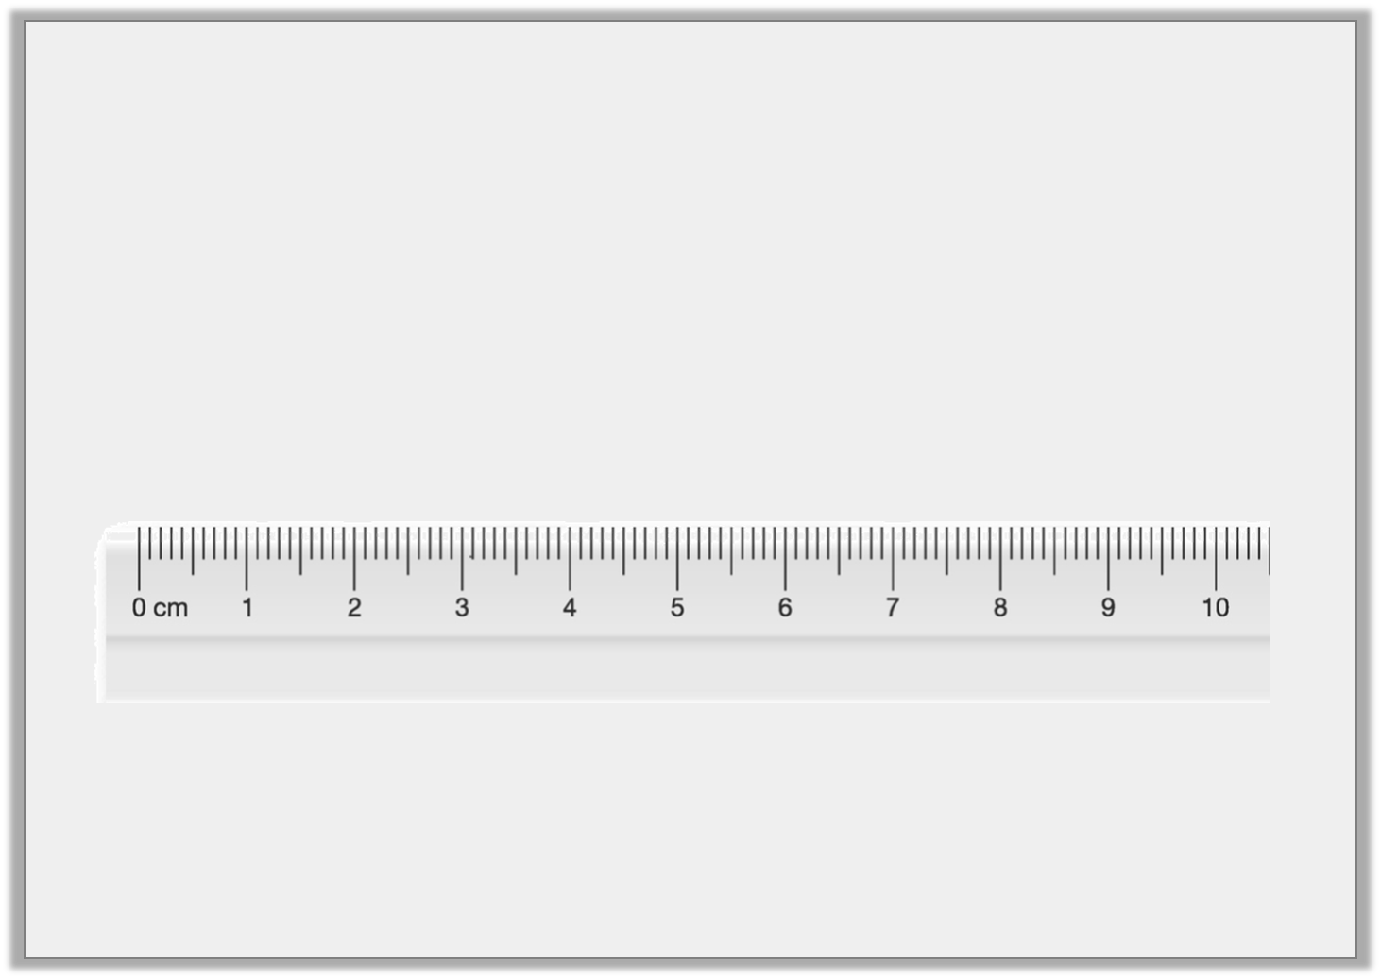
Varied Fluency 2
Matthew draws a 2cm line. He starts at the arrow.
What number will he finish at?
Y2
© Classroom Secrets Limited 2019

Slide 16
Varied Fluency 2
Matthew draws a 2cm line. He starts at the arrow.
What number will he finish at?
6cm
Y2
© Classroom Secrets Limited 2019

Slide 17
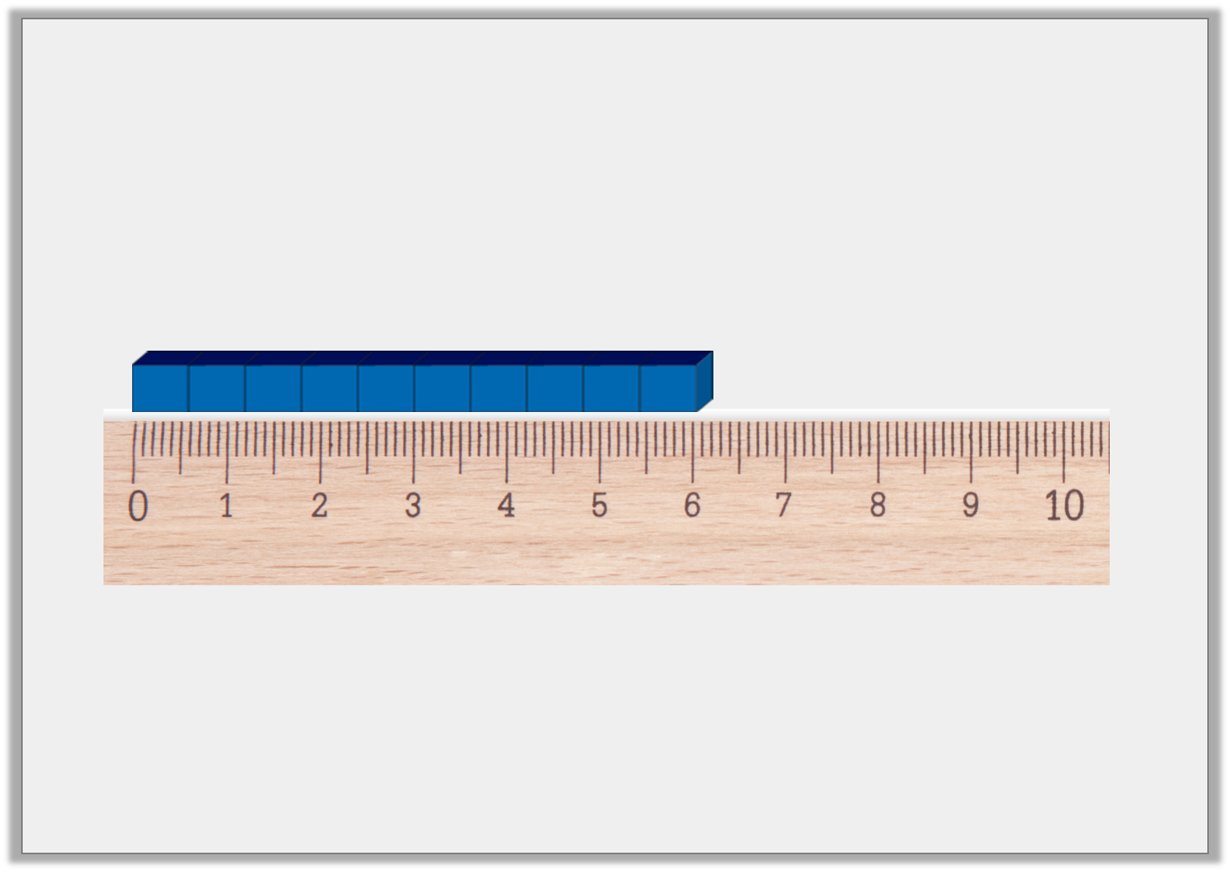
Varied Fluency 3
True or false?
This Base Ten is 8cm long.
Y2
© Classroom Secrets Limited 2019

Slide 18
Varied Fluency 3
True or false?
This Base Ten is 8cm long.
False. It is 6cm long.
Y2
© Classroom Secrets Limited 2019

Slide 19
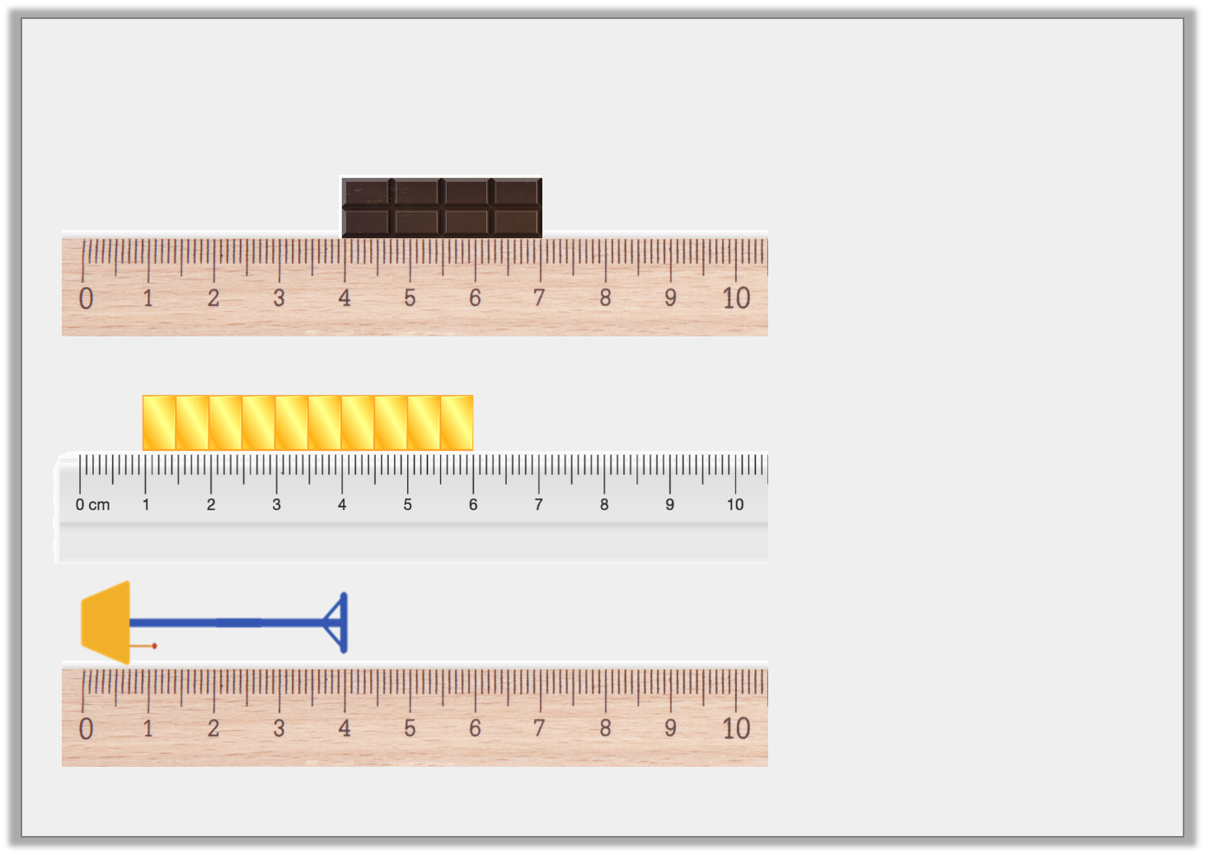
Varied Fluency 4
Match the measurement to the object.
5cm
4cm
3cm
Y2
© Classroom Secrets Limited 2019

Slide 20
Varied Fluency 4
Match the measurement to the object.
5cm
4cm
3cm
5cm
4cm
3cm
Y2
© Classroom Secrets Limited 2019

Slide 21
Reasoning 1
Alex measured an object in his classroom.
The object was 4 cubes long.
What could Alex have measured?
Explain your reasoning.
Y1
© Classroom Secrets Limited 2019

Slide 22
Reasoning 1
Alex measured an object in his classroom.
The object was 4 cubes long.
What could Alex have measured?
Explain your reasoning.
Various possible answers, for example: Alex could have measured a glue stick because…
Y1
© Classroom Secrets Limited 2019

Slide 23
Reasoning 1
Alex measured an object in his classroom.
The object was 4 cubes long.
What could Alex have measured?
Explain your reasoning.
Various possible answers, for example: Alex could have measured a glue stick because this is a small object you could find in a classroom and cubes are a small unit of measurement.
Y1
© Classroom Secrets Limited 2019

Slide 24
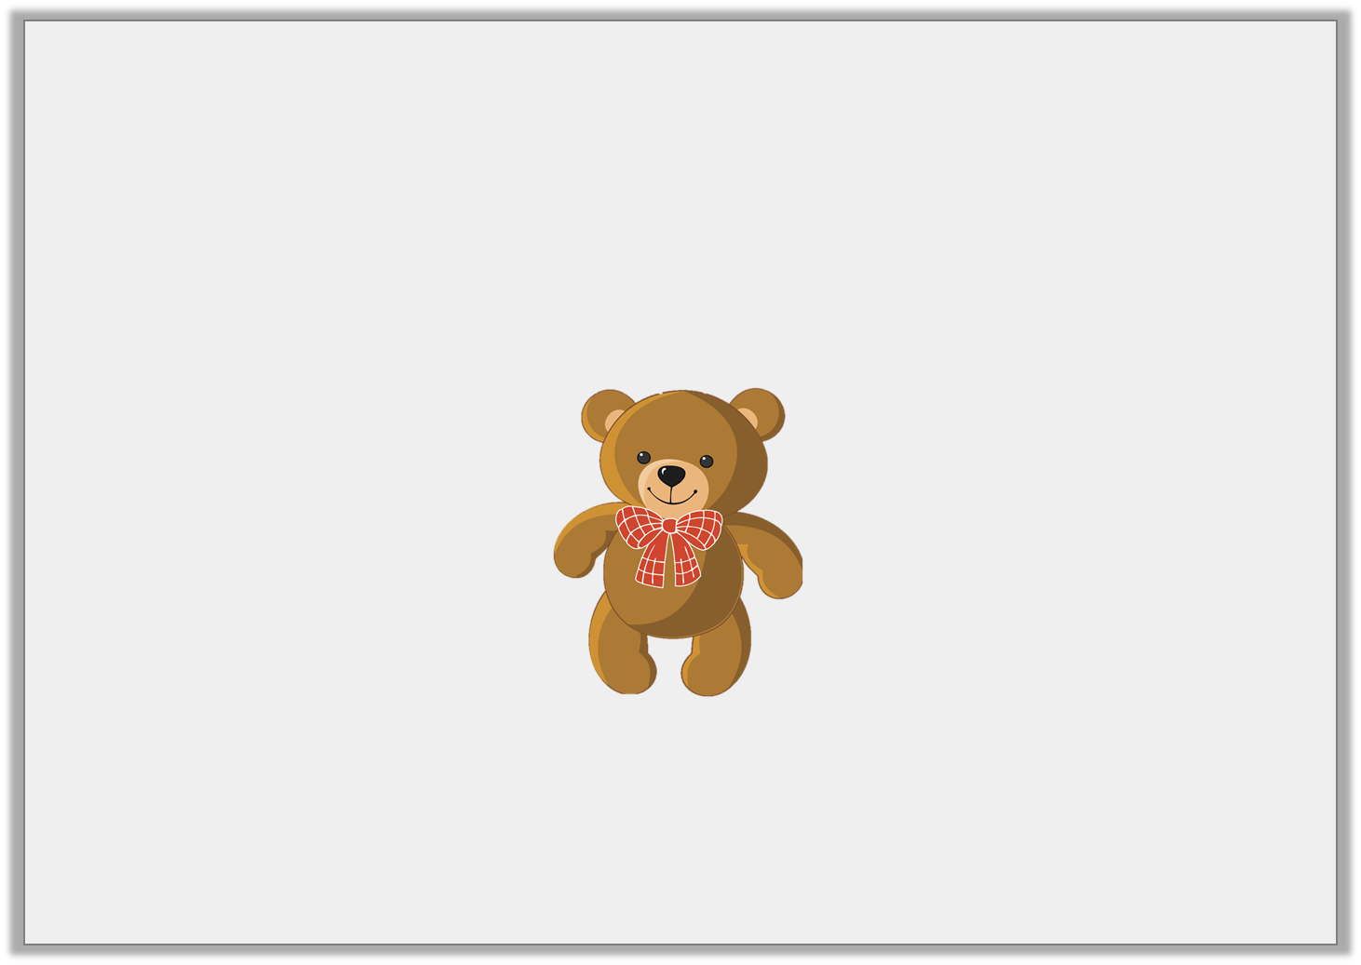
Problem Solving 1
Mel’s book is 2 straws long.
Her desk is 12 straws long.
Her teddy bear is longer than her book but shorter than her desk.
How many straws long could her teddy bear be?
Y1
© Classroom Secrets Limited 2019

Slide 25
Problem Solving 1
Mel’s book is 2 straws long.
Her desk is 12 straws long.
Her teddy bear is longer than her book but shorter than her desk.
How many straws long could her teddy bear be?
Any number from 3 to 11.
Y1
© Classroom Secrets Limited 2019

Slide 26
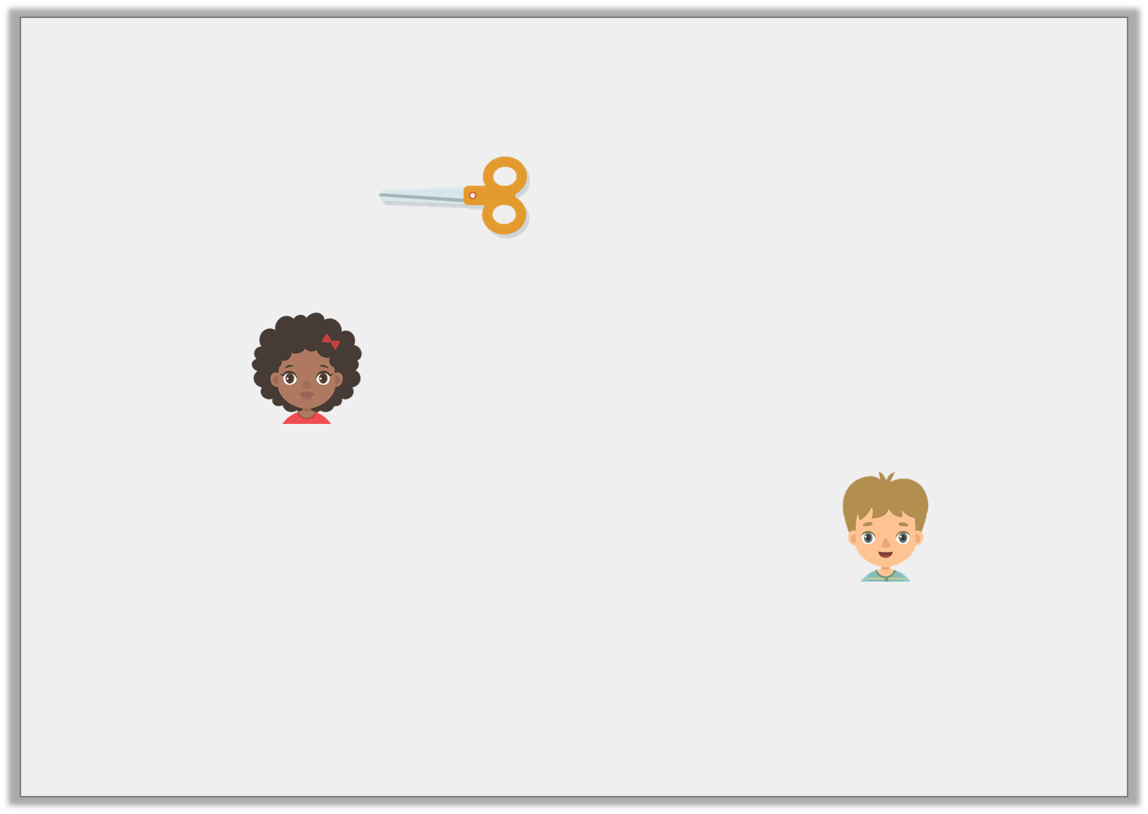
Reasoning 2
The measurement units are missing below.
Kelly says,
Ed says,
Who is correct? Convince me.
= 8 _____________
I think it is 8 hands long.
I think it is 8 counters long.
Y1
© Classroom Secrets Limited 2019

Slide 27
Reasoning 2
The measurement units are missing below.
Kelly says,
Ed says,
Who is correct? Convince me.
Ed is correct because…
= 8 _____________
I think it is 8 hands long.
I think it is 8 counters long.
Y1
© Classroom Secrets Limited 2019

Slide 28
Reasoning 2
The measurement units are missing below.
Kelly says,
Ed says,
Who is correct? Convince me.
Ed is correct because 8 hands are much longer than a pair of scissors. Counters are a smaller unit of measurement.
= 8 _____________
I think it is 8 hands long.
I think it is 8 counters long.
Y1
© Classroom Secrets Limited 2019

Slide 29
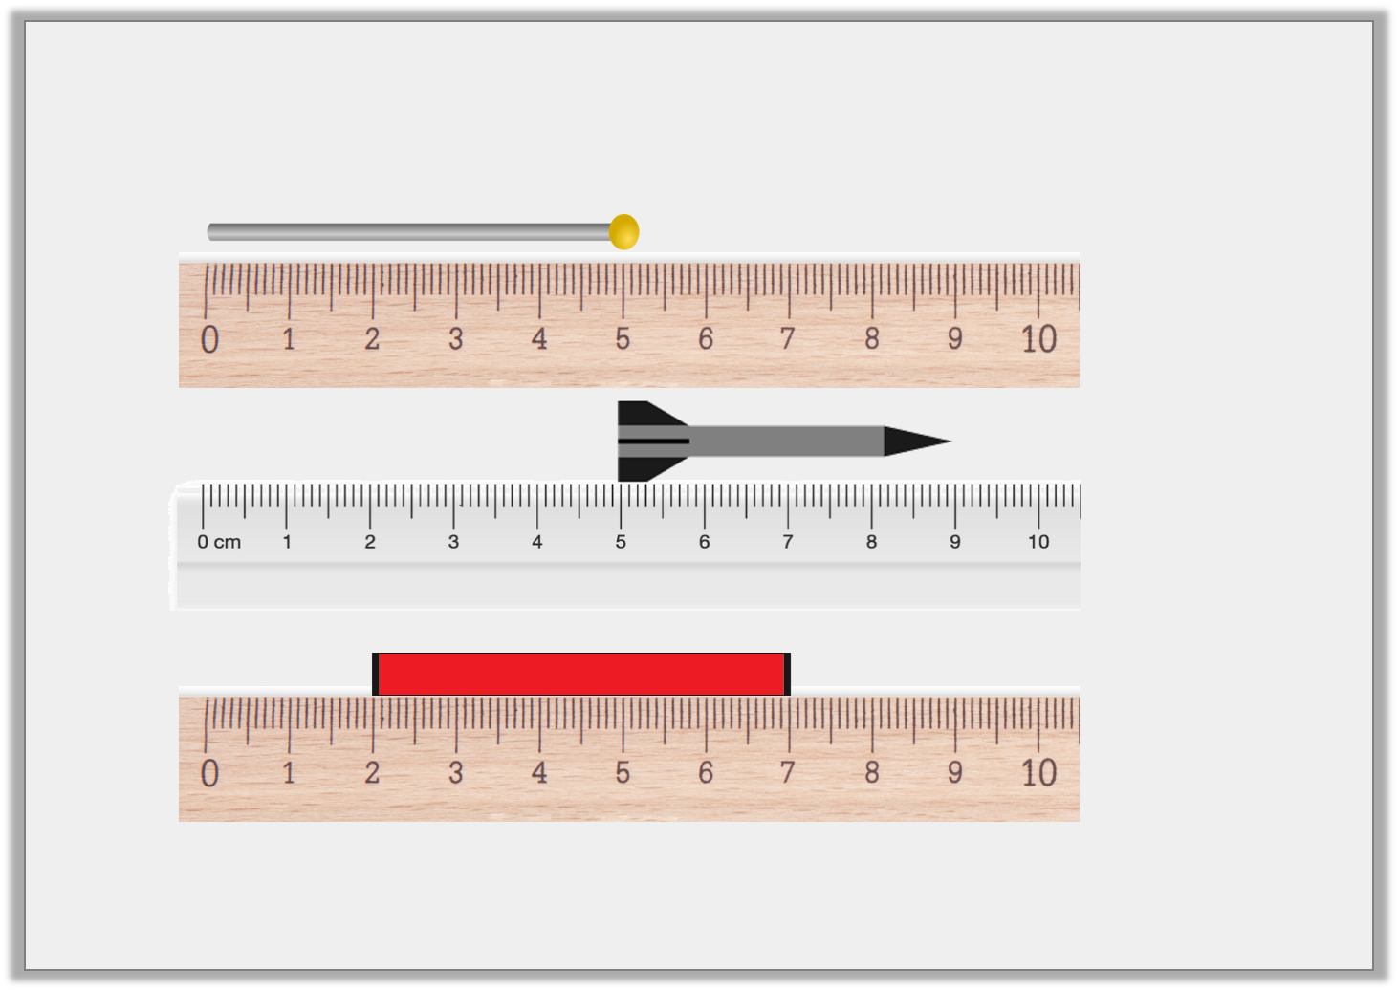
Reasoning 1
Which is the odd one out?
A.
B.
C.
Y2
© Classroom Secrets Limited 2019

Slide 30
Reasoning 1
Which is the odd one out?
B is the odd one out because…
A.
B.
C.
Y2
© Classroom Secrets Limited 2019

Slide 31
Reasoning 1
Which is the odd one out?
B is the odd one out because it is 4cm. The other two are 5cm long.
A.
B.
C.
Y2
© Classroom Secrets Limited 2019

Slide 32
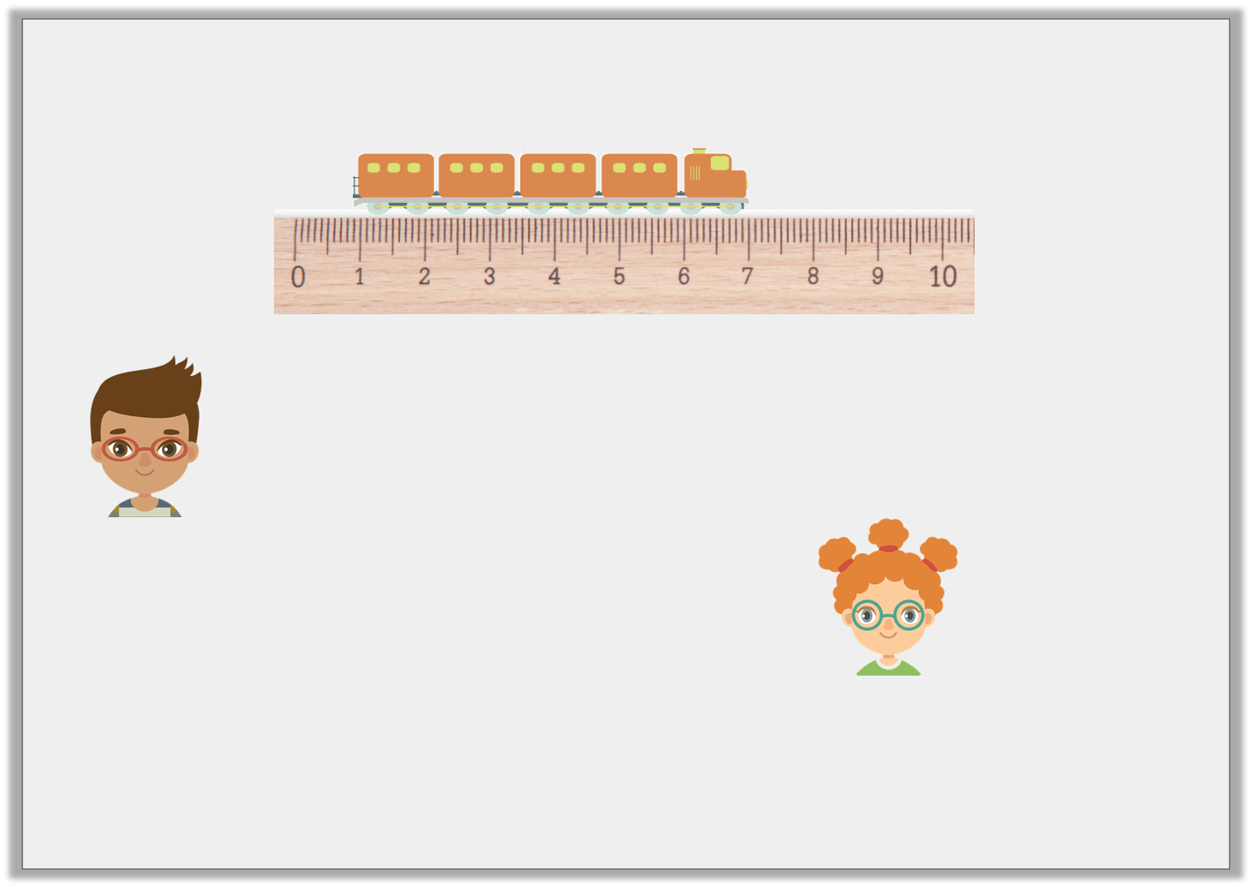
Reasoning 2
James and Laura are measuring the length of a train.
James says,
Laura says,
Who is correct? Explain your answer.
The train is 5cm long.
The train is 6cm long.
Y2
© Classroom Secrets Limited 2019

Slide 33
Reasoning 2
James and Laura are measuring the length of a train.
James says,
Laura says,
Who is correct? Explain your answer.
Laura is correct because…
The train is 5cm long.
The train is 6cm long.
Y2
© Classroom Secrets Limited 2019

Slide 34
Reasoning 2
James and Laura are measuring the length of a train.
James says,
Laura says,
Who is correct? Explain your answer.
Laura is correct because she has taken into account that the object is measured from 1cm and not 0cm.
The train is 5cm long.
The train is 6cm long.
Y2
© Classroom Secrets Limited 2019

Slide 35

Problem Solving 1
George’s flag measures between 7cm and 12cm in length.
What are the possible lengths his flag could be?
Y2
© Classroom Secrets Limited 2019

Slide 36
Problem Solving 1
George’s flag measures between 7cm and 12cm in length.
What are the possible lengths his flag could be?
Various answers, for example: 8cm, 9cm, 10cm and 11cm.
Y2
© Classroom Secrets Limited 2019

