Slide 1

Year 2 – Spring Block 2 – Apostrophes – Recognising Simple Contractions
About This Resource:
This PowerPoint has been designed to support your teaching of this small step. It includes a starter activity and an example of each question from the Varied Fluency and Application and Reasoning resources also provided in this pack. You can choose to work through all examples provided or a selection of them depending on the needs of your class.
National Curriculum Objectives:
English Year 2: (2G5.8) Apostrophes to mark where letters are missing in spelling and to mark singular possession in nouns [for example, the girl’s name]
Terminology for pupils:
  English Year 2: (2G5.8) apostrophe
More resources from our Grammar, Punctuation and Spelling scheme of work.
Did you like this resource? Don’t forget to review it on our website.
© Classroom Secrets Limited 2019

Slide 2
Year 2 – Spring Block 2 – Apostrophes – Recognising Simple Contractions
Notes and Guidance:
This step introduces the punctuation mark apostrophe.
In this first step, children will begin to recognise apostrophes used in simple contractions to mark where letters are missing.
Children need to know that the apostrophe is always placed where the letter has been removed. For example: can not becomes can’t; it is becomes it’s; I will becomes I’ll.
Children should be able to recognise apostrophes in simple contractions and identify which missing letters they replace.
Focused Questions:
Identify the apostrophe in the sentence. What letters are missing from the words?
Which word is the contraction in the sentence?
© Classroom Secrets Limited 2019

Slide 3
Year 2 – Spring Block 2 – Apostrophes
Step 1: Recognising Simple Contractions
© Classroom Secrets Limited 2019

Slide 4
Introduction
Match the punctuation marks to their labels below.
?
comma
,
question mark
!
full stop
’
exclamation mark
.
apostrophe
© Classroom Secrets Limited 2019

Slide 5
Introduction
Match the punctuation marks to their labels below.
?
comma
,
question mark
!
full stop
’
exclamation mark
.
apostrophe
© Classroom Secrets Limited 2019

Slide 6
Varied Fluency 1
Circle the contraction in the sentence below.
I think we’ll need to catch the bus.
© Classroom Secrets Limited 2019

Slide 7
Varied Fluency 1
Circle the contraction in the sentence below.
I think we’ll need to catch the bus.
© Classroom Secrets Limited 2019

Slide 8
Varied Fluency 2
True or false?
The apostrophe in the word we’ve replaces the letter a.
© Classroom Secrets Limited 2019

Slide 9
Varied Fluency 2
True or false?
The apostrophe in the word we’ve replaces the letter a.
False, it replaces the letters h and a.
© Classroom Secrets Limited 2019

Slide 10
Varied Fluency 3
Match the words with their contractions.
is not
she’ll
you have
don’t
do not
you’ve
she will
isn’t
© Classroom Secrets Limited 2019

Slide 11
Varied Fluency 3
Match the words with their contractions.
is not
she’ll
you have
don’t
do not
you’ve
she will
isn’t
© Classroom Secrets Limited 2019

Slide 12
Varied Fluency 4
Circle the contractions which have been written correctly.
cann’t | shouldn’t
hadn’t | did’nt
are’nt | wasn’t
© Classroom Secrets Limited 2019

Slide 13
Varied Fluency 4
Circle the contractions which have been written correctly.
cann’t | shouldn’t
hadn’t | did’nt
are’nt | wasn’t
© Classroom Secrets Limited 2019

Slide 14
Application 1
Which words below can be put together to make a simple contraction?
Find three possibilities.
us | had | will
could | we | let
are | you | not
© Classroom Secrets Limited 2019

Slide 15
Application 1
Which words below can be put together to make a simple contraction?
Find three possibilities.
Various answers, for example: had not, could not, let us.
us | had | will
could | we | let
are | you | not
© Classroom Secrets Limited 2019

Slide 16
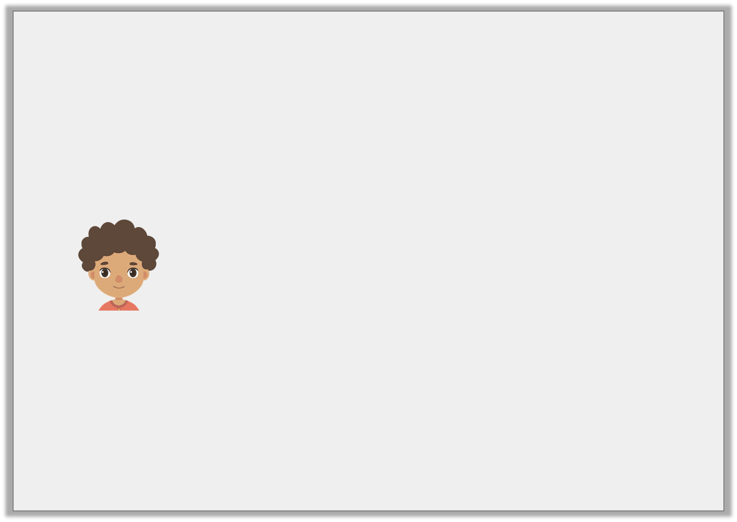
Reasoning 1
Josh has written the sentence below.
He says,
Is he correct?
Explain your reasoning.
After maths, we have got English.
I cannot use any contractions in my sentence.
© Classroom Secrets Limited 2019

Slide 17
Reasoning 1
Josh has written the sentence below.
He says,
Is he correct?
Explain your reasoning.
Josh is incorrect because…
After maths, we have got English.
I cannot use any contractions in my sentence.
© Classroom Secrets Limited 2019

Slide 18
Reasoning 1
Josh has written the sentence below.
He says,
Is he correct?
Explain your reasoning.
Josh is incorrect because he could join the words we and have to make we’ve.
After maths, we have got English.
I cannot use any contractions in my sentence.
© Classroom Secrets Limited 2019

Slide 19
Application 2
Fill in the missing contractions from the word bank to complete the sentence.
__________ go to the shops first then __________ go to the swimming pool.
how’s | can’t | we’ll | let’s
© Classroom Secrets Limited 2019

Slide 20
Application 2
Fill in the missing contractions from the word bank to complete the sentence.
Let’s go to the shops first then we’ll go to the swimming pool.
how’s | can’t | we’ll | let’s
© Classroom Secrets Limited 2019

