Slide 1



LIFE/work balance
We have started a #LIFEworkbalance campaign and we need your help to complete our LIFE/work balance survey.
We hope to publish the results soon, so please give 15 minutes of your time to help us get a true picture of school life.
Want to be a part of this campaign? Take the survey on our website and share it with your colleagues!
© Classroom Secrets Limited 2020

Slide 2
Year 4 – Spring Block 4 – Decimals – Divide 1 Digit by 10
About This Resource:
This PowerPoint has been designed to support your teaching of this small step. It includes a starter activity and an example of each question from the Varied Fluency and Reasoning and Problem Solving resources also provided in this pack. You can choose to work through all examples provided or a selection of them depending on the needs of your class.
National Curriculum Objectives:
Mathematics Year 4: (4F9) Find the effect of dividing a one- or two-digit number by 10 and 100, identifying the value of the digits in the answer as ones, tenths and hundredths
More Year 4 Decimals resources.
Did you like this resource? Don’t forget to review it on our website.
© Classroom Secrets Limited 2019

Slide 3
Year 4 – Spring Block 4 – Decimals
Step 5: Divide 1 Digit by 10
© Classroom Secrets Limited 2019

Slide 4
Introduction
What numbers are represented in these place value grids?
Tens | Ones | Tenths | Hundredths
Tens | Ones | Tenths | Hundredths
Tens | Ones | Tenths | Hundredths
© Classroom Secrets Limited 2019

Slide 5
Introduction
What numbers are represented in these place value grids?
Tens | Ones | Tenths | Hundredths
4
Tens | Ones | Tenths | Hundredths
50
Tens | Ones | Tenths | Hundredths
0.8
© Classroom Secrets Limited 2019

Slide 6
Varied Fluency 1
Use the Gattegno chart to divide the circled number by 10.
10 | 20 | 30 | 40 | 50 | 60 | 70 | 80 | 90
1 | 2 | 3 | 4 | 5 | 6 | 7 | 8 | 9
0.1 | 0.2 | 0.3 | 0.4 | 0.5 | 0.6 | 0.7 | 0.8 | 0.9
0.01 | 0.02 | 0.03 | 0.04 | 0.05 | 0.06 | 0.07 | 0.08 | 0.09
© Classroom Secrets Limited 2019

Slide 7
Varied Fluency 1
Use the Gattegno chart to divide the circled number by 10.
3 ÷ 10 = 0.3
10 | 20 | 30 | 40 | 50 | 60 | 70 | 80 | 90
1 | 2 | 3 | 4 | 5 | 6 | 7 | 8 | 9
0.1 | 0.2 | 0.3 | 0.4 | 0.5 | 0.6 | 0.7 | 0.8 | 0.9
0.01 | 0.02 | 0.03 | 0.04 | 0.05 | 0.06 | 0.07 | 0.08 | 0.09
© Classroom Secrets Limited 2019

Slide 8
Varied Fluency 2
Which of the following numbers is the answer to 9 ÷ 10?
A. | Tens | Ones | Tenths | Hundredths
 |  | 0 | 9
B. | Tens | Ones | Tenths | Hundredths
 |  | 9 | 0
© Classroom Secrets Limited 2019

Slide 9
Varied Fluency 2
Which of the following numbers is the answer to 9 ÷ 10?
A. | Tens | Ones | Tenths | Hundredths
 |  | 0 | 9
B. | Tens | Ones | Tenths | Hundredths
 |  | 9 | 0
© Classroom Secrets Limited 2019

Slide 10
Varied Fluency 3
Which equation matches the answer shown in the place value grid?
A.
10 ÷ 8
B.
8 ÷ 10
C.
0.8 ÷ 10
Tens | Ones | Tenths | Hundredths
 | 0 | 8
© Classroom Secrets Limited 2019

Slide 11
Varied Fluency 3
Which equation matches the answer shown in the place value grid?
A.
10 ÷ 8
B.
8 ÷ 10
C.
0.8 ÷ 10
Tens | Ones | Tenths | Hundredths
 | 0 | 8
© Classroom Secrets Limited 2019

Slide 12
Varied Fluency 4
Complete the calculation:
9 ÷ 10 = 0.9
Tens | Ones | Tenths | Hundredths
 | 9
© Classroom Secrets Limited 2019

Slide 13
Varied Fluency 4
Complete the calculation:
9 ÷ 10 = 0.9
Tens | Ones | Tenths | Hundredths
 | 0 | 9
© Classroom Secrets Limited 2019

Slide 14
Reasoning 1
Daniel is dividing 1-digit numbers by 10 and circling the answer on the Gattegno chart.
Explain the mistake he has made.
10 | 20 | 30 | 40 | 50 | 60 | 70 | 80 | 90
1 | 2 | 3 | 4 | 5 | 6 | 7 | 8 | 9
0.1 | 0.2 | 0.3 | 0.4 | 0.5 | 0.6 | 0.7 | 0.8 | 0.9
0.01 | 0.02 | 0.03 | 0.04 | 0.05 | 0.06 | 0.07 | 0.08 | 0.09
© Classroom Secrets Limited 2019

Slide 15
Reasoning 1
Daniel is dividing 1-digit numbers by 10 and circling the answer on the Gattegno chart.
Explain the mistake he has made.
Daniel has multiplied…
10 | 20 | 30 | 40 | 50 | 60 | 70 | 80 | 90
1 | 2 | 3 | 4 | 5 | 6 | 7 | 8 | 9
0.1 | 0.2 | 0.3 | 0.4 | 0.5 | 0.6 | 0.7 | 0.8 | 0.9
0.01 | 0.02 | 0.03 | 0.04 | 0.05 | 0.06 | 0.07 | 0.08 | 0.09
© Classroom Secrets Limited 2019

Slide 16
Reasoning 1
Daniel is dividing 1-digit numbers by 10 and circling the answer on the Gattegno chart.
Explain the mistake he has made.
Daniel has multiplied by 10 instead of dividing by 10.
The answer should be 0.8.
10 | 20 | 30 | 40 | 50 | 60 | 70 | 80 | 90
1 | 2 | 3 | 4 | 5 | 6 | 7 | 8 | 9
0.1 | 0.2 | 0.3 | 0.4 | 0.5 | 0.6 | 0.7 | 0.8 | 0.9
0.01 | 0.02 | 0.03 | 0.04 | 0.05 | 0.06 | 0.07 | 0.08 | 0.09
© Classroom Secrets Limited 2019

Slide 17
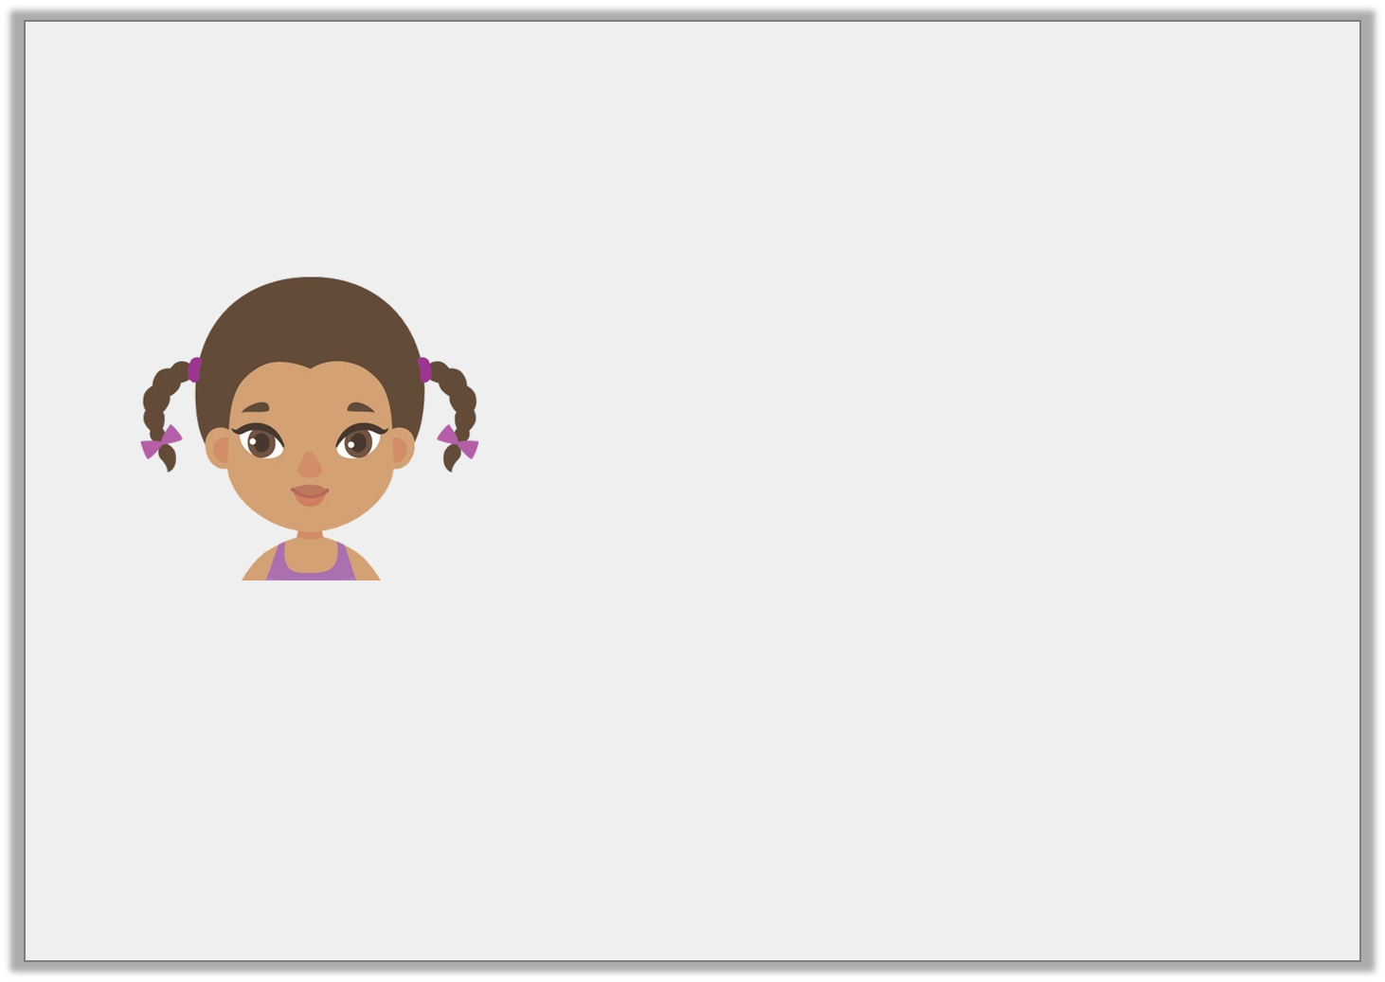
Problem Solving 1
Soraya is thinking of a 1-digit number.
What number could her number be?
It is an odd 1-digit number.
When divided by 10, my number is greater than 0.4.
© Classroom Secrets Limited 2019

Slide 18
Problem Solving 1
Soraya is thinking of a 1-digit number.
What number could her number be?
5, 7 or 9
It is an odd 1-digit number.
When divided by 10, my number is greater than 0.4.
© Classroom Secrets Limited 2019

Slide 19
Problem Solving 2
Use the digit cards to make the following statement correct.
Give 3 possibilities.
 | ÷ | 10 | > |  | ÷ | 10
4
2
8
1
© Classroom Secrets Limited 2019

Slide 20
Problem Solving 2
Use the digit cards to make the following statement correct.
Give 3 possibilities.
Various answers, for example: 4 ÷ 10 > 2 ÷ 10; 8 ÷ 10 > 4 ÷ 10
8 | ÷ | 10 | > | 1 | ÷ | 10
4
2
8
1
© Classroom Secrets Limited 2019

