Slide 1
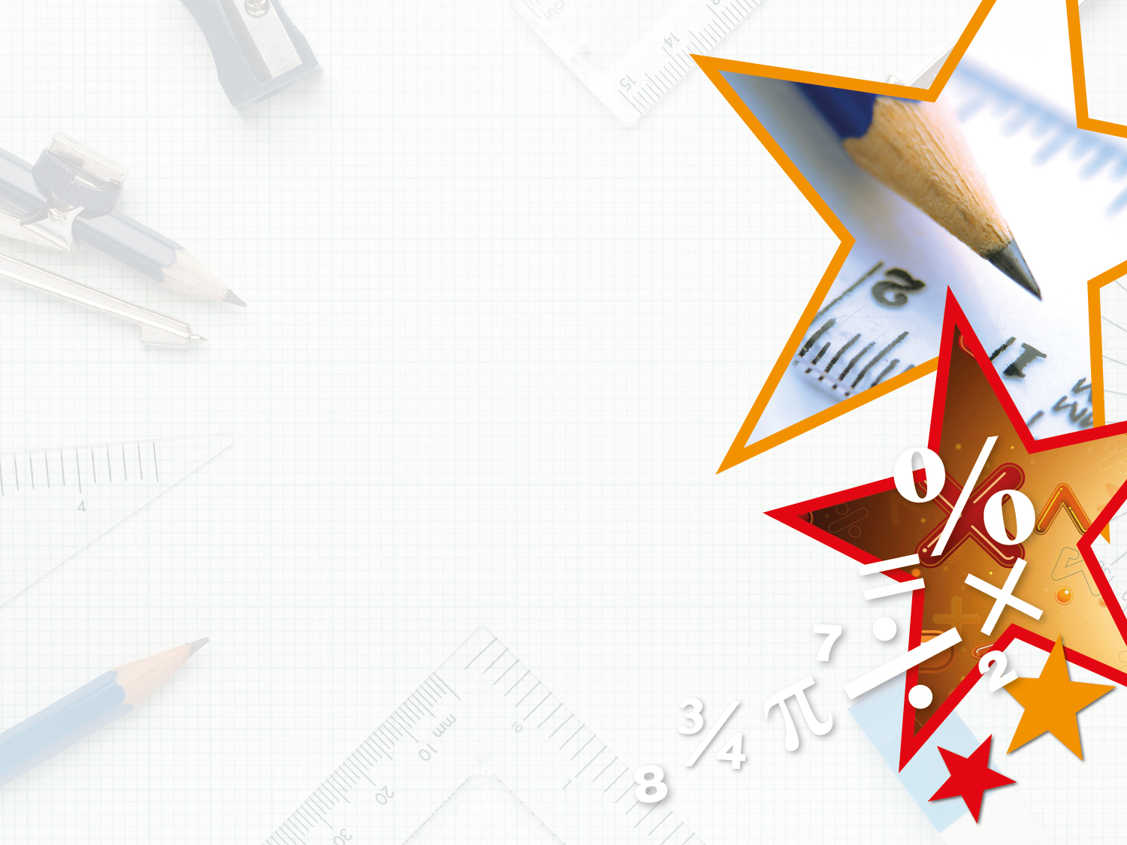

Year 4 – Spring Block 4 – Decimals – Hundredths As Decimals
About This Resource:
This PowerPoint has been designed to support your teaching of this small step. It includes a starter activity and an example of each question from the Varied Fluency and Reasoning and Problem Solving resources also provided in this pack. You can choose to work through all examples provided or a selection of them depending on the needs of your class.
National Curriculum Objectives:
Mathematics Year 4: (4F6b) Recognise and write decimal equivalents of any number of tenths or hundredths
More Year 4 Decimals resources.
Did you like this resource? Don’t forget to review it on our website.
© Classroom Secrets Limited 2019

Slide 2
Year 4 – Spring Block 4 – Decimals
Step 8: Hundredths As Decimals
© Classroom Secrets Limited 2019

Slide 3
Introduction
Circle the numbers greater than one.
99
100
0.5
9
8
0.16
2
10
3
2
1.03
© Classroom Secrets Limited 2019

Slide 4
Introduction
Circle the numbers greater than one.
99
100
0.5
9
8
0.16
2
10
3
2
1.03
© Classroom Secrets Limited 2019

Slide 5
Varied Fluency 1
Match the equivalent values.
0.06 |  |  | 0.71
 | 71 |  | 0.03
 | 100
three hundredths |  |  | forty hundredths
 | 40 |  |  | 6
 | 100 |  |  | 100
© Classroom Secrets Limited 2019

Slide 6
Varied Fluency 1
Match the equivalent values.
0.06 |  |  | 0.71
 | 71 |  | 0.03
 | 100
three hundredths |  |  | forty hundredths
 | 40 |  |  | 6
 | 100 |  |  | 100
© Classroom Secrets Limited 2019

Slide 7
Varied Fluency 2
True or false?
0.85 is equivalent to eighty five hundredths.
© Classroom Secrets Limited 2019

Slide 8
Varied Fluency 2
True or false?
0.85 is equivalent to eighty five hundredths.
True
© Classroom Secrets Limited 2019

Slide 9
Varied Fluency 3
Convert the hundredths to decimals.
72
100
5
100
64
100
=
=
=
© Classroom Secrets Limited 2019

Slide 10
Varied Fluency 3
Convert the hundredths to decimals.
72
100
5
100
64
100
=
0.72
0.05
0.64
=
=
© Classroom Secrets Limited 2019

Slide 11
Varied Fluency 4
What numbers go in the boxes below?
A
B
0.4 |  |  |  |  | 0.45 |  |  |  |  | 0.5
© Classroom Secrets Limited 2019

Slide 12
Varied Fluency 4
What numbers go in the boxes below?
0.44
0.48
0.4 |  |  |  |  | 0.45 |  |  |  |  | 0.5
© Classroom Secrets Limited 2019

Slide 13
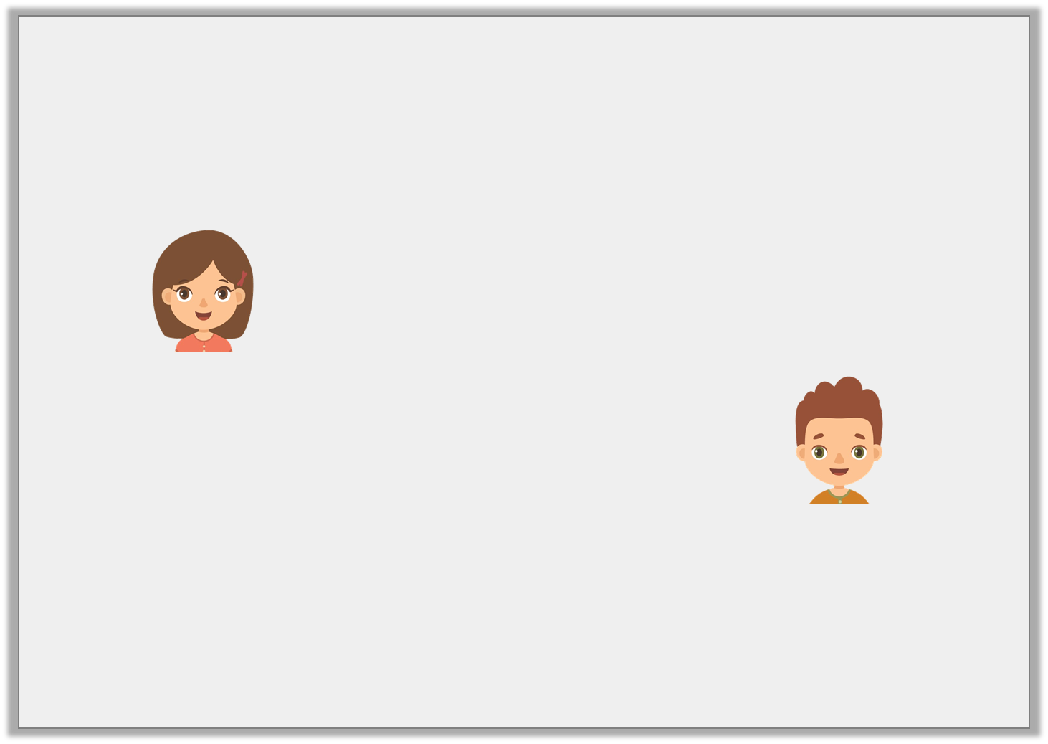
Reasoning 1
Who is correct?
Explain your answer.
5 | = | 0.05
100
This decimal is correct as it shows 50 hundredths.
Helen
This decimal is correct because it shows 5 hundredths.
Carl
© Classroom Secrets Limited 2019

Slide 14
Reasoning 1
Who is correct?
Explain your answer.
Carl is correct because...
5 | = | 0.05
100
This decimal is correct as it shows 50 hundredths.
Helen
This decimal is correct because it shows 5 hundredths.
Carl
© Classroom Secrets Limited 2019

Slide 15
Reasoning 1
Who is correct?
Explain your answer.
Carl is correct because the decimal has 5 hundredths and zero tenths. 50 hundredths would be 0.5 as a decimal.
5 | = | 0.05
100
This decimal is correct as it shows 50 hundredths.
Helen
This decimal is correct because it shows 5 hundredths.
Carl
© Classroom Secrets Limited 2019

Slide 16
Problem Solving 1
Use the digit cards to make three decimals less than one.
Write the equivalent fraction for each decimal you create.
4
6
0
0
© Classroom Secrets Limited 2019

Slide 17
Problem Solving 1
Use the digit cards to make three decimals less than one.
Write the equivalent fraction for each decimal you create.
Various answers, for example: 0.06 =
0.64 = , 0.40 =
4
6
0
0
6
100
64
100
40
100
© Classroom Secrets Limited 2019

Slide 18
Reasoning 2
Is this statement correct?
Explain your answer.
0.22 | > | 0.02
© Classroom Secrets Limited 2019

Slide 19
Reasoning 2
Is this statement correct?
Explain your answer.
Yes, the statement is correct because…
0.22 | > | 0.02
© Classroom Secrets Limited 2019

Slide 20
Reasoning 2
Is this statement correct?
Explain your answer.
Yes, the statement is correct because twenty two hundredths are greater than 2 hundredths.
0.22 | > | 0.02
© Classroom Secrets Limited 2019

