Slide 1
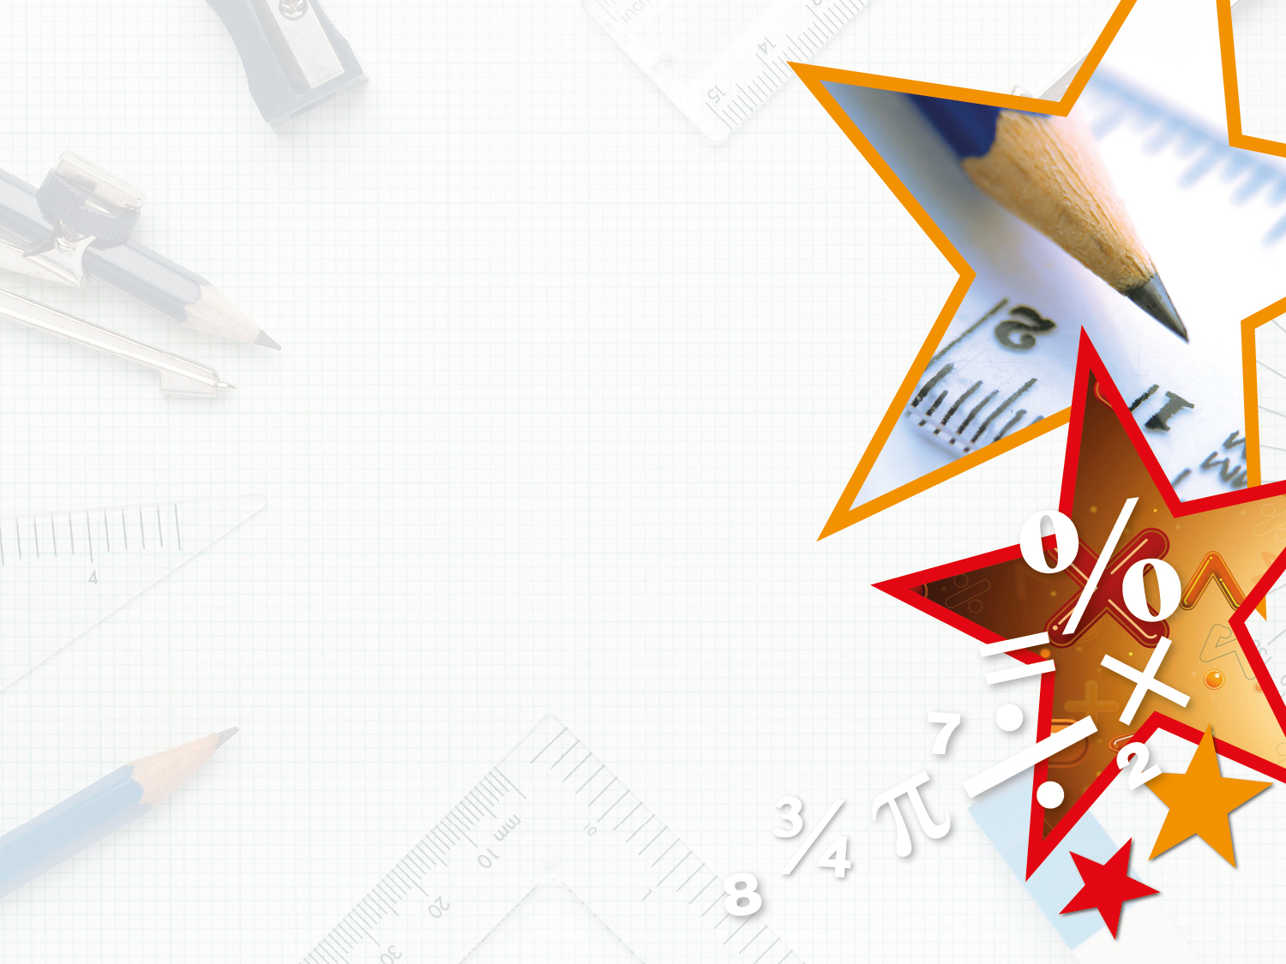


LIFE/work balance
We have started a #LIFEworkbalance campaign and we need your help to complete our LIFE/work balance survey.
We hope to publish the results soon, so please give 15 minutes of your time to help us get a true picture of school life.
Want to be a part of this campaign? Take the survey on our website and share it with your colleagues!
© Classroom Secrets Limited 2020

Slide 2
Year 4 – Spring Block 4 – Decimals – Tenths as Decimals
About This Resource:
This PowerPoint has been designed to support your teaching of this small step. It includes a starter activity and an example of each question from the Varied Fluency and Reasoning and Problem Solving resources also provided in this pack. You can choose to work through all examples provided or a selection of them depending on the needs of your class.
National Curriculum Objectives:
Mathematics Year 4: (4F6b) Recognise and write decimal equivalents of any number of tenths or hundredths
More Year 4 Decimals resources.
Did you like this resource? Don’t forget to review it on our website.
© Classroom Secrets Limited 2019

Slide 3
Year 4 – Spring Block 4 – Decimals
Step 2: Tenths as Decimals
© Classroom Secrets Limited 2019

Slide 4
Introduction
Use the part-whole model to partition 38 hundredths
into tenths and hundredths.
38
100
10
100
© Classroom Secrets Limited 2019

Slide 5
Introduction
Use the part-whole model to partition 38 hundredths
into tenths and hundredths.
38
100
3
10
8
100
© Classroom Secrets Limited 2019

Slide 6
Varied Fluency 1
Use the image to complete the fraction and decimal.
 | .
© Classroom Secrets Limited 2019

Slide 7
Varied Fluency 1
Use the image to complete the fraction and decimal.
6
10
0 | . | 6
© Classroom Secrets Limited 2019

Slide 8
Varied Fluency 2
Complete the statement using a decimal.
___ is the same as three tenths.
© Classroom Secrets Limited 2019

Slide 9
Varied Fluency 2
Complete the statement using a decimal.
___ is the same as three tenths.
0.3
© Classroom Secrets Limited 2019

Slide 10
Varied Fluency 3
Draw an arrow to show where 0.1 would be placed on the number line.
Write the decimal as a fraction:
0 |  |  |  |  |  |  |  |  |  | 1
© Classroom Secrets Limited 2019

Slide 11
Varied Fluency 3
Draw an arrow to show where 0.1 would be placed on the number line.
Write the decimal as a fraction:
0 |  |  |  |  |  |  |  |  |  | 1
1
10
© Classroom Secrets Limited 2019

Slide 12
Varied Fluency 4
Circle the odd one out.
0.1
0.1
0.1
0.1
A.
1.
0.2
0.1
0.1
0.1
one tenth
0.7
B.
2.
7
10
0.1
C.
3.
© Classroom Secrets Limited 2019

Slide 13
Varied Fluency 4
Circle the odd one out.
0.1
0.1
0.1
0.1
A.
1.
0.2
0.1
0.1
0.1
one tenth
0.7
B.
2.
7
10
0.1
C.
3.
© Classroom Secrets Limited 2019

Slide 14
Reasoning 1
Hamza is using a number line to represent a decimal.
He writes down the decimal as 0.7.
Is Hamza correct? Explain your answer.
0 |  |  |  |  | 0.5 |  |  |  |  | 1
© Classroom Secrets Limited 2019

Slide 15
Reasoning 1
Hamza is using a number line to represent a decimal.
He writes down the decimal as 0.7.
Is Hamza correct? Explain your answer.
Hamza is incorrect because…
0 |  |  |  |  | 0.5 |  |  |  |  | 1
© Classroom Secrets Limited 2019

Slide 16
Reasoning 1
Hamza is using a number line to represent a decimal.
He writes down the decimal as 0.7.
Is Hamza correct? Explain your answer.
Hamza is incorrect because the arrow on the number line is showing 6 tenths or 0.6.
0 |  |  |  |  | 0.5 |  |  |  |  | 1
© Classroom Secrets Limited 2019

Slide 17

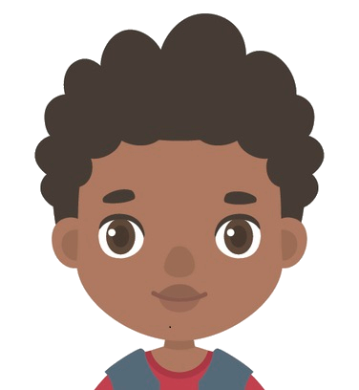
Reasoning 2
Katrina and Joseph are discussing tenths.
Who is correct? Explain your answer.
Five tenths = 50
Katrina
Five tenths = 0.5
Joseph
© Classroom Secrets Limited 2019

Slide 18
Reasoning 2
Katrina and Joseph are discussing tenths.
Who is correct? Explain your answer.
Joseph is correct because…
Five tenths = 50
Katrina
Five tenths = 0.5
Joseph
© Classroom Secrets Limited 2019

Slide 19
Reasoning 2
Katrina and Joseph are discussing tenths.
Who is correct? Explain your answer.
Joseph is correct because five tenths is written as 0.5. Katrina has calculated five tens, not tenths.
Five tenths = 50
Katrina
Five tenths = 0.5
Joseph
© Classroom Secrets Limited 2019

Slide 20
Problem Solving 1
Catherine is thinking of a decimal.
Write down 2 possibilities that Catherine’s decimal could be.
It is smaller than .
7
10
The tenth is an odd number.
0 |  |  |  |  |  |  |  |  |  | 1
© Classroom Secrets Limited 2019

Slide 21
Problem Solving 1
Catherine is thinking of a decimal.
Write down 2 possibilities that Catherine’s decimal could be.
Various answers, for example: 0.1 and 0.3
It is smaller than .
7
10
The tenth is an odd number.
0 |  |  |  |  |  |  |  |  |  | 1
© Classroom Secrets Limited 2019

