Slide 1


LIFE/work balance
We have started a #LIFEworkbalance campaign and we need your help to complete our LIFE/work balance survey.
We hope to publish the results soon, so please give 15 minutes of your time to help us get a true picture of school life.
Want to be a part of this campaign? Take the survey on our website and share it with your colleagues!
© Classroom Secrets Limited 2019

Slide 2
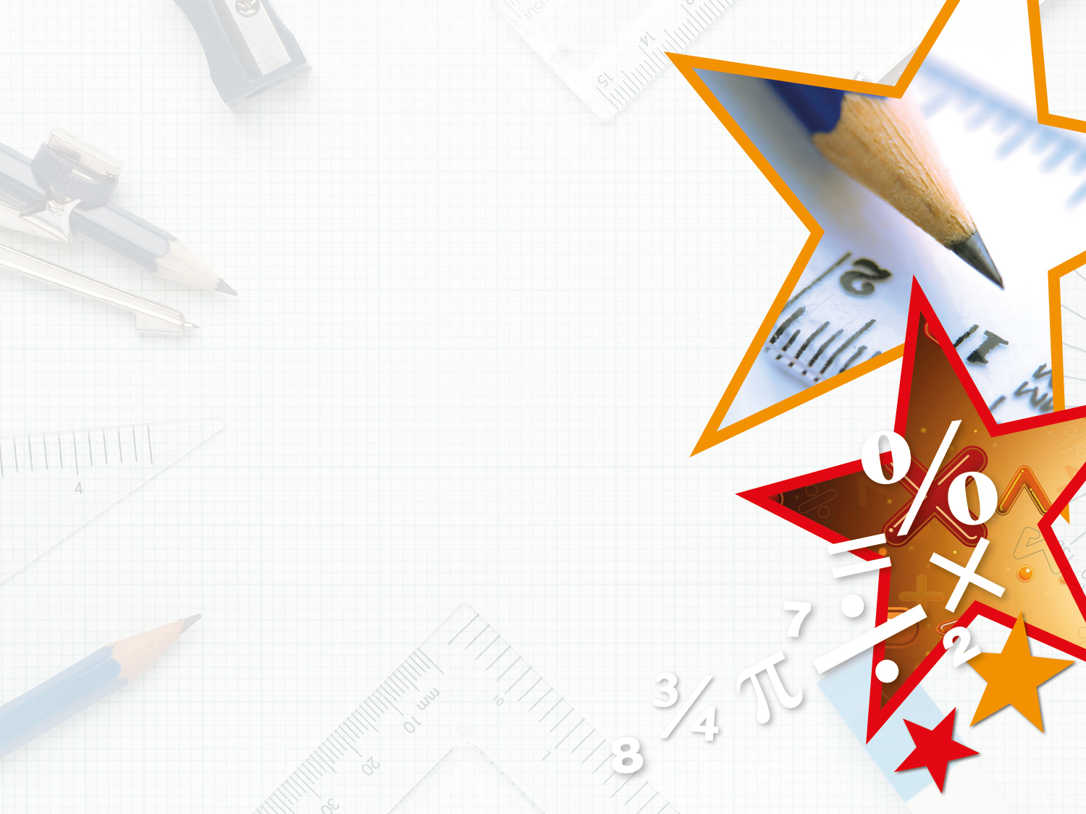
Year 4 – Summer Block 1 – Decimals – Order Decimals
About This Resource:
This PowerPoint has been designed to support your teaching of this small step. It includes a starter activity and an example of each question from the Varied Fluency and Reasoning and Problem Solving resources also provided in this pack. You can choose to work through all examples provided or a selection of them depending on the needs of your class.
National Curriculum Objectives:
Mathematics Year 4: (4F8) Compare numbers with the same number of decimal places up to two decimal places
Mathematics Year 4: (4F10b) Solve simple measure and money problems involving fractions and decimals up to two decimal places
More Year 4 Decimals resources.
Did you like this resource? Don’t forget to review it on our website.
© Classroom Secrets Limited 2019

Slide 3
Year 4 – Summer Block 1 – Decimals
Step 4: Order Decimals
© Classroom Secrets Limited 2019

Slide 4
Introduction
Complete the statements by adding
< > or =
1.5 |  | 1.5 |  | 0.9 |  | 0.99
0.75 |  | 0.74 |  | 3.32 |  | 3.31
5.05 |  | 5.5 |  | 0.01 |  | 0.1
© Classroom Secrets Limited 2019

Slide 5
Introduction
Complete the statements by adding
< > or =
1.5 | = | 1.5 |  | 0.9 | < | 0.99
0.75 | > | 0.74 |  | 3.32 | > | 3.31
5.05 | < | 5.5 |  | 0.01 | < | 0.1
© Classroom Secrets Limited 2019

Slide 6
Varied Fluency 1
The place value counters below make three different decimals. Write them in ascending order.
1
1
0.01
0.1
0.1
1
1
0.01
0.01
1
1
0.1
0.01
0.01
1
0.01
0.01
0.01
1
1
0.01
0.01
0.01
© Classroom Secrets Limited 2019

Slide 7
Varied Fluency 1
The place value counters below make three different decimals. Write them in ascending order.
In ascending order: 2.12, 3.26, 4.23
4.23
1
1
0.01
0.1
0.1
1
1
0.01
0.01
2.12
1
1
0.1
0.01
0.01
1
0.01
0.01
0.01
3.06
1
1
0.01
0.01
0.01
© Classroom Secrets Limited 2019

Slide 8
Varied Fluency 2
The decimals below are in ascending order.
Which decimal completes the sequence?
5.14 | 5.38 |  | 5.62
5.63 | 5.47 | 5.34 | 5.22
© Classroom Secrets Limited 2019

Slide 9
Varied Fluency 2
The decimals below are in ascending order.
Which decimal completes the sequence?
5.14 | 5.38 |  | 5.62
5.63 | 5.47 | 5.34 | 5.22
© Classroom Secrets Limited 2019

Slide 10
Varied Fluency 3
Where would each decimal show on the number line?
6
7
6.29 |  | 6.05 |  | 6.81 |  | 6.75
© Classroom Secrets Limited 2019

Slide 11
Varied Fluency 3
Where would each decimal show on the number line?
6
7
6.29 |  | 6.05 |  | 6.81 |  | 6.75
© Classroom Secrets Limited 2019

Slide 12
Varied Fluency 4
Is each row of decimals in descending order?
 |  |  |  | Yes | No
5.28 | 5.24 | 5.17 | 5.06
7.22 | 7.29 | 7.43 | 7.48
3.48 | 3.23 | 3.18 | 3.19
© Classroom Secrets Limited 2019

Slide 13
Varied Fluency 4
Is each row of decimals in descending order?
 |  |  |  | Yes | No
5.28 | 5.24 | 5.17 | 5.06 | ✓
7.22 | 7.29 | 7.43 | 7.48 |  | ✓
3.48 | 3.23 | 3.18 | 3.19 |  | ✓
© Classroom Secrets Limited 2019

Slide 14
Problem Solving 1
Look at the number sequence.
Use the number cards below to make all possible numbers with 2 decimal places that can fill the missing space in the sequence.
2.23 | 2.32 |  | 2.84
5
2
3
8
© Classroom Secrets Limited 2019

Slide 15
Problem Solving 1
Look at the number sequence.
Use the number cards below to make all possible numbers with 2 decimal places that can fill the missing space in the sequence.
2.35; 2.38; 2.53; 2.58; 2.83
2.23 | 2.32 |  | 2.84
5
2
3
8
© Classroom Secrets Limited 2019

Slide 16
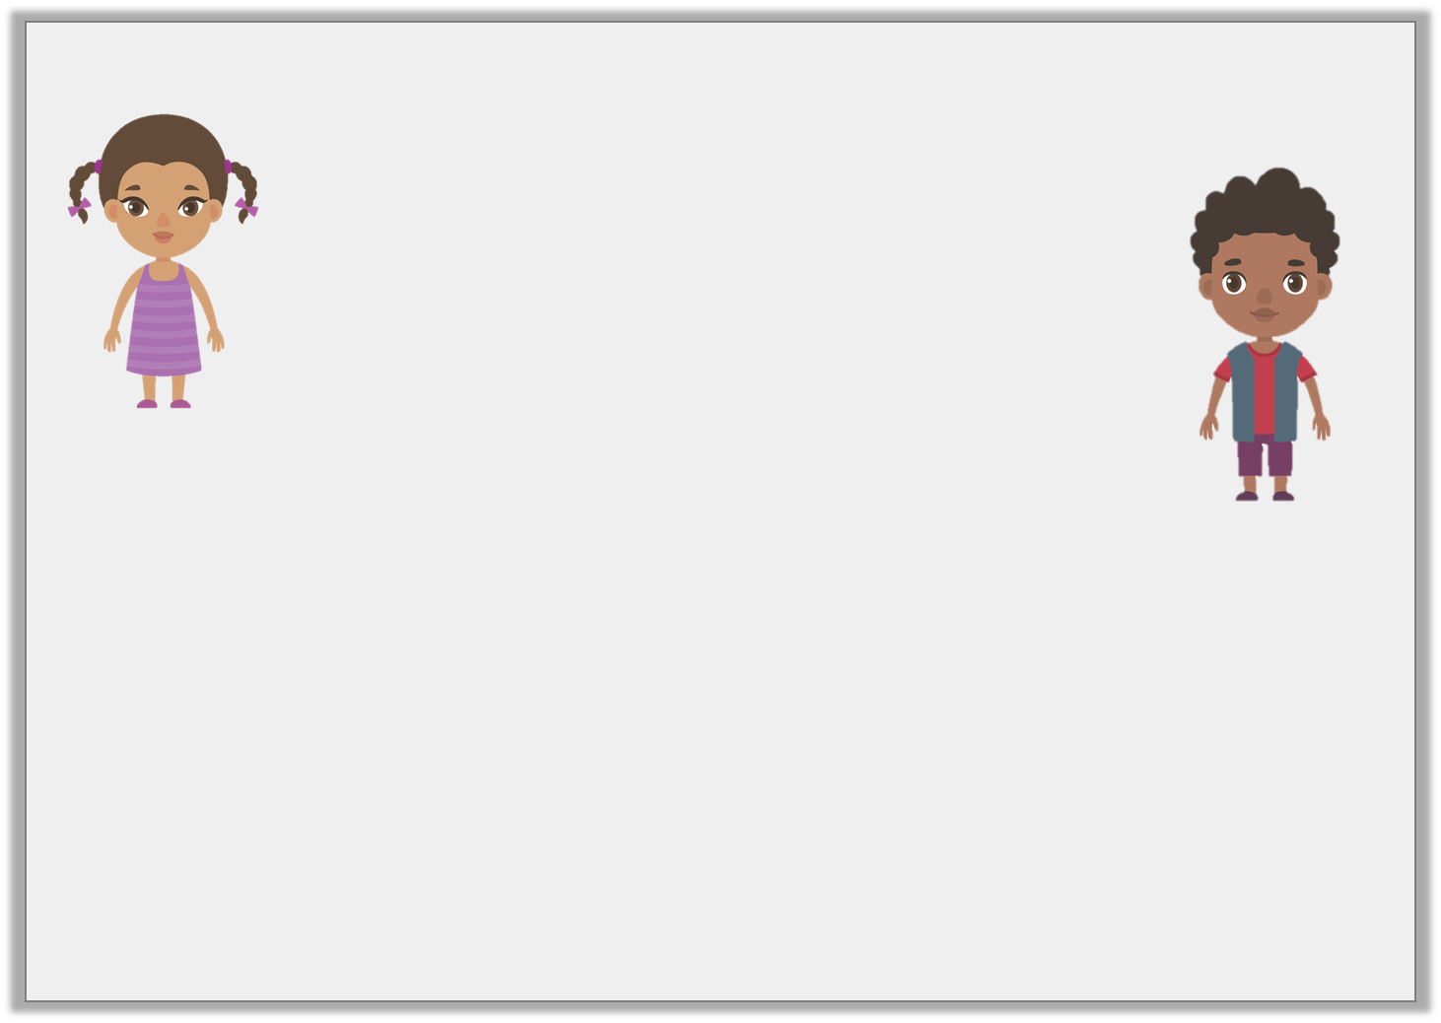
Reasoning 1
Who is correct?
Explain your answer.
I think that
6.42 > 6.38 < 6.55
I think that
6.42 < 6.38 > 6.55
Sally
Milo
© Classroom Secrets Limited 2019

Slide 17
Reasoning 1
Who is correct?
Explain your answer.
Sally is correct because…
I think that
6.42 > 6.38 < 6.55
I think that
6.42 < 6.38 > 6.55
Sally
Milo
© Classroom Secrets Limited 2019

Slide 18
Reasoning 1
Who is correct?
Explain your answer.
Sally is correct because6.42 is greater than 6.38 as it has 4 more hundredths. Also, 6.38 is less than 6.55 because it has 17 less hundredths.
I think that
6.42 > 6.38 < 6.55
I think that
6.42 < 6.38 > 6.55
Sally
Milo
© Classroom Secrets Limited 2019

Slide 19
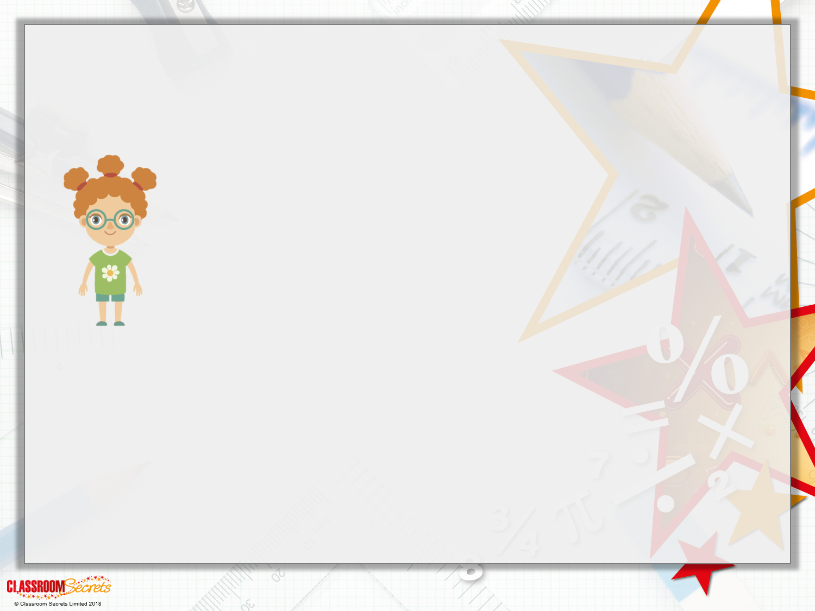
Reasoning 2
Cathy is comparing the heights of children in her class.
Do you agree with Cathy? Explain your answer.
Child | Height
Lucy | 1.38 m
Jason | 1.35 m
Bobby | 1.29 m
Max | 1.28 m
Liam | 1.31 m
Seima | 1.27 m
I have ordered the heights from tallest to smallest.

Slide 20
Reasoning 2
Cathy is comparing the heights of children in her class.
Do you agree with Cathy? Explain your answer.
Cathy is incorrect because…
Child | Height
Lucy | 1.38 m
Jason | 1.35 m
Bobby | 1.29 m
Max | 1.28 m
Liam | 1.31 m
Seima | 1.27 m
I have ordered the heights from tallest to smallest.

Slide 21
Reasoning 2
Cathy is comparing the heights of children in her class.
Do you agree with Cathy? Explain your answer.
Cathy is incorrect because she begins to order the heights correctly as 1.38m is the tallest, followed by 1.35m. However, 1.31m is greater than the remaining heights, so should be listed next.
Child | Height
Lucy | 1.38 m
Jason | 1.35 m
Liam | 1.31 m
Bobby | 1.29 m
Max | 1.28 m
Seima | 1.27 m
I have ordered the heights from tallest to smallest.

