Slide 1


LIFE/work balance
We have started a #LIFEworkbalance campaign and we need your help to complete our LIFE/work balance survey.
We hope to publish the results soon, so please give 15 minutes of your time to help us get a true picture of school life.
Want to be a part of this campaign? Take the survey on our website and share it with your colleagues!
© Classroom Secrets Limited 2019

Slide 2

Year 4 – Summer Block 2 – Money – Four Operations
About This Resource:
This PowerPoint has been designed to support your teaching of this small step. It includes a starter activity and an example of each question from the Varied Fluency and Reasoning and Problem Solving resources also provided in this pack. You can choose to work through all examples provided or a selection of them depending on the needs of your class.
National Curriculum Objectives:
Mathematics Year 4: (4M9) Estimate, compare and calculate different measures, including money in pounds and pence
Mathematics Year 4: (4F10b) Solve simple measure and money problems involving fractions and decimals to two decimal places
More Year 4 Money resources.
Did you like this resource? Don’t forget to review it on our website.
© Classroom Secrets Limited 2018

Slide 3
Year 4 – Summer Block 2 – Money
Step 4: Four Operations
© Classroom Secrets Limited 2018

Slide 4
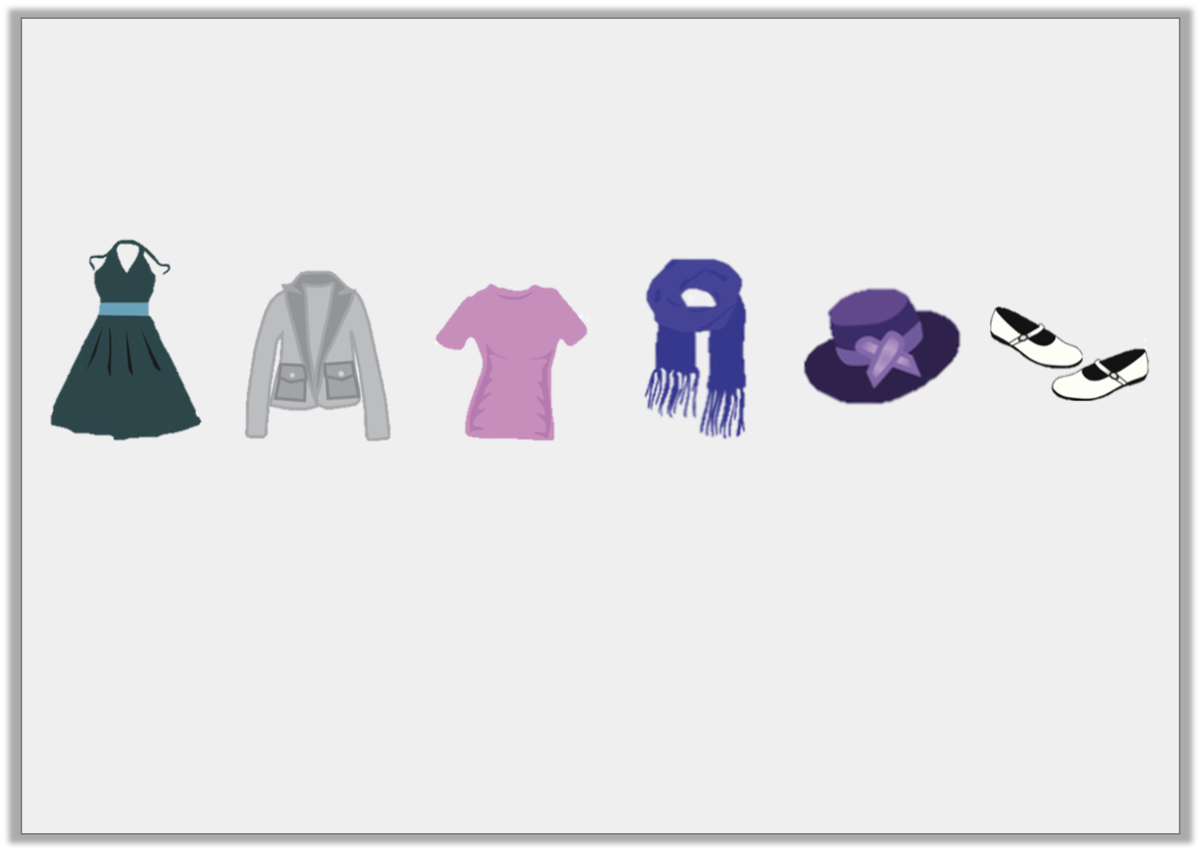
Introduction
Lana is shopping.
She has about £20 to spend.
Estimate what she could purchase.
Dress
£11.45
Jacket
£5.75
Shirt
£7.30
Scarf
£8.55
Hat
£4.95
Shoes
£6.80
© Classroom Secrets Limited 2018

Slide 5
Introduction
Lana is shopping.
She has about £20 to spend.
Estimate what she could purchase.
Dress
£11.45
Jacket
£5.75
Shirt
£7.30
Scarf
£8.55
Hat
£4.95
Shoes
£6.80
There are several possible combinations that, when estimated, will cost £20. For example, she could purchase:
the dress and the scarf (£11 + £9 = £20)
the jacket, shirt and shoes (£6 + £7 + £7 = £20)
the hat, jacket and scarf (£5 + £6 + £9 = £20)
© Classroom Secrets Limited 2018

Slide 6
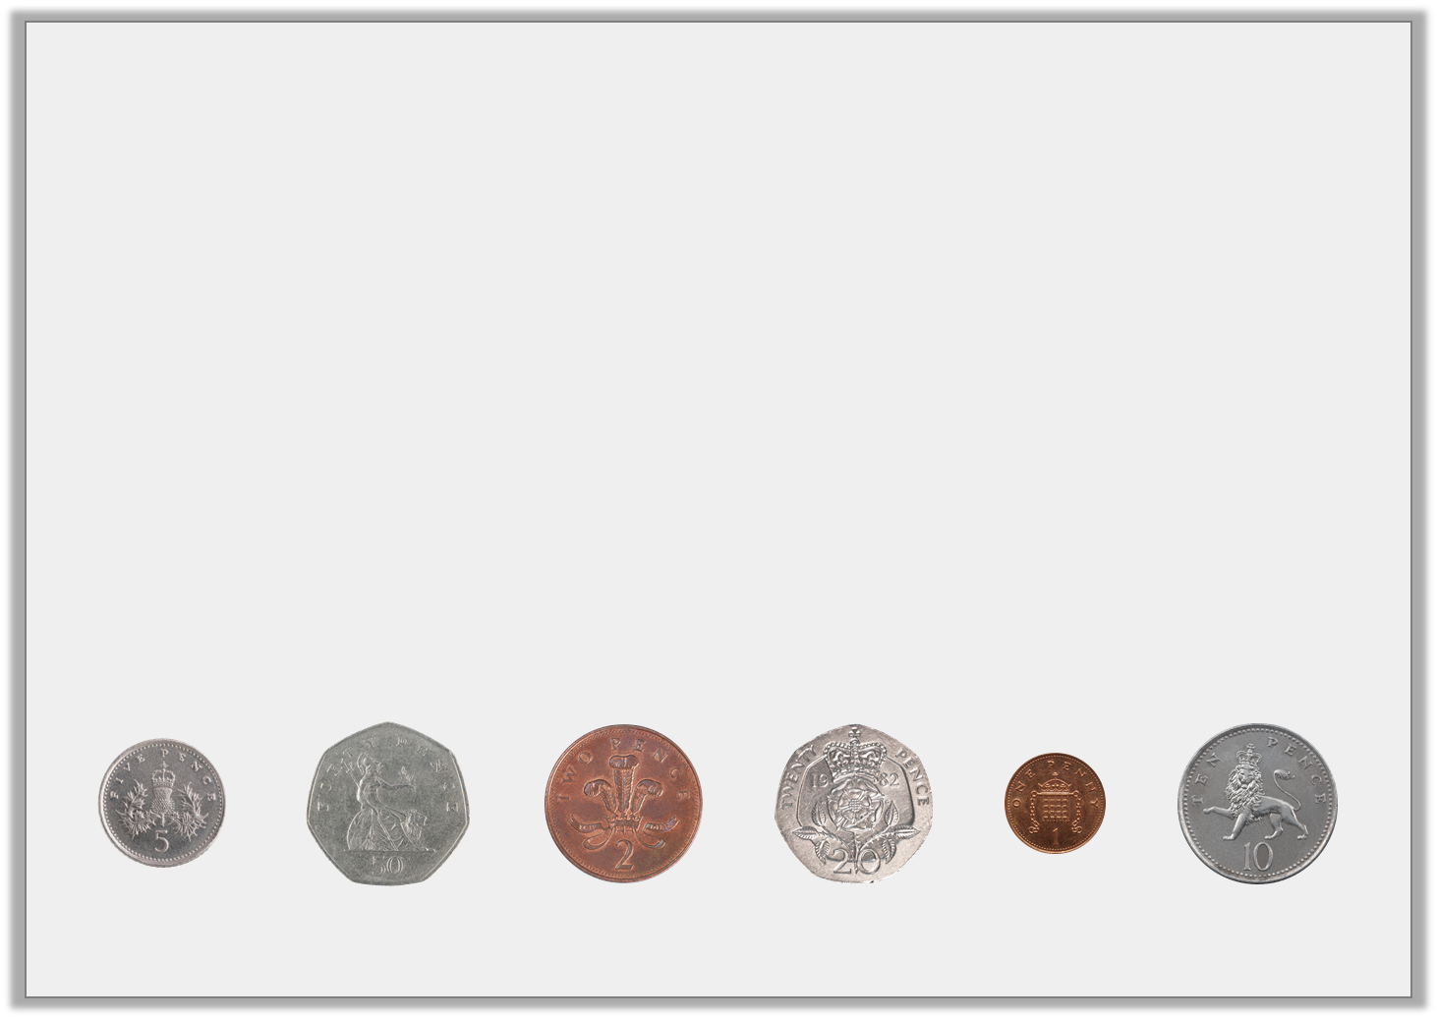
Varied Fluency 1
Which coins would complete this bar model?
You can use coins more than once.
£1.60
© Classroom Secrets Limited 2018

Slide 7
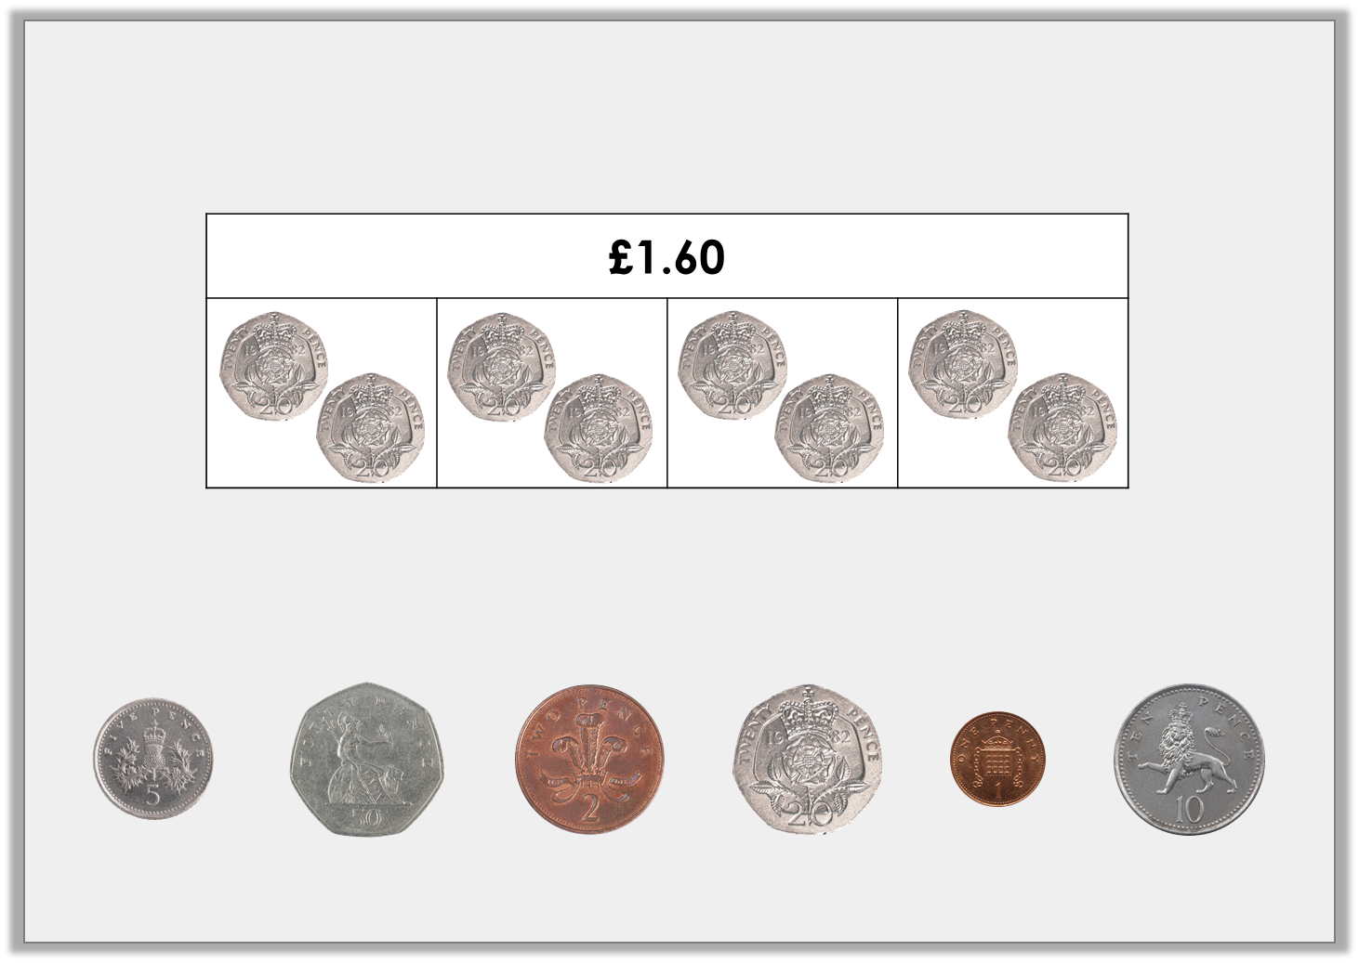
Varied Fluency 1
Which coins would complete this bar model?
You can use coins more than once.
Possible answer
© Classroom Secrets Limited 2018

Slide 8
Varied Fluency 2
Complete the bar model for the problem.
Bobby goes to the shopping centre. He spends £12.50 on a new pair of shorts and £10.80 on a t-shirt.
How much money does he spend altogether?
© Classroom Secrets Limited 2018

Slide 9
Varied Fluency 2
Complete the bar model for the problem.
Bobby goes to the shopping centre. He spends £12.50 on a new pair of shorts and £10.80 on a t-shirt.
How much money does he spend altogether?
£23.30
£12.50
£10.80
£12.50 + £10.80 = £23.30
© Classroom Secrets Limited 2018

Slide 10
Varied Fluency 3
Calculate the missing numbers:
6 | x |  | = | £1.80
 | x | 7 | = | £1.40
© Classroom Secrets Limited 2018

Slide 11
Varied Fluency 3
Calculate the missing numbers:
6 | x | £0.30 | = | £1.80
£0.20 | x | 7 | = | £1.40
© Classroom Secrets Limited 2018

Slide 12
Varied Fluency 4
The table below shows ticket prices for the theatre.
How much would it cost for two adults and two children to visit the theatre during the afternoon?
 | Afternoon | Evening
Adult | £16.25 | £20.50
Child | £8.75 | £9.50
© Classroom Secrets Limited 2018

Slide 13
Varied Fluency 4
The table below shows ticket prices for the theatre.
How much would it cost for two adults and two children to visit the theatre during the afternoon?
 | Afternoon | Evening
Adult | £16.25 | £20.50
Child | £8.75 | £9.50
£16.25 x 2 = £32.50
£8.75 x 2 = £17.50
£32.50 + £17.50 = £50
© Classroom Secrets Limited 2018

Slide 14

Reasoning 1
Tabitha loves to buy cookies for her friends.
She plans to buy 30 cookies to share with her friends, so she decides to buy her cookies in packs of 5. Do you agree with her decision? Explain your answer.
25p per cookie
5 for £1.50
10 for £2.20
© Classroom Secrets Limited 2018

Slide 15
Reasoning 1
Tabitha loves to buy cookies for her friends.
She plans to buy 30 cookies to share with her friends, so she decides to buy her cookies in packs of 5. Do you agree with her decision? Explain your answer.
No because….
25p per cookie
5 for £1.50
10 for £2.20
© Classroom Secrets Limited 2018

Slide 16
Reasoning 1
Tabitha loves to buy cookies for her friends.
She plans to buy 30 cookies to share with her friends, so she decides to buy her cookies in packs of 5. Do you agree with her decision? Explain your answer.
No because she should buy them in packs of 10. 3 x £2.20 = £6.60. Buying in packs of 5 would cost £9 and buying individually would cost £7.50.
25p per cookie
5 for £1.50
10 for £2.20
© Classroom Secrets Limited 2018

Slide 17
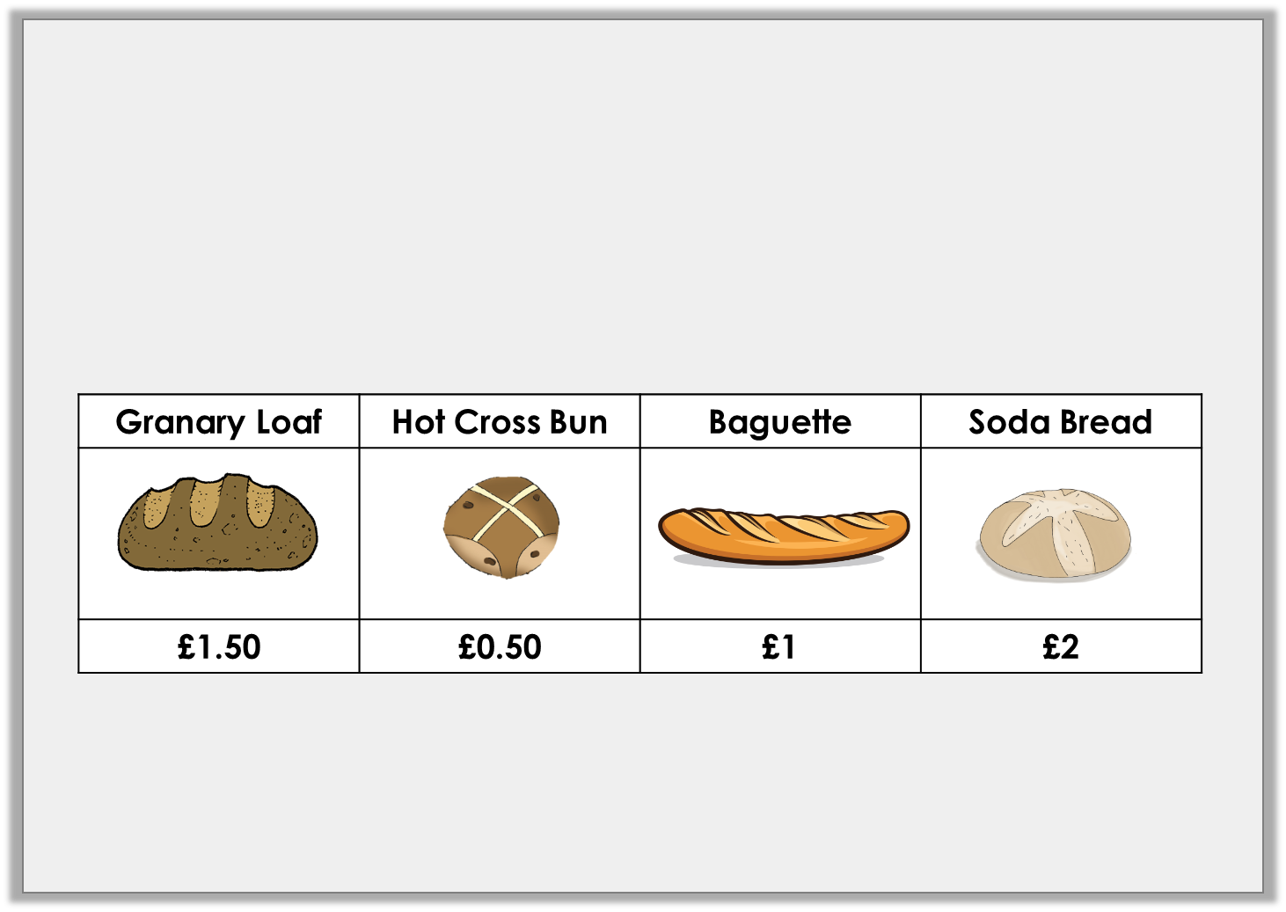
Problem Solving 1
At the bakery, Hernant spent £4 altogether.
What could she have bought?
Find more than one possibility.
© Classroom Secrets Limited 2018

Slide 18
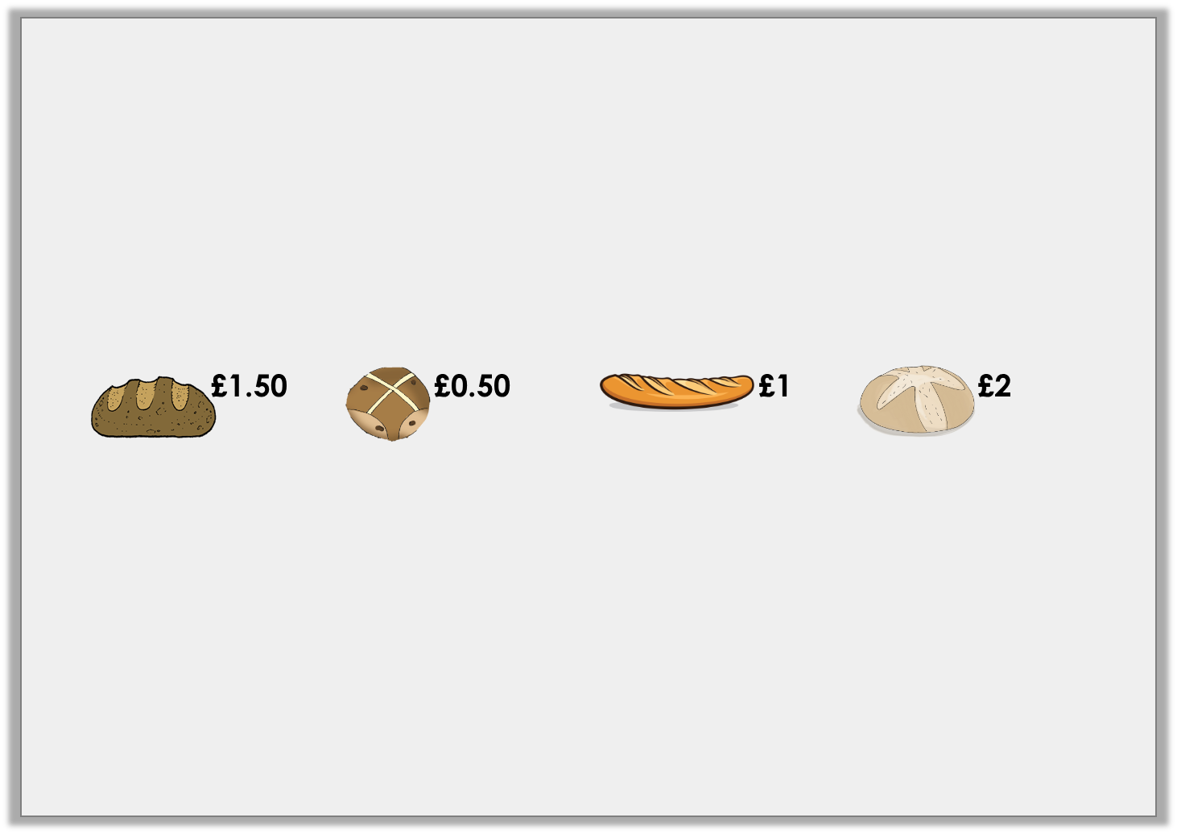
Problem Solving 1
At the bakery, Hernant spent £4 altogether.
What could she have bought?
Find more than one possibility.
Various possible answers, including:
Option | Granary loaf | Hot Cross Bun | Baguette | Soda Bread | Total
1 | 0 | 0 | 0 | 2 | £4
2 | 0 | 0 | 2 | 1 | £4
3 | 0 | 4 | 0 | 1 | £4
© Classroom Secrets Limited 2018

Slide 19

Problem Solving 2
Carice buys three sunflowers and two tulips.
She pays with £10.
How much change will she receive?
Sunflower | Tulip
£1.50 | £2.50
© Classroom Secrets Limited 2018

Slide 20
Problem Solving 2
Carice buys three sunflowers and two tulips.
She pays with £10.
How much change will she receive?
50p
Sunflower | Tulip
£1.50 | £2.50
© Classroom Secrets Limited 2018

