Slide 1



LIFE/work balance​
​
​
​
​
​
​
​
​
​
​
​
We have started a #LIFEworkbalance campaign and we need your help to complete our LIFE/work balance survey.​
​
​ We hope to publish the results soon, so please give 15 minutes of your time to help us get a true picture of school life.​
​
​
Want to be a part of this campaign? Take the survey on our website and share it with your colleagues!
© Classroom Secrets Limited 2019

Slide 2
Year 4 – Summer Block 2 – Money – Using Rounding to Estimate Money
About This Resource:
This PowerPoint has been designed to support your teaching of this small step. It includes a starter activity and an example of each question from the Varied Fluency and Reasoning and Problem Solving resources also provided in this pack. You can choose to work through all examples provided or a selection of them depending on the needs of your class.
National Curriculum Objectives:
Mathematics Year 4: (4M1) Compare different measures, including money in pounds and pence
Mathematics Year 4: (4M2) Estimate different measures, including money in pounds and pence
Mathematics Year 4: (4M9) Calculate different measures, including money in pounds and pence
More Year 4 Money resources.
Did you like this resource? Don’t forget to review it on our website.
© Classroom Secrets Limited 2018

Slide 3
Year 4 – Summer Block 2 – Money
Step 3: Using Rounding to Estimate Money
© Classroom Secrets Limited 2018

Slide 4
Introduction
Round each number to the nearest 100 and match
it to the number line.
851
126
575
386
100 | 200 | 300 | 400 | 500 | 600 | 700 | 800 | 900
164
849
270
548
655
© Classroom Secrets Limited 2018

Slide 5
Introduction
Round each number to the nearest 100 and match
it to the number line.
164
386
575
849
100 | 200 | 300 | 400 | 500 | 600 | 700 | 800 | 900
126
270
548
655
851
© Classroom Secrets Limited 2018

Slide 6
Varied Fluency 1
Which whole pounds does the given amount come in between?
Round the amount to the nearest pound.
£7.82
© Classroom Secrets Limited 2018

Slide 7
Varied Fluency 1
Which whole pounds does the given amount come in between?
Round the amount to the nearest pound.
£8.00
£7.82
£7.00
£8.00
© Classroom Secrets Limited 2018

Slide 8
Varied Fluency 2
Match the amounts to the letters on the number line.
A
B
C
£5
£6
£5.95
559p
£5.05
© Classroom Secrets Limited 2018

Slide 9
Varied Fluency 2
Match the amounts to the letters on the number line.
A
B
C
£5
£6
£5.95 | C
559p | B
£5.05 | A
© Classroom Secrets Limited 2018

Slide 10
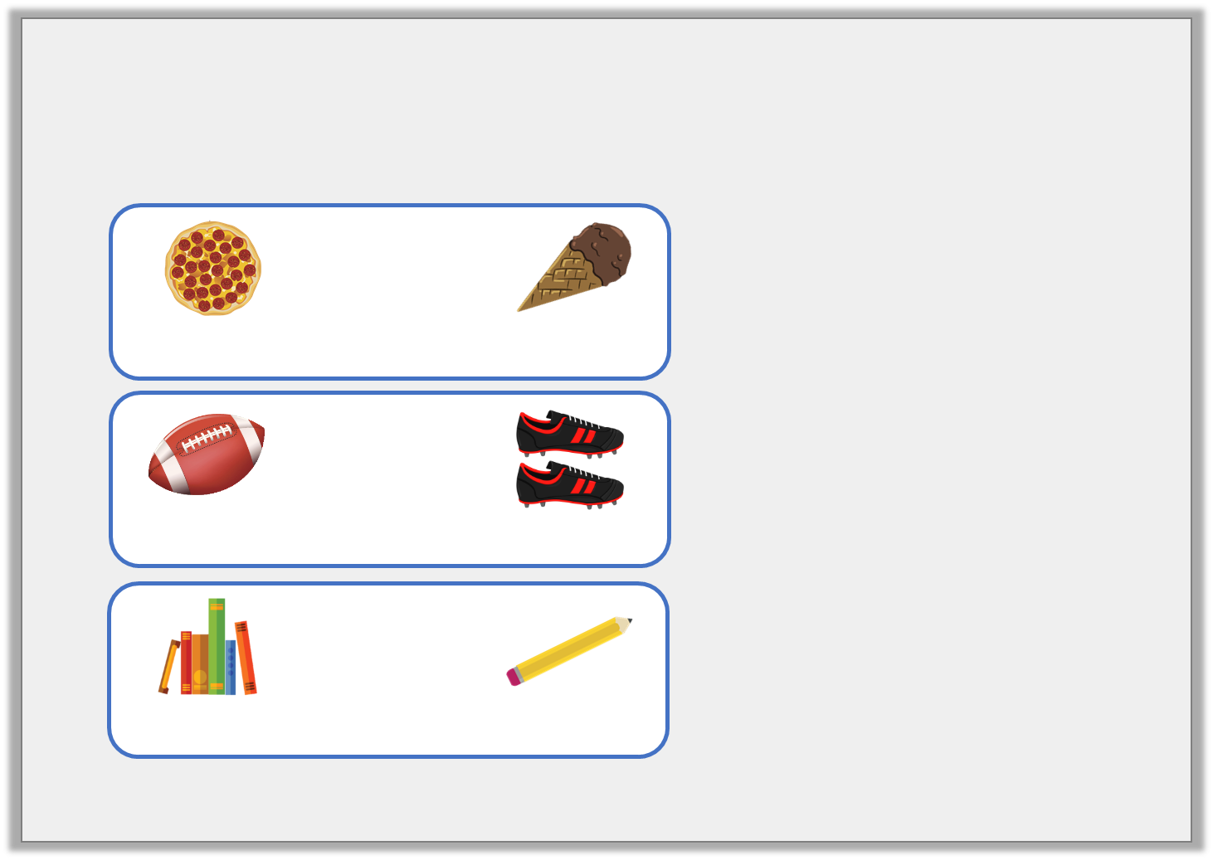
Varied Fluency 3
Match the items to the rounded totals.
 | +
468p |  | £1.67
£4.00
£7.00
£9.00
 | +
225p |  | £6.89
 | +
£3.44 |  | 72p
© Classroom Secrets Limited 2018

Slide 11
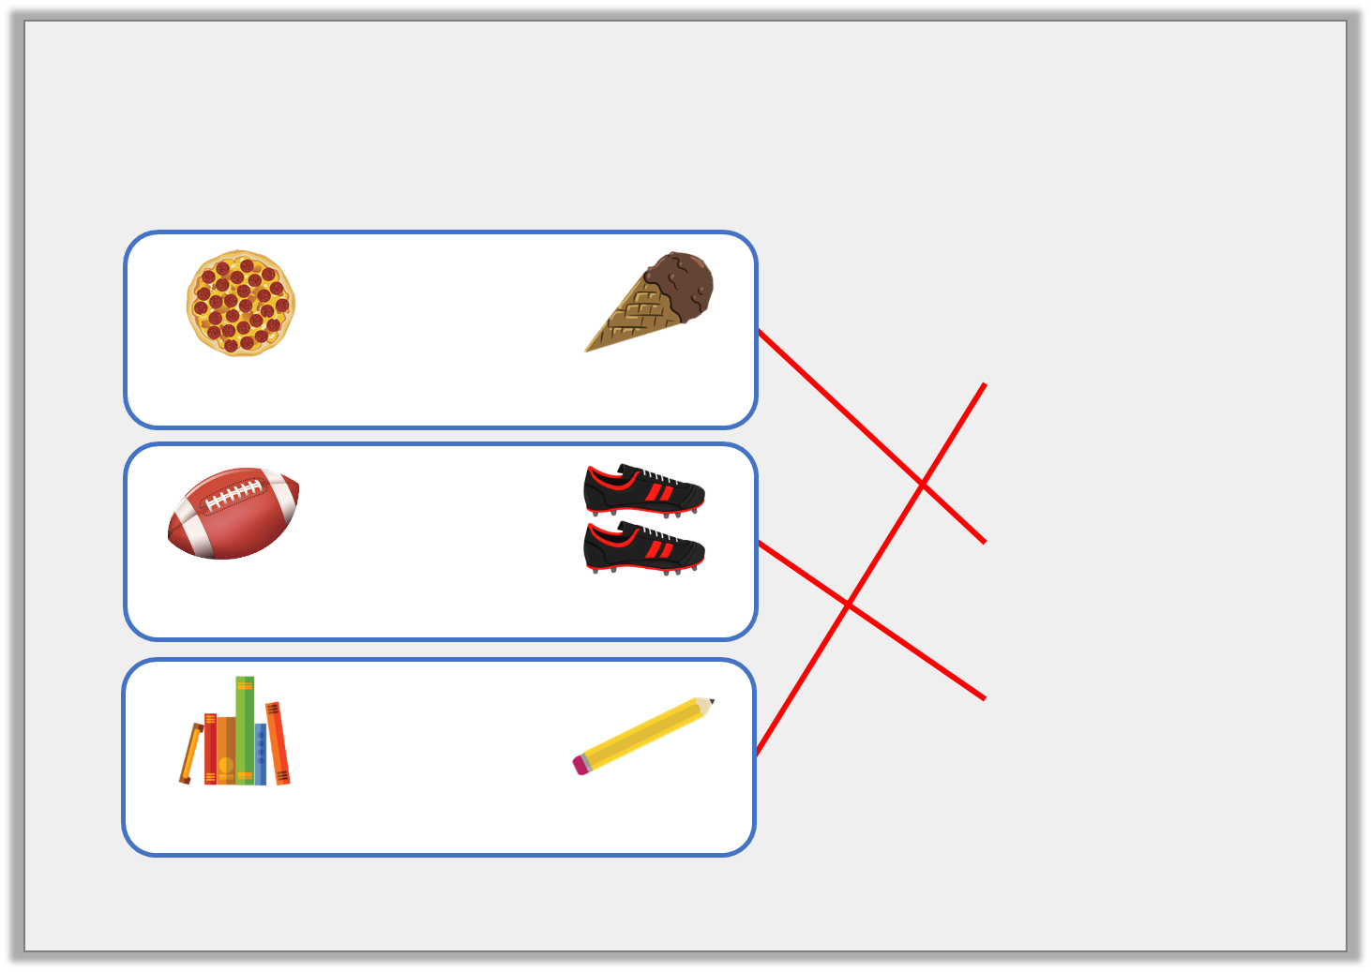
Varied Fluency 3
Match the items to the rounded totals.
 | +
468p |  | £1.67
£4.00
£7.00
£9.00
 | +
225p |  | £6.89
 | +
£3.44 |  | 72p
© Classroom Secrets Limited 2018

Slide 12
Varied Fluency 4
James wants to buy a pair of shorts for £4.54
and a t-shirt for £5.28.
What does each amount round to?
He has £12.00.
How much change will he receive approximately?
© Classroom Secrets Limited 2018

Slide 13
Varied Fluency 4
James wants to buy a pair of shorts for £4.54
and a t-shirt for £5.28.
What does each amount round to?
£5.00 and £5.00
He has £12.00.
How much change will he receive approximately?
£12 – £10 = £2.00
© Classroom Secrets Limited 2018

Slide 14
Reasoning 1
What amount could the arrow be pointing to?
Explain why.
500p
600p
© Classroom Secrets Limited 2018

Slide 15
Reasoning 1
What amount could the arrow be pointing to?
Explain why.
The arrow is pointing to less than a quarter of the way along the number line, so the amount must be less than…
500p
600p
© Classroom Secrets Limited 2018

Slide 16
Reasoning 1
What amount could the arrow be pointing to?
Explain why.
The arrow is pointing to less than a quarter of the way along the number line, so the amount must be less than 525p or £5.25. The price could be between £5.10 or 510p and £5.20 or 520p.
500p
600p
© Classroom Secrets Limited 2018

Slide 17
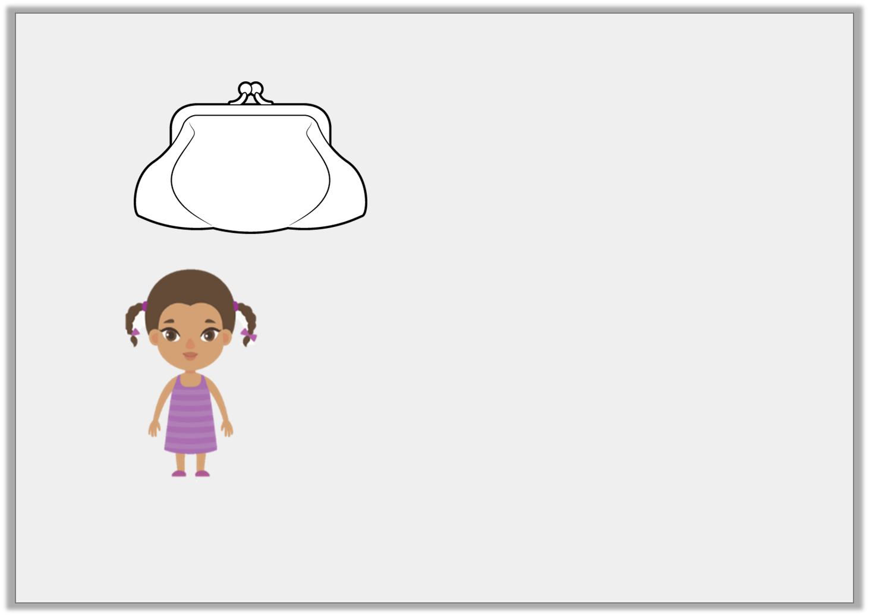
Reasoning 2
Cleo has:
She says,
Do you agree? Explain why.
£2.32
My amount rounds to £3.
© Classroom Secrets Limited 2018

Slide 18
Reasoning 2
Cleo has:
She says,
Do you agree? Explain why.
I disagree because…
£2.32
My amount rounds to £3.
© Classroom Secrets Limited 2018

Slide 19
Reasoning 2
Cleo has:
She says,
Do you agree? Explain why.
I disagree because any amount less than £2.50 rounds down to £2.00. £2.32 is less than £2.50 and is nearer to £2.00 than £3.00.
£2.32
My amount rounds to £3.
© Classroom Secrets Limited 2018

Slide 20
Problem Solving 1
Kaylum has these digit cards:
Find all the amounts he can make which round to 500p.
5
4
1
9
© Classroom Secrets Limited 2018

Slide 21
Problem Solving 1
Kaylum has these digit cards:
Find all the amounts he can make which round to 500p.
491p 514p
495p 519p
451p 541p
459p 549p
5
4
1
9
© Classroom Secrets Limited 2018

