Slide 1
Star Project
Skills Used:
Construction – using compasses, protractors, rulers
Factors
Shape properties
Rounding
Area/Circumference
Cross-Curricular:
ICT
Art

Slide 2
Star Project
Instructions:
Draw at least three concentric circles
Key Word:
Concentric – circles that share the same centre

Slide 3
Star Project
Draw a vertical line from the centre to the top of the outer circle

Slide 4
Star Project
Decide on which factor of 360 you will use, and divide up the circles equally by your chosen factor.
Example: Factor 45

Slide 5
Star Project
Add lines to your diagram, ensuring you make equal steps around the circle to create your stars.

Slide 6
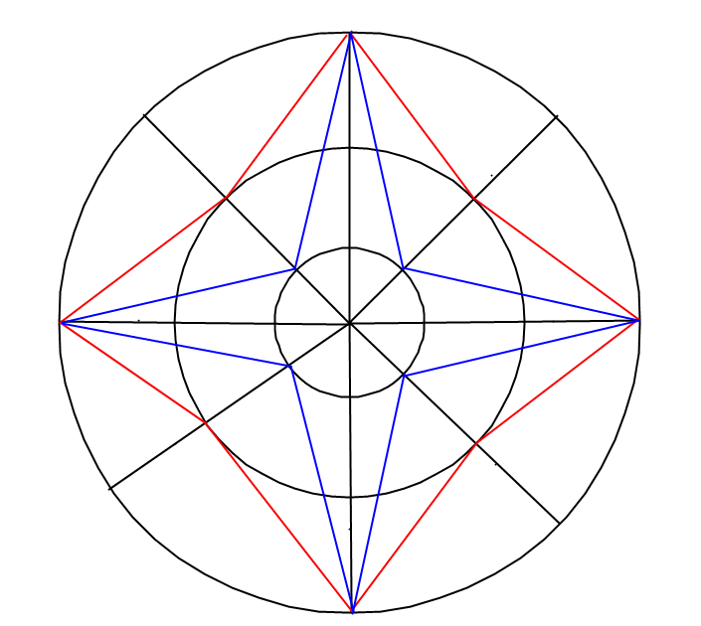
Star Project
Continue adding stars of all shapes and sizes until you are happy with your end design

Slide 7
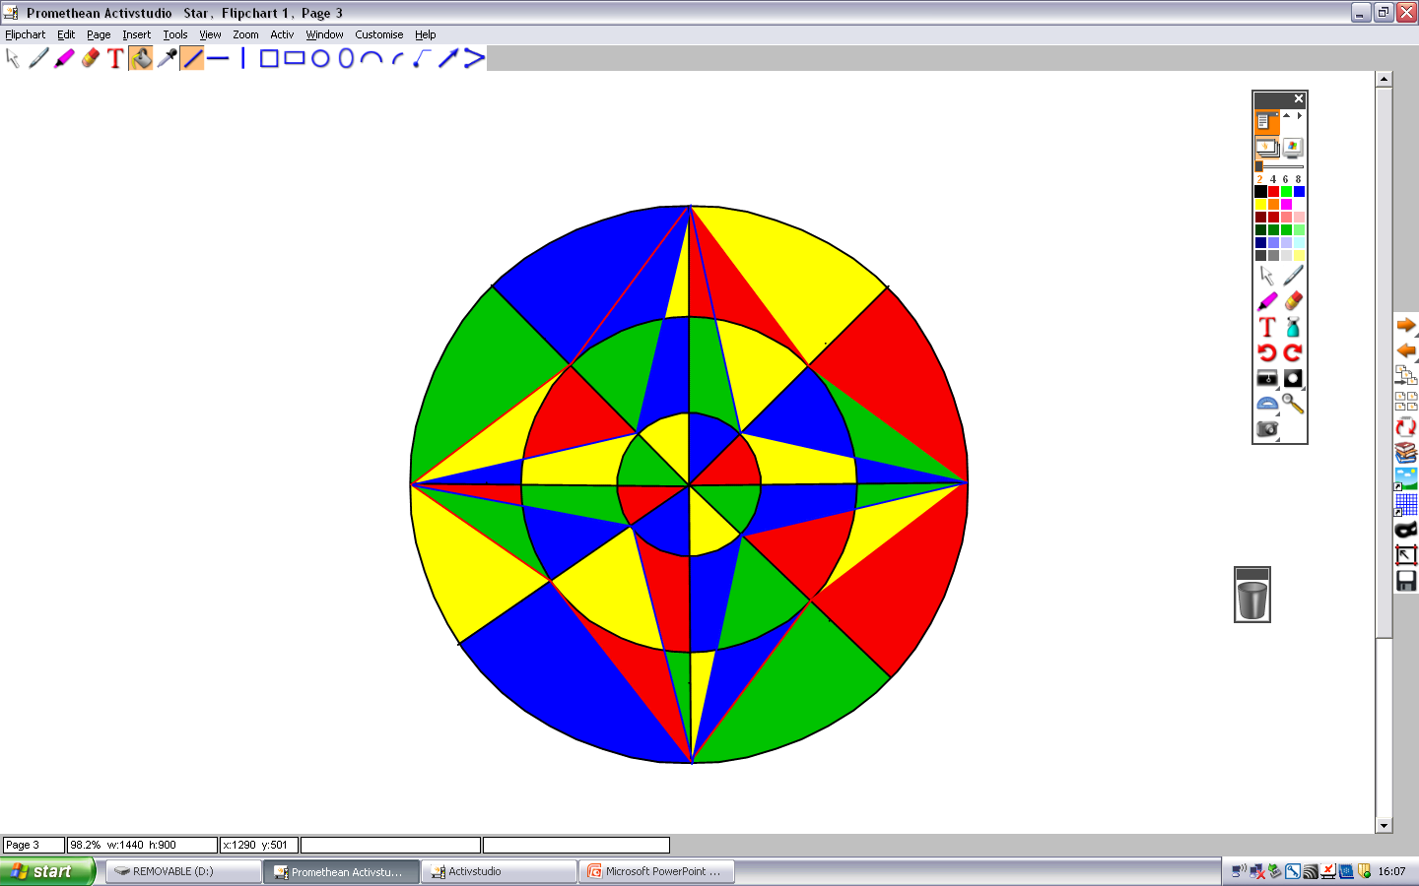
Star Project
Colour in the different sections in different colours

Slide 8
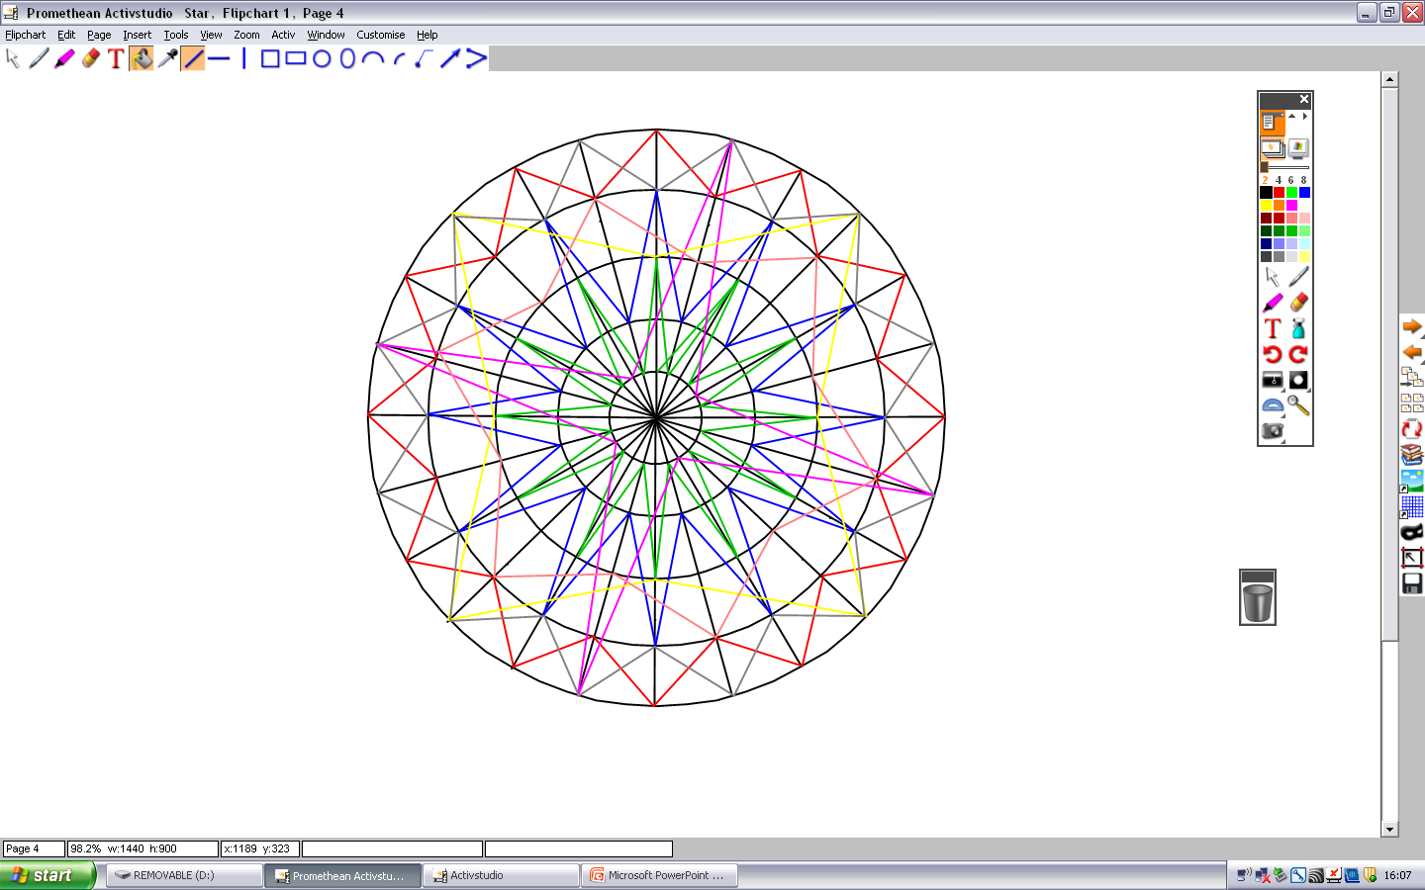
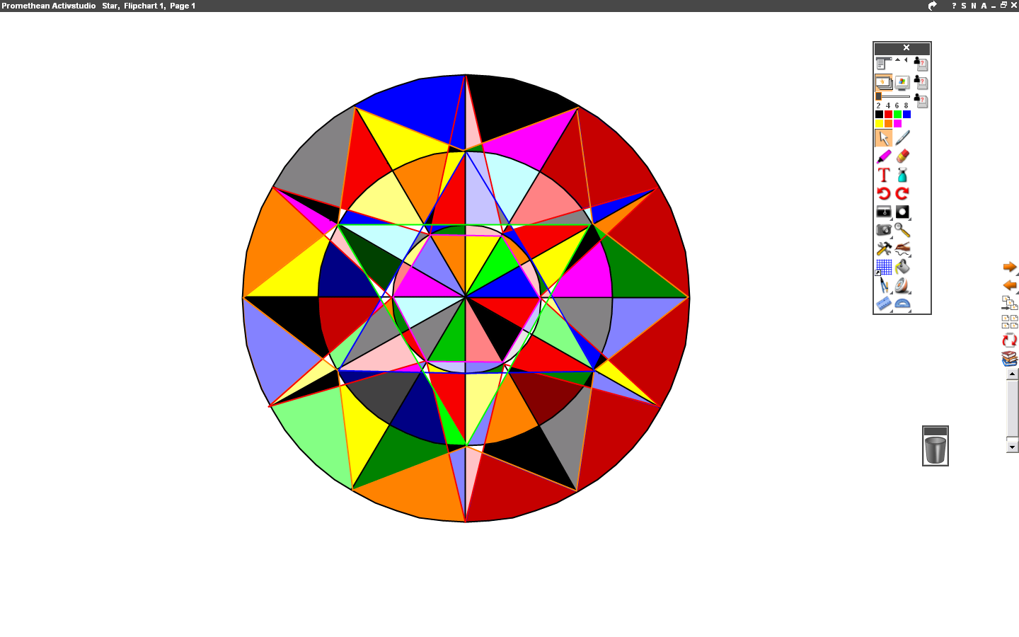
Star Project
You can make your design as simple or as complicated as you like...
Add more stars and try adding more shapes such as triangles and hexagons...
...or add more circles...and more lines!!!

Slide 9
Star Project
Add labels to your image, identifying shapes, angles, and, the circumference and area of each circle, etc...
Right angle, 90º
Sector, angle at centre 45º

Slide 10
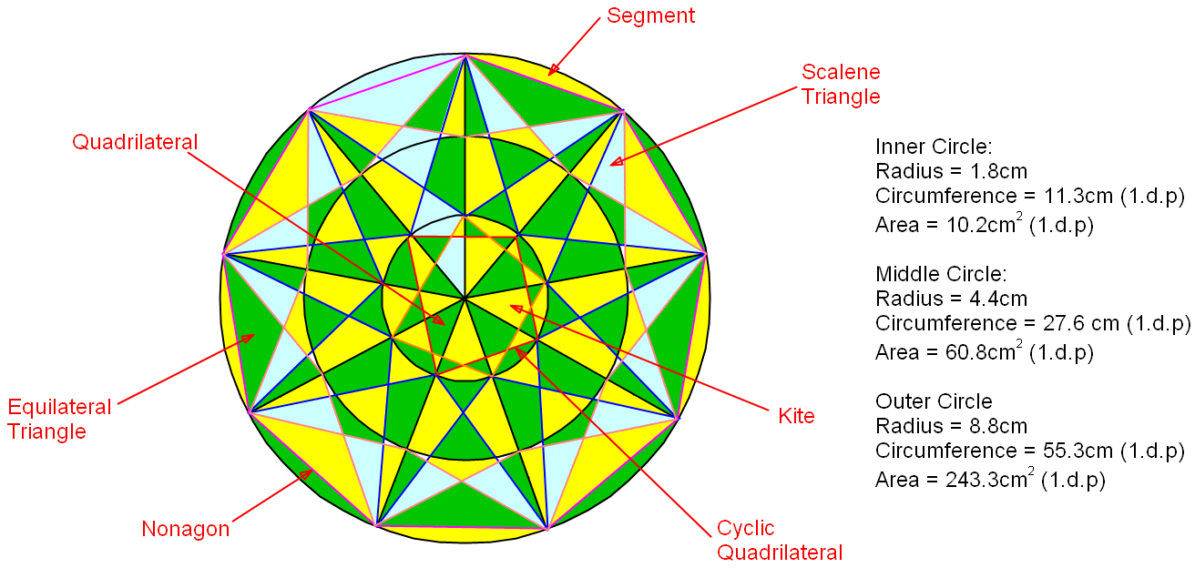
Example of a finished Star Project

Slide 15
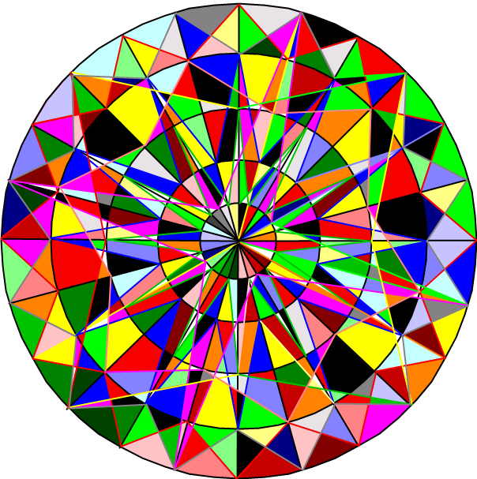

Slide 17
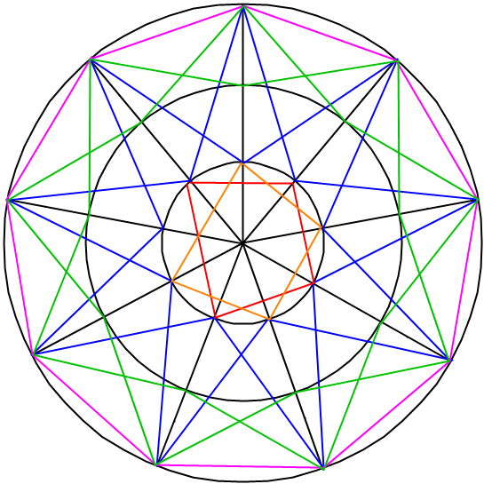

Slide 18
